Slide 1


™
Dr. Srividya Bansal
Dr. Odesma Dalrymple
Dr. Ashraf Gaffar

Slide 2
what is IMODS™?
An open-source web-based tool (still under development)
An open-source web-based tool (still under development)
That will guide individual or collaborating STEM educators,
That will guide STEM educators,
That will guide individual or collaborating STEM educators,
step-by-step, through an outcome-based education process for
step-by-step, through an outcome-based education process as
designing courses

Slide 3
what is outcome based education?
DEFINE OUTCOMES
what students are expected to know, understand or do
An approach where the product defines the process
Benefits
Win-for-all solution
Supports How People Learn framework
Growing adoption of outcome-based program accreditation
Alignment with other models that are meant to increase innovation in STEM education.
APPLY INSTRUCTIONAL APPROACH
learning activities to help students achieve outcomes
APPLY ASSESSMENT CRITERIA
asses the extent to which student meets outcomes

Slide 4
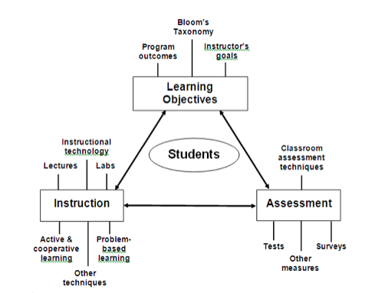
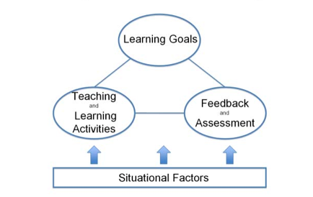
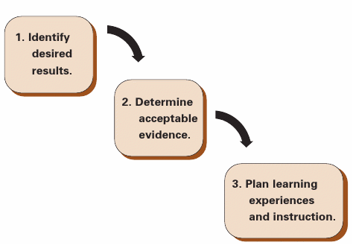
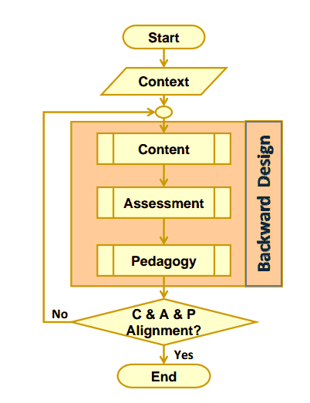
previous models
Effective Course Model by Felder & Brent (2003)
Integrated Course Design by Fink (2003)
Backward Design by Wiggins & McTighe (2005)
CAP Model by Streveler, Smith & Chavela (2009)

Slide 5
PC³ Model

Slide 6



imod system
Outcomes-Based Education
Translate literature on outcomes based education into a software tool.
Notes:
Translate literature on outcomes based education into a software tool.

Slide 7




imod system
1
2
3
Step-by-step outcome-based education process
Repository of current best pedagogical and assessment practices
Generates documentation of course design
Provides help to the user
Provides feedback on the fidelity of the course design

Slide 8
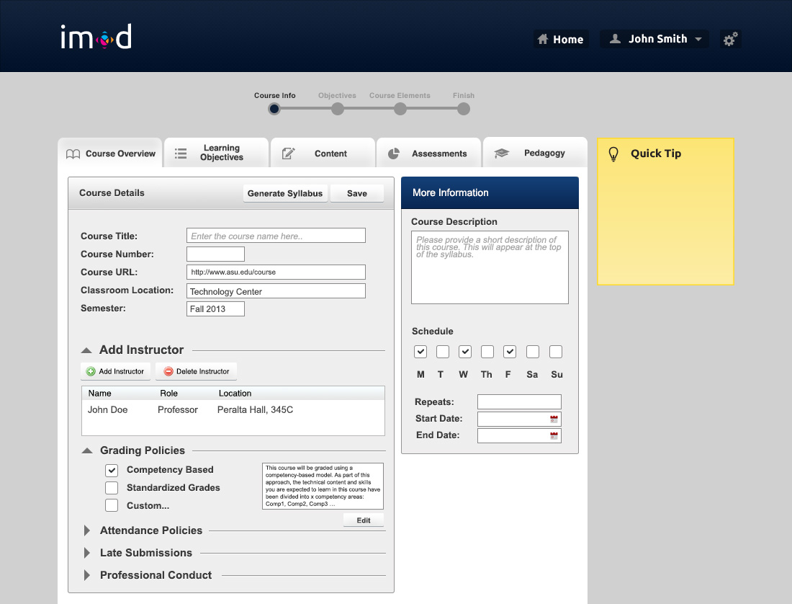
course overview

Slide 9
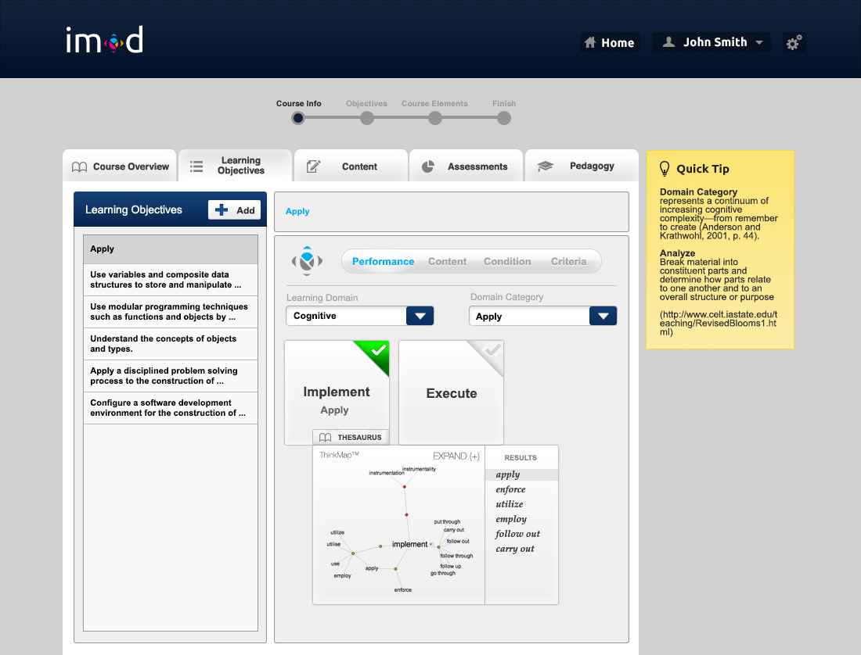
learning objectives _ performance

Slide 10
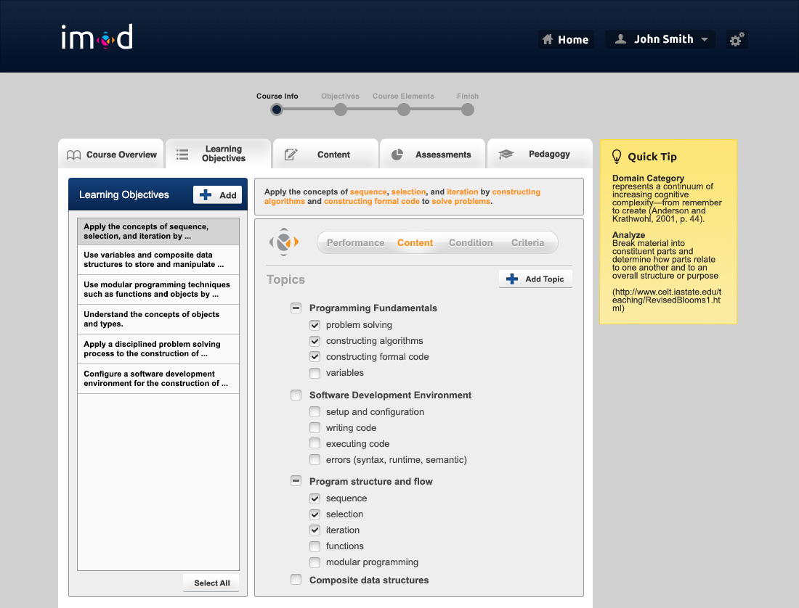
learning objectives _ content

Slide 11
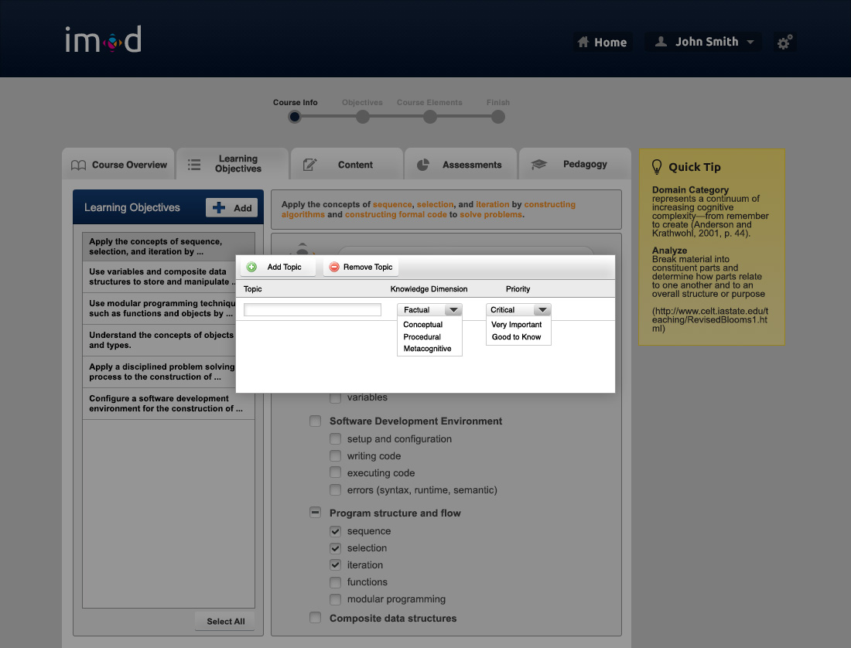
learning objectives _ content

Slide 12
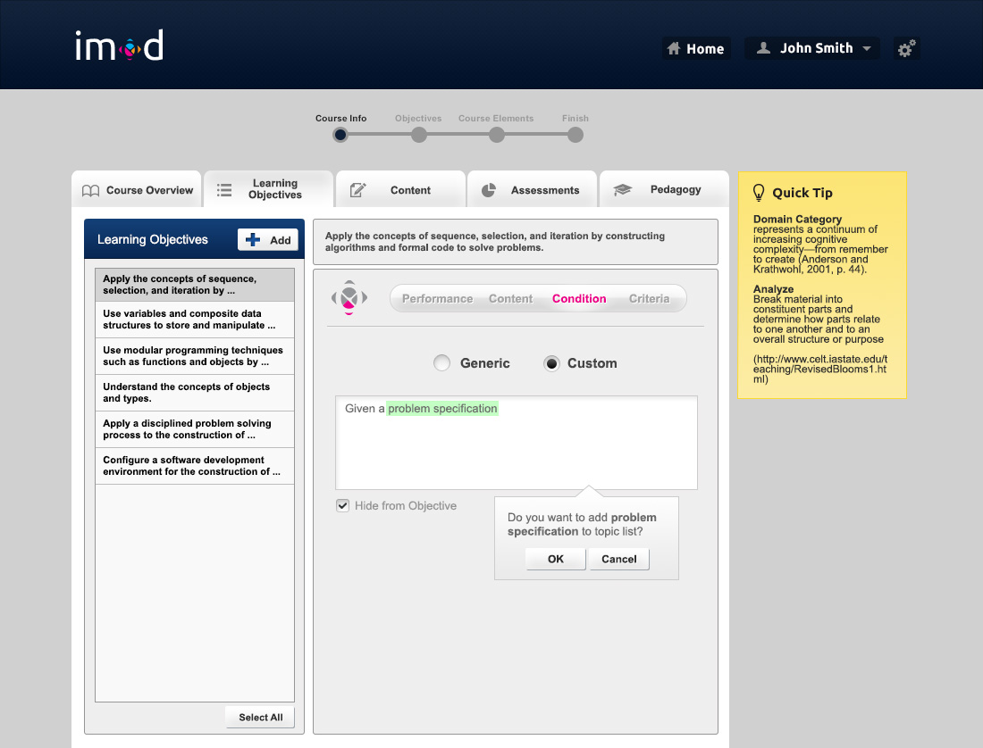
learning objectives _ condition

Slide 13
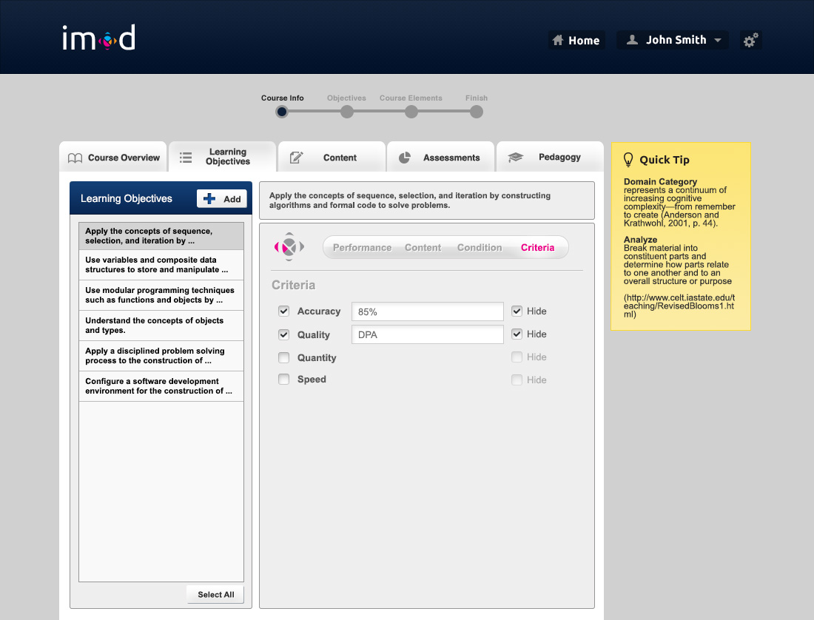
learning objectives _ criteria

Slide 14
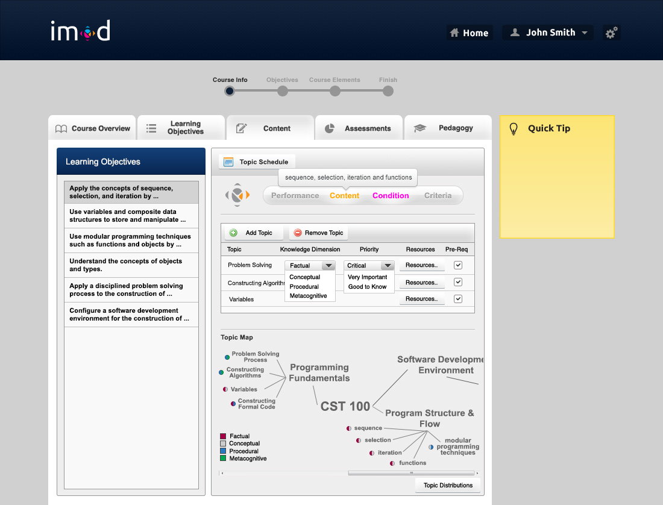
content

Slide 15
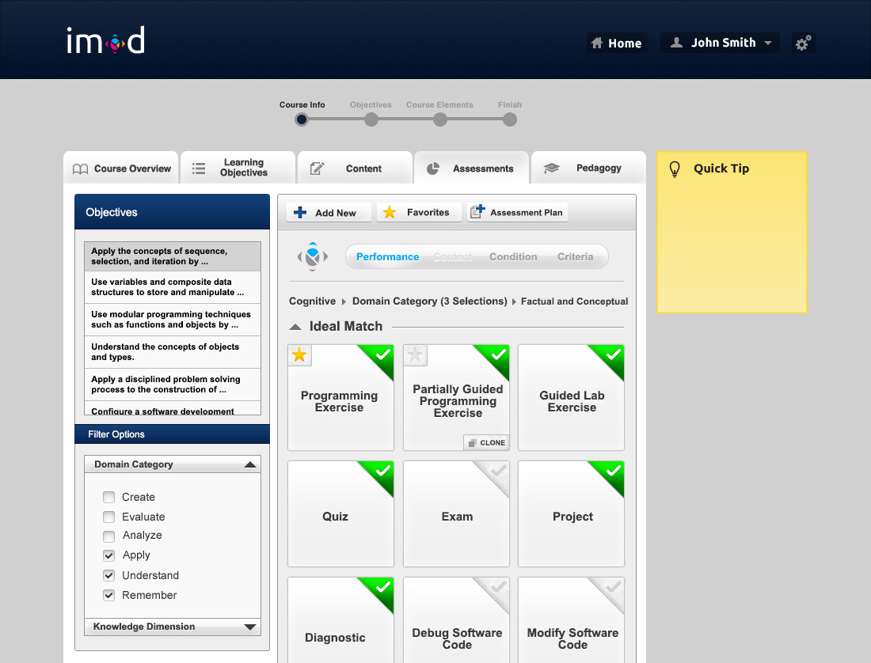
assessments

Slide 16
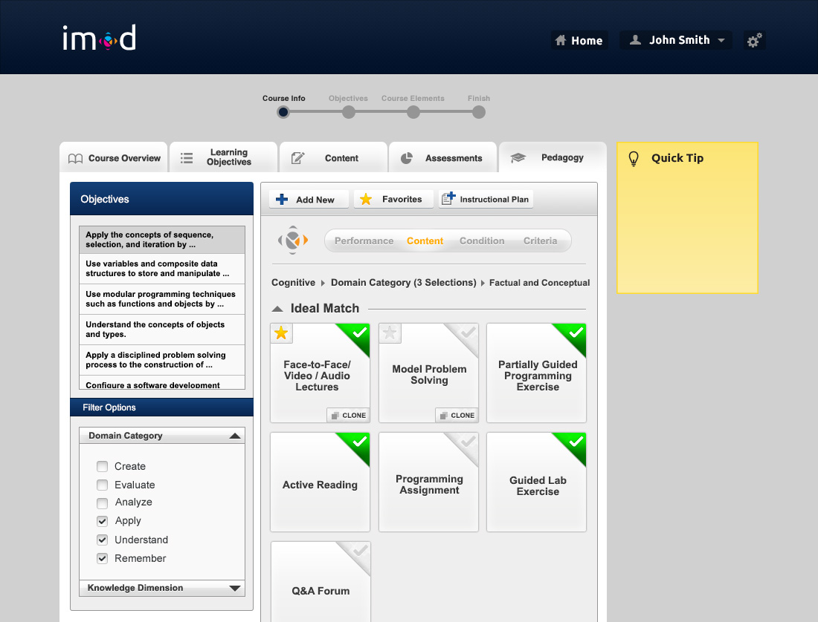
pedagogy

