Slide 1
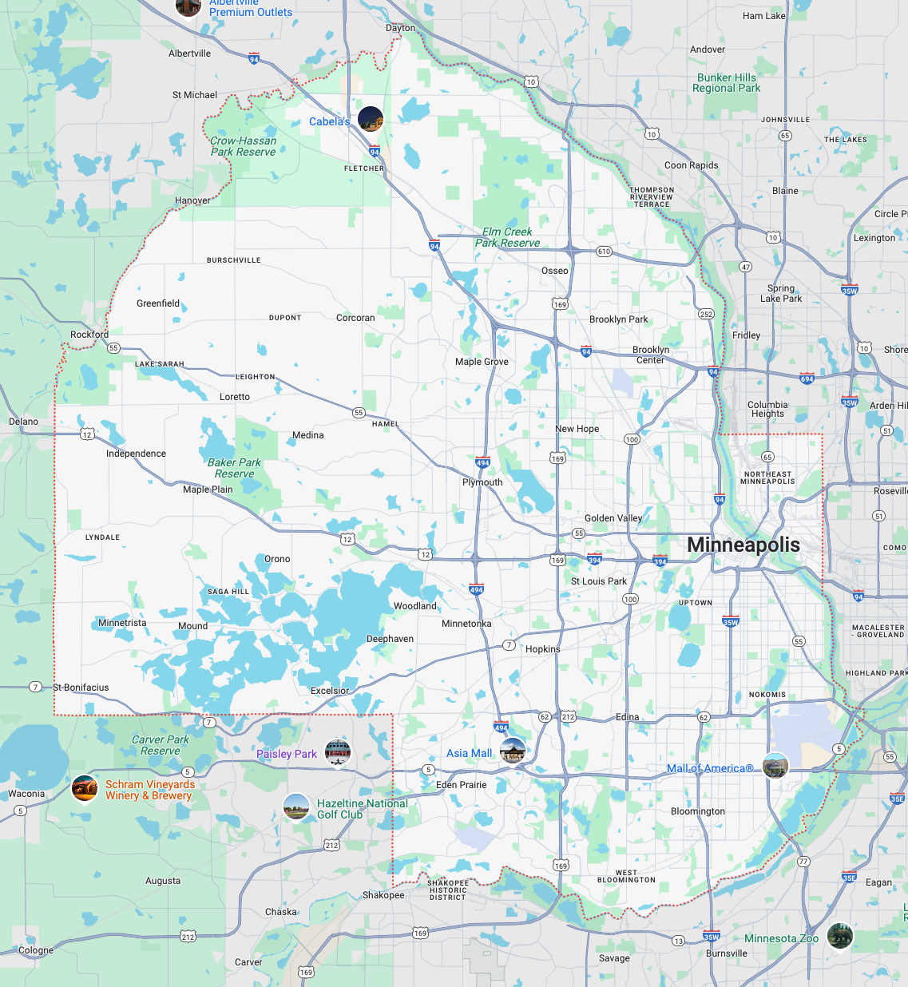
Housing Biases
Group 7 – DATA-6550

Slide 2
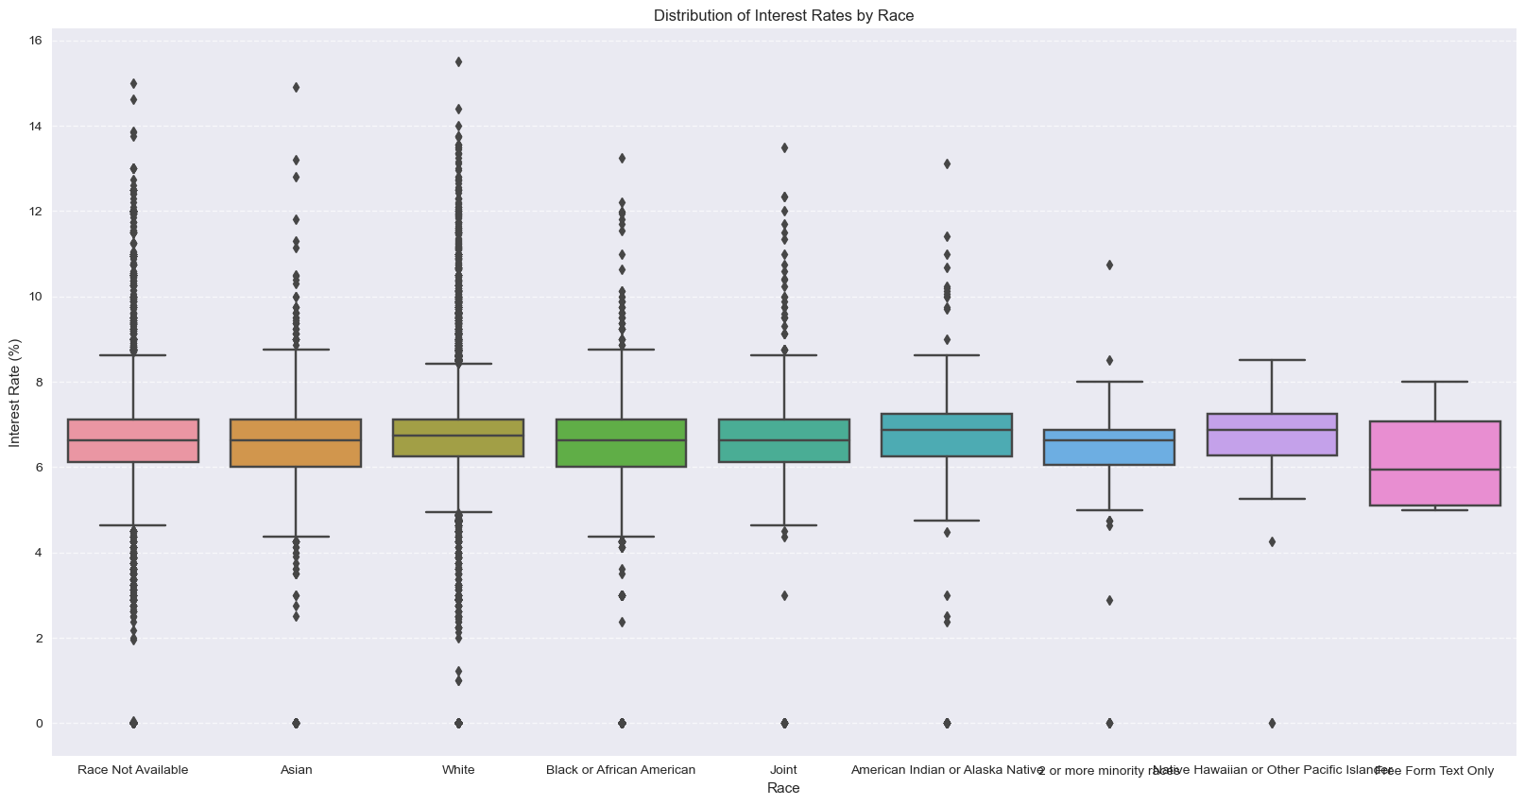
Introduction Data Biases in Housing
Housing discrimination has played a major role in shaping economic and social inequalities!
Algorithm decision-making has replaced human judgment in many financial processes!
Project focuses on Hennepin County, Minnesota.

Slide 3
Methodology Data Bias
Examined Historical Racial Covenants compared to Modern Property Values
Economic Indicators
Neighborhood Demographics

Slide 4
Methodology Algorithmic Bias
Investigated Mortgage Approval Rates
Evaluated Potential Proxy Variables

Slide 5
Proposed Mitigation

Slide 6
Thank you - Questions
Group 7 – DATA-6550

