Slide 1
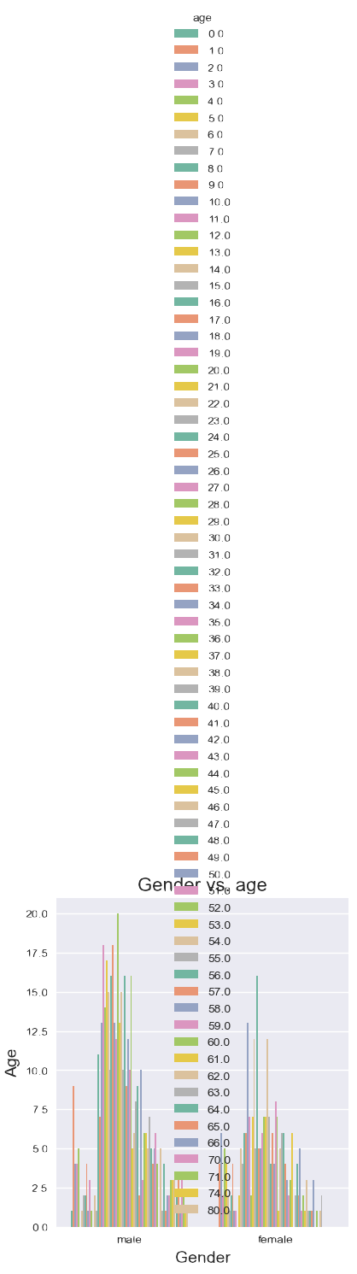
Biases in Visuals
Group 7 – DATA-6550

Slide 2
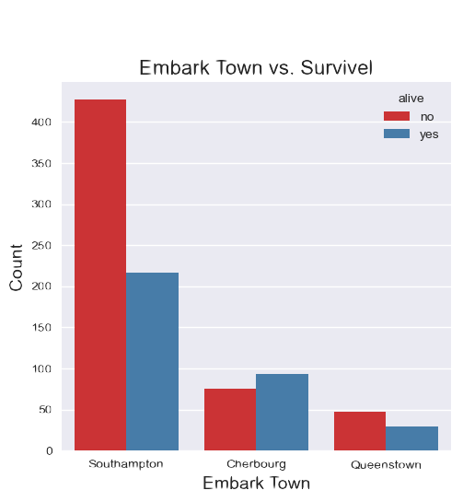
Key Biases - Bad Embarkment vs. Survival Rate
It seems Embarkment is a clear indicator of survival rate!
Conclusion passengers from Cherbourg are better swimmers!
It does not take the Fare class in mind…

Slide 3
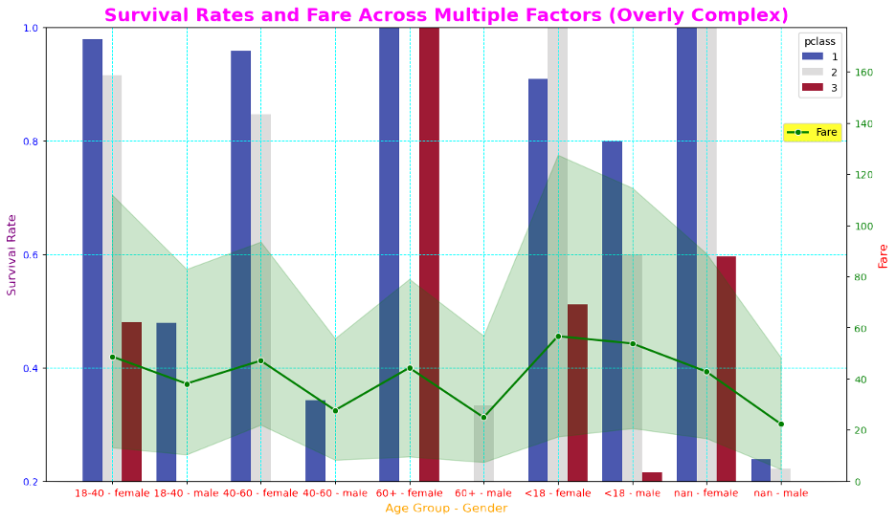
Key Biases - Bad Survival Rate & Fare Across Many Factors
This visual benchmarks Survival Rate & Fare (multi-axis scale).
We then have multiple Factors in the X-Axis
This is a very complicated visual to understand and is not overly useful
Very Pretty! ☺

Slide 4
Mitigation Strategies
Visual #01 – Determine what we need to display… In case of Embarkment we could indicate the the Fare class counts as a stacked-bar chart
Visual #01 – Make the scale of the Survival Rate be a percentage rather than number.
Visual #02 – Instead of having the Survival Rate and Fare Cost in the same Y-Axis make two charts side-by-side.
Visual #02 – Split the Gender and Age Ranges into two visuals

Slide 5
Thank you - Questions
Group 7 – DATA-6550

