Slide 1
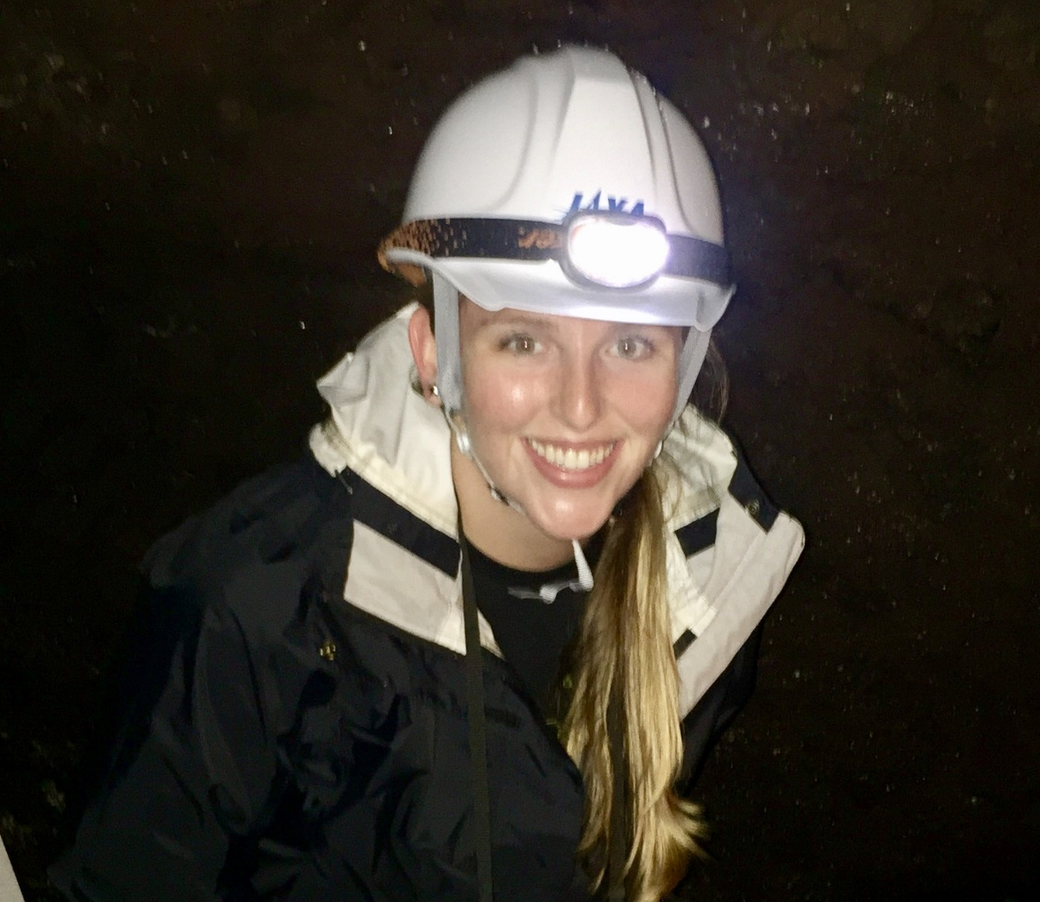
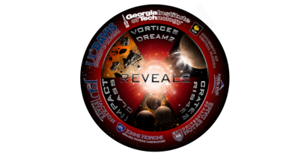




Reilly Brennan Astrochemistry Micrometeorite Impact Simulations on Airless Bodies

