Slide 1
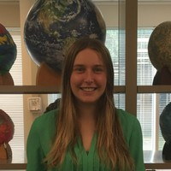




Abigail Flom Lunar Remote Sensing

