Slide 1
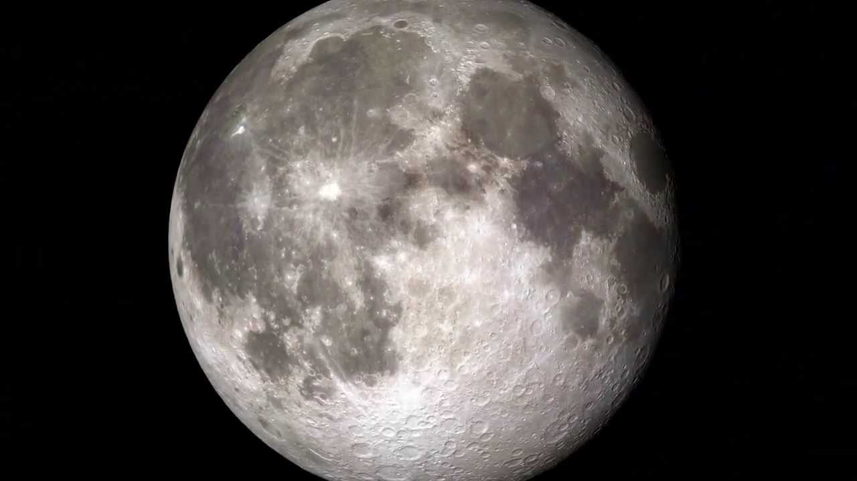
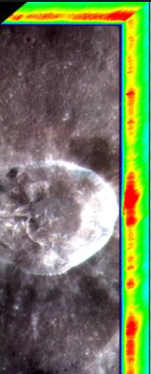


LunGradCon Icebreaker
Lingzhi Sun
University of Hawaii
Lunar Remote Sensing
Apollo next generation sample analysis program

