Slide 1
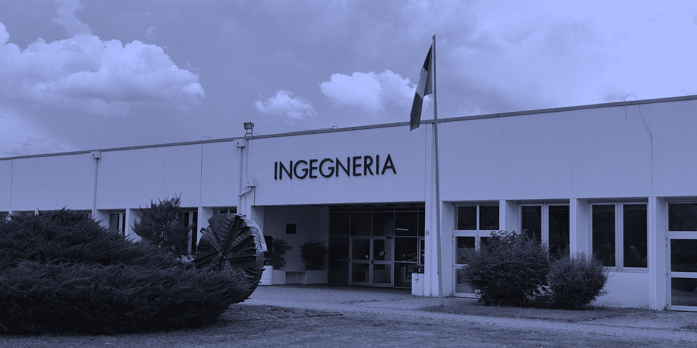

TITOLO TESI
Nome Tesista
IMP Lab
Relatore: Andrea Prati
Co-relatore: …...
Notes:
Good afternoon and thanks to be here.
My name is Leonardo Rossi and I will present now our work on a new architecture for instance segmentation.

Slide 2

Arguments
Description and motivation
State of the art
Contributions:
  ...
Conclusions and future works

Slide 3
State of the art
Description….
Notes:
Usually we have a model composed by two stages:
The first which looks for a generic type of object and which will return a list of proposals, which is a list of bounding boxes where likely there is an object.
This is list is built using only positive bounding boxes.
That is, the ones which overlap the ground truth at least with a minimum IoU (Intersection over Union, used as threshold).
This list will be used by the second stage which will scans them, one by one, and it will classify, make a better localization and, finally, it returns also the segmentation.

Slide 4
Contributions
Description...

Slide 5
Conclusions

Slide 6
Future works

Slide 7

Thank you for listening..
Questions? :)

Slide 8
TITOLO TESI
Nome Tesista
IMP Lab
Relatore: Andrea Prati
Co-relatore: …...
Notes:
Good afternoon and thanks to be here.
My name is Leonardo Rossi and I will present now our work on a new architecture for instance segmentation.

