Slide 1

Event Management System
CSC382
Fahad Bin Sultan University
College of Computing
Computer Science Department
Instructor
Dr. Osamah Ghaleb
Prepared By
Sallam Hamdan Sallam Al-Omrani202322090
Abdullah Ali Khalaf Al-Rashidi202422065
Ayman Abdullah Al-Omari202412014

Slide 2

The Problem: Manual Event Management
Traditional event management processes often rely on manual methods, such as spreadsheets and email communication, which are prone to errors, lack scalability, and consume significant administrative time. This leads to inefficiencies in registration, attendee tracking, and communication.
Data Inconsistency
Inefficient Registration
Difficulty in maintaining a single, accurate source of truth for attendee data across multiple systems.
Manual form processing and confirmation delays result in poor user experience and administrative overhead.
Lack of Real-time Insights
Poor Scalability
Inability to monitor registration progress and capacity in real-time, leading to poor decision-making.
Manual systems break down when managing a large number of events or attendees, limiting growth.

Slide 3


Introducing the Event Management System
A Centralized Digital Platform
The EMS is a web-based application designed to streamline the entire event lifecycle, from creation and promotion to registration and post-event analysis. It provides a single, centralized platform for both administrators and attendees.
Core Features
•
Event Creation & Management:
Administrators can easily create, edit, and publish new events.
•
Online Registration:
A simple, user-friendly interface for attendees to register for events.
•
Real-time Tracking:
The system provides immediate updates on registration numbers and event capacity.
•
Secure Administration:
A dedicated dashboard for managing events, users, and registrations.

Slide 4

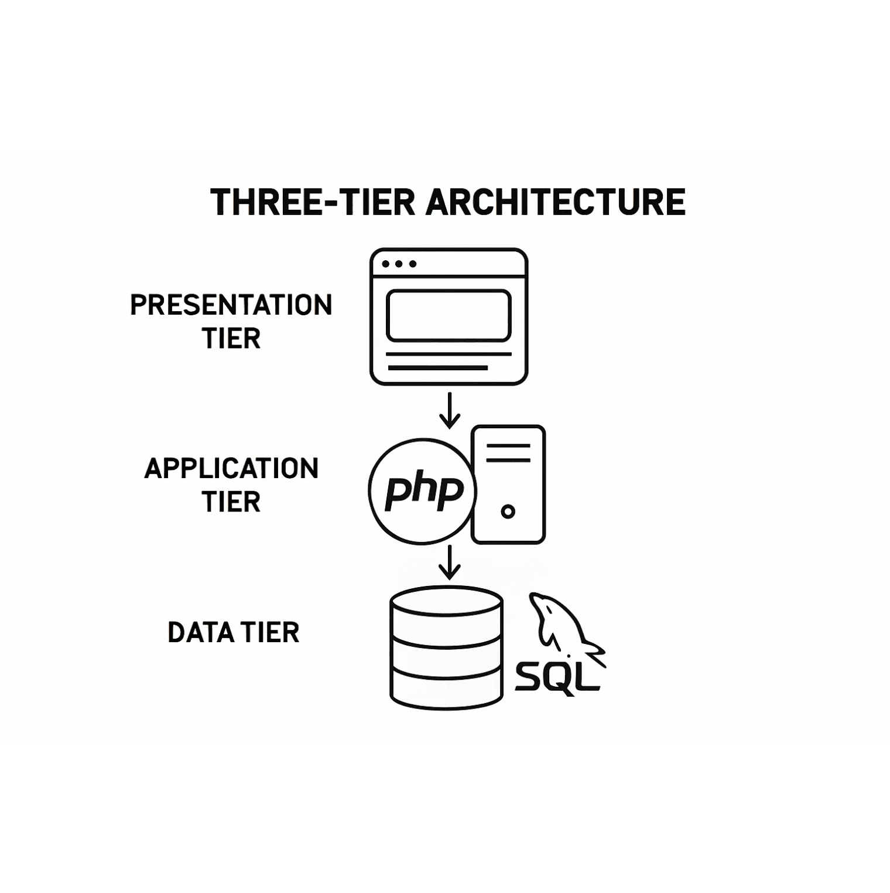
System Design: Three-Tier Architecture
Technical Foundation
Technology Stack
Component
Technology
Purpose
Frontend
HTML5, CSS3, JavaScript
User Interface and Interaction
Backend
PHP
Server-side Scripting and Business Logic
Database
MySQL
Data Storage and Retrieval

Slide 5

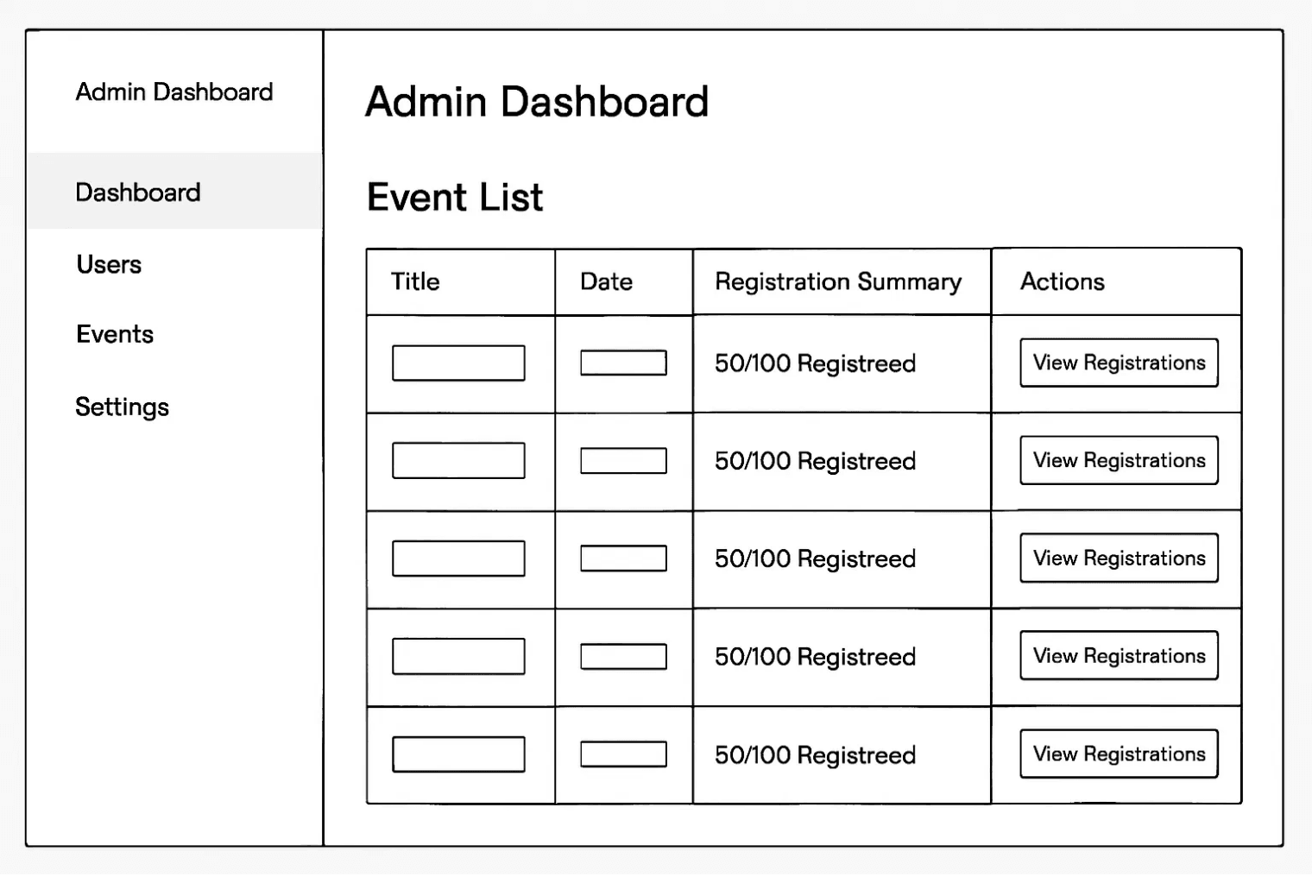
User Interface and Experience Design
The UI is designed with a focus on simplicity and ease of use for both the public-facing registration pages and the administrative dashboard, ensuring that users can accomplish their goals efficiently and intuitively.
Key Interface Components
→
Public Interface
Simple forms for event registration and information viewing, designed for accessibility and ease of use.
→
Admin Dashboard
A secure, centralized control panel for event administrators with comprehensive management capabilities.
→
Event List View
Displays all events with key metrics: Title, Date, and Registration Summary (e.g., "50/100 Registered").
→
Registration Detail View
Provides a granular list of all attendees for a specific event: Name, Email, Seats, and Registration Date.

Slide 6

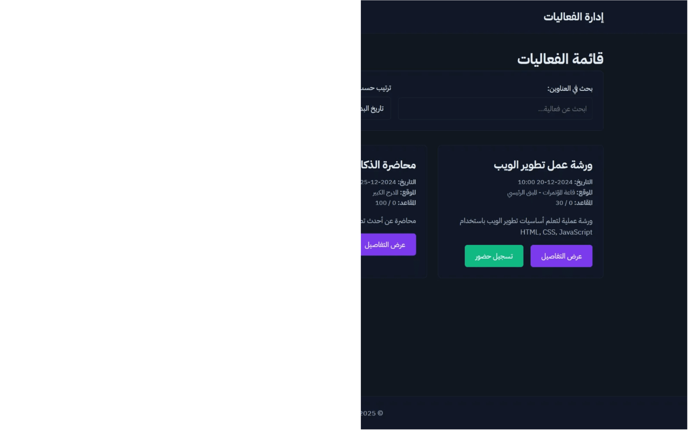
Demo: Public Event Registration Interface
This interface provides a user-friendly platform where potential attendees can discover and register for upcoming events. The public-facing page displays all available events with essential information and a streamlined registration process.
Event Discovery: Users can browse all available events with key details such as title, date, and capacity information.
•
Simple Registration: A straightforward form allows users to register for events with minimal required information.
•
Real-time Availability: The system displays current registration status, helping users understand event capacity and availability.
•
Confirmation: Users receive immediate feedback upon successful registration, with confirmation details.
•

Slide 7
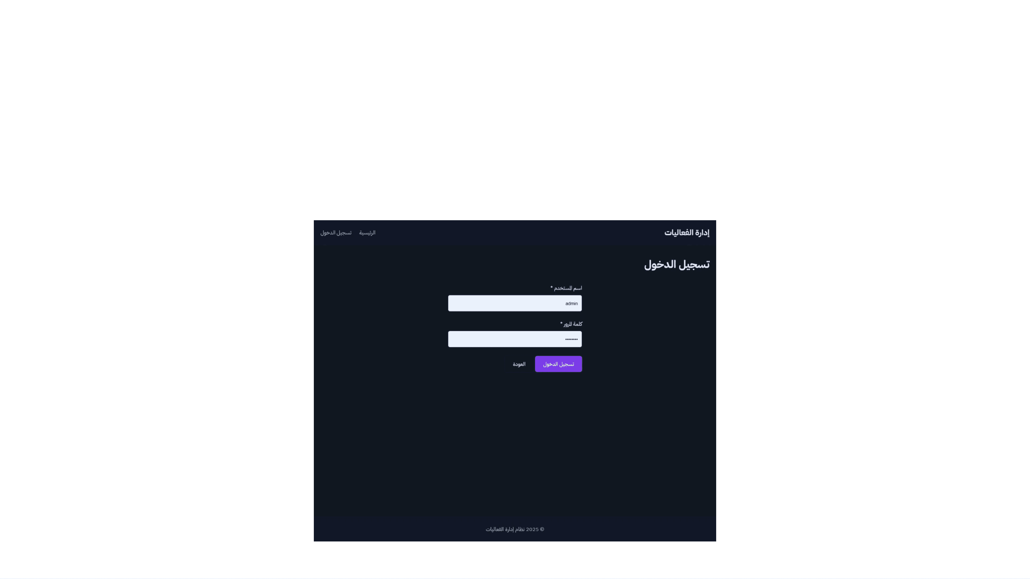
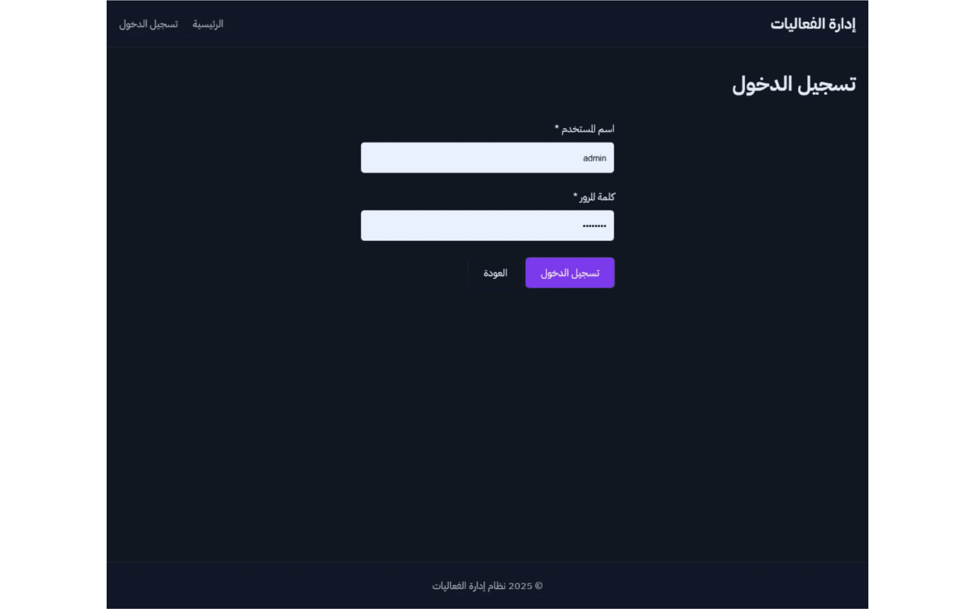
Demo: User Authentication and Login
This demonstrates the secure login form interface used by administrators and registered users to access the system. The authentication system ensures that only authorized users can access their respective dashboards and manage events or registrations.

Slide 8

Demo: Admin Dashboard - Event List
Main administrative view showing all events with registration summaries and management options
Title
Date
Registration Summary
Actions
Web Development Workshop
2024-12-15
45 registered / 100 capacity
View Registrations
AI & Machine Learning Seminar
2024-12-20
78 registered / 150 capacity
View Registrations
Cloud Computing Conference
2025-01-10
120 registered / 200 capacity
View Registrations
Cybersecurity Training
2025-01-18
32 registered / 60 capacity
View Registrations
Database Design Masterclass
2025-02-05
56 registered / 80 capacity
View Registrations

Slide 9

Demo: Event Creation and Management
This interface allows administrators to create new events and manage existing ones. The form provides a comprehensive set of fields to define all essential event details, ensuring complete information capture for successful event execution.
Event Title
Event Description
The name or title of the event that will be displayed to attendees.
Detailed information about the event, including objectives, agenda, and key highlights.
Text input field
Rich text area
Date & Time
Location/Venue
The scheduled date and time for the event, with start and end time specifications.
The physical or virtual location where the event will take place.
Date and time picker
Text input field
Event Capacity
Registration Deadline
The maximum number of attendees allowed for the event.
The final date and time by which attendees must register for the event.
Numeric input field
Date and time picker
Create Event / Save Changes: Administrators can submit the form to create a new event or update an existing event's details. The system validates all required fields before processing.

Slide 10

Conclusion and Future Enhancements
Summary of Achievements
Future Enhancements
✓
Improved Efficiency
→
Payment Gateway Integration
Automated registration and tracking processes reduce
Adding support for online payment processing for paid events and
administrative overhead and human error.
ticketing systems.
✓
Enhanced Data Quality
→
Automated Email Notifications
Centralized MySQL database ensures data consistency and reliability
Implementing system-triggered emails for registration
across the entire system.
confirmations and event reminders.
✓
Better Oversight
→
Advanced Reporting Module
Real-time dashboard provides administrators with critical event
Developing comprehensive reporting features for data analysis,
metrics and registration insights.
export, and business intelligence.

