Slide 1
딥러닝 스터디 3주차
황상빈

Slide 2
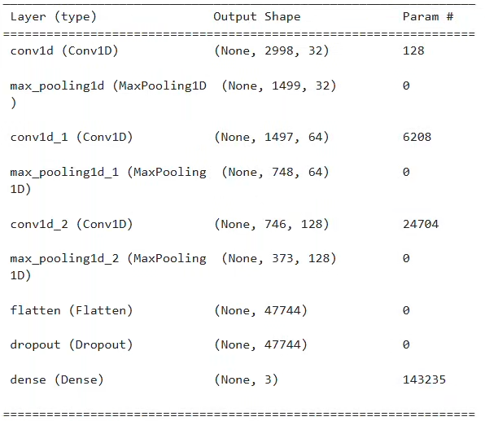
Methodology
Parameter
Layer
Loss function : CrossEntropyLoss
Optimizer: Adam
Learning rate : 0.001
Epoch = 10

