Slide 1
PanzerMower
(More design changes will be added, rough structure of power point)

Slide 2
Who we are
(Need picture from everyone)
Team Leader
Backend
Application
Mower

Slide 3
Low level requirements
Different tasks to accomplish high level requirements

Slide 4
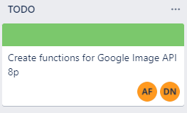
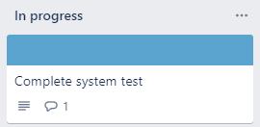
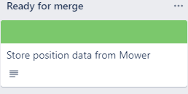
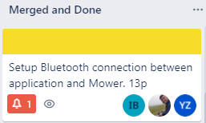
Work breakdown structure

Slide 5
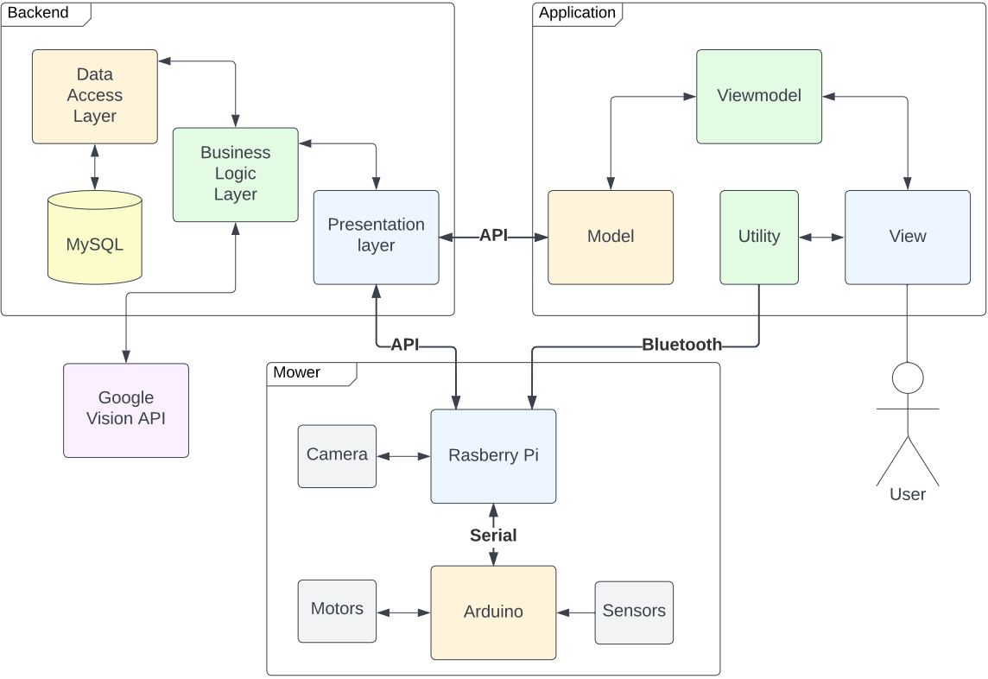
System architectural overview

Slide 6
System diagnostics
(needs more information)

Slide 7
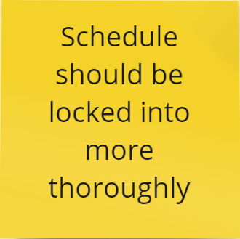
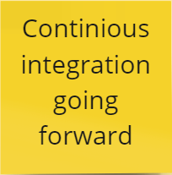

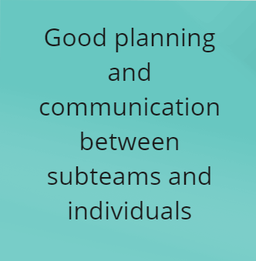
Lessons learned

Slide 8
Live demo

