Slide 1
CPE 301 Project Presentation
Jiajian Chen
Email:chenj21@unlv.nevada.edu

Slide 2
AIM & ACCOMPLISHMENT
AIM:
The goal of this project is to display the heartbeat signal in its entirety using the Pulsesensor.
Step 1: Collect and display data from Pulsesensor on to the UART terminal.
Step 2: Use a BT/BLE (HC06/HC10) module to transmit the data from AVR to host using BT/BLE communication and display the live data on the host.
Step 3: apply smoothing/filtering algorithms to raw data in post-processing.
ACCOMPLISHMENT
All completed

Slide 3
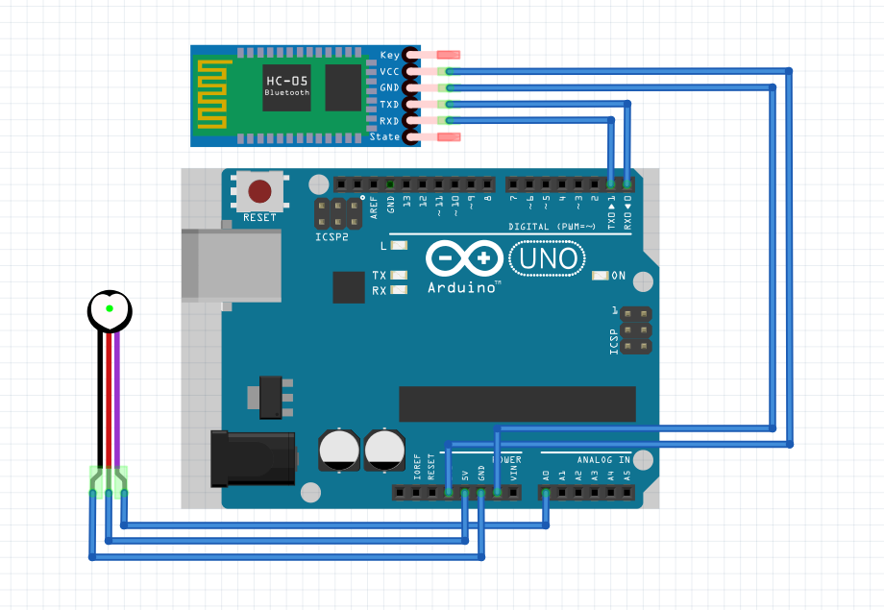
SCHEMATICS
Complete schematics

Slide 4
DESIGN STAGES
Components
AVR ATMEGA328p
HC-06
Pulse sensor
Interfaces
Atmega328p – Pulse sensor using ADC interrupt
Atmega328p – HC-06 using USART interrupt
Atmega328p – PC using TIMER1 interrupt to display the BPM

Slide 5
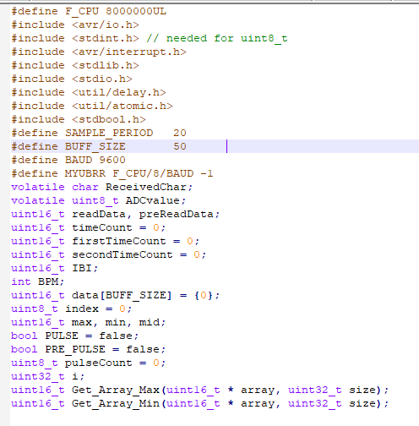
CODE DEVELOPMENT
Initialization

Slide 6
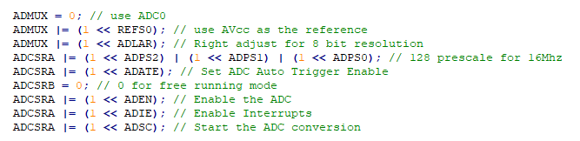

CODE DEVELOPMENT
Data Collection

Slide 7
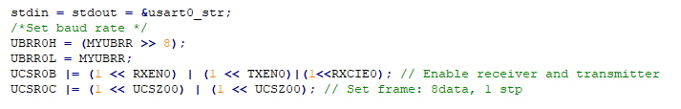
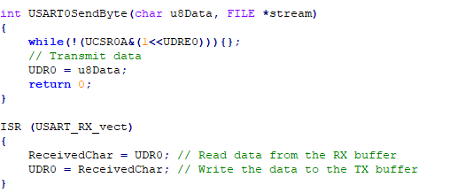
CODE DEVELOPMENT
Networking/Visualization

Slide 8
DEMO SNAPSHOT/VIDEO
https://www.youtube.com/watch?v=EuiVsJtVaSY

Slide 9
Group Projects
Student Name: Jiajian Chen
Task Completed: ALL
Contribution % towards the project: 100%
Coding (%): 100%
Implementation (%): 100%
Testing/Demo (%): 100%
Documentation (%): 100%
Presentation (%): 100%

