Slide 1
PLANNING

Slide 2

Planning Agent
sensors
?
environment
agent
actuators
A1 A2 A3

Slide 3
Purpose of Planning
The purpose of planning is to find a sequence of actions that achieves a given goal when performed starting in a given state.
In other words, given a set of operator instances (defining the possible primitive actions by the agent), an initial state description, and a goal state description or predicate, the planning agent computes a plan.
Start
Operator
Instances
PLAN
Final

Slide 4
What is Plan?
The task of coming up with a sequence of actions that will achieve a goal is called Planning.
Planning Problems so far:
search-based problem solving
logical planning
Consider only environment that are fully observable, deterministic, finite, static (change happens only when the agent acts), and discrete (in time, action, objects and effects). These are called Classical Planning.

Slide 5
Why Planning
Intelligent agents must operate in the world.
Take intelligent actions
Compose actions together to achieve complex goals
Change the world to suit the needs. Agents need to reason about what the world will be like after executing a sequence of actions
Need to reason about dynamic environment

Slide 6

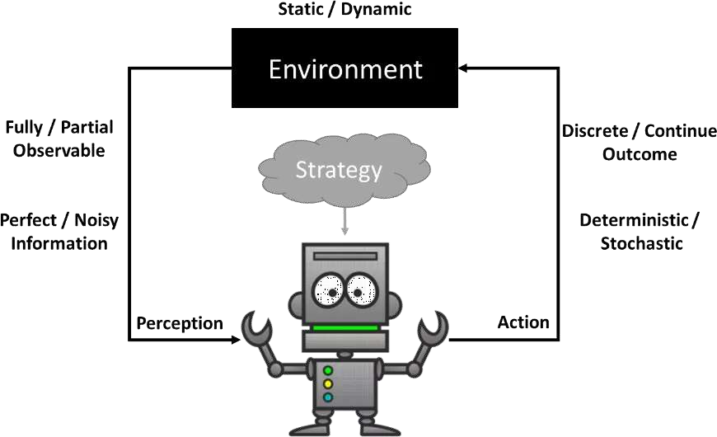

Slide 7
Planning Algorithm
Generate a goal to achieve
Construct a plan to achieve goal from current state
Execute plan until finished
Begin again with new goal

Slide 8
The language Planning Problems
Planning algorithms should take advantage of the logical structure of the problem.
The key is to find a language that is expressive enough to describe a wide variety problems, but restrictive enough to allow efficient algorithms to operate over it.
The problem should be expressed in a suitable logical language.
Planning is considered different from problem solving because of the difference in the way they represent states, goals, actions, and the differences in the way they construct action sequences.

Slide 9
Continue…
Representation of states
Planners decompose the world into logical conditions and represent a state as conjunction of positive literals
Example; prepositional logic P V Q
Representation of goals
A goal is partially specified state, represented as a conjunction of positive ground literals, such as 𝐏 𝖠Q.
A propositional state s satisfies a goal g if s contains all the atoms in g.
Example; P𝖠 𝑸 𝖠R satisfies the goal 𝐏 𝖠Q
Representation of actions
An action is specified in terms of the pre conditions that must hold before it can be executed and the effects that ensue when it is executed.
Example: Action(Fly(p,From,To),
PRECOND: At(p, from) 𝖠 Plane(p) 𝖠 Airport(from) 𝖠 Airport(to),
EFFECT: ~At(p,from) 𝖠 At(p,to))

Slide 10
Continue…
This is called an action schema, meaning that it represents a number of different actions that can be derived by instantiating the variables p, from and to to different constants. In general action schema consists of three parts:
The action name and parameter list
The precondition is a conjunction of function-free positive literals stating what must be true in state before the actions can be executed.
The effect is a conjunction of function-free literals describing how the state changes when the action is executed.

Slide 11
Continue…
To improve the readability, some planning systems divide the effect into the add list for positive literals and delete list for negative literals.
If an action is applicable in any state that satisfies the precondition; otherwise, the action has no effect.
Example; Action(Fly(p,From,To),
PRECOND: At(p, from) 𝖠 Plane(p) 𝖠 Airport(from) 𝖠 Airport(to), EFFECT: ~At(p,from) 𝖠 At(p,to))
Starting in state s, the result of executing an applicable action a is a state s` that is the same as s except

Slide 12
A Planning Problem
Goal :
Have a birthday party
Current situation:
Agent at home, has flour, Does not have butter, Does not have sugar.
To Do:
Invite friends, Buy butter, Buy sugar, Buy balloons, Decorate house, Bake cake ….

Slide 13
Example: Shopping
Start
At(Home) ^ Sells(SM,Milk) ^ Sells(SM,Banana) ^ Sells(HWS,Drill)^Loc(Home)^Loc(SM)^Loc(HWS)
Buy(x)
PRE: At(store), Sells(store, x)
EFF: Have(x)
Go(x, y)
PRE: At(x),Loc(y)
EFF: At(y),¬At(x)
Goal
Have(Milk) ^ Have(Banana) ^ Have(Drill)

Slide 14
Solution
Initial state : At(Home) /\ -Have(Milk) /\ -Have(Bananas) /\ -Have(Drill) /\
...
A state description does not have to be complete. We just want to obtain a successful plan to a set of possible complete states. But if it does not mention a given positive literal, then the literal can be assumed to be false.
Goals are a conjunction of literals. Therefore the goal is
At(Home) /\ Have(Milk) /\ Have(Bananas) /\ Have(Drill)
Goals can also contain variables. Being at a store that sells milk is equivalent to
At(x) /\ Sells(x,Milk)

Slide 15
Continue…
Operator Schema: an operator with variables.
it is a family of actions, one for each of the different values of the variables.
every variable must have a value
Preconditions and Effects are restrictive. Operator o is applicable in a state s if every one of the preconditions in o are true in s. An example is if the initial situation includes the literals
At(Home, Path(Home, Supermarket)...
then the action Go(Supermarket) is applicable, and the resulting situation contains the literals
-At(Home),At(Supermarket), Path(Home, Supermarket)...
The result is all positive literals in Effect(o) hold, all literals in s hold and negative literals in Effect(o) are ignored.

Slide 16
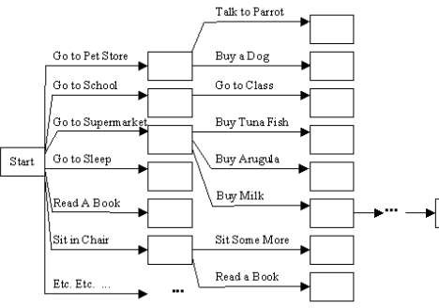
Example
"Get a quart of milk and a bunch of bananas and a variable speed cordless drill" for a problem solving exercise we need to specify:
Initial State: the agent is at home without any objects that he is wanting.
Operator Set: everything the agent can do.
Heuristic function: the # of things that
have not yet been acquired.

Slide 17
Solution
Planning emphasizes what is in operator and goal representations. There are three key ideas behind planning:
to "open up" the representations of state, goals, and operators so that a reasoner can more intelligently select actions when they are needed
the planner is free to add actions to the plan wherever they are needed, rather than in an incremental sequence starting at the initial state
most parts of the world are independent of most other parts which makes it feasible to take a conjunctive goal and solve it with a divide-and-conquer strategy

Slide 18














A
Another Example: Box World
C
C
A
B
B

Slide 19
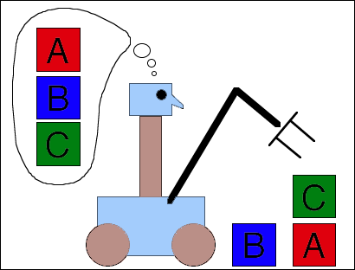
Continue…
Initial State:
ontable(A) Λ 𝑜𝑛𝑡𝑎𝑏𝑙𝑒(𝐵)Λon(C,B) Λclear(A) Λ
Goal State:
ontable(B) Λon(C,B) Λ 𝑜𝑛 𝐴, 𝐶 Λclear(A) Λ

Slide 20
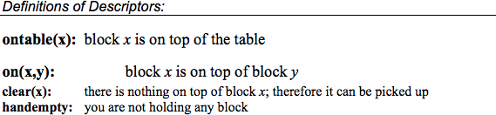
Description

Slide 21
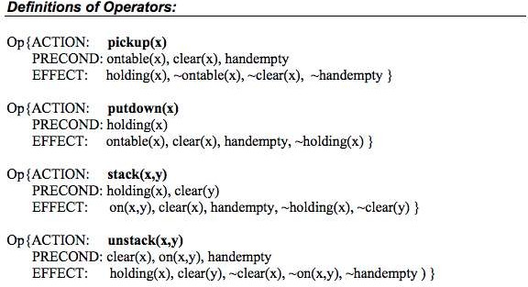

Slide 22





Another Example: Box World
A
C
B
A
B
C

Slide 23






































C
A
B
C
A
B
A B C
B
A
C

Slide 24















C
Operations
Op{Action: unstack(C,B)}
Op{Action: pickup(B)}
Op{Action: stack(B,C)}
Op{Action: pickup(A)}
Op{Action: stack(A,B)}
A B C
A
B
A B C
B
A
C

Slide 25
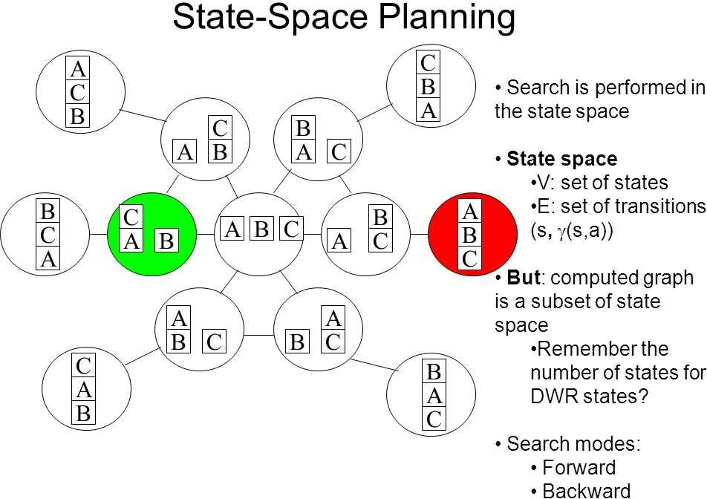

Slide 26
Planning with state space search
Planning as Search:
There are two main approaches to solving planning problems, depending on the kind of search space that is explored:
Situation-space search 2.Planning-space search

Slide 27
Situation-Space Search
In situation space search
The search space is the space of all possible states or situations of the world
Initial state defines one node
A goal node is a state where all goals in the goal state are satisfied
A solution plan is the sequence of actions (e.g. operator instances) in the path from the start node to a goal node

Slide 28














C
A B C
A
B
Putdown(A)
A B C
B
A
C
Pickup(A)
START
Stack(A,C)
Unstack(C,B)
Finish
Stack(C,A)
Stack(C,B)

Slide 29
Planning-space search
The search space is the space of all possible plans
A node corresponds to a partial plan
Initially we will specify an "initial plan" which is one node in this space
A goal node is a node containing a plan which is complete, satisfying all of the goals in the goal state
The node itself contains all of the information for determining a solution plan (e.g. sequence of actions)

Slide 30
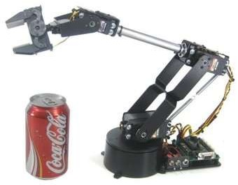



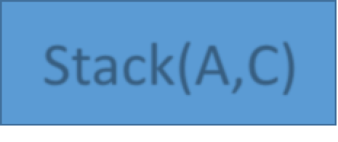


Start
Handempty
Pickup(A)
Holding(A)
Stack(A,C)
On(A,C)
Finish

Slide 31
Situation Planning

Slide 32
Situation Planning Algorithms
There are 2 approaches to situation-space planning:
Progression situation-space planning
Regression situation-space planning

Slide 33
Progression(Forward) situation-space planning
Forward search through the space of states, starting from the initial state and using the problem’s actions until the member of goal states are found.
You can use any search method you like (i.e. BFS, DFS, A*)
Since the forward search is prone to exploring unrelated nodes, and tend to have many state spaces, it has been regarded as inefficient without the help of accurate heuristics.
Disadvantage: huge search space to explore, so usually very inefficient

Slide 34
Continue…
Algorithm:
Start from initial state
Find all operators whose preconditions are true in the initial state
Compute effects of operators to generate successor
states
Repeat steps #2-#3 until a new state satisfies the goal conditions

Slide 35
Regression (Backward) situation-space planning
Backward search through the relevant states, starting from the goal state, to the initial state using the inverse of actions.
Backward-chaining from goal state to initial state
Regression situation-space planning is usually more efficient than progression because many operators are applicable at each state, yet only a small number of operators are applicable for achieving a given goal
Hence, regression is more goal-directed than progression situation- space planning.
Disadvantage: cannot always find a plan even if one exists!

Slide 36
Continue…
Algorithm:
Start with goal node corresponding to goal to be achieved
Choose an operator that will add one of the goals
Replace that goal with the operator's preconditions
Repeat steps #2-#3 until you have reached the initial state

Slide 37
Heuristics planning
We can derive an admissible heuristics by defining a relaxed problem.
There are two ways to make the problem easier: by adding more edges to the graph making it easier to find the path or by forming an abstraction of state space that has fewer states.

Slide 38
Continue…
Neither progression or regression are very efficient without a good heuristic.
How many actions are needed to achieve the goal?
Exact solution is NP hard, find a good estimate
Two approaches to find admissible heuristic:
The optimal solution to the relaxed problem.
Remove all preconditions from actions
The subgoal independence assumption:
The cost of solving a conjunction of subgoals is approximated by the sum of the costs of solving the subproblems independently.

Slide 39
Total-order Plan
Start
Start
Start
Start
Start
Start
Right Sock
Right Sock
Left Sock
Left Sock
Right Sock
Left Sock
Left
Sock
Left
Sock
Right
Sock
Right
Sock
Right
Shoe
Left
Shoe
Left Shoe
RightSh
RightSh
Left Shoe
Left Sock
RightSo
oe
oe
ck
RightSh
Left
Shoe
Left
Shoe
RightSh
Left
Shoe
Right
Shoe
oe
oe
Finish
Finish
Finish
Finish
Finish
Finish

Slide 40
Planning-space search

Slide 41
Partial-Order Planning
Progression and regression planning are totally ordered plan
search forms.
They cannot take advantage of problem decomposition.
Decisions must be made on how to sequence actions on all the subproblems
Least commitment strategy:
Delay choice during search

Slide 42
Continue…
Partially ordered collection of steps with
Start step has the initial state description as its effect
Finish step has the goal description as its precondition causal links from outcome of one step to precondition of another
temporal ordering between pairs of steps
Open condition = precondition of a step not yet causally linked
A plan is complete iff every precondition is achieved
A precondition is achieved iff it is the effect of an earlier step and no possibly intervening step undoes it

Slide 43
Continue…
Partially Ordered Plans:
no strict sequence
partly parallel
observe threats

Slide 44
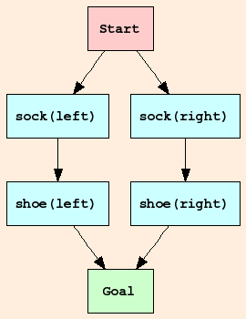
Shoe & Sock
Any planning algorithm that can place two actions into a plan without which comes first is a PO plan.

Slide 45
Continue…
Start with a rough plan and refine iteratively.
First plan consists only of start and finish actions:
start - T as precondition, initial world state as effect
finish - goal as precondition, NIL as effect
Select actions to achieve sub-goals separately, quasi in parallel → partial- order plan
Fulfill open preconditions (sub-goals), until no more unsatisfied preconditions are left (last one is T of start)

Slide 46
Continue…
Add causal links to connect effects from actions to matching preconditions for plan, e.g.
move(A,B,x) has effect clear(B)
clear(B) is precondition for move(B,y,z)
Causal links specify a partial order.

Slide 47
Continue…
Recognize threats - the effect of an action A destroys the precondition of another action B, e.g.
move(A,x,B) destroys clear(B) (in DELETE-list)
clear(B) is precondition for move(B,y,z)
thus, move(B,Fl,C) has to be done before move (A,Fl,B)
Add threats as partial order to plan: b<a (do b before a).

Slide 48
POP-Algorithm
In essence, the POP algorithm is the following: 1.Make the initial plan, i.e. the one that contains only
the Start and Finish steps.
Do until you have a solution plan
Take an unachieved precondition from the plan; achieve it
Resolve any threats using promotion or demotion

Slide 49

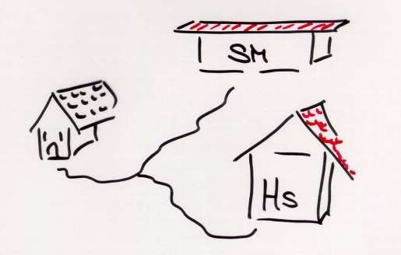
Another Example
At(Home)
Sells(SM, Banana)
Sells(HS, Drill)
Have(Drill)
Have(Milk)
Have(Banana)
Get a quart of milk and a bunch of bananas and a variable speed cordless drill

Slide 50
Partial Order Planning
Start
At(Home)
Buy(Banana)
Buy(Milk)
Buy(Drill)
Causal links
At(Home)
Have(Banana) Have(Milk)
Have(Drill)
End

Slide 51
NB: all causal links are also ordering links
Start
At(Home)
Ordering links
At(s) Sells(s,Banana)
At(s) Sells(s,Milk)
At(s) Sells(s,Drill)
Buy(Banana)
Buy(Milk)
Buy(Drill)
Causal links
At(Home)
Have(Banana) Have(Milk)
Have(Drill)
End

Slide 52
NB: all causal links are also ordering links
Start
At(Home)
At(SM) Sells(SM,Banana)
At(SM) Sells(SM,Milk)
At(HWS) Sells(HWS,Drill)
Buy(Banana)
Buy(Milk)
Buy(Drill)
Causal links
At(Home)
Have(Banana) Have(Milk)
Have(Drill)
End

Slide 53
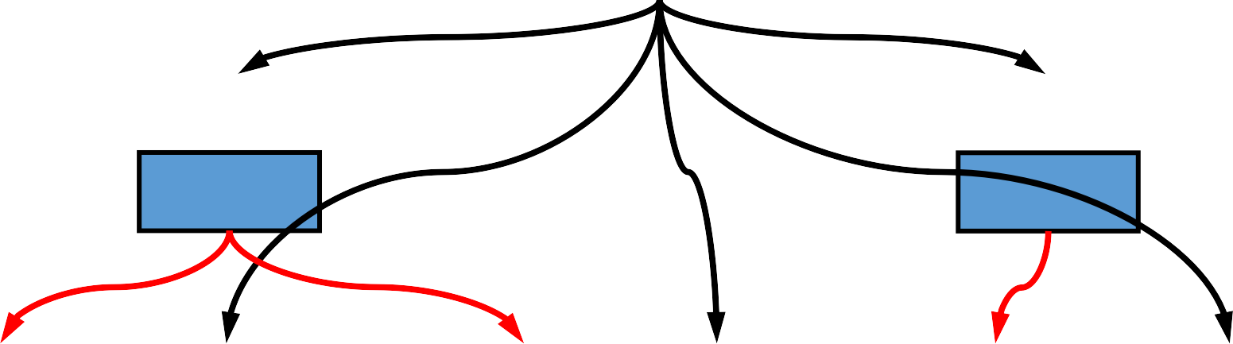
At(Home)
Start
At(s)
At(s)
Go(SM)
Go(HWS)
At(SM) Sells(SM,Banana)
At(SM) Sells(SM,Milk)
At(HWS) Sells(HWS,Drill)
Buy(Banana)
Buy(Milk)
Buy(Drill)
At(Home)
Have(Banana) Have(Milk)
Have(Drill)
End

Slide 54
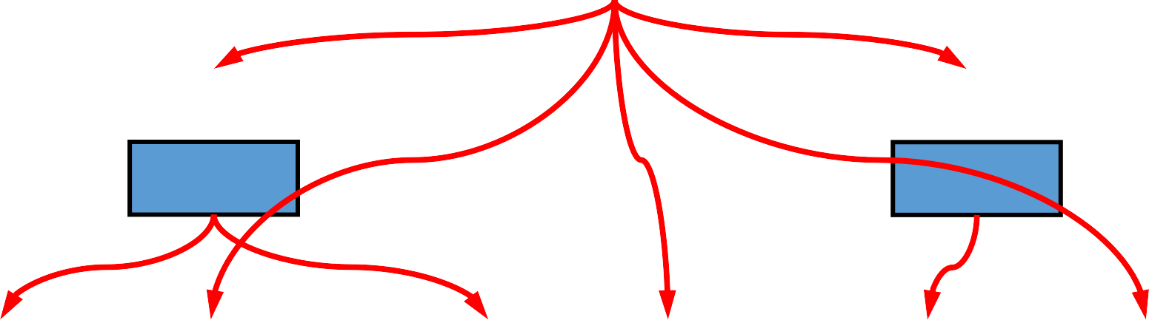
At(Home)
Start
At(Home)
At(Home)
Go(SM)
Go(HWS)
At(SM) Sells(SM,Banana)
At(SM) Sells(SM,Milk)
At(HWS) Sells(HWS,Drill)
Buy(Banana)
Buy(Milk)
Buy(Drill)
At(Home)
Have(Banana) Have(Milk)
Have(Drill)
End

Slide 55
Threats to Causal Links
Start
At(Home)
At(Home)
At(Home)
Go(SM)
Go(HWS)
At(SM) Sells(SM,Banana)
At(SM) Sells(SM,Milk)
At(HWS) Sells(HWS,Drill)
Buy(Banana)
Buy(Milk)
Buy(Drill)
At(Home)
Have(Banana) Have(Milk)
Have(Drill)
End

Slide 56
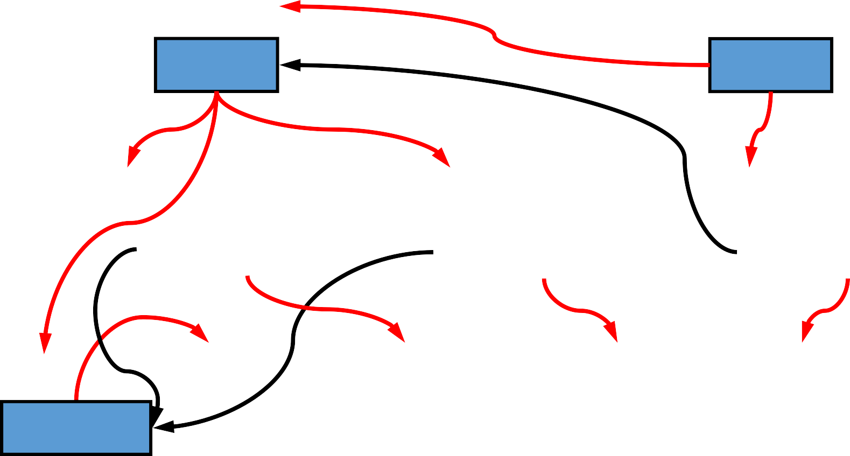
Threats to Causal Links: Demotion
Start
At(Home)
At(HWS)
At(Home)
Go(SM)
Go(HWS)
At(SM) Sells(SM,Banana)
At(SM) Sells(SM,Milk)
At(HWS) Sells(HWS,Drill)
Buy(Banana)
Buy(Milk)
Buy(Drill)
At(SM)
At(Home)
Have(Banana) Have(Milk)
Have(Drill)
Go(Home)
End

