Slide 1
ETHICS OF AI
SWATHI R
MTech CS (DS & AI)
Department of Computer Science
CUSAT

Slide 2
AGENDA
INTRODUCTION
KEY ETHICAL ISSUES
ETHICAL PRINCIPLES
IMPLEMENTING ETHICAL AI
CONCLUSION

Slide 3
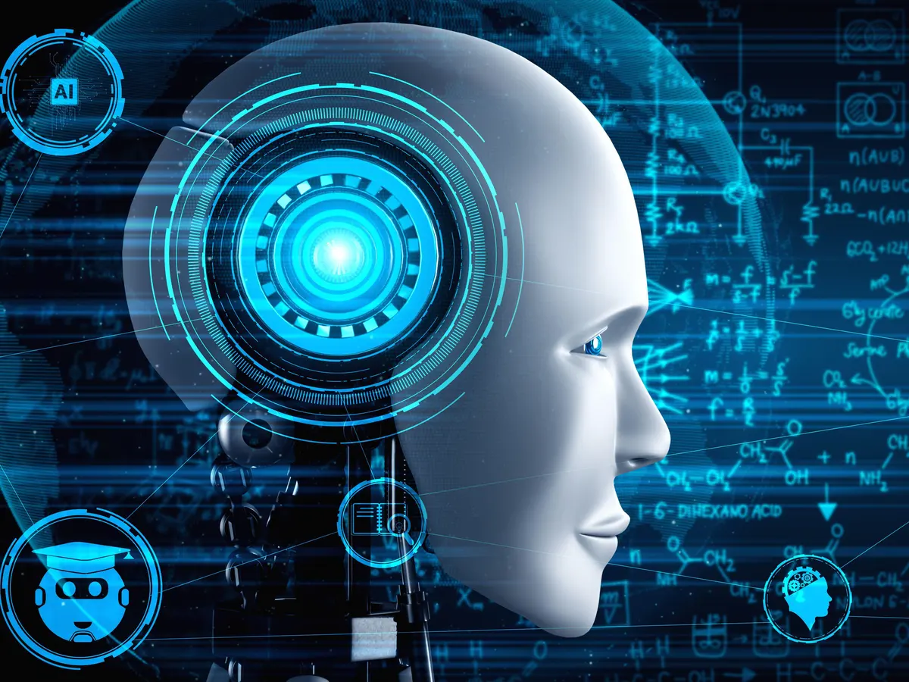
INTRODUCTION
Artificial intelligence (AI) is rapidly transforming our world, with the potential to revolutionize many industries and aspects of our lives.
However, as AI becomes more powerful and pervasive, it is important to consider the ethical implications of its development and use.

Slide 4
KEY ETHICAL ISSUES
Bias: AI systems can be biased, reflecting the biases of the data they are trained on and the people who design and develop them. This can lead to discrimination and other harms.
Privacy: AI systems can collect and process large amounts of personal data. This raises concerns about privacy and the potential for misuse of this data.
Transparency and accountability: AI systems can be complex and opaque, making it difficult to understand how they work and make decisions. This raises concerns about transparency and accountability.
Safety and security: AI systems can be dangerous if they are not designed and deployed carefully. For example, AI-powered weapons systems could be used to kill people without human intervention.

Slide 5
ETHICAL PRINCIPLES
Beneficence
AI systems should be used to promote human well-being and avoid harm.
Nonmaleficence
AI systems should not be used to cause harm to individuals or society.
AI systems should be used in a fair and just manner, without discrimination.
Autonomy
Individuals should have the right to choose whether or not to interact with AI systems and to have control over their interactions with AI systems.
Justice
AI systems should be transparent and accountable, so that individuals can understand how they work and make decisions.
Transparency

Slide 6
IMPLEMENTING ETHICAL AI
AI ethics guidelines: Many organizations are developing AI ethics guidelines to help their employees develop and use AI systems in an ethical manner. These guidelines often cover topics such as bias, fairness, accountability, privacy, and safety.
AI ethics review boards: Some organizations have established AI ethics review boards to review AI projects before they are deployed. These review boards help to ensure that AI projects are aligned with the organization's AI ethics principles.
AI ethics impact assessments: Some organizations conduct AI ethics impact assessments to identify and mitigate the potential ethical risks of AI projects. These assessments help to ensure that AI projects are deployed in a safe and responsible manner.

Slide 7
CONCLUSION
AI ethics is an important and complex field. As AI technology continues to develop, it is essential that we develop ethical guidelines and practices for the development and use of AI systems. By doing so, we can help to ensure that AI is used for good and that it benefits all of humanity.

Slide 8
THANK YOU

