Slide 1
CSC 594 Topics in AI – Natural Language Processing
Spring 2016/17
6. Part-Of-Speech Tagging, HMM (1)
(Some slides adapted from Jurafsky & Martin, and Raymond Mooney at UT Austin)

Slide 2
POS Tagging
The process of assigning a part-of-speech or lexical class marker to each word in a sentence (and all sentences in a collection).
Input: the lead paint is unsafe
Output: the/Det lead/N paint/N is/V unsafe/Adj
Speech and Language Processing - Jurafsky and Martin
<number>
Notes:
<number>

Slide 3
Why is POS Tagging Useful?
First step of a vast number of practical tasks
Helps in stemming/lemmatization
Parsing
Need to know if a word is an N or V before you can parse
Parsers can build trees directly on the POS tags instead of maintaining a lexicon
Information Extraction
Finding names, relations, etc.
Machine Translation
Selecting words of specific Parts of Speech (e.g. nouns) in pre-processing documents (for IR etc.)
Speech and Language Processing - Jurafsky and Martin
<number>
Notes:
<number>

Slide 4
Parts of Speech
8 (ish) traditional parts of speech
Noun, verb, adjective, preposition, adverb, article, interjection, pronoun, conjunction, etc
Called: parts-of-speech, lexical categories, word classes, morphological classes, lexical tags...
Lots of debate within linguistics about the number, nature, and universality of these
We’ll completely ignore this debate.
Speech and Language Processing - Jurafsky and Martin
<number>
Notes:
<number>

Slide 5
POS examples
N noun chair, bandwidth, pacing
V verb study, debate, munch
ADJ adjective purple, tall, ridiculous
ADV adverb unfortunately, slowly
P preposition of, by, to
PRO pronoun I, me, mine
DET determiner the, a, that, those
Speech and Language Processing - Jurafsky and Martin
<number>
Notes:
<number>

Slide 6
POS Tagging
The process of assigning a part-of-speech or lexical class marker to each word in a collection.
WORD tag
the DET
koala N
put V
the DET
keys N
on P
the DET
table N
Speech and Language Processing - Jurafsky and Martin
<number>
Notes:
<number>

Slide 7
Why is POS Tagging Useful?
First step of a vast number of practical tasks
Speech synthesis
How to pronounce “lead”?
INsult inSULT
OBject obJECT
OVERflow overFLOW
DIScount disCOUNT
CONtent conTENT
Parsing
Need to know if a word is an N or V before you can parse
Information extraction
Finding names, relations, etc.
Machine Translation
Speech and Language Processing - Jurafsky and Martin
<number>
Notes:
<number>

Slide 8
Open and Closed Classes
Closed class: a small fixed membership
Prepositions: of, in, by, …
Auxiliaries: may, can, will had, been, …
Pronouns: I, you, she, mine, his, them, …
Usually function words (short common words which play a role in grammar)
Open class: new ones can be created all the time
English has 4: Nouns, Verbs, Adjectives, Adverbs
Many languages have these 4, but not all!
Speech and Language Processing - Jurafsky and Martin
<number>
Notes:
<number>

Slide 9
Open Class Words
Nouns
Proper nouns (Boulder, Granby, Eli Manning)
English capitalizes these.
Common nouns (the rest).
Count nouns and mass nouns
Count: have plurals, get counted: goat/goats, one goat, two goats
Mass: don’t get counted (snow, salt, communism) (*two snows)
Adverbs: tend to modify things
Unfortunately, John walked home extremely slowly yesterday
Directional/locative adverbs (here,home, downhill)
Degree adverbs (extremely, very, somewhat)
Manner adverbs (slowly, slinkily, delicately)
Verbs
In English, have morphological affixes (eat/eats/eaten)
Speech and Language Processing - Jurafsky and Martin
<number>
Notes:
<number>

Slide 10
Closed Class Words
Examples:
prepositions: on, under, over, …
particles: up, down, on, off, …
determiners: a, an, the, …
pronouns: she, who, I, ..
conjunctions: and, but, or, …
auxiliary verbs: can, may should, …
numerals: one, two, three, third, …
Speech and Language Processing - Jurafsky and Martin
<number>
Notes:
<number>

Slide 11
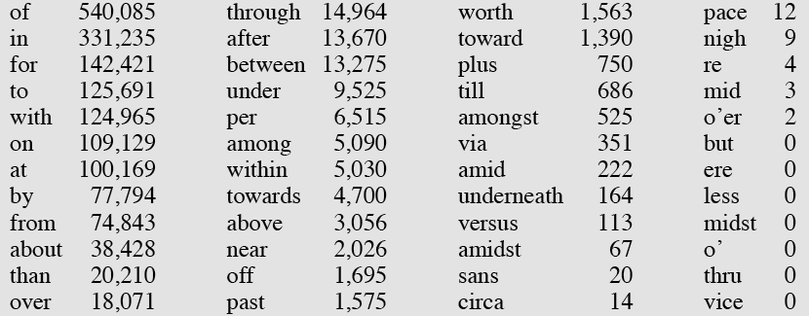
Prepositions from CELEX
Speech and Language Processing - Jurafsky and Martin
<number>
Notes:
<number>

Slide 12
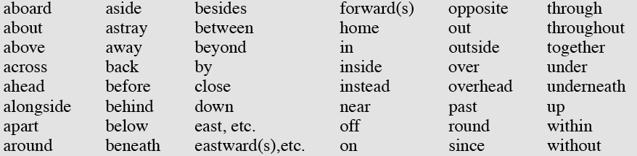
English Particles
Speech and Language Processing - Jurafsky and Martin
<number>
Notes:
<number>

Slide 13
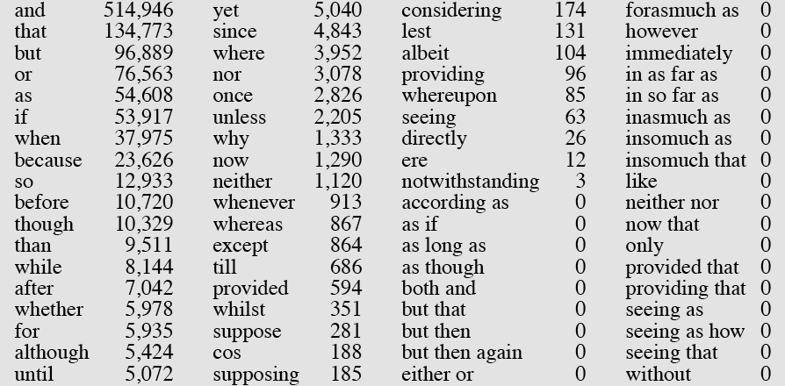
Conjunctions
Speech and Language Processing - Jurafsky and Martin
<number>
Notes:
<number>

Slide 14
POS Tagging Choosing a Tagset
There are so many parts of speech, potential distinctions we can draw
To do POS tagging, we need to choose a standard set of tags to work with
Could pick very coarse tagsets
N, V, Adj, Adv.
More commonly used set is finer grained, the “Penn TreeBank tagset”, 45 tags
PRP$, WRB, WP$, VBG
Even more fine-grained tagsets exist
Speech and Language Processing - Jurafsky and Martin
<number>
Notes:
<number>

Slide 15
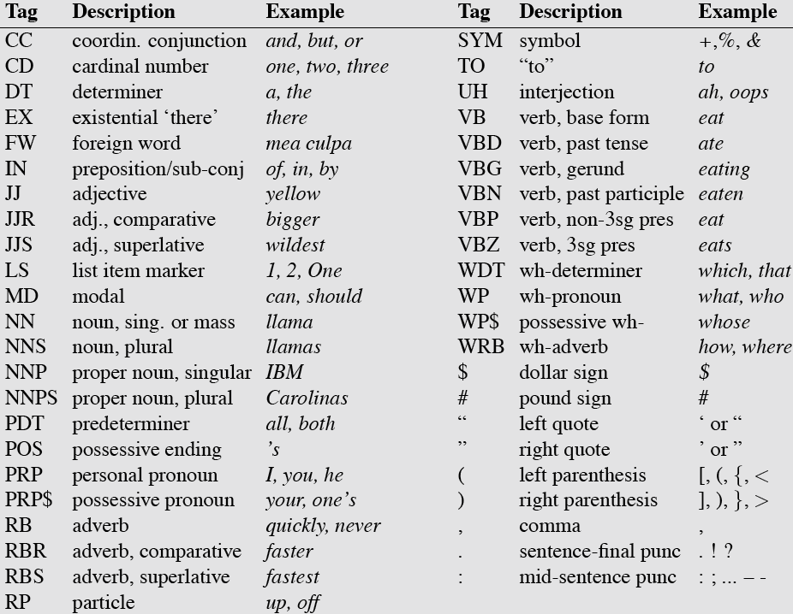
Penn TreeBank POS Tagset
Speech and Language Processing - Jurafsky and Martin
<number>
Notes:
<number>

Slide 16
Using the Penn Tagset
The/DT grand/JJ jury/NN commented/VBD on/IN a/DT number/NN of/IN other/JJ topics/NNS ./.
Prepositions and subordinating conjunctions marked IN (“although/IN I/PRP..”)
Except the preposition/complementizer “to” is just marked “TO”.
Speech and Language Processing - Jurafsky and Martin
<number>
Notes:
<number>

Slide 17
POS Tagging
Words often have more than one POS: back
The back door = JJ
On my back = NN
Win the voters back = RB
Promised to back the bill = VB
The POS tagging problem is to determine the POS tag for a particular instance of a word.
Speech and Language Processing - Jurafsky and Martin
<number>
Notes:
<number>

Slide 18
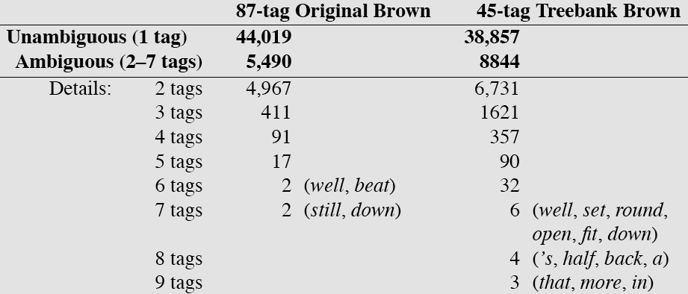
How Hard is POS Tagging? Measuring Ambiguity
Speech and Language Processing - Jurafsky and Martin
<number>
Notes:
<number>

Slide 19
Two Methods for POS Tagging
Rule-based tagging
Stochastic
Probabilistic sequence models
HMM (Hidden Markov Model) tagging
MEMMs (Maximum Entropy Markov Models)
Speech and Language Processing - Jurafsky and Martin
<number>
Notes:
<number>

Slide 20
POS Tagging as Sequence Classification
We are given a sentence (an “observation” or “sequence of observations”)
Secretariat is expected to race tomorrow
What is the best sequence of tags that corresponds to this sequence of observations?
Probabilistic view
Consider all possible sequences of tags
Out of this universe of sequences, choose the tag sequence which is most probable given the observation sequence of n words w₁…w_{n}.
Speech and Language Processing - Jurafsky and Martin
<number>
Notes:
<number>

Slide 21
Classification Learning
Typical machine learning addresses the problem of classifying a feature-vector description into a fixed number of classes.
There are many standard learning methods for this task:
Decision Trees and Rule Learning
Naïve Bayes and Bayesian Networks
Logistic Regression / Maximum Entropy (MaxEnt)
Perceptron and Neural Networks
Support Vector Machines (SVMs)
Nearest-Neighbor / Instance-Based
Raymond Mooney (UT Austin)
<number>
<number>
Notes:
<number>

Slide 22
Beyond Classification Learning
Standard classification problem assumes individual cases are disconnected and independent (i.i.d.: independently and identically distributed).
Many NLP problems do not satisfy this assumption and involve making many connected decisions, each resolving a different ambiguity, but which are mutually dependent.
More sophisticated learning and inference techniques are needed to handle such situations in general.
Raymond Mooney (UT Austin)
<number>
Notes:
<number>

Slide 23
Sequence Labeling Problem
Many NLP problems can viewed as sequence labeling.
Each token in a sequence is assigned a label.
Labels of tokens are dependent on the labels of other tokens in the sequence, particularly their neighbors (not i.i.d).
foo bar blam zonk zonk bar blam
Raymond Mooney (UT Austin)
<number>
Notes:
<number>

Slide 24
Information Extraction
Identify phrases in language that refer to specific types of entities and relations in text.
Named entity recognition is task of identifying names of people, places, organizations, etc. in text.
people organizations places
Michael Dell is the CEO of Dell Computer Corporation and lives in Austin Texas.
Extract pieces of information relevant to a specific application, e.g. used car ads:
make model year mileage price
For sale, 2002 Toyota Prius, 20,000 mi, $15K or best offer. Available starting July 30, 2006.
Raymond Mooney (UT Austin)
<number>
Notes:
<number>

Slide 25
Semantic Role Labeling
For each clause, determine the semantic role played by each noun phrase that is an argument to the verb.
agent patient source destination instrument
John drove Mary from Austin to Dallas in his Toyota Prius.
The hammer broke the window.
Also referred to a “case role analysis,” “thematic analysis,” and “shallow semantic parsing”
Raymond Mooney (UT Austin)
<number>
Notes:
<number>

Slide 26
Bioinformatics
Sequence labeling also valuable in labeling genetic sequences in genome analysis.
extron intron
AGCTAACGTTCGATACGGATTACAGCCT
Raymond Mooney (UT Austin)
<number>
Notes:
<number>

Slide 27
Problems with Sequence Labeling as Classification
Not easy to integrate information from category of tokens on both sides.
Difficult to propagate uncertainty between decisions and “collectively” determine the most likely joint assignment of categories to all of the tokens in a sequence.
Raymond Mooney (UT Austin)
<number>
Notes:
<number>

Slide 28
Probabilistic Sequence Models
Probabilistic sequence models allow integrating uncertainty over multiple, interdependent classifications and collectively determine the most likely global assignment.
Two standard models
Hidden Markov Model (HMM)
Conditional Random Field (CRF)
Raymond Mooney (UT Austin)
<number>
Notes:
<number>

Slide 29
Markov Model / Markov Chain
A finite state machine with probabilistic state transitions.
Makes Markov assumption that next state only depends on the current state and independent of previous history.
Raymond Mooney (UT Austin)
<number>
Notes:
<number>

Slide 30

Getting to HMMs
We want, out of all sequences of n tags t₁…t_{n} the single tag sequence such that
P(t₁…t_{n}|w₁…w_{n}) is highest.
Hat ^ means “our estimate of the best one”
Argmax_{x} f(x) means “the x such that f(x) is maximized”
Speech and Language Processing - Jurafsky and Martin
<number>
Notes:
<number>

Slide 31
Getting to HMMs
This equation should give us the best tag sequence
But how to make it operational? How to compute this value?
Intuition of Bayesian inference:
Use Bayes rule to transform this equation into a set of probabilities that are easier to compute (and give the right answer)
Speech and Language Processing - Jurafsky and Martin
<number>
Notes:
<number>

Slide 32
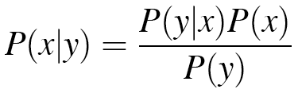
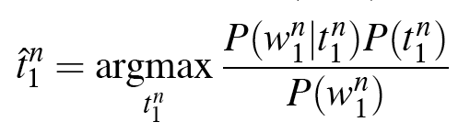
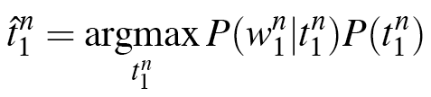
Using Bayes Rule
Know this.
Speech and Language Processing - Jurafsky and Martin
<number>
Notes:
<number>

Slide 33
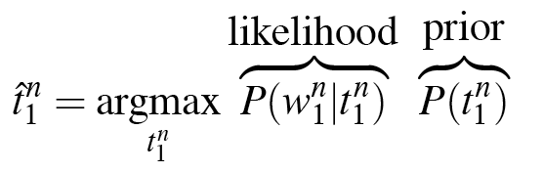
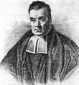
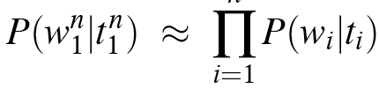
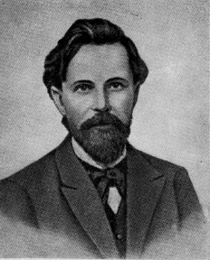
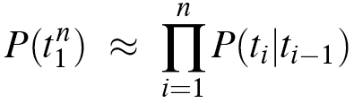
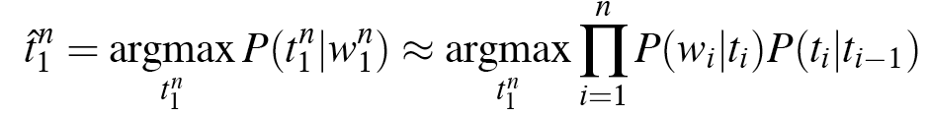
Likelihood and Prior
Speech and Language Processing - Jurafsky and Martin
<number>
Notes:
<number>

Slide 34
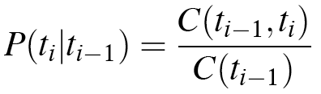
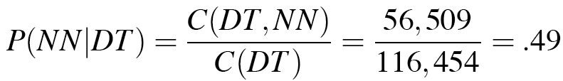
Two Kinds of Probabilities
Tag transition probabilities -- p(t_{i}|t_{i-1})
Determiners likely to precede adjs and nouns
That/DT flight/NN
The/DT yellow/JJ hat/NN
So we expect P(NN|DT) and P(JJ|DT) to be high
Compute P(NN|DT) by counting in a labeled corpus:
Speech and Language Processing - Jurafsky and Martin
<number>
Notes:
<number>

Slide 35
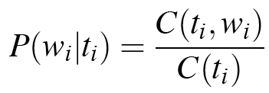
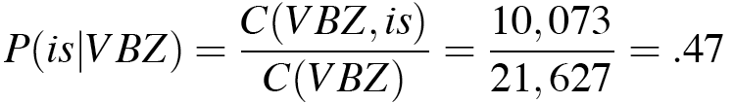
Two Kinds of Probabilities
Word likelihood/emission probabilities p(w_{i}|t_{i})
VBZ (3sg Pres Verb) likely to be “is”
Compute P(is|VBZ) by counting in a labeled corpus:
Speech and Language Processing - Jurafsky and Martin
<number>
Notes:
<number>

Slide 36
Example: The Verb “race”
Secretariat/NNP is/VBZ expected/VBN to/TO race/VB tomorrow/NR
People/NNS continue/VB to/TO inquire/VB the/DT reason/NN for/IN the/DT race/NN for/IN outer/JJ space/NN
How do we pick the right tag?
Speech and Language Processing - Jurafsky and Martin
<number>
Notes:
<number>

Slide 37
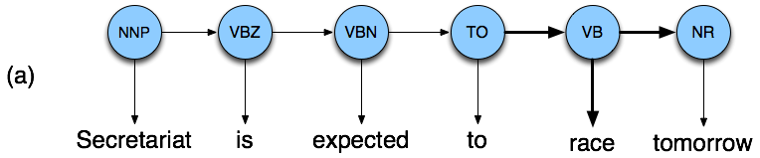

Disambiguating “race”
Speech and Language Processing - Jurafsky and Martin
<number>
Notes:
<number>

Slide 38
Disambiguating “race”
Speech and Language Processing - Jurafsky and Martin
<number>
Notes:
<number>

Slide 39
Example
P(NN|TO) = .00047
P(VB|TO) = .83
P(race|NN) = .00057
P(race|VB) = .00012
P(NR|VB) = .0027
P(NR|NN) = .0012
P(VB|TO)P(NR|VB)P(race|VB) = .00000027
P(NN|TO)P(NR|NN)P(race|NN)=.00000000032
So we (correctly) choose the verb tag for “race”
Speech and Language Processing - Jurafsky and Martin
<number>
Notes:
<number>

Slide 40
Hidden Markov Models
What we’ve just described is called a Hidden Markov Model (HMM)
This is a kind of generative model.
There is a hidden underlying generator of observable events
The hidden generator can be modeled as a network of states and transitions
We want to infer the underlying state sequence given the observed event sequence
Speech and Language Processing - Jurafsky and Martin
<number>
Notes:
<number>

Slide 41
Hidden Markov Models
States Q = q₁, q₂…q_{N;}
Observations O= o₁, o₂…o_{N;}
Each observation is a symbol from a vocabulary V = {v₁,v₂,…v_{V}}
Transition probabilities
Transition probability matrix A = {a_{ij}}
Observation likelihoods
Output probability matrix B={b_{i}(k)}
Special initial probability vector π
Speech and Language Processing - Jurafsky and Martin
<number>
Notes:
<number>

Slide 42
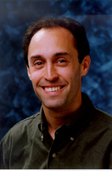
HMMs for Ice Cream
You are a climatologist in the year 2799 studying global warming
You can’t find any records of the weather in Baltimore for summer of 2007
But you find Jason Eisner’s diary which lists how many ice-creams Jason ate every day that summer
Your job: figure out how hot it was each day
Speech and Language Processing - Jurafsky and Martin
<number>
Notes:
<number>

Slide 43
Eisner Task
Given
Ice Cream Observation Sequence: 1,2,3,2,2,2,3…
Produce:
Hidden Weather Sequence:
H,C,H,H,H,C, C…
Speech and Language Processing - Jurafsky and Martin
<number>
Notes:
<number>

Slide 44
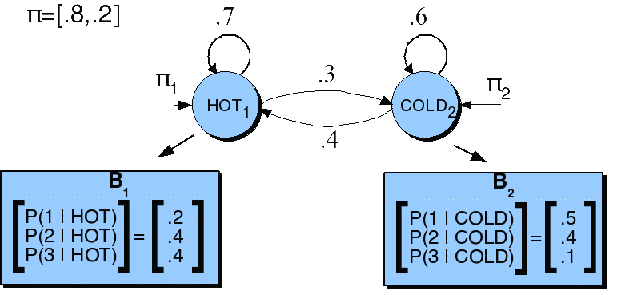
HMM for Ice Cream
Speech and Language Processing - Jurafsky and Martin
<number>
Notes:
<number>

Slide 45
Ice Cream HMM
Let’s just do 131 as the sequence
How many underlying state (hot/cold) sequences are there?
How do you pick the right one?
HHH
HHC
HCH
HCC
CCC
CCH
CHC
CHH
Argmax P(sequence | 1 3 1)
Speech and Language Processing - Jurafsky and Martin
<number>

Slide 46
Ice Cream HMM
Let’s just do 1 sequence: CHC
Cold as the initial state
P(Cold|Start)
.2
.5
.4
.4
.3
.5
Observing a 1 on a cold day
P(1 | Cold)
Hot as the next state
P(Hot | Cold)
Observing a 3 on a hot day
P(3 | Hot)
Cold as the next state
P(Cold|Hot)
.0024
Observing a 1 on a cold day
P(1 | Cold)
Speech and Language Processing - Jurafsky and Martin
<number>

Slide 47
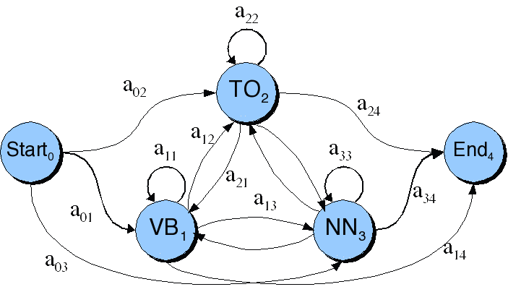
POS Transition Probabilities
Speech and Language Processing - Jurafsky and Martin
<number>
Notes:
<number>

Slide 48
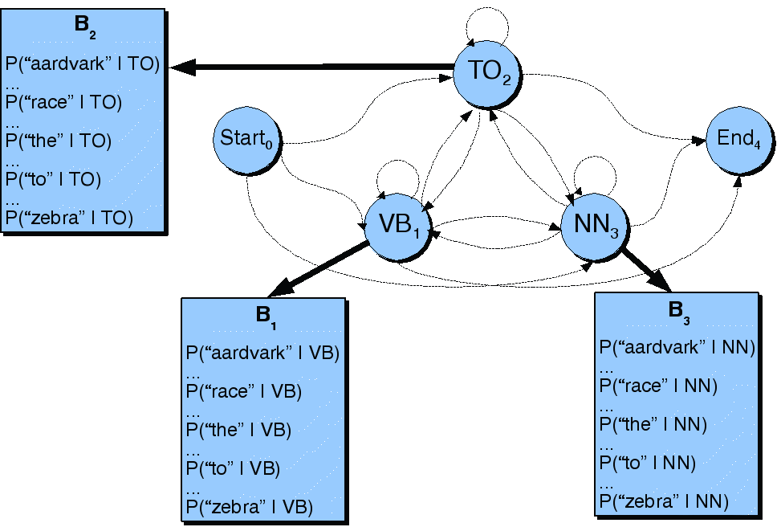
Observation Likelihoods
Speech and Language Processing - Jurafsky and Martin
<number>
Notes:
<number>

Slide 49
Question
If there are 30 or so tags in the Penn set
And the average sentence is around 20 words...
How many tag sequences do we have to enumerate to argmax over in the worst case scenario?
30²⁰
Speech and Language Processing - Jurafsky and Martin
<number>

Slide 50
Three Problems
Given this framework there are 3 problems that we can pose to an HMM
Given an observation sequence, what is the probability of that sequence given a model?
Given an observation sequence and a model, what is the most likely state sequence?
Given an observation sequence, find the best model parameters for a partially specified model
Speech and Language Processing - Jurafsky and Martin
<number>
Notes:
<number>

Slide 51
Problem 1: Obserbation Likelihood
The probability of a sequence given a model...
Used in model development... How do I know if some change I made to the model is making things better?
And in classification tasks
Word spotting in ASR, language identification, speaker identification, author identification, etc.
Train one HMM model per class
Given an observation, pass it to each model and compute P(seq|model).
Speech and Language Processing - Jurafsky and Martin
<number>
Notes:
<number>

Slide 52
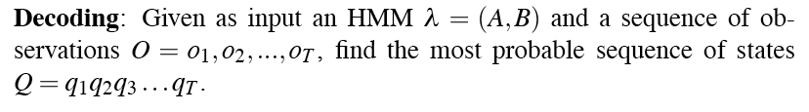
Problem 2: Decoding
Most probable state sequence given a model and an observation sequence
Typically used in tagging problems, where the tags correspond to hidden states
As we’ll see almost any problem can be cast as a sequence labeling problem
Speech and Language Processing - Jurafsky and Martin
<number>
Notes:
<number>

Slide 53
Problem 3: Learning
Infer the best model parameters, given a partial model and an observation sequence...
That is, fill in the A and B tables with the right numbers...
The numbers that make the observation sequence most likely
Useful for getting an HMM without having to hire annotators...
That is, you tell me how many tags there are and give me a boatload of untagged text, and I can give you back a part of speech tagger.
Speech and Language Processing - Jurafsky and Martin
<number>
Notes:
<number>

Slide 54
Solutions
Problem 2: Viterbi
Problem 1: Forward
Problem 3: Forward-Backward
An instance of EM
Speech and Language Processing - Jurafsky and Martin
<number>
Notes:
<number>

Slide 55
Problem 2: Decoding
Ok, assume we have a complete model that can give us what we need. Recall that we need to get
We could just enumerate all paths (as we did with the ice cream example) given the input and use the model to assign probabilities to each.
Not a good idea.
Luckily dynamic programming helps us here
Speech and Language Processing - Jurafsky and Martin
<number>

Slide 56
Intuition
Consider a state sequence (tag sequence) that ends at some state j (i.e., has a particular tag T at the end)
The probability of that tag sequence can be broken into parts
The probability of the BEST tag sequence up through j-1
Multiplied by
the transition probability from the tag at the end of the j-1 sequence to T.
And the observation probability of the observed word given tag T
Speech and Language Processing - Jurafsky and Martin
<number>

Slide 57
Viterbi Algorithm
Create an array
Columns corresponding to observations
Rows corresponding to possible hidden states
Recursively compute the probability of the most likely subsequence of states that accounts for the first t observations and ends in state s_{j}.
Also record “backpointers” that subsequently allow backtracing the most probable state sequence.
Speech and Language Processing - Jurafsky and Martin
<number>

Slide 58
Computing the Viterbi Scores
Initialization
Recursion
Termination
Raymond Mooney at UT Austin
<number>
<number>
Notes:
<number>

Slide 59
Viterbi Backpointers
s₁
• • •
s₂
• • •
•
•
•
•
•
•
•
•
•
•
•
•
•
•
•
s₀
• • •
s_{F}
s_{N}
• • •
t₁
t₂
t₃
t_{T-1}
t_{T}
Raymond Mooney at UT Austin
<number>
Notes:
<number>

Slide 60
Viterbi Backtrace
s₁
• • •
s₂
• • •
•
•
•
•
•
•
•
•
•
•
•
•
•
•
•
s₀
• • •
s_{F}
s_{N}
• • •
t₁
t₂
t₃
t_{T-1}
t_{T}
Most likely Sequence: s₀ s_{N} s₁ s₂ …s₂ s_{F}
Raymond Mooney at UT Austin
<number>
<number>
Notes:
<number>

Slide 61
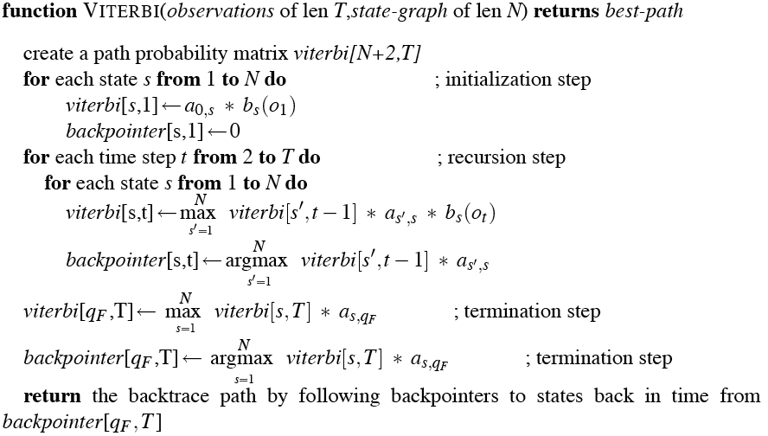
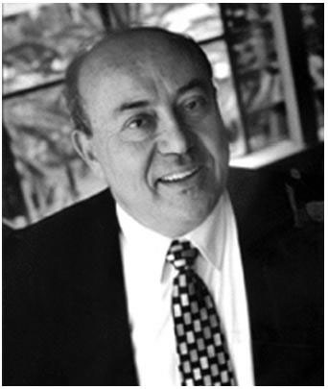
The Viterbi Algorithm
Speech and Language Processing - Jurafsky and Martin
<number>
Notes:
<number>

Slide 62
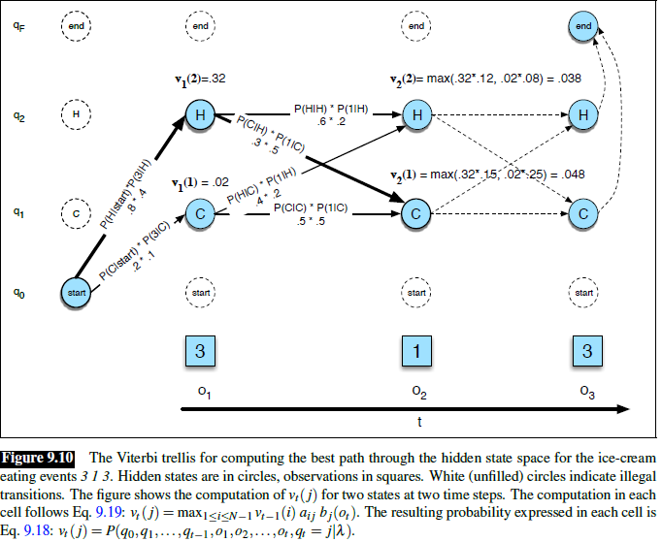
Viterbi Example (1): Ice Cream
Speech and Language Processing - Jurafsky and Martin
<number>
Notes:
<number>

Slide 63
Viterbi Example (1)
<number>
Notes:
<number>

Slide 64
Viterbi Summary
Create an array
With columns corresponding to inputs
Rows corresponding to possible states
Sweep through the array in one pass filling the columns left to right using our transition probs and observations probs
Dynamic programming key is that we need only store the MAX prob path to each cell, (not all paths).
Speech and Language Processing - Jurafsky and Martin
<number>

Slide 65
Evaluation
So once you have you POS tagger running how do you evaluate it?
Overall error rate with respect to a gold-standard test set.
Error rates on particular tags
Error rates on particular words
Tag confusions...
Speech and Language Processing - Jurafsky and Martin
<number>

Slide 66
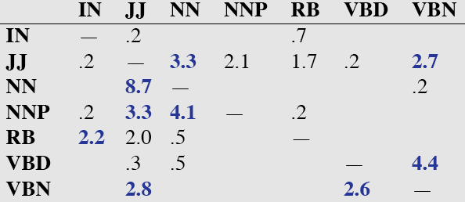
Error Analysis
Look at a confusion matrix
See what errors are causing problems
Noun (NN) vs ProperNoun (NNP) vs Adj (JJ)
Preterite (VBD) vs Participle (VBN) vs Adjective (JJ)
Speech and Language Processing - Jurafsky and Martin
<number>
Notes:
<number>

Slide 67
Evaluation
The result is compared with a manually coded “Gold Standard”
Typically accuracy reaches 96-97%
This may be compared with result for a baseline tagger (one that uses no context).
Important: 100% is impossible even for human annotators.
Speech and Language Processing - Jurafsky and Martin
<number>
Notes:
<number>

Slide 68
Viterbi Example (2)
Fish sleep.
Ralph Grishman at NYU
<number>

Slide 69
A Simple POS HMM
0.2
0.1
0.8
start
0.8
noun
verb
0.7
end
0.2
0.1
0.1
Ralph Grishman at NYU
<number>

Slide 70
Word Emission Probabilities P ( word | state )
A two-word language: “fish” and “sleep”
Suppose in our training corpus,
“fish” appears 8 times as a noun and 5 times as a verb
“sleep” appears twice as a noun and 5 times as a verb
Emission probabilities:
Noun
P(fish | noun) : 0.8
P(sleep | noun) : 0.2
Verb
P(fish | verb) : 0.5
P(sleep | verb) : 0.5
Ralph Grishman at NYU
<number>

Slide 71
Viterbi Probabilities
Ralph Grishman at NYU
<number>

Slide 72
0.2
0.1
0.8
0.8
0.7
end
start
noun
verb
0.2
0.1
0.1
Ralph Grishman at NYU
<number>

Slide 73
0.2
0.1
0.8
0.8
0.7
end
start
noun
verb
0.2
0.1
0.1
Token 1: fish
Ralph Grishman at NYU
<number>

Slide 74
0.2
0.1
0.8
0.8
0.7
end
start
noun
verb
0.2
0.1
0.1
Token 1: fish
Ralph Grishman at NYU
<number>

Slide 75
0.2
0.1
0.8
0.8
0.7
end
start
noun
verb
0.2
0.1
0.1
Token 2: sleep
(if ‘fish’ is verb)
Ralph Grishman at NYU
<number>

Slide 76
0.2
0.1
0.8
0.8
0.7
end
start
noun
verb
0.2
0.1
0.1
Token 2: sleep
(if ‘fish’ is verb)
Ralph Grishman at NYU
<number>

Slide 77
0.2
0.1
0.8
0.8
0.7
end
start
noun
verb
0.2
0.1
0.1
Token 2: sleep
(if ‘fish’ is a noun)
Ralph Grishman at NYU
<number>

Slide 78
0.2
0.1
0.8
0.8
0.7
end
start
noun
verb
0.2
0.1
0.1
Token 2: sleep
(if ‘fish’ is a noun)
Ralph Grishman at NYU
<number>

Slide 79
0.2
0.1
0.8
0.8
0.7
end
start
noun
verb
0.2
0.1
0.1
Token 2: sleep take maximum, set back pointers
Ralph Grishman at NYU
<number>

Slide 80
0.2
0.1
0.8
0.8
0.7
end
start
noun
verb
0.2
0.1
0.1
Token 2: sleep take maximum, set back pointers
Ralph Grishman at NYU
<number>

Slide 81
0.2
0.1
0.8
0.8
0.7
end
start
noun
verb
0.2
0.1
0.1
Token 3: end
Ralph Grishman at NYU
<number>

Slide 82
0.2
0.1
0.8
0.8
0.7
end
start
noun
verb
0.2
0.1
0.1
Token 3: end take maximum, set back pointers
Ralph Grishman at NYU
<number>

Slide 83
0.2
0.1
0.8
0.8
0.7
end
start
noun
verb
0.2
0.1
0.1
Decode: fish = noun sleep = verb
Ralph Grishman at NYU
<number>

Slide 84
Complexity?
How does time for Viterbi search depend on number of states and number of words?
Ralph Grishman at NYU
<number>

Slide 85
Complexity
time = O ( s² n) for s states and n words
(Relatively fast: for 40 states and 20 words,
32,000 steps)
Ralph Grishman at NYU
<number>

Slide 86
Problem 1: Forward
Given an observation sequence return the probability of the sequence given the model...
Well in a normal Markov model, the states and the sequences are identical... So the probability of a sequence is the probability of the path sequence
But not in an HMM... Remember that any number of sequences might be responsible for any given observation sequence.
Speech and Language Processing - Jurafsky and Martin
<number>
Notes:
<number>

Slide 87
Forward
Efficiently computes the probability of an observed sequence given a model
P(sequence|model)
Nearly identical to Viterbi; replace the MAX with a SUM
Speech and Language Processing - Jurafsky and Martin
<number>
Notes:
<number>

Slide 88
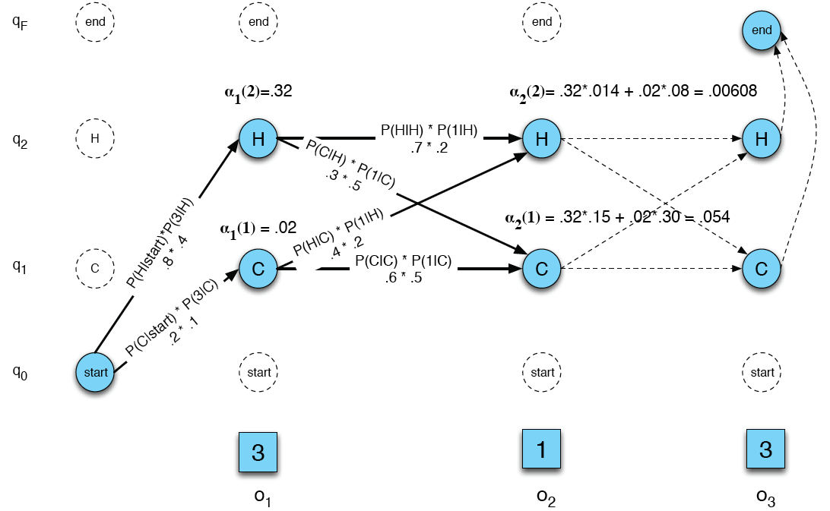
Ice Cream Example
Speech and Language Processing - Jurafsky and Martin
<number>
Notes:
<number>

Slide 89
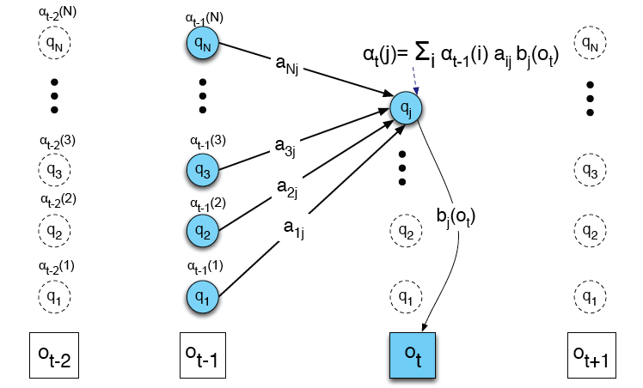
Ice Cream Example
Speech and Language Processing - Jurafsky and Martin
<number>
Notes:
<number>

Slide 90
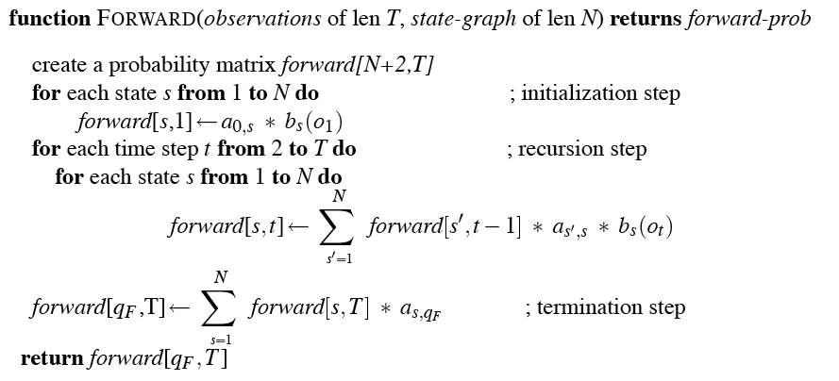
Forward
Speech and Language Processing - Jurafsky and Martin
<number>
Notes:
<number>

