Slide 1
Text Categorization
(actually, methods apply for categorizing anything into fixed categories – tagging, WSD, PP attachment ...)

Slide 2
Why Text Categorization?
Is it spam?
Is it Spanish?
Is it interesting to this user?
  News filtering
  Helpdesk routing
Is it interesting to this NLP program?
  e.g., should my calendar system try to interpret this email as an appointment (using info. extraction)?
Where should it go in the directory?
  Yahoo! / Open Directory / digital libraries
  Which mail folder? (work, friends, junk, urgent ...)

Slide 3
How to Categorize?
Subject: would you like to . . . .
. . drive a new vehicle for free ? ? ? this is not hype or a hoax , there are hundreds of people driving brand new cars , suvs , minivans , trucks , or rvs . it does not matter to us what type of vehicle you choose . if you qualify for our program , it is your choice of vehicle , color , and options . we don ' t care . just by driving the vehicle , you are promoting our program . if you would like to find out more about this exciting opportunity to drive a brand new vehicle for free , please go to this site : http : / / 209 . 134 . 14 . 131 / ntr to watch a short 4 minute audio / video presentation which gives you more information about our exciting new car program . if you do n't want to see the short video , but want us to send you our information package that explains our exciting opportunity for you to drive a new vehicle for free , please go here : http : / / 209 . 134 . 14 . 131 / ntr / form . htm we would like to add you the group of happy people driving a new vehicle for free . happy motoring .
600.465 - Intro to NLP - J. Eisner

Slide 4
How to Categorize? (supervised)
We’ve seen lots of options in this course!
Build n-gram model of each category
  Question: How to classify test message?
  Answer: Bayes’ Theorem

Slide 5
How to Categorize? (supervised)
We’ve seen lots of options in this course!
Represent each document as a vector
(must choose representation and distance measure; use SVD?)
  Question: How to classify test message?
  Answer 1: Category whose centroid is most similar
  (may not work well if category is diverse)
  Answer 2: Cluster each category into subcategories
  (then use answer 1 to pick a subcategory)
  (return the category that the subcategory is in)
  (this can also be useful for n-gram models)
  Answer 3: Just look at labels of nearby training docs
  (e.g., let the k nearest neighbors vote – flexible!)
  (maybe the closer ones get a bigger vote)

Slide 6
How to Categorize? (supervised)
We’ve seen lots of options in this course!
Treat it like word-sense disambiguation
  Vector model – use all the features (we just saw this)
  Decision list – use single most indicative feature
  Naive Bayes – use all the features, weighted by how well they discriminate among the categories
  Decision tree – use some of the features in sequence
  Other options from machine learning, like perceptron, Support Vector Machine (SVM), logistic regression, …
Features matter more than which machine learning method

Slide 7
Review: Vector Model
These two documents are similar:
After normalizing vector length to 1,
  Close in Euclidean space (similar endpoint)
  High dot product (similar direction)
abandoned
aardvark
abacus
abbot
abduct
zymurgy
above
zygote
(0, 0, 3, 1, 0, 7, . . . 1, 0)
(0, 0, 1, 0, 0, 3, . . . 0, 1)
Can play lots of encoding games when creating vector:
Remove function words or reduce their weight
Use features other than unigrams

Slide 8
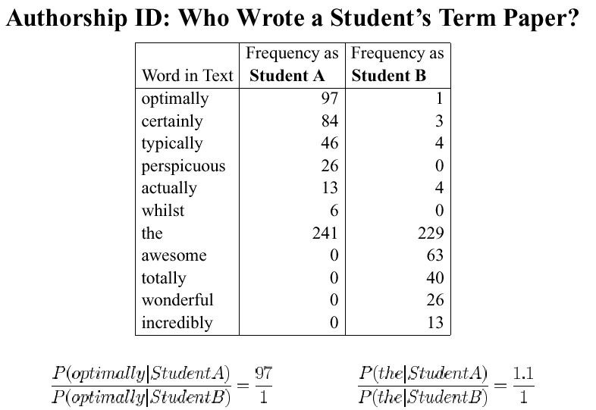
slide courtesy of D. Yarowsky (modified)
Review: Combining Cues via Naive Bayes
these stats come from term papers of known authorship
(i.e., supervised training)
600.465 - Intro to NLP - J. Eisner

Slide 9
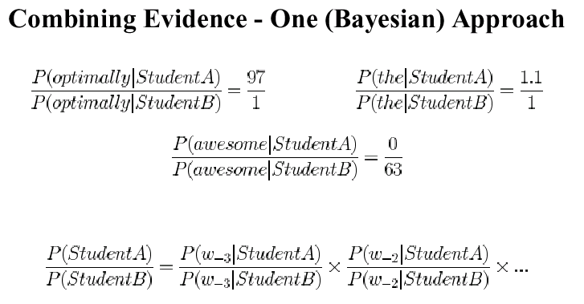
slide courtesy of D. Yarowsky (modified)
Review: Combining Cues via Naive Bayes
1
2
1
2
Would this kind of sentence be more typical of a student A paper or a student B paper?
“Naive Bayes” model for classifying text
  (Note the naive independence assumptions!)
600.465 - Intro to NLP - J. Eisner

Slide 10
example from Manning & Schütze
Decision Trees
Is this Reuters article an Earnings Announcement?
split on feature that reduces our uncertainty most
2301/7681 = 0.3 of all docs
contains “cents” ≥ 2 times
contains “cents” < 2 times
1607/1704 = 0.943
694/5977 = 0.116
contains “versus”
≥ 2 times
contains “versus”
< 2 times
contains “net”
≥ 1 time
contains “net”
< 1 time
1398/1403
= 0.996
209/301
= 0.694
422/541
= 0.780
272/5436
= 0.050
“yes”
“no”

Slide 11
Features Besides Unigrams
All these approaches (except n-gram model) can use “interesting” features, not just unigrams.
There’s generally a heuristic feature selection problem
  Use some very large set of features defined by a template
  Maybe restrict to features that look useful in isolation?
  Add features greedily, one at a time
    Measure or guess expected improvement of each feature
    Make sure to smooth when doing this – why?
  At the end, remove features that hurt performance on held-out data

Slide 12
How to Categorize? (unsupervised)
What if we don’t have supervised training data?
Might try an iterative approach as usual:
Cluster the messages
Train n-gram, Naive Bayes, or decision list model to discriminate among the clusters
Use the model to reassign messages to clusters
(most will stay put but some will move)
Return to step 2 until convergence
600.465 - Intro to NLP - J. Eisner

Slide 13
How to Categorize? (semisupervised)
What if we have only a little supervised data?
Could try bootstrapping like Yarowsky’s WSD:
Start with very small, rather accurate classes
Train n-gram, Naive Bayes, or decision list model to discriminate among the classes
Augment each class with new messages
that the model confidently classifies there
(maybe also move or remove some existing messages)
Return to step 2 until convergence

Slide 14
How to Categorize? (adaptive)
What if we gradually get more new data over time?
User feedback (active or passive) on our classifications
News / email systems that categorize, or judge relevance
  Add new articles / messages to training data
  If they’re unlabeled (no supervision), label them automatically
    Add them only if we’re confident? Add them fractionally, like EM?
So model adjusts over time:
E.g., change the cluster centroids or n-gram parameters
May want to weight the more recent data more heavily, since the future is more like the present than the past
  E.g., message from k days ago has weight 0.9^{k} (k=0,1,2, ...)
  So today’s model = today’s data + 0.9 * yesterday’s model

Slide 15
How to Categorize? (hierarchical)
What if we are putting document in a Yahoo! category?
There are thousands of categories (at least) – too hard!
Choose one of the 14 top-level categories, e.g., Science
Then use a Science-specific classifier to choose one of the 54 second-level categories within Science (14 are symlinks)
Continue working your way down the tree ...
When you can’t classify with high confidence, ask a human (then use the human’s answer as more training data)

