Slide 1
Report 15/10/2021
Minh-Triet
Binh Minh
Ganglin

Slide 2
INDEX
Weekly Summary
1.1 Project planning
1.2 Work assignments
1.3 Database pre-processing
1.4 Ressources
Current problems
2.1 Problem 1: Sliding window
2.2 Problem 2: Information to be extracted
Assignments for next week

Slide 3
CHAPTER 1
Weekly Summary

Slide 4
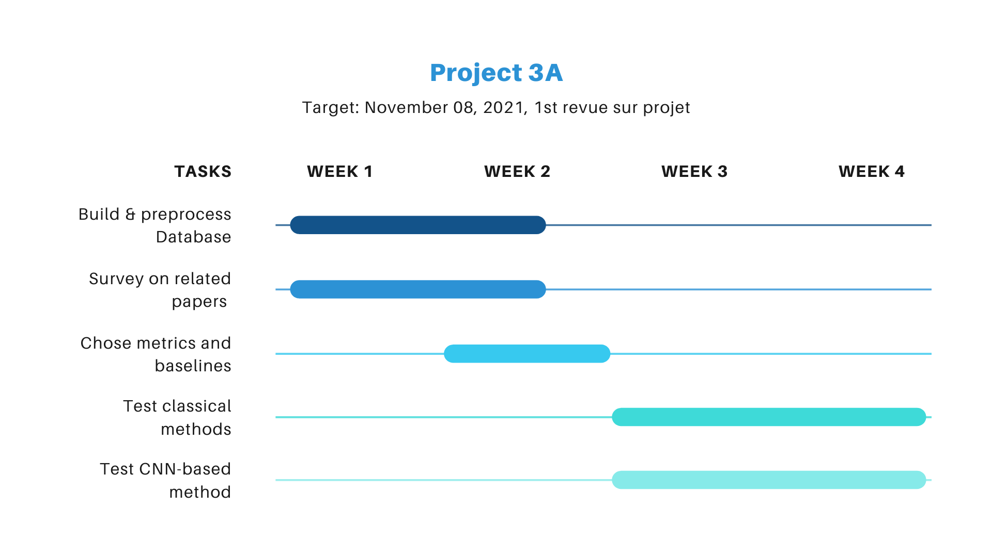
CHAPTER 1 : Weekly summary
1.1 Project planning

Slide 5
CHAPTER 1 : Weekly summary
1.2 Work assignments
Minh-Triet and Ganglin:
Build and pre-process MODIS dataset
Survey on general and specific metrics in Super Resolution
Test the classical methods, including Tsharp and ATPRK
Binh Minh:
Research on CNN-based methods
Test some CNN-based methods on MODIS dataset
Metrics:
PSNR, MSE
SSM. SSIM
SAM
Q, QNR
Kappa
End member similarity measure
Baselines:
Tsharp, ATPRK
SRCNN, msiSRCNN
Dis_D_U, DMCN
Self-defined model
Notes:
Tsharp or ATPRK

Slide 6
CHAPTER 1 : Weekly summary
1.3 Database pre-processing
Download MODIS automatically:
Based on pymodis.downmodis.downModis()
Save LST MODIS to npy file:
npy files just contain images of Day and Night now.
We can add other necessary informations in npy files.
Perform sliding windows on downloaded MODIS files:
The saved cropped information is only the images now, the others are under considered.
Database folder structure
dataset
├── hdf_files
│ ├── listfileMOD11A1.006.txt
│ ├── MOD11A1.A2014217.h18v04.006.2016206083731.hdf
│ ├── MOD11A1.A2014217.h18v04.006.2016206083731.hdf.xml
│ └── ...
├── imgs_1km
│ ├── Day
│ │ ├── MOD11A1.A2014217.h18v04.006.2016206083731.hdf.npy
│ │ ├── MOD11A1.A2014217.h19v04.006.2016206083751.hdf.npy
│ │ └── ...
│ └── Night
│ ├── MOD11A1.A2014217.h18v04.006.2016206083731.hdf.npy
│ ├── MOD11A1.A2014217.h19v04.006.2016206083751.hdf.npy
│ └── ...
├── imgs_4km
│ ├── Day
│ └── Night
Notes:
LST MODIS

Slide 7
CHAPTER 1 : Weekly summary
1.4 Ressources
Group Code Repository:
https://github.com/IMT-Project-LTS-SR
Weekly report on:
https://drive.google.com/drive/folders/1ySHFAxoOlFDFMZXUT75XiOj55_nthBYS?usp=sharing
Final report on:
https://www.overleaf.com/5195651744czffrbpgvnbj
Processed database:
Coming soon....

Slide 8
CHAPTER 2
Current problems

Slide 9
CHAPTER 2 : Current problems
2.1 ...
Problem 1:
Size and step of the sliding window.
Information preservation (not 8 bits)
Problem 2:
Other information (Projection? Georeference? Band?), alongs with pixel values (images Day and Night), to be extracted and saved.
How to organize the information? 1 metadata on big images or each cropped image has its own meta (georeferenced coordinates for example?
Notes:
Tsharp or ATPRK

Slide 10
CHAPTER 3
Assignments for next week

Slide 11
CHAPTER 3 : Assignments for next week
3.1 ...
Complete the database and upload to server/cloud/google drive.
Survey on related papers, including classical methods and CNN-based methods.
Summarize metrics and baseline for this project.
Test some algorithms.

