Slide 1

By: Joshua Wagner

Slide 2
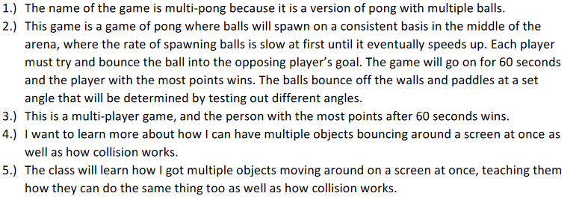
Project Proposal

Slide 3
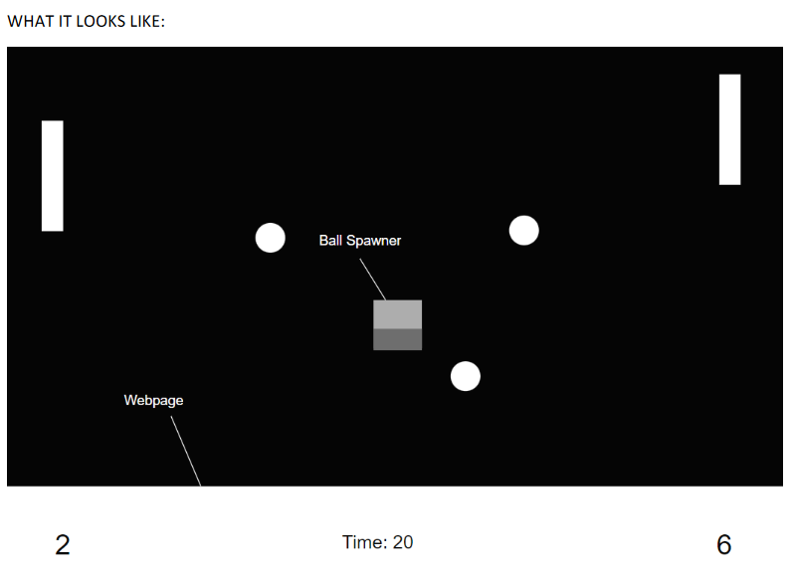
Diagram

Slide 4
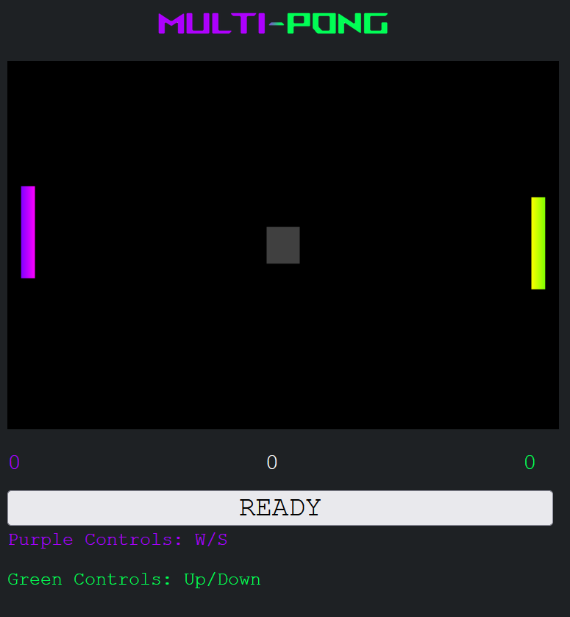
Screenshots

Slide 5
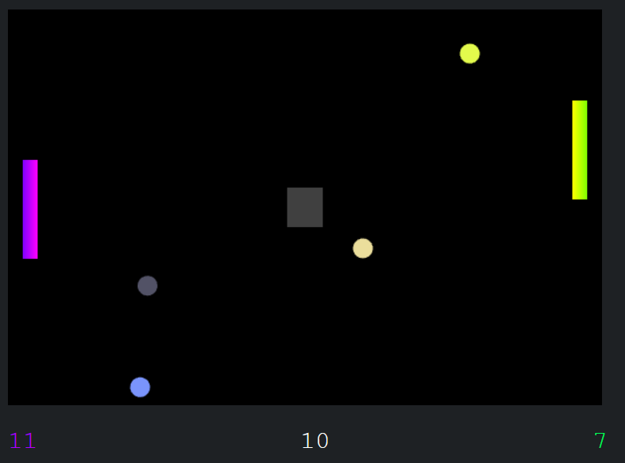
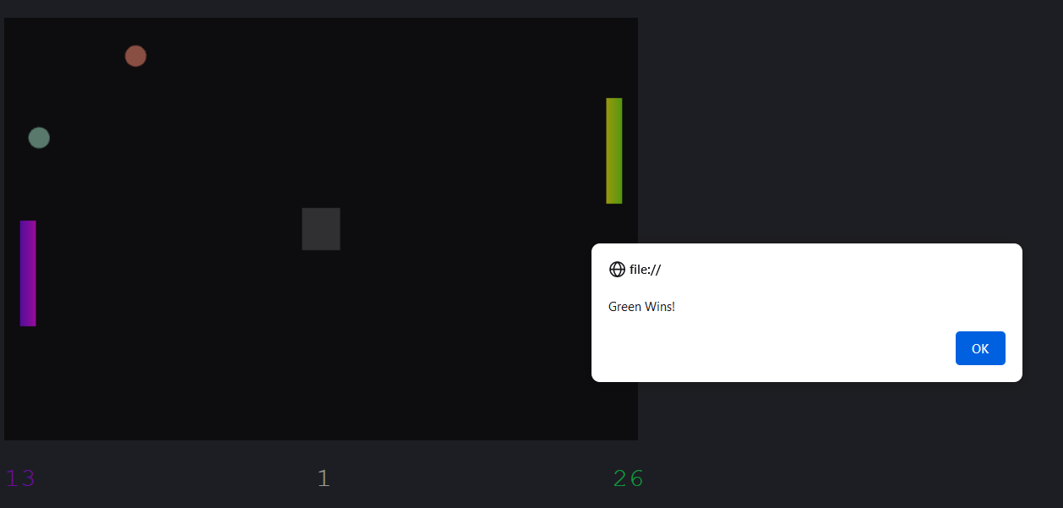
Screenshots

Slide 6
Implementation
Positional data
Moving Paddles
Multiple balls bouncing
Random ball colors
Collisions

Slide 7
Conclusion

