Slide 1
Finance Management Application (Backend)
Author: Ivan Sedakov
Study programme: Open Informatics
Branch of study / Specialization: (BPOI318) Software
Thesis Supervisor: Ing. Šebek Jiří

Slide 2

The main goal of the work is to implement a backend support for a web application that helps manage finances.

Slide 3
Similar Applications
Feature | Spendee | CoinKeeper | Wallet
Accounts | + | + | +
Transactions and Categories | + | + | +
Statistics and Graphs | + | + | +
Bank synchronization | + (Premium) | - | + (Premium)
Goals | - | - | +
Debts | - | - | +
Without Ads | + | + (Premium) | +
Rating | 2 | 3 | 1

Slide 4
Use Cases
UC-1: Transaction, Subscription, Debt, Goal entities
CRUD Operations
GET/DELETE by User Id
History Mode for Debts, Subscriptions, Goals (shows old and not active)
Pagination support for Transactions and History Mode
UC-2: User Registration and Authorization logic UC-3: Group Operations
Users can create Group with rights and roles
Users with required group rights can add/delete other users to the Group
Users with required group rights can change other users rights and roles
Users with required group rights can add/delete transactions and subscriptions from their own accounts to the group’s accounts
UC-4: Settings
Users can change their personal data
UC-5: Notifications
Users can GET their own notifications Count and all their notifications
Users can change the read status of their own notifications and delete them.
UC-6: Categories
Users can create/delete own categories
User can add/update/delete category from transaction
UC-7: Dashboard
Get Last Transactions, Subscriptions, Debts, Goals
Statistic Data

Slide 5
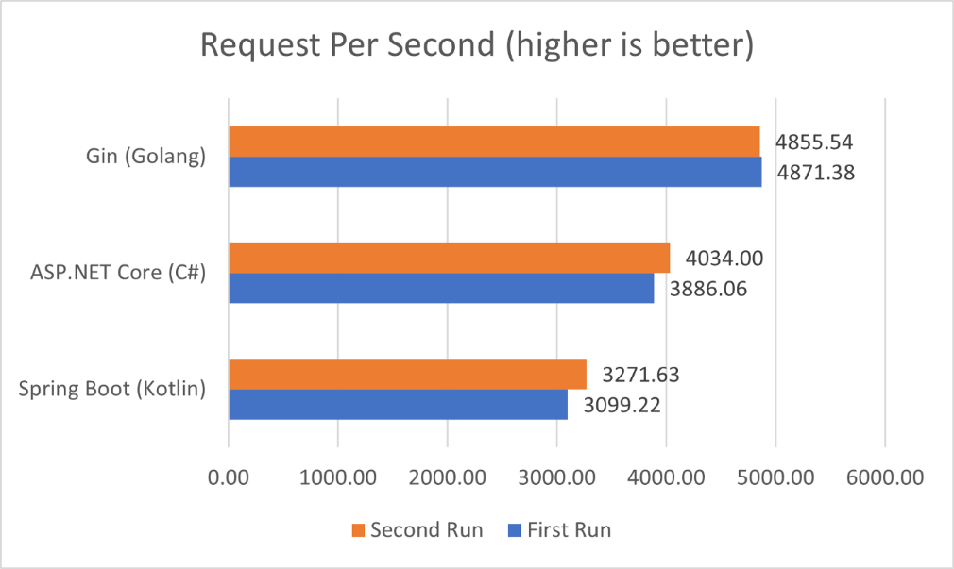
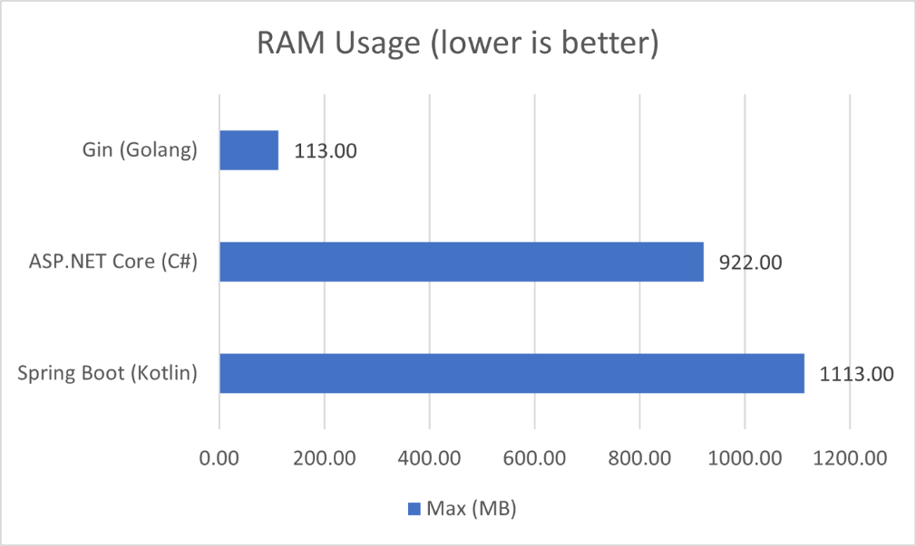
Languages and Platforms
C#
.NET 6
PostgreSQL

Slide 6
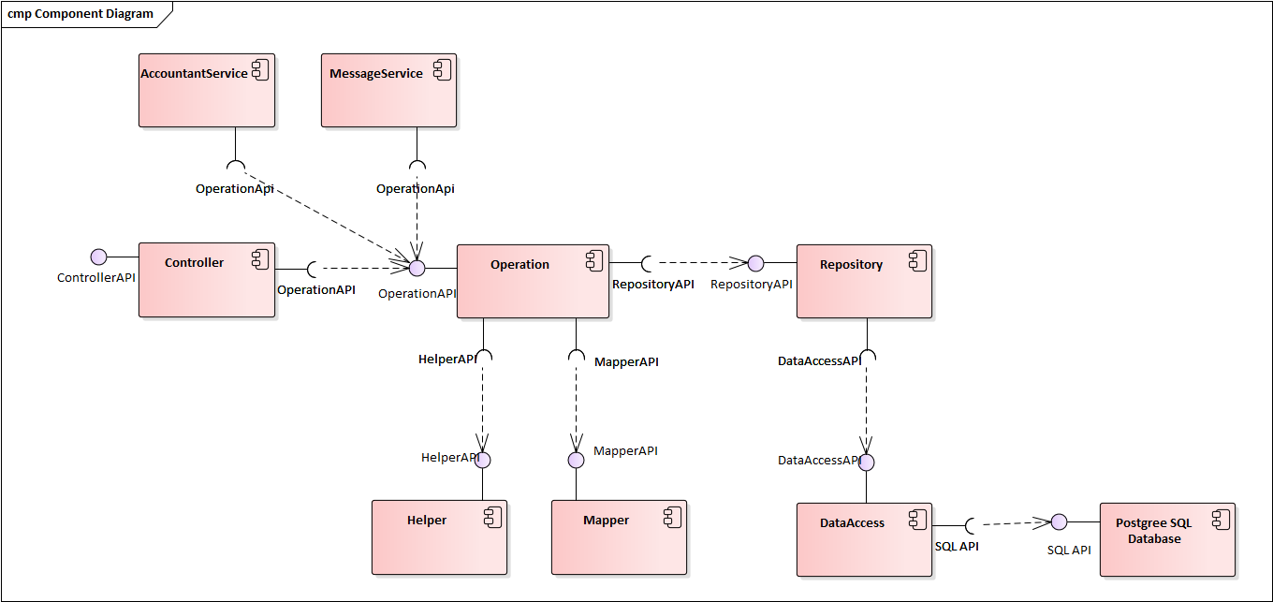
Architecture
The application has a multitier architecture that means a client-server architecture in which data management logic and application processing are physically separated.
Controller Layer
Repository Layer
Operation Layer
Services

Slide 7
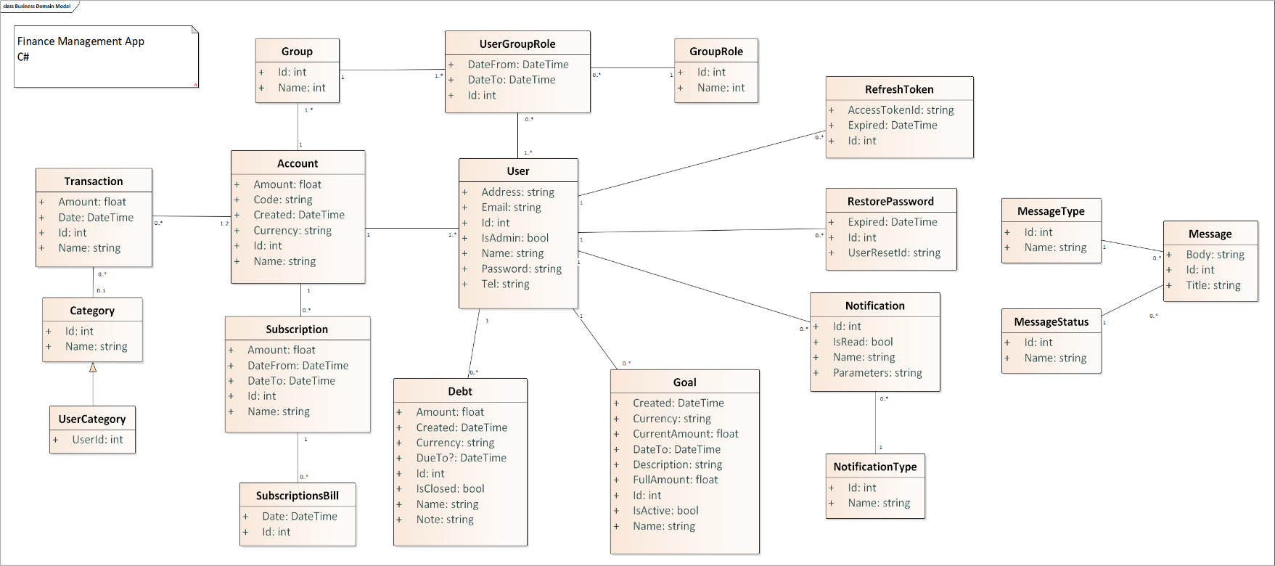
Models
Database Context and Class Models are auto-generated from database tables

Slide 8
External packages
Serilog
MiniProfile
SignalR
Mapster
Dapper
Entity Framework

Slide 9
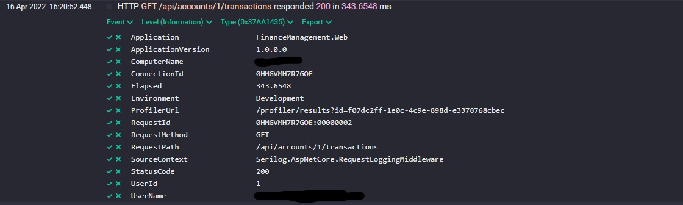
Serilog
Serilog is a diagnostic logging library for .NET applications. While it's useful even in the simplest applications, Serilog's support for structured logging shines when instrumenting complex, distributed, and asynchronous applications and systems. Serilog provides diagnostic logging to files, the console, and many other outputs.

Slide 10
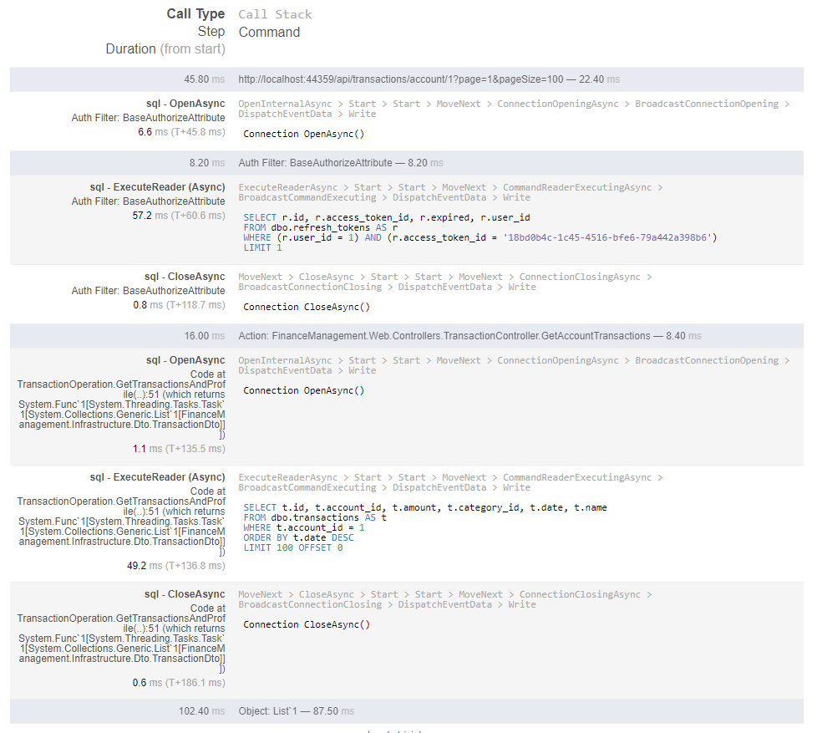
MiniProfile
Profiling is used for complex operations and database requests. This gives us a clear idea of the project's performance and weaknesses in the code.

Slide 11
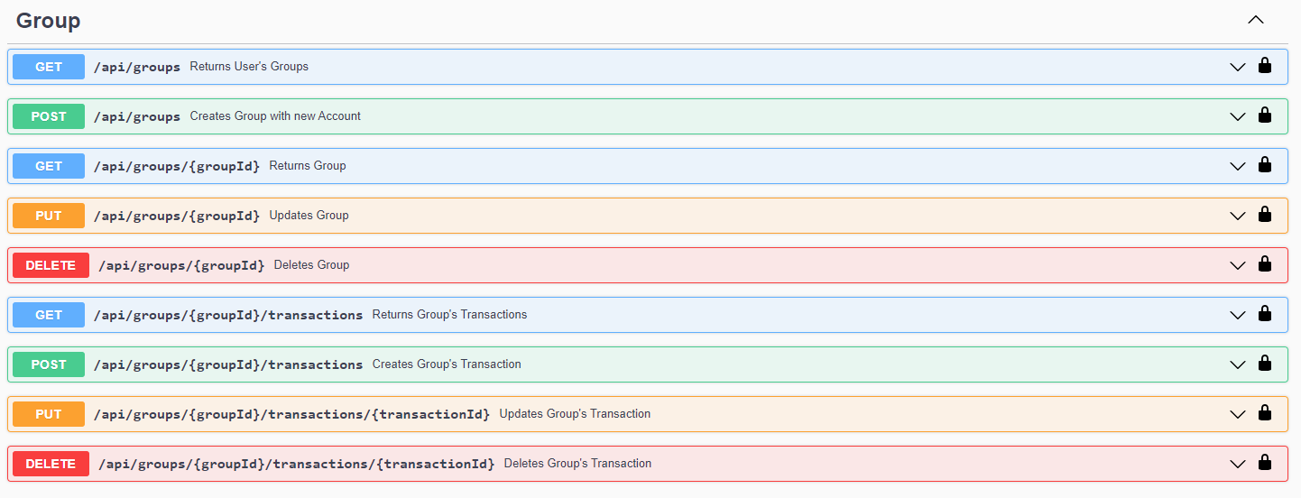
API Documentation: Swagger

Slide 12
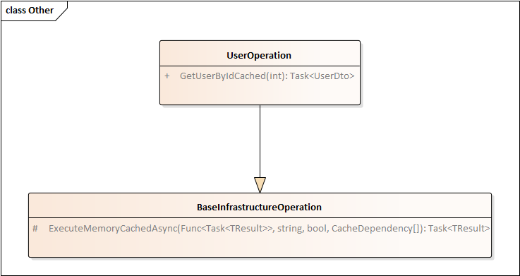
Caching
One of the most important features of an application is data caching. Each entity that the user wants to access is cached and has its own type of cache invalidation.
protected virtual async Task<TResult> ExecuteMemoryCachedAsync<TResult>(
Func<Task<TResult>> function, string cacheKey, bool ignoreCachedValue, bool cacheNullValue, params CacheDependency[] dependencies);
public interface ICacheModule
{
void Run();
......
bool HandleDataCacheNotification(CacheNotification notification);
}

Slide 13
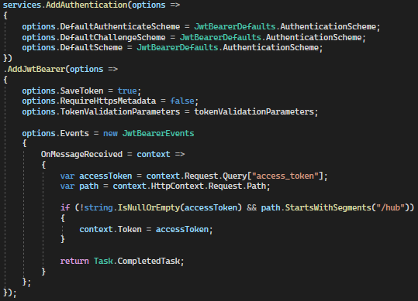
Authorization and Authentication
JWT authentication
Bearer schema
Access tokens
Refresh Tokens

Slide 14
Design Patterns
Repository and Unit of Work
Dependency Injection
Facade
Observer
Strategy
Builder

Slide 15
Testing
Benchmarks
Unit Tests
Functional Tests
The tests cover the most important features of the application. They check authentication, user roles, database queries, and function logic, measure complex queries and help us change some functions without possible errors in the future.

Slide 16
Thank you for your attention!

