Slide 1
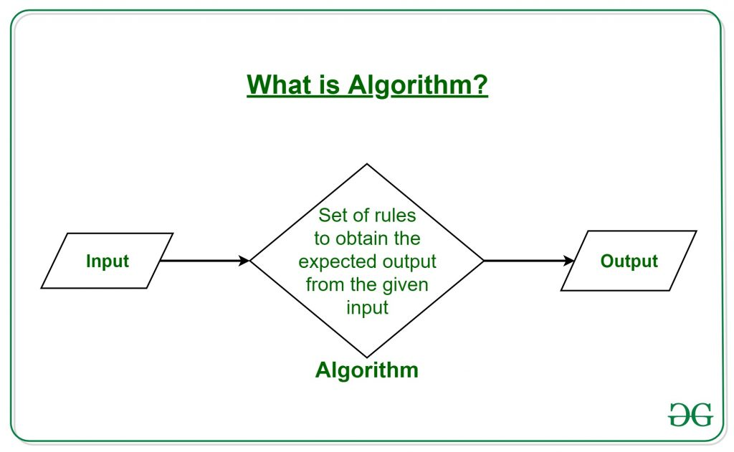
Algorithm
Ivan Morales

Slide 2
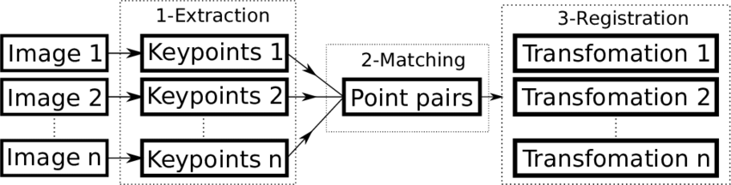
What is an algorithm?
Describe: An algorithm is a process used to solve problems or perform calculations. An algorithm acts as a precise list of instructions that step by step performs specified operations in the hardware.
The key points of the algorithm is consist of three basic building blocks: sorting, selection and iteration.

Slide 3
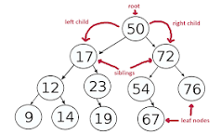
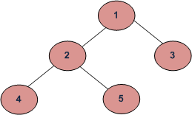
How to write an algorithm for counting the number of leaf nodes in a binary tree?
My describe Step 1: If the current node is null, return value 0. The 2 step is: If a leaf node is encountered, that is, if the current node's left and right nodes are both null, then return 1. And third step is to recursively calculate the number of leaf nodes by adding the number of leaf nodes in the left subtree to the number of leaf nodes in the right subtree.
Key Points: If the root is null then return zero and pop the last node and push the left and right children of the last node if they are not null.

Slide 4
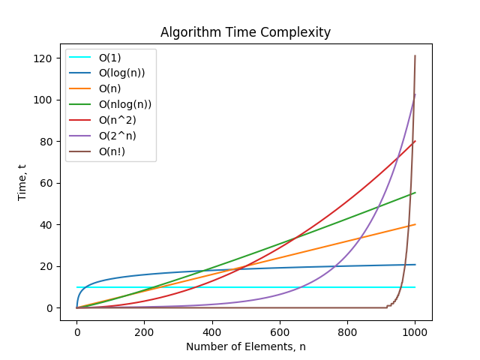
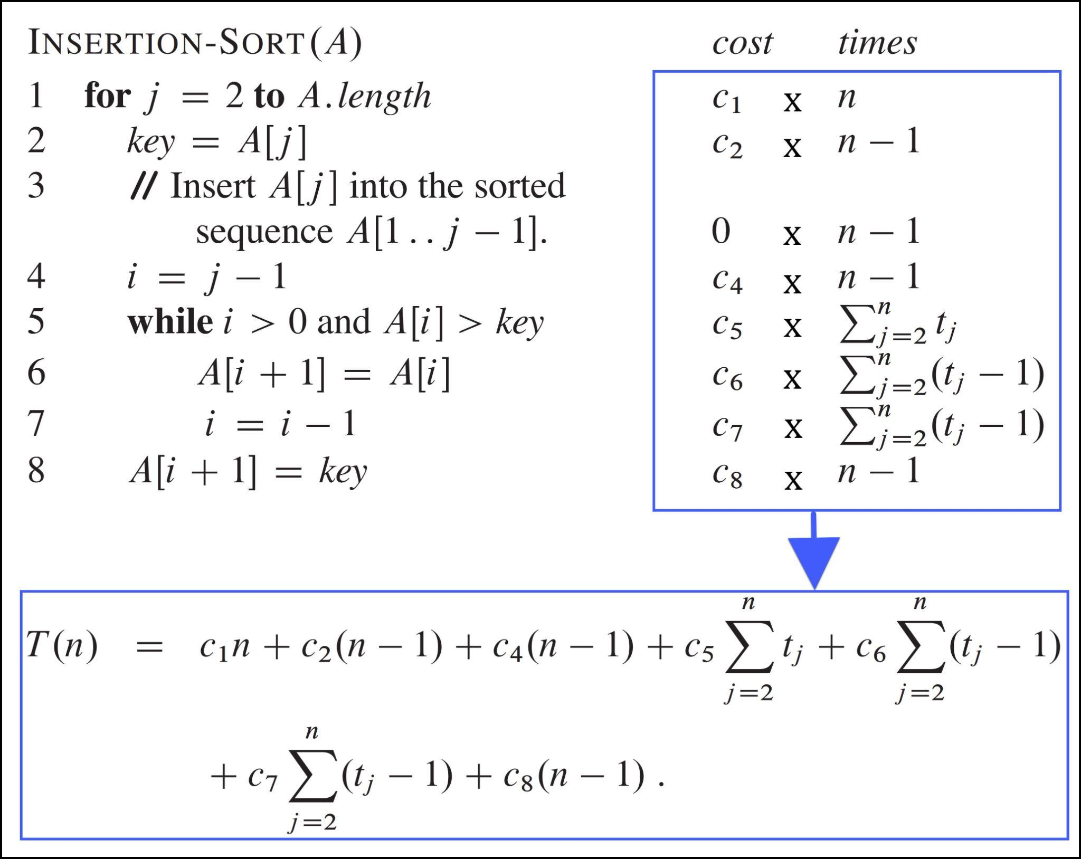
What is the Complexity of Algorithm?
Describe: Algorithm complexity is a way of classifying the efficiency of an algorithm compared to alternative algorithms. It focuses on how execution time increases with the data set to be processed. The computational complexity of an algorithm is important in computing. Great for classifying algorithms based on the relative amount of time or relative space they require, and specifying the growth of time/space requirements as a function of input size.
Key points: The complexity of an algorithm refers to the amount of resources (such as time or memory) required to solve a problem or perform a task.

Slide 5
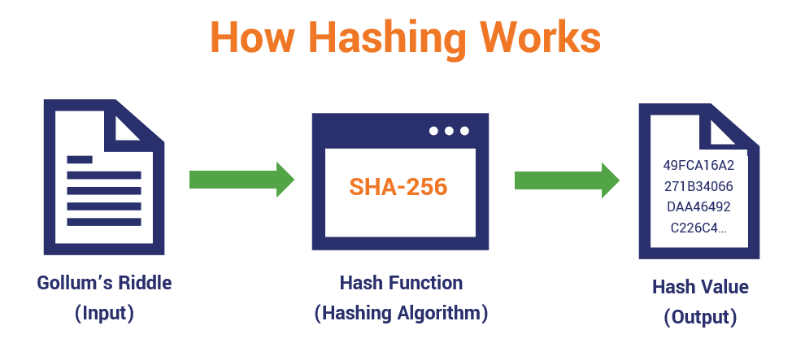
What's a “Hash Algorithm” is and what are they used for?
My describe: A hash algorithm is a hash function that takes a string of arbitrary length and reduces it to a unique fixed-length string. It's usage for password validity, message, and data integrity and for many other cryptographic systems. A hashing algorithm is a method of taking an input and always having the same output, also known as a 1-to-1 function.
Key Points: Hashing algorithms can be used to authenticate data.

Slide 6
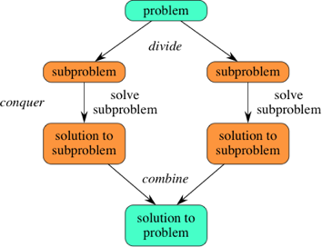
What are Divide and Conquer algorithms?
Describe: The divide and conquer algorithm is a strategy for solving large problems by breaking the problem into smaller sub-problems and solving the sub-problems. First, we divide the problem into smaller pieces and work to solve each of them independently. Once we’ve solved all of the pieces, we take all of the resulting smaller solutions and combine them into a single integrated comprehensive solution.
The key point of divide and conquer algorithm is to recursively solve sub-problems, each sub-problem must be smaller than the original problem, and the sub-problem must have a base case.

