Slide 1

Quiz App
(Examination System)

Slide 2
Creators :
Mostafa Saad
Yousef Adel
Nouran Hossam

Slide 3
WE HELP TEACHERS TO TEST THEIR STUDENTS IN A SAFE WAY.
WE HELP STUDENTS TO PERFORM THEIR EXAMES EASILY AND GET THEIR RESULTS ONCE THEY FINISH.

Slide 4
THE TEACHER IS AN ADMIN,
SO HE CAN ADD ANY QUIZ AT ANY TIME HE WANTS.

Slide 5
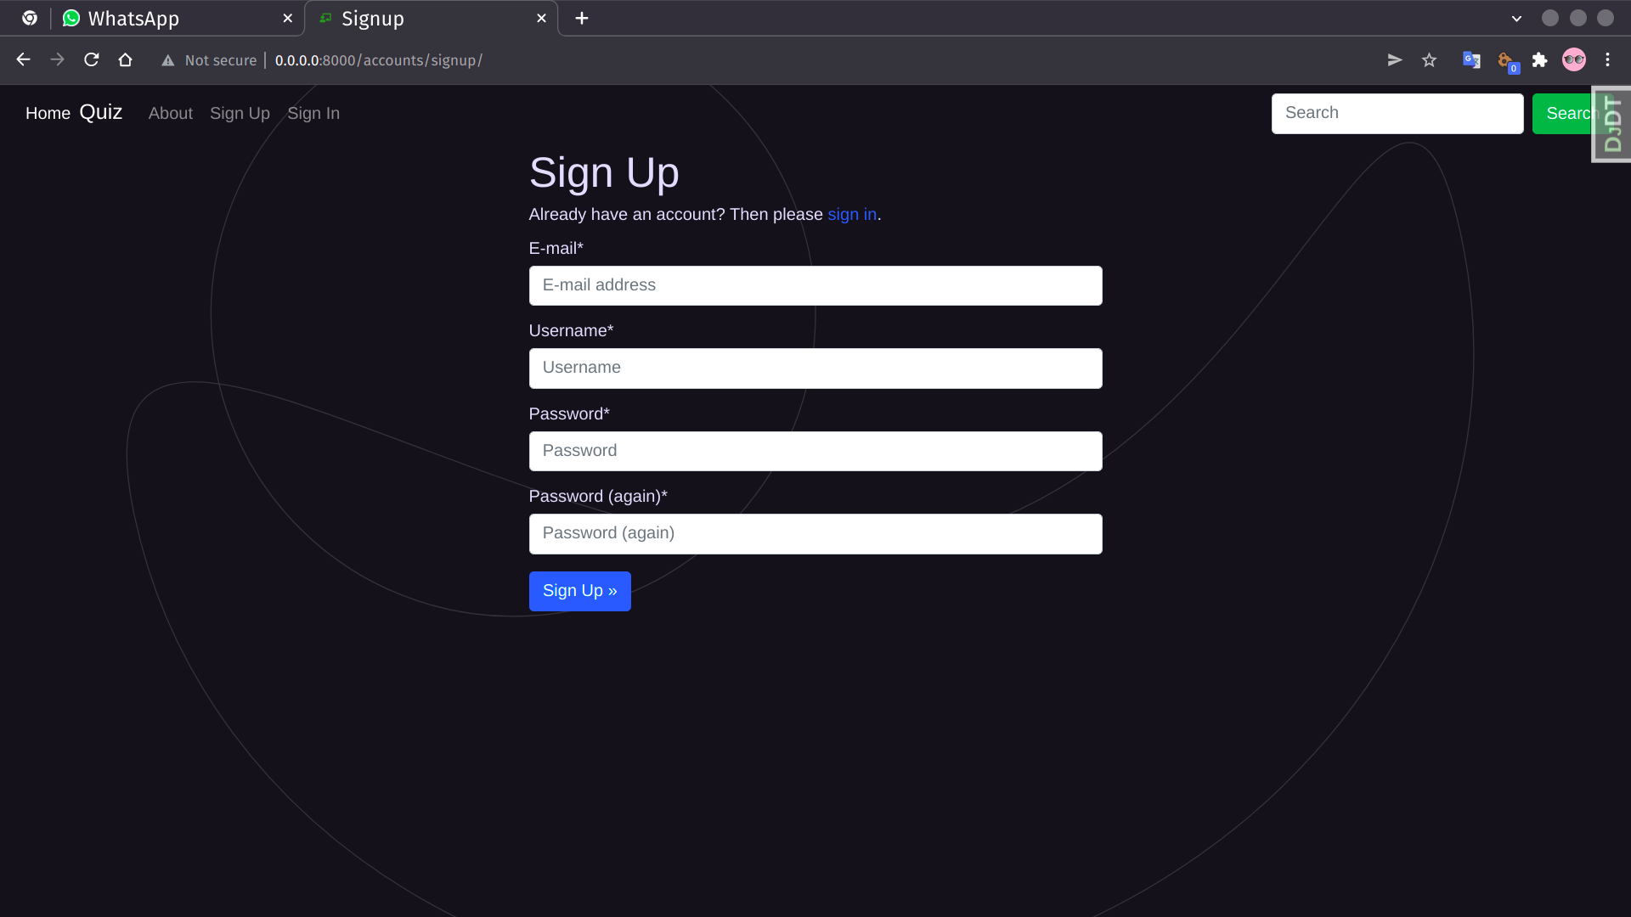

Slide 6
WHEN YOU SIGN IN OUR SITE YOU HAVE TWO OPTIONS:
STUDENT
PROFESSOR

Slide 7
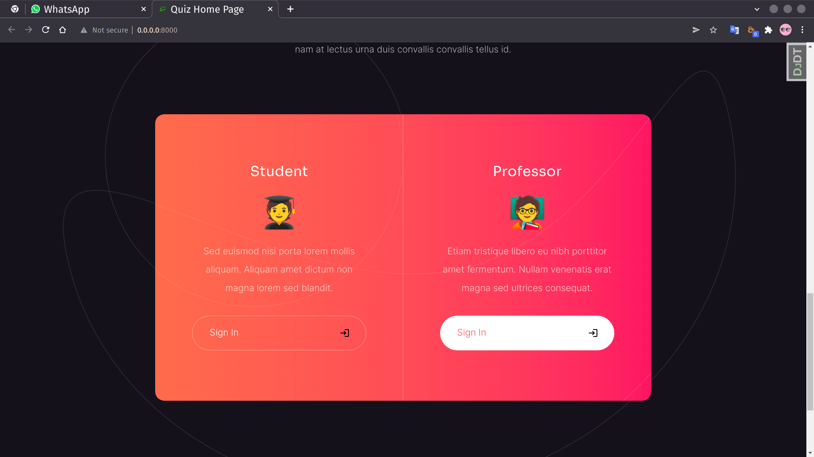

Slide 8
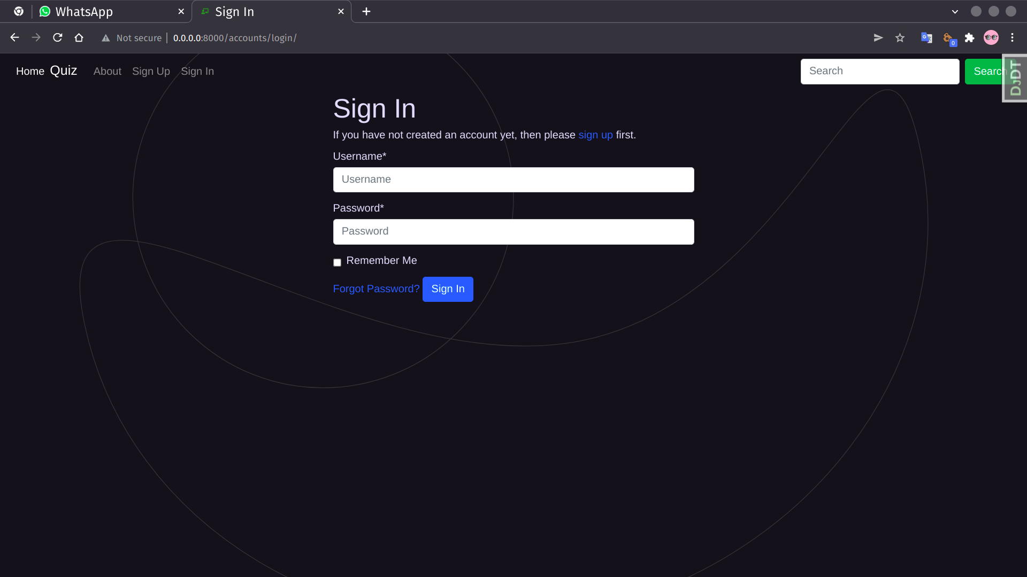

Slide 9
AS A STUDENT I’M BEING ASKED IF I WANT TO START MY QUIZ OR NOT, AND THE APP GIVES ME A BREVIEW ABOUT IT.

Slide 10
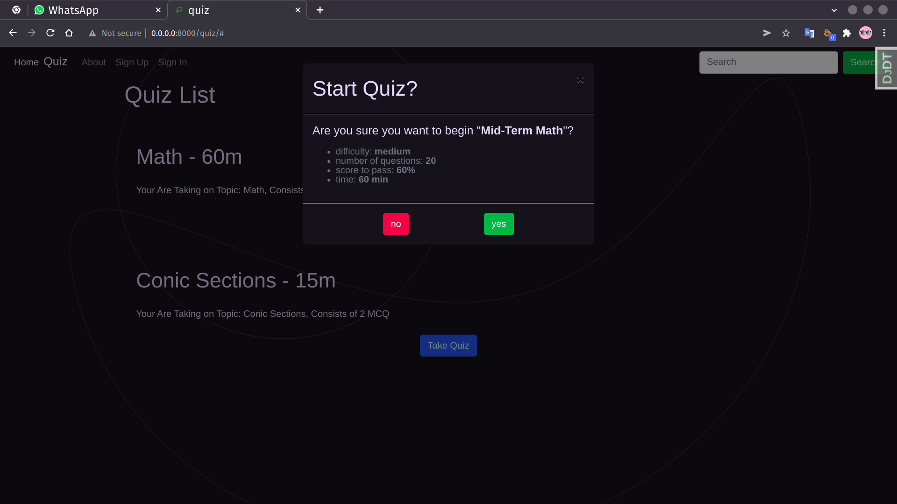

Slide 11
RETURN BUTTON TO GO TO THE PREVIOUS QUESTION.
SAVE BUTTON TO SAVE MY ANSWERS AND SHOW THE RESULT.

Slide 12
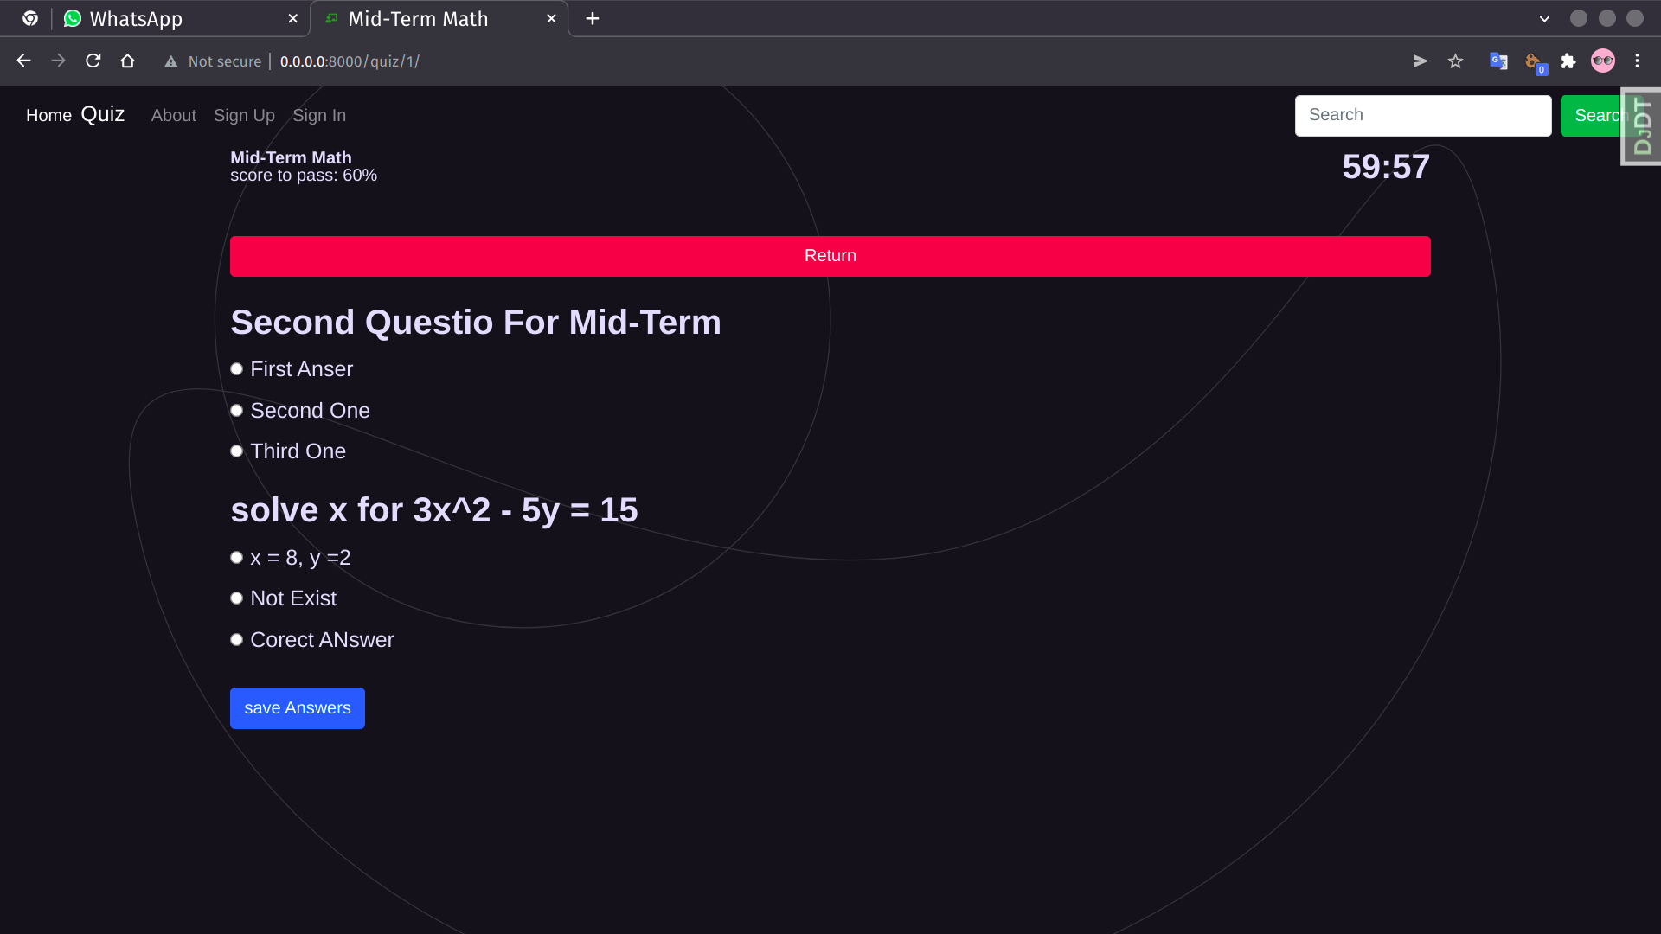

Slide 13
UNDER THE SUPERVISION
Dr: Aida Nasr

Slide 14
NOW WE ARE READY TO ANSWER YOUR QUESTIONS.

Slide 15
THANK YOU.

