Slide 1
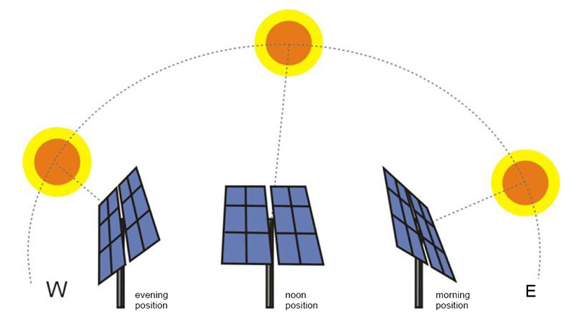
Chasing The Sun
Automatic Solar Tracker
Group Members:
SHIVAM SHINDE (CO3067) AJAY CHIGALE(CO3009)
SHANTANU LONDHE(CO3033) RUTURAJ THOPATE(CO3073)

Slide 2
Introduction
Components
Block Diagram
Implementation
Benefits
Conclusion

Slide 3
INTRODUCTION
The automatic solar tracker using Arduino is a device that tracks the movement of the sun and adjusts the position of the solar panel accordingly. This ensures that the panel always faces the sun, maximizing its efficiency and energy output.
This project is designed to be an affordable and easy-to-implement solution for individuals or small businesses looking to harness solar power.

Slide 4
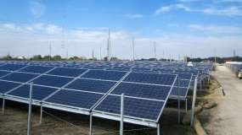
COMPONENTS
The components required for this project include :
An Arduino microcontroller.
A motor driver.
A light sensor.
A servo motor.
A solar panel.

Slide 5
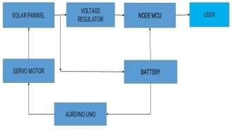
BLOCK DIAGRAM
The block diagram for the automatic solar tracker using Arduino is relatively simple. The light sensor detects the intensity and direction of the sun's rays, which is then sent to the Arduino microcontroller. The microcontroller processes this information and sends signals to the motor driver, which in turn controls the movement of the servo motor.
The servo motor adjusts the position of the solar panel based on the information received from the light sensor, ensuring that it is always facing the sun. This process is repeated throughout the day, allowing the solar panel to harvest the maximum amount of energy possible.

Slide 6
IMPLEMENTATION
The implementation of this project involves assembling the various components and programming the Arduino microcontroller to control the system. The light sensor is mounted on the solar panel, while the servo motor is attached to a support structure that allows it to move the panel in two dimensions.
Once the system is assembled and programmed, it can be tested and adjusted as needed to ensure optimal performance. With proper calibration, the automatic solar tracker will be able to track the sun's movement throughout the day, maximizing the amount of energy harvested from the sun.

Slide 7
BENIFITS
The benefits of using an automatic solar tracker are numerous.
By ensuring that the panel is always facing the sun, it increases the amount of energy that can be harvested from the sun's rays.
This translates to increased efficiency and cost savings over time.
The solar panel is constantly adjusting its position, it reduces wear and tear on the panel and extends its lifespan.
The use of solar power reduces reliance on fossil fuels and helps to reduce carbon emissions, making it an environmentally friendly choice.

Slide 8
CONCLUSION
The automatic solar tracker using Arduino is an innovative and practical solution for those looking to harness the power of the sun. By using readily available components and simple programming, this system can be implemented by anyone with basic technical skills.
With its numerous benefits and relatively low cost, the automatic solar tracker is a smart investment for individuals or small businesses looking to reduce their reliance on fossil fuels and save money in the long run.

Slide 9
THANK YOU

