Slide 1
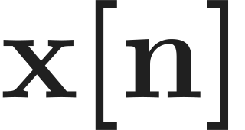
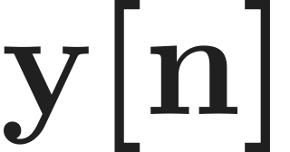

Two-point moving average
The known input
Input
Output
Average a pair
Input sample values
4
2
2
0
0
0
-1
0
1
2
3
4
Given
Two adjacent input samples produce one output value.
Notes:
The index n locates an individual sample in the sequence x. The five supplied samples run from n=0 to n=4. The extra value x[-1]=0 is given so that a previous sample is available at the left edge. We will use two adjacent input samples to construct one output at a time.

Slide 2
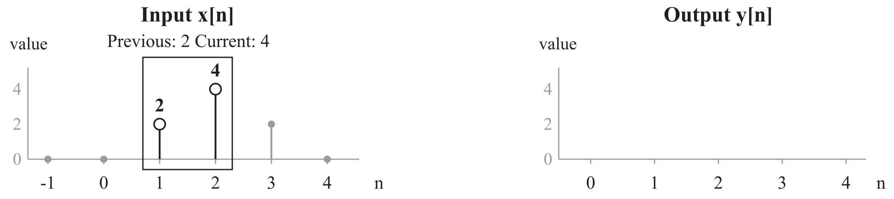
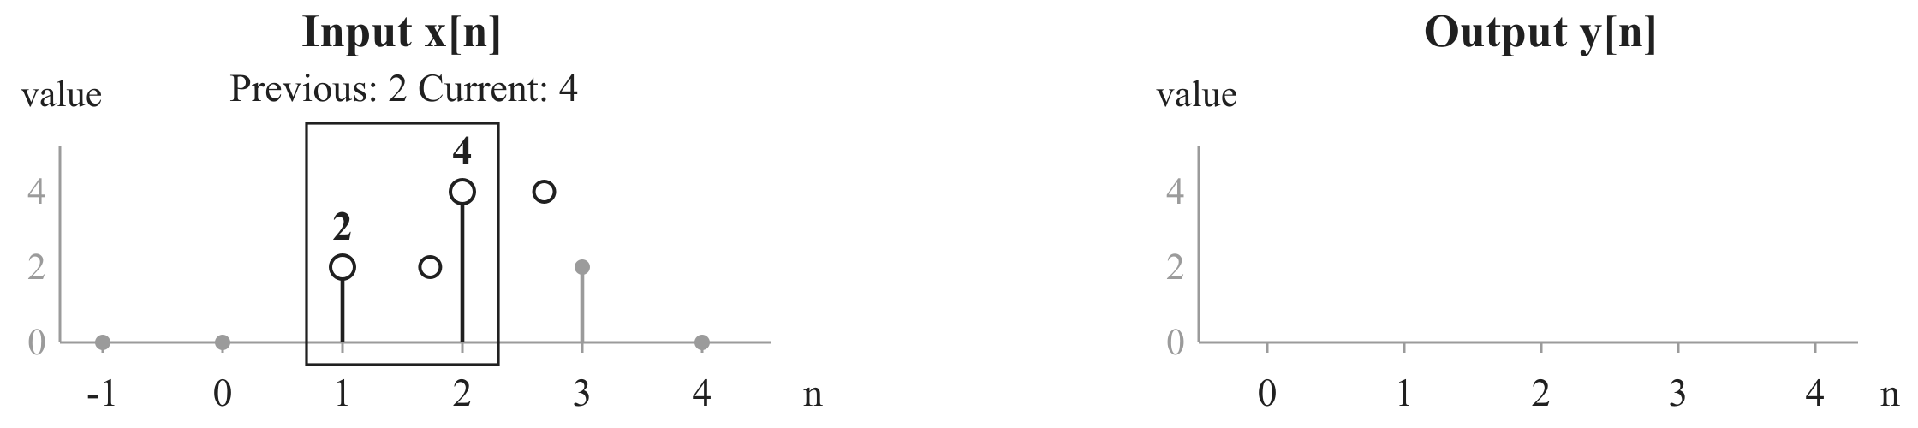
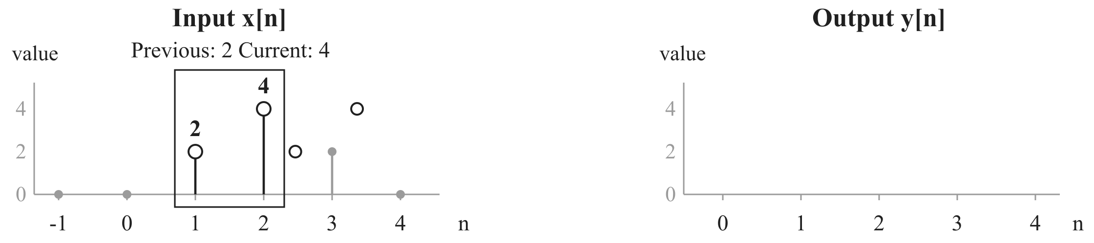


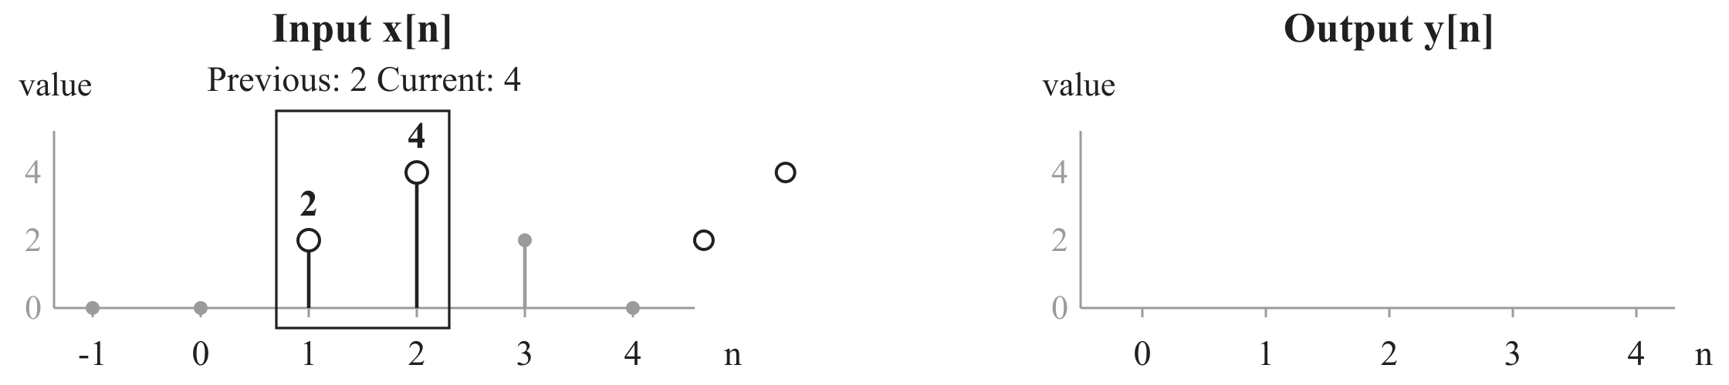
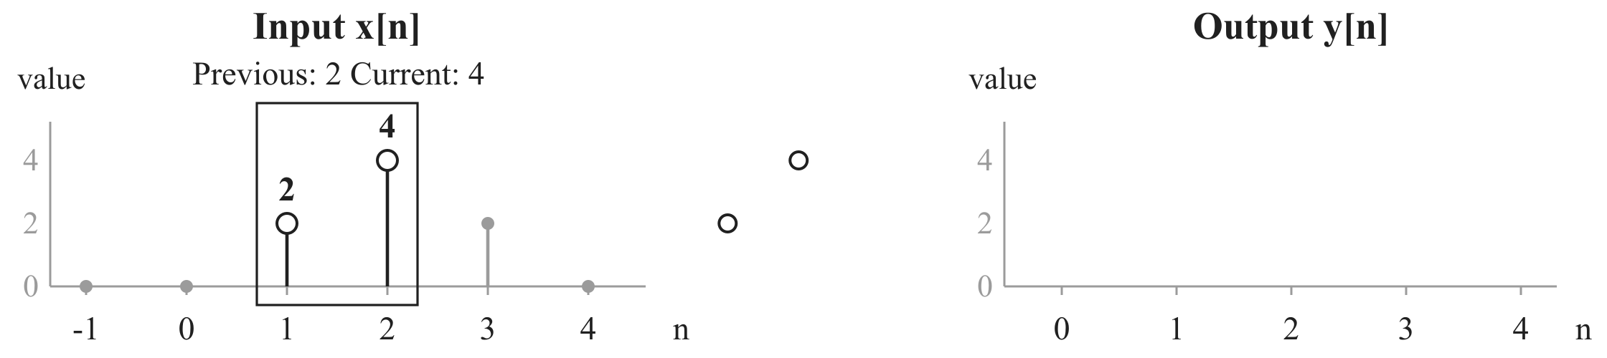

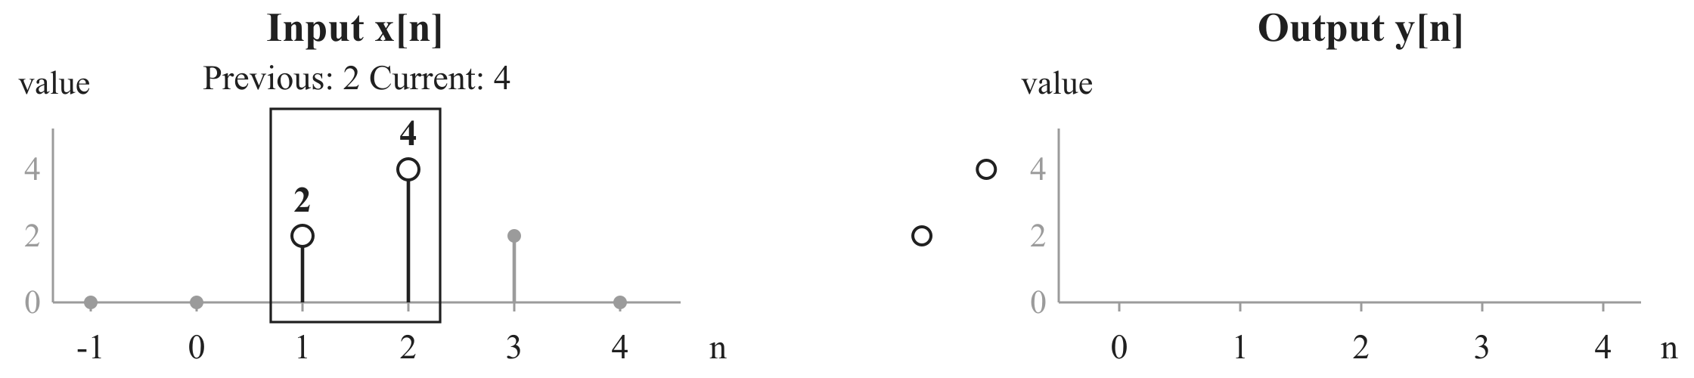


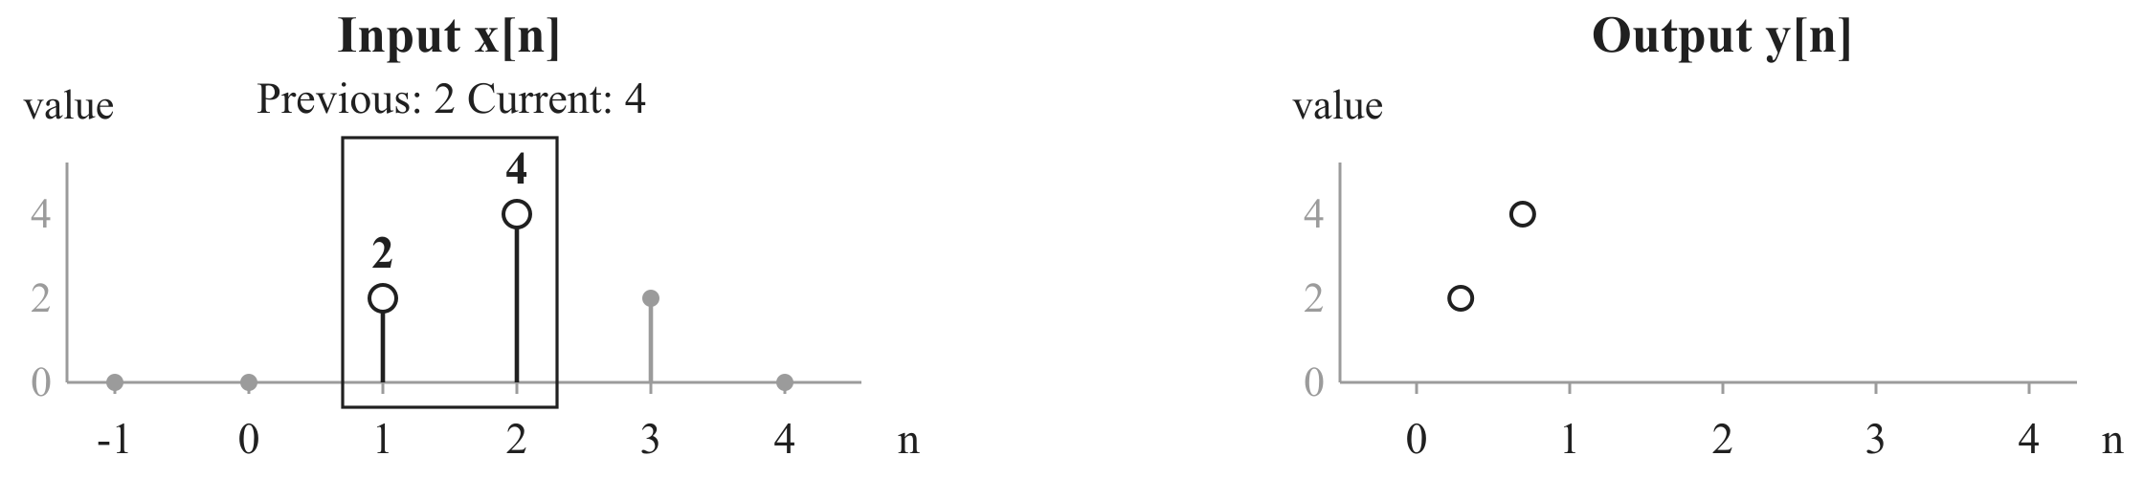

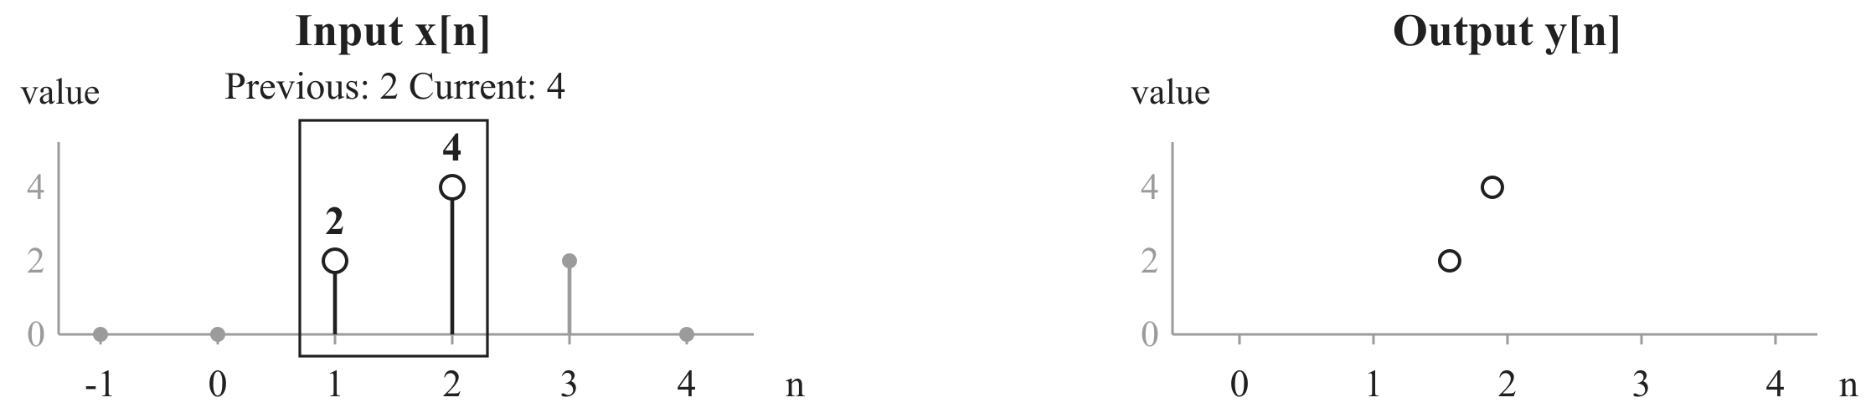
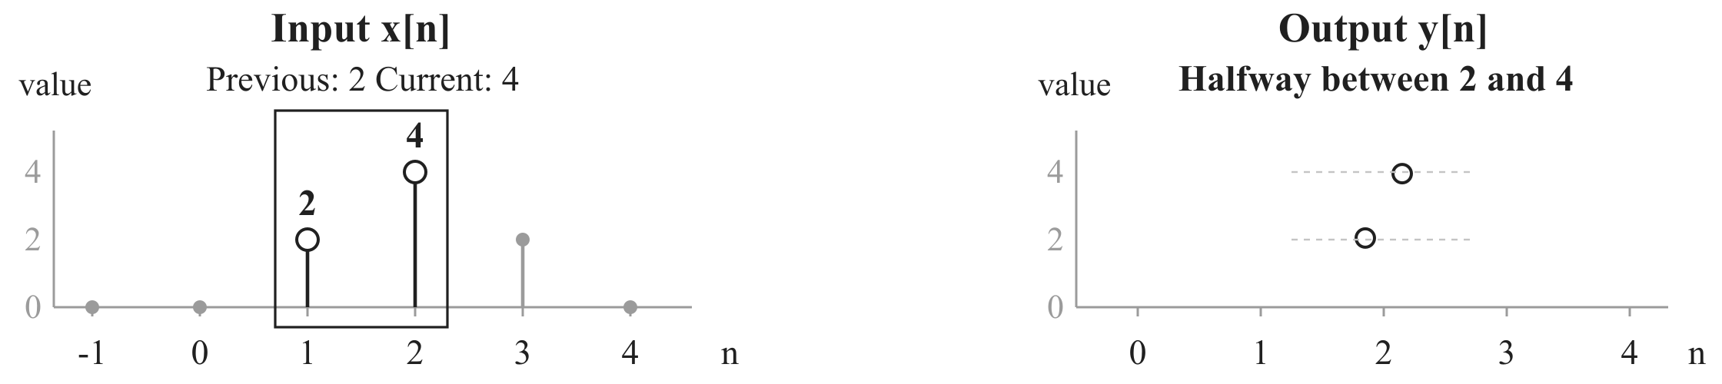













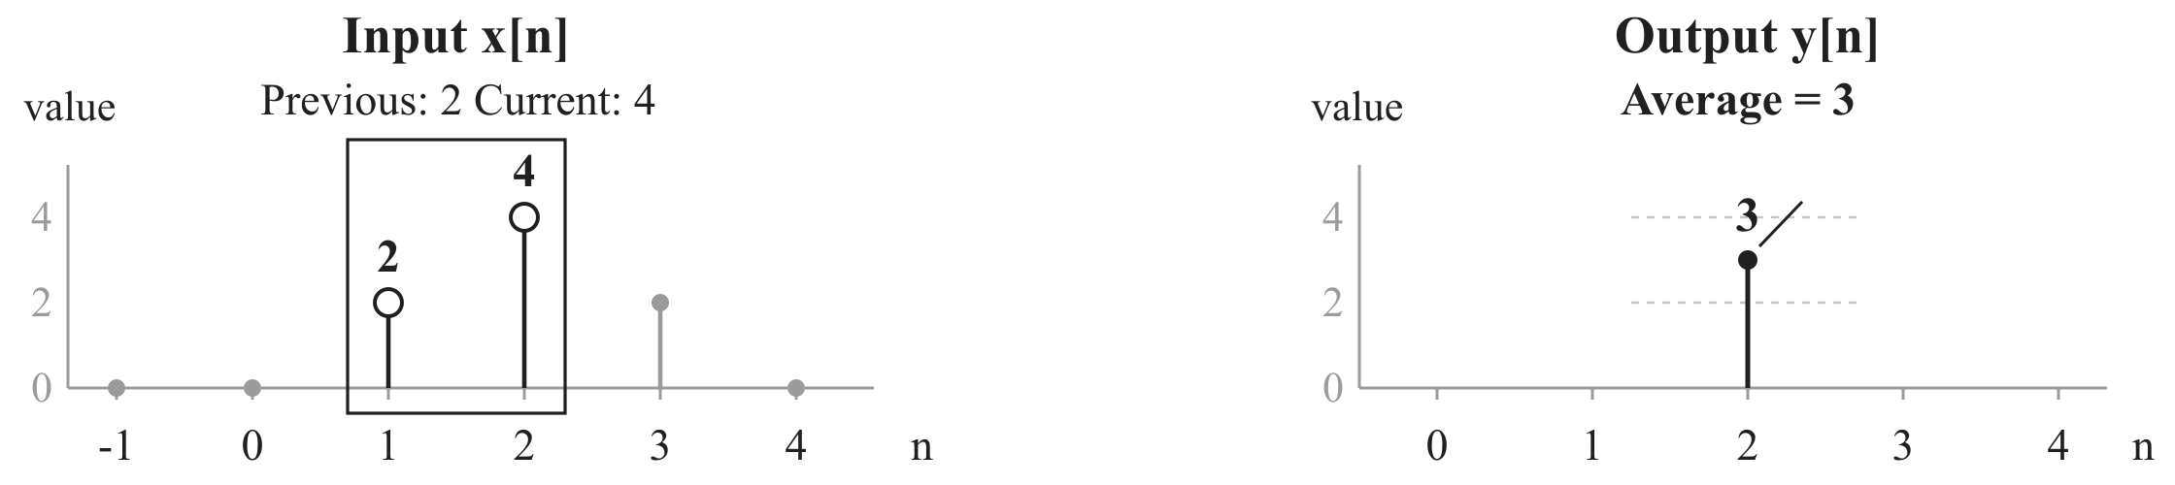
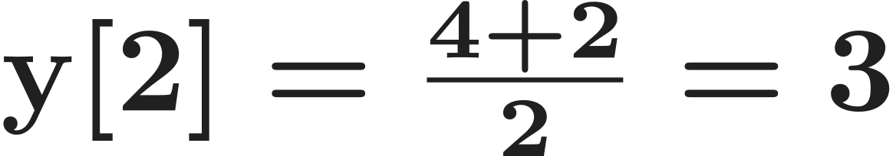
One pair, one output
At index 2
Input
Output
Average a pair
Average: halfway between the two sample heights.
Notes:
Select the current sample x[2]=4 and its previous neighbour x[1]=2. An average is halfway between their heights. A click copies these same two heights to output index 2, then brings them together at height 3. The source samples remain visible. After the result holds, the next click records the full arithmetic. The output belongs at index 2, the current index.

Slide 3
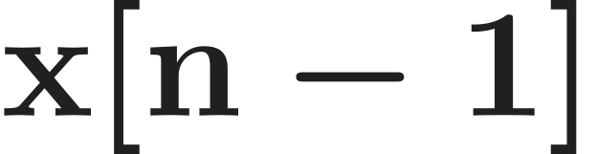
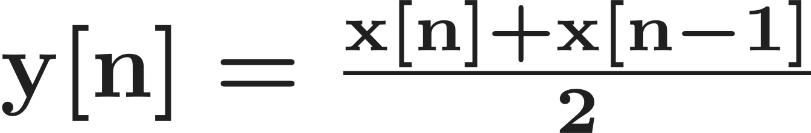
The averaging rule
Current and previous
Input
Output
Average a pair
Current input sample at index n
Previous input sample, one index earlier
Two input samples. One output at the current index n.
Notes:
The numerical example uses current value 4 and previous value 2. Replace the specific current index 2 with the integer index n. Then x[n] is current, x[n-1] is previous, and y[n] is the output at that same current index. Add both inputs and divide the sum by 2. Two-point counts the two input samples used for each output.

Slide 4
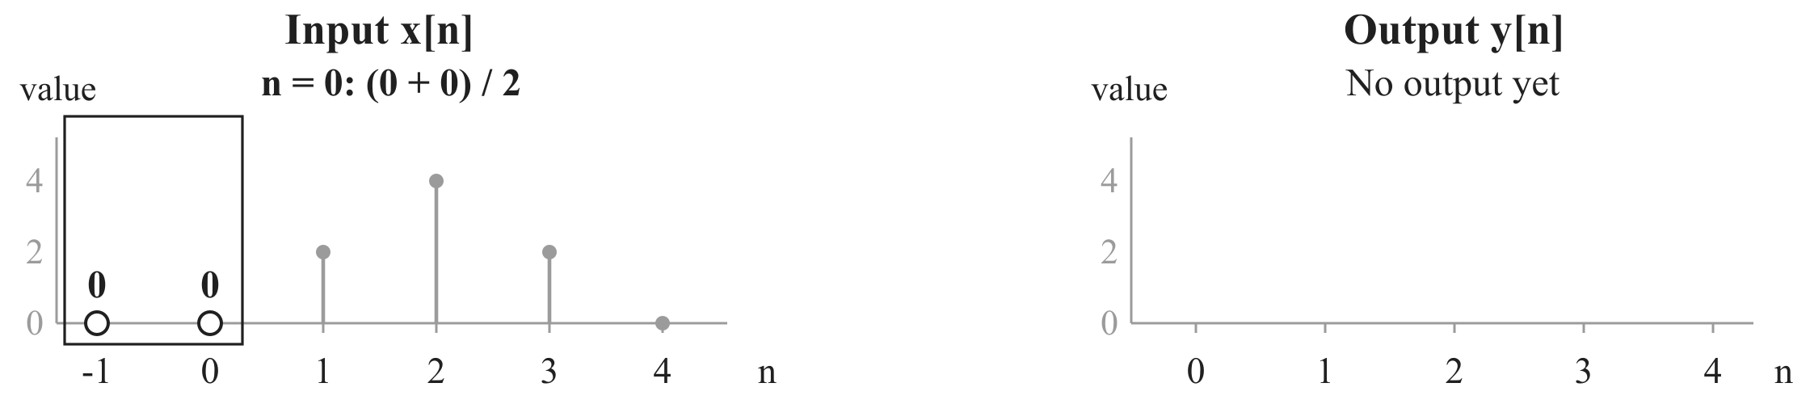
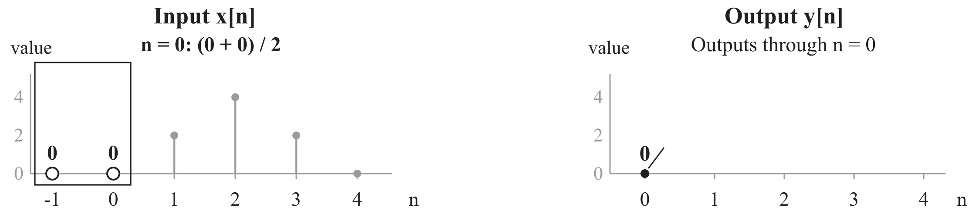
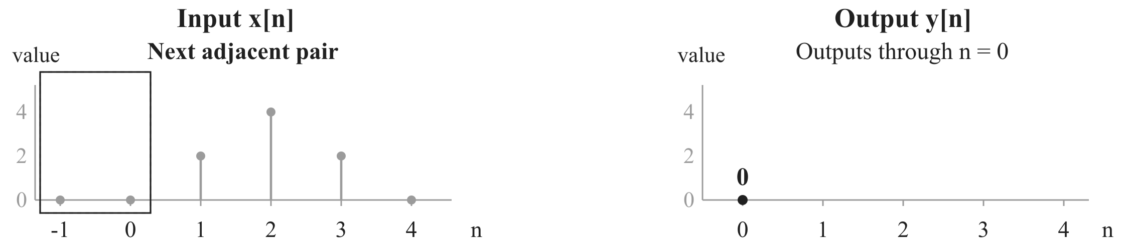
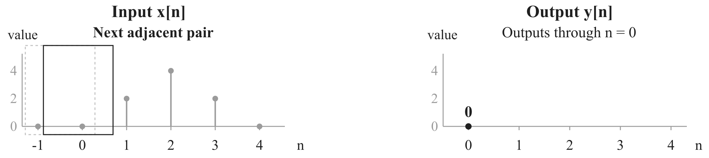
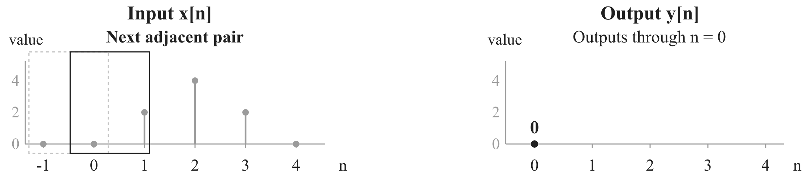
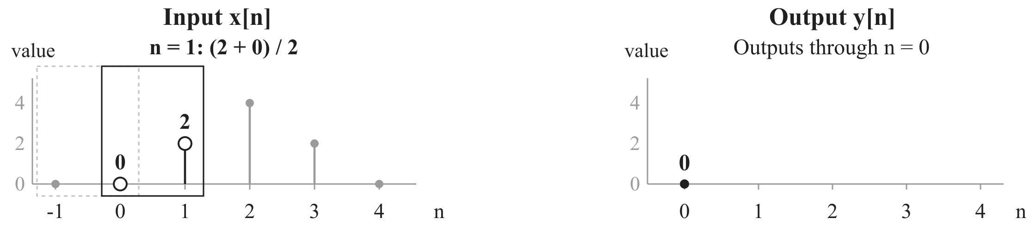
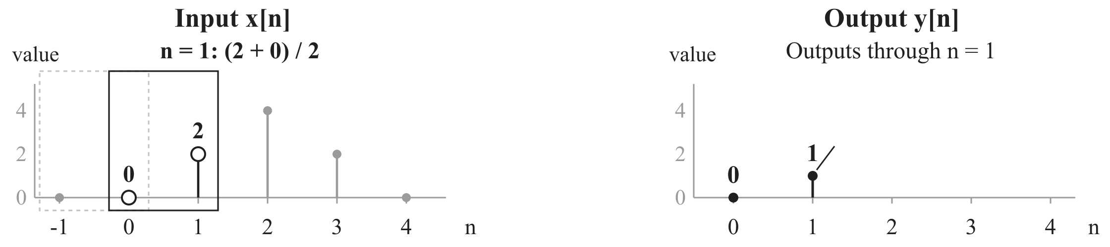
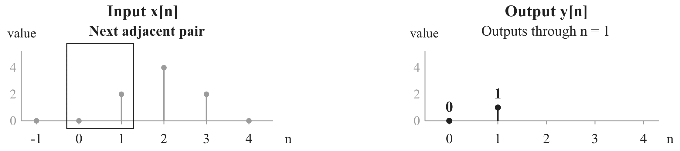
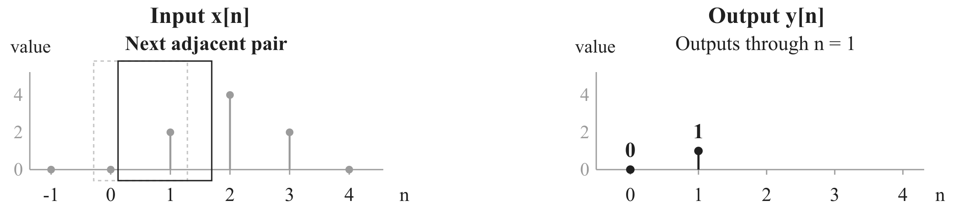
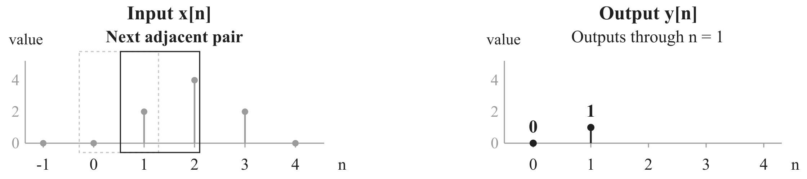
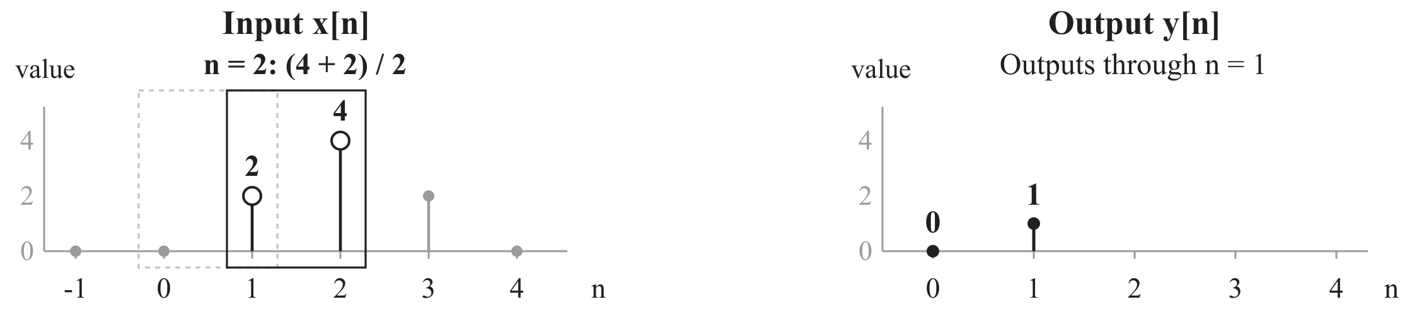
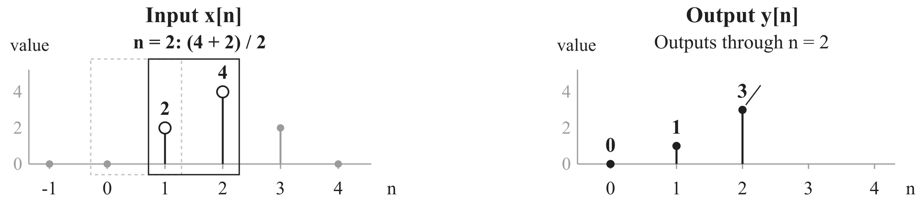
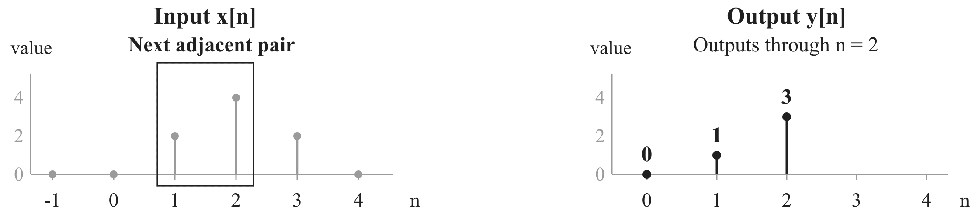


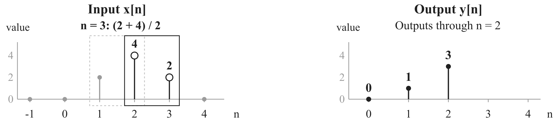
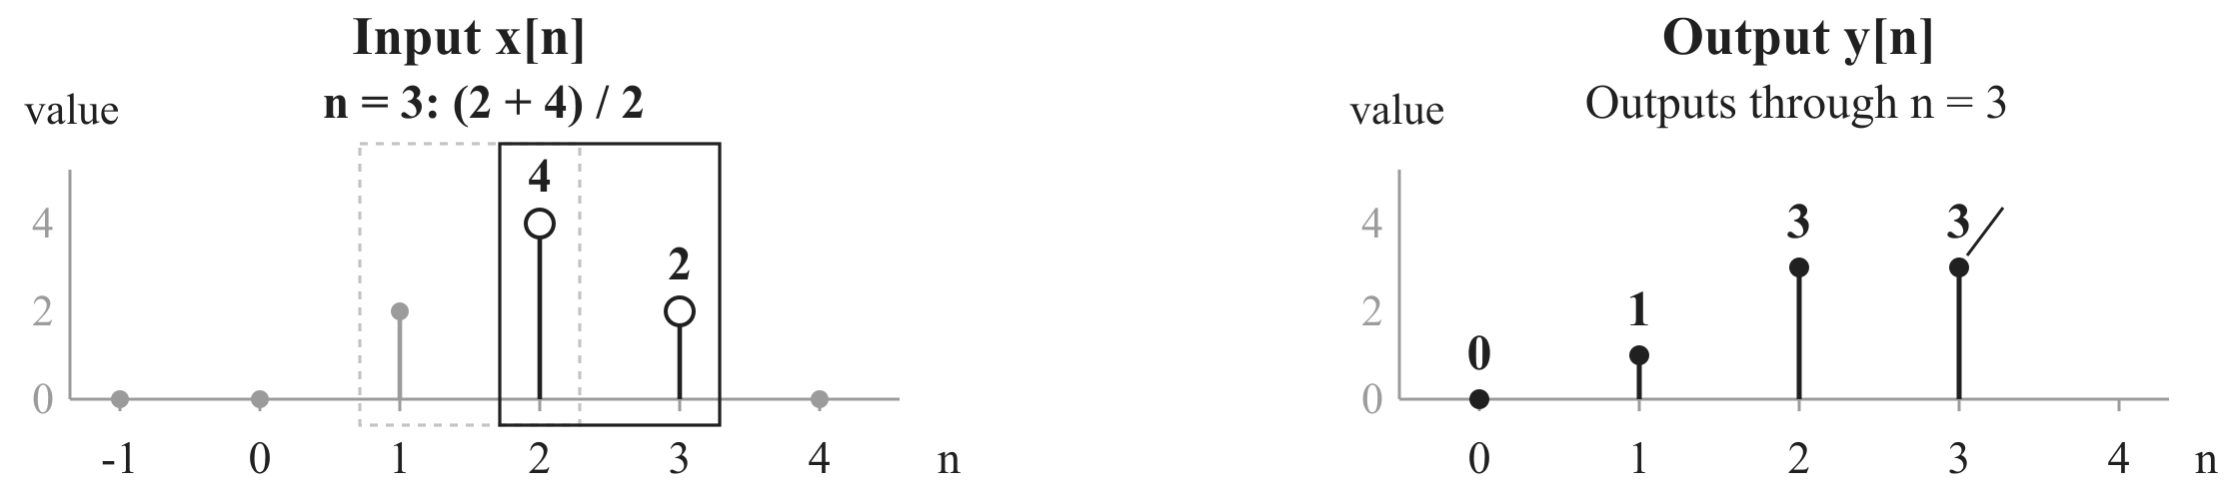
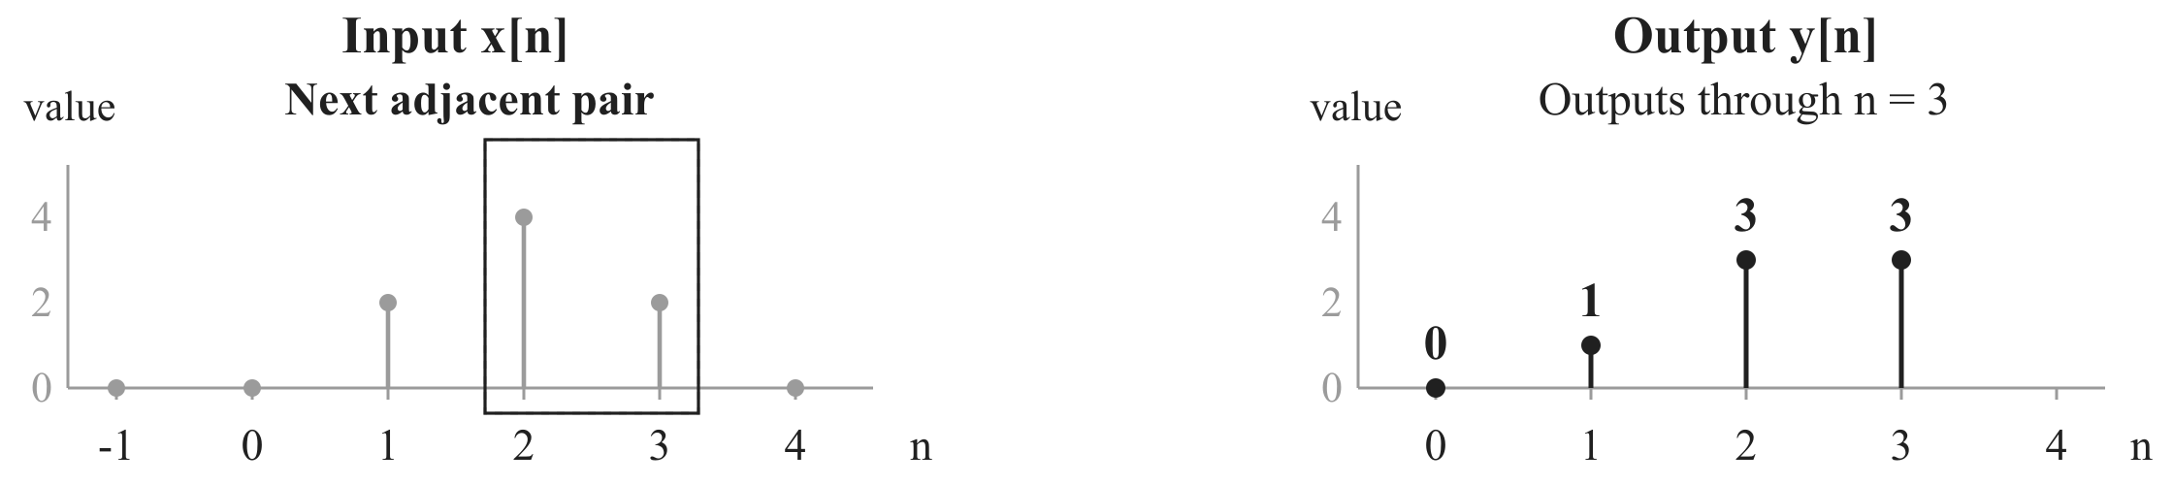
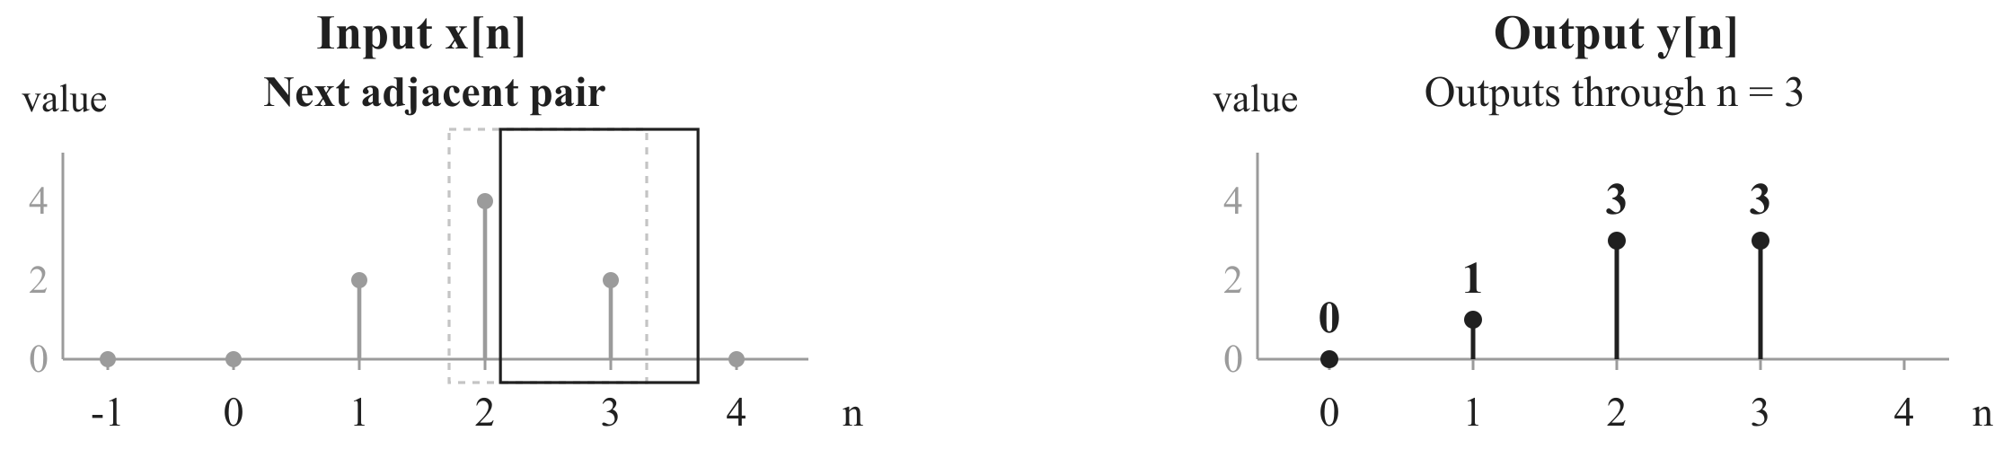

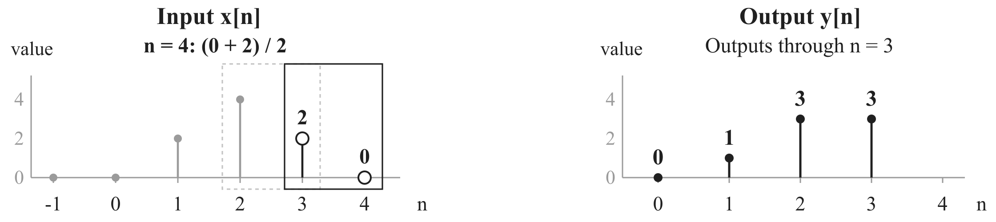
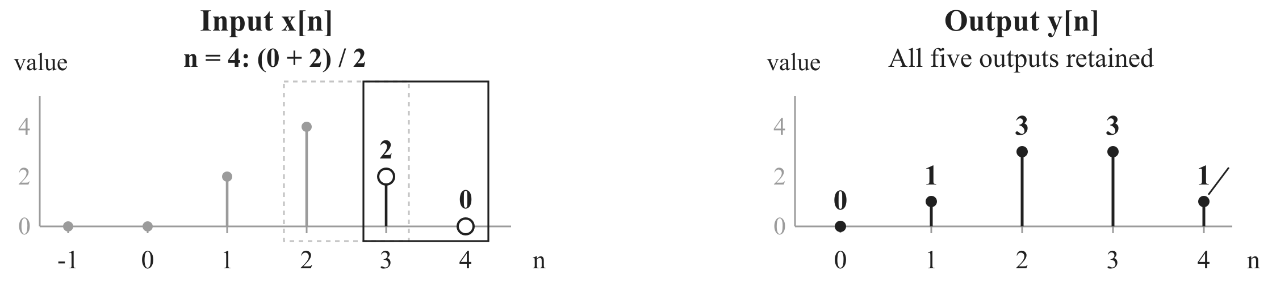
The moving pair
One index at a time
Input
Output
Average a pair
Notes:
Apply the established rule at n=0,1,2,3,4. At n=0 use the supplied previous value x[-1]=0. The outline moves one input index forward for each new output, so successive pairs overlap by one sample. Each output appears only after the selected pair has settled. Earlier outputs stay visible. Only outputs n=0 through n=4 are requested, and no future input is assumed.

Slide 5
Complete worked example
All five outputs
Input
Output
Average a pair
n | Previous | Current | Average | Output
0 | 0 | 0 | (0 + 0) / 2 | 0
1 | 0 | 2 | (2 + 0) / 2 | 1
2 | 2 | 4 | (4 + 2) / 2 | 3
3 | 4 | 2 | (2 + 4) / 2 | 3
4 | 2 | 0 | (0 + 2) / 2 | 1
Notes:
This page keeps the problem statement and every numerical substitution visible together. Read previous input, current input, their sum divided by 2, and the resulting output in each row. Notice that x[2]=4 is reused in two overlapping pairs. It produces outputs 3 at both n=2 and n=3. The starting value x[-1]=0 is given. The final vector contains only n=0 through n=4.

Slide 6
Two-point moving average
Takeaway
Input
Output
Average a pair
Current + previous, divided by two.
Move forward one index. Use the next overlapping pair.
Notes:
For each current index n, add x[n] and its previous input x[n-1], then divide by 2 to obtain y[n]. Advance n by one and use the next overlapping pair. Supply a previous input for the first output; here x[-1]=0. In this example, [0,2,4,2,0] becomes [0,1,3,3,1] over the same five indices.

