Slide 1
ELEG2310B
Tutorial 4
Phase and Frequency Modulation
Teaching Assistants: WANG, Runbang; TIAN, Feng
runbang@link.cuhk.edu.hk
Notes:
Tutorial 4. Phase and Frequency Modulation. Teaching Assistants: WANG, Runbang; TIAN, Feng. Contact: runbang@link.cuhk.edu.hk.

Slide 2
Modulation
Transmission
Demodulation
Ideal channel
Notes:
The complete communication path is m(t) -> s(t) -> r(t) -> recovered m(t). The equality r(t) = s(t) assumes an ideal channel; it is not true for a general channel.

Slide 3
Notes:
Under the ideal-channel assumption r(t) = s(t), the communication path simplifies to m(t) -> s(t) -> recovered m(t).

Slide 4
Sinusoidal carrier
Change amplitude
Change phase
Change frequency
AM schemes
PM
FM
Pulses
Change pulse height
PAM
Notes:
For a sinusoidal carrier, the message can control amplitude, phase, or instantaneous frequency. In sampled PAM, message samples control the amplitudes of shifted pulses. These are alternative modulation choices, not consecutive processing stages.

Slide 5





Sinusoidal carrier
Change phase
Change frequency
PM
FM
Positive m: phase advances
Positive m: more cycles per second
Gray: unmodulated carrier
Notes:
Continue the sinusoidal-carrier branch in the preceding course router. The same cosine and its phase/frequency choices remain. Keep carrier amplitude fixed. PM controls added phase; FM controls oscillation rate. The displayed constant positive message illustrates the two different actions, not a general-message formula. Source: Fall2026/Note6_PM_FM.pdf pp. 4-5. Unless specified otherwise, plotted time is ms, frequency is kHz, Ac=Am=1, fc=12.25 kHz and fm=1 kHz. Numerical demonstrations illustrate the equations; they are not exercises.

Slide 6



PM and FM
Today
Generate
Bandwidth
Recover
Change phase
Find occupied band
Recover message
PM
Change frequency
Find occupied band
Recover message
FM
Notes:
The same three tasks frame this lesson: generate s from m, determine the bandwidth of s, and recover m. Each column is a task, not a separate signal path. The PM narrow-band estimate assumes small added phase. Larger phase needs further sidebands. FM uses the approximate Carson bandwidth. The PM frequency-reader method requires a known initial message value. All recovery statements assume the ideal receiver conditions established in the lesson. Source: Fall2026/Note6_PM_FM.pdf pp. 4-10,17-28. Numerical demonstrations are illustrations, not exercises. Unless labeled otherwise, Ac=Am=1, fc=12.25 kHz, fm=1 kHz, time in ms. Integration from zero fixes a reference phase; it is equivalent to the lecture convention up to that reference. The negative-frequency counterpart is included in spectra. Bandwidth BT refers to the width of one RF band, not the sum of both frequency halves.

Slide 7


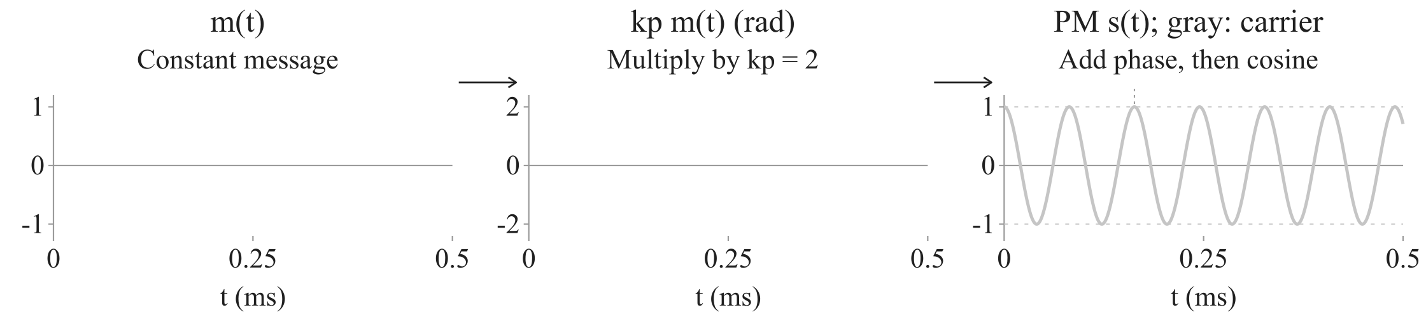
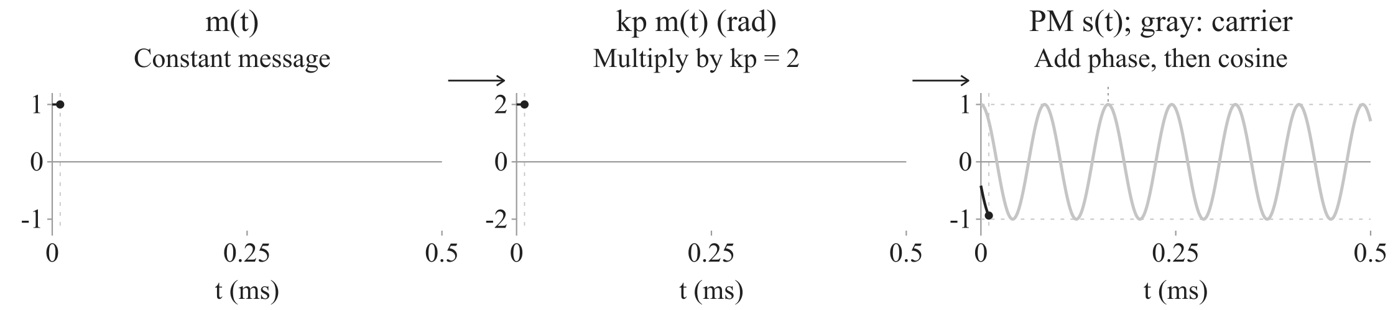

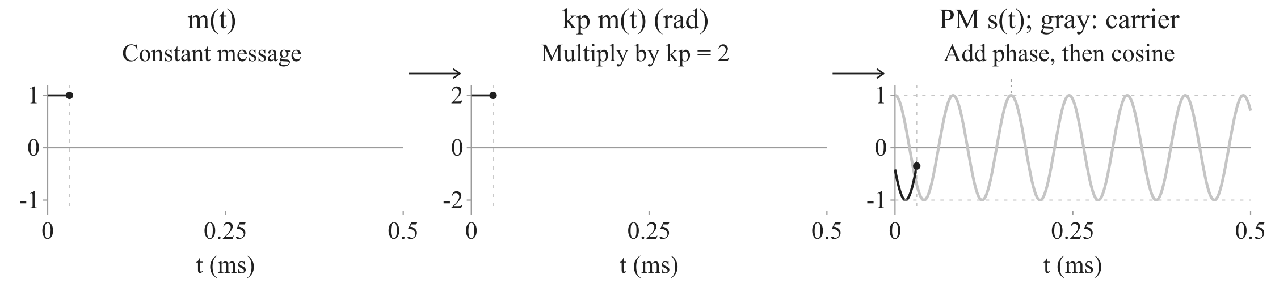
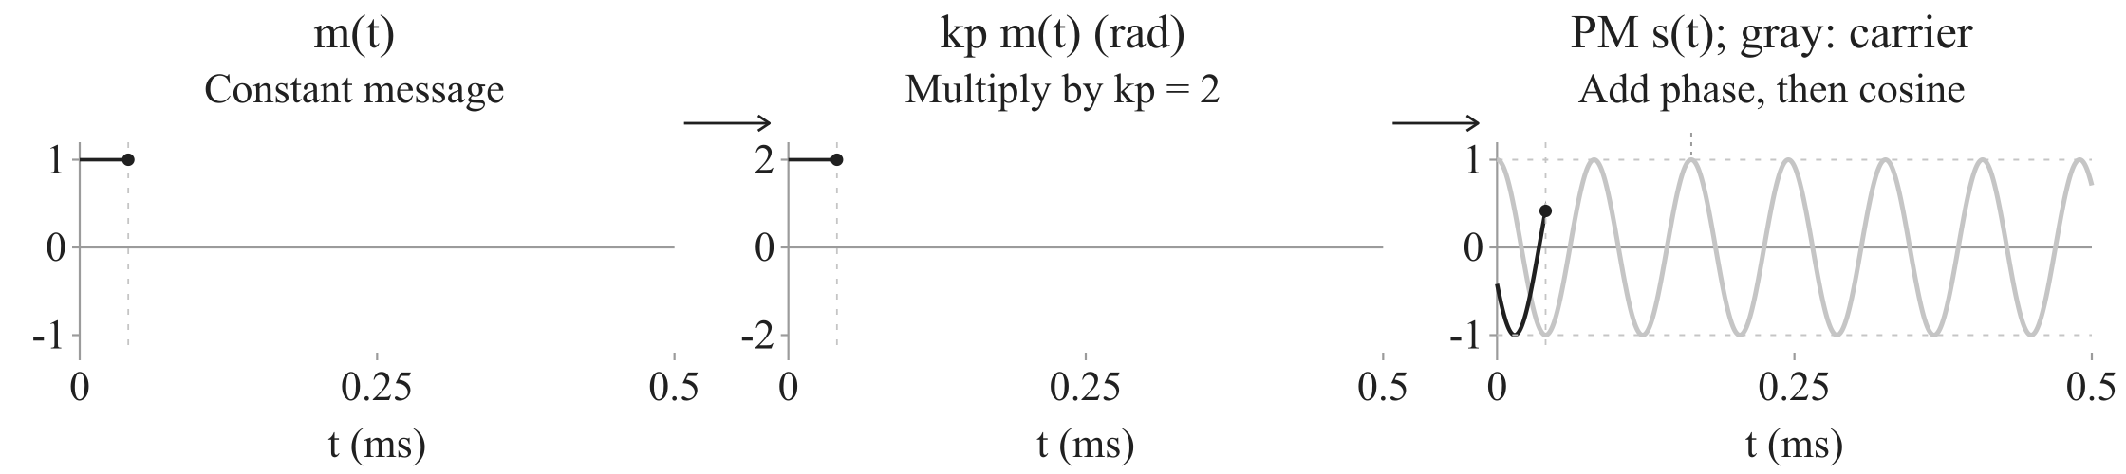
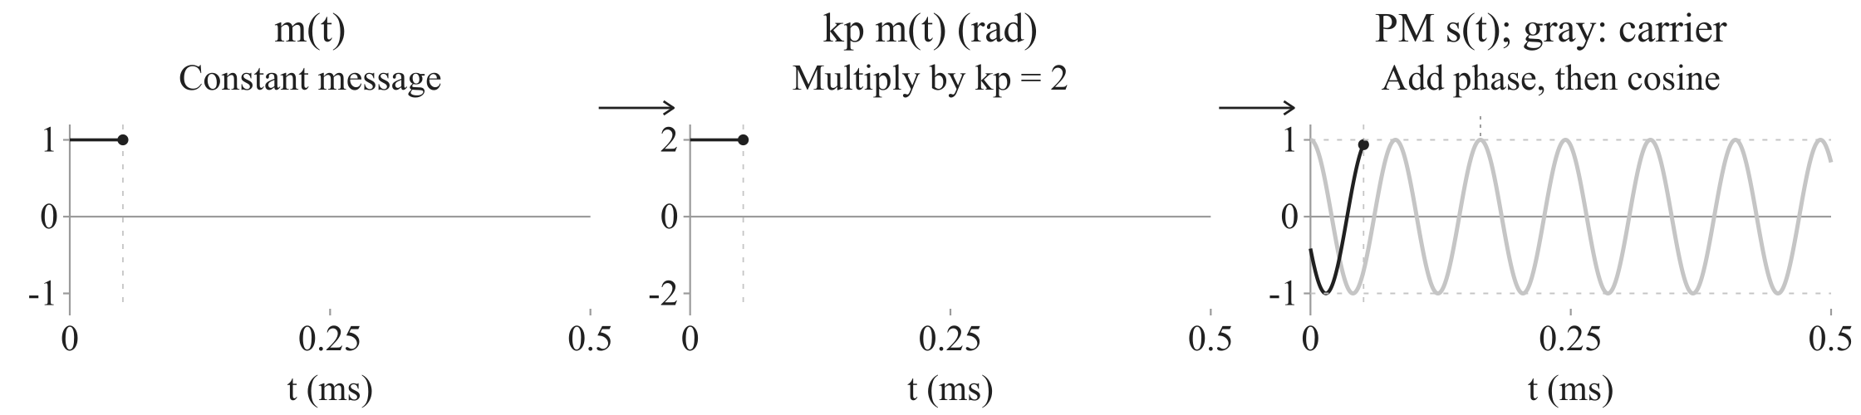

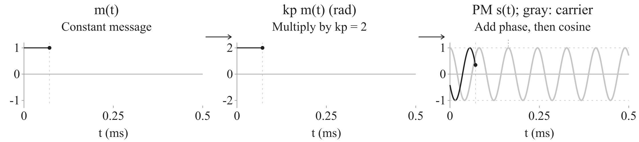
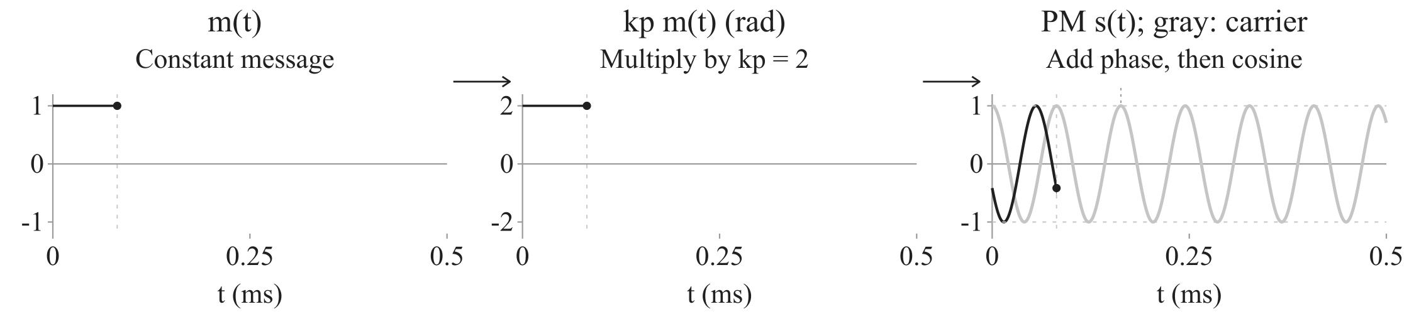
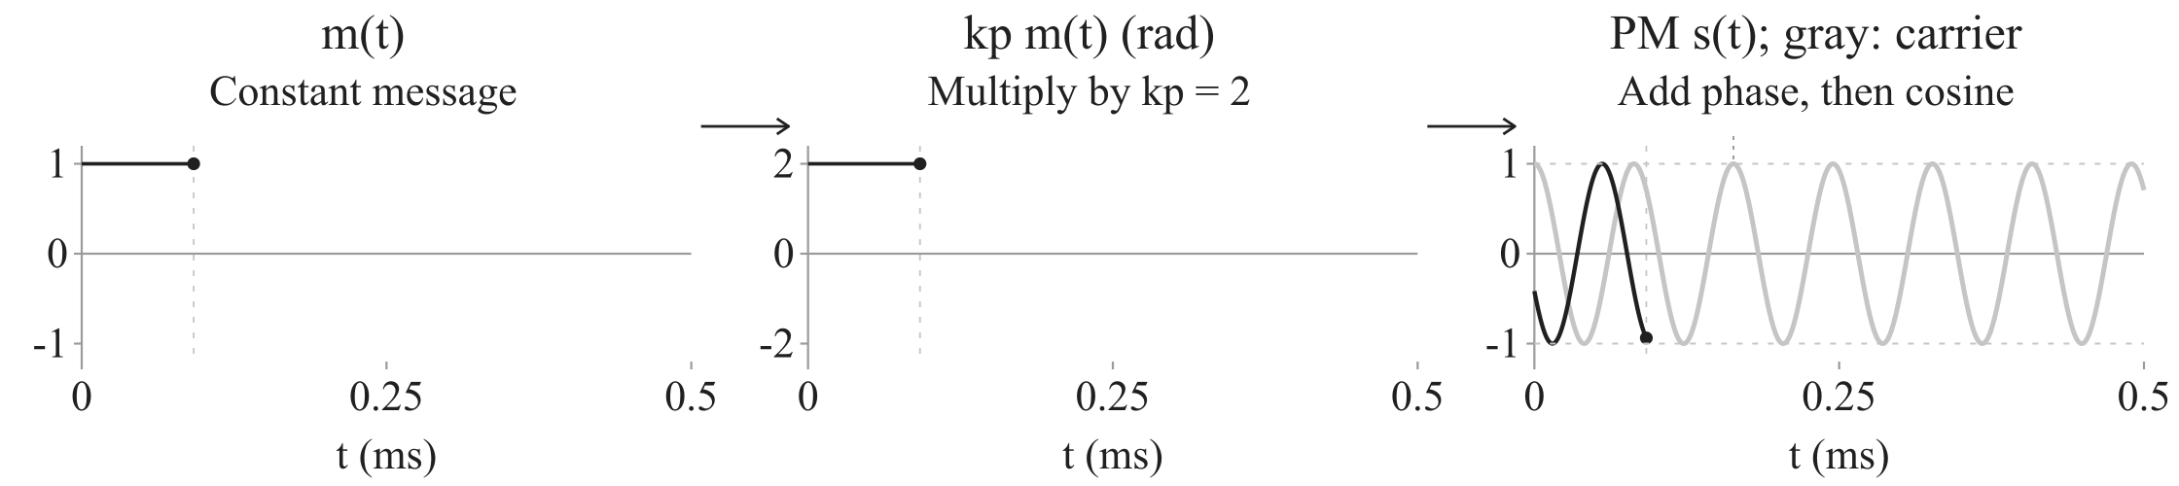
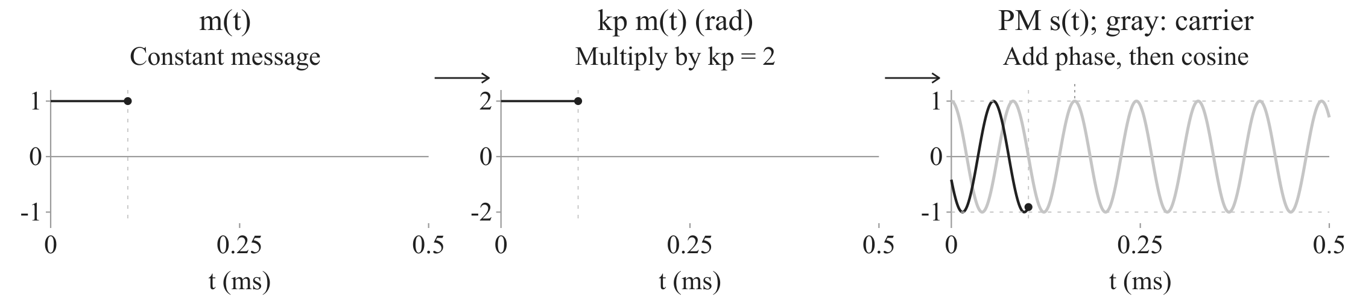
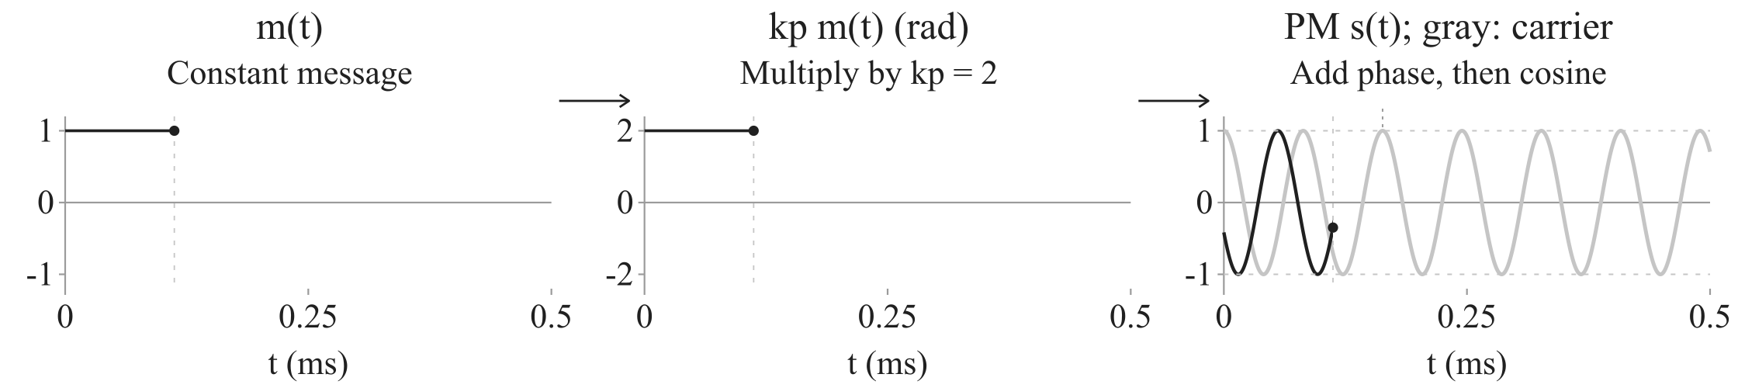
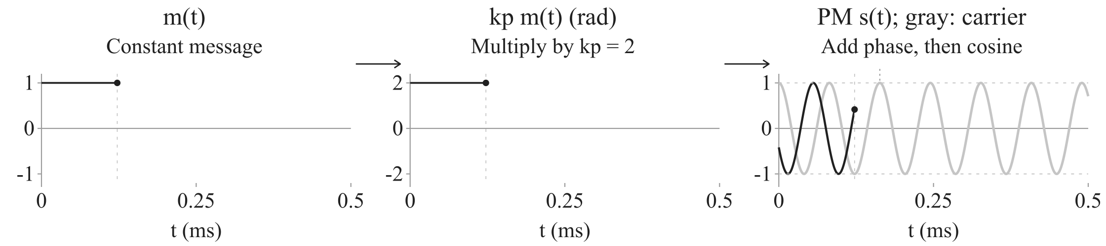

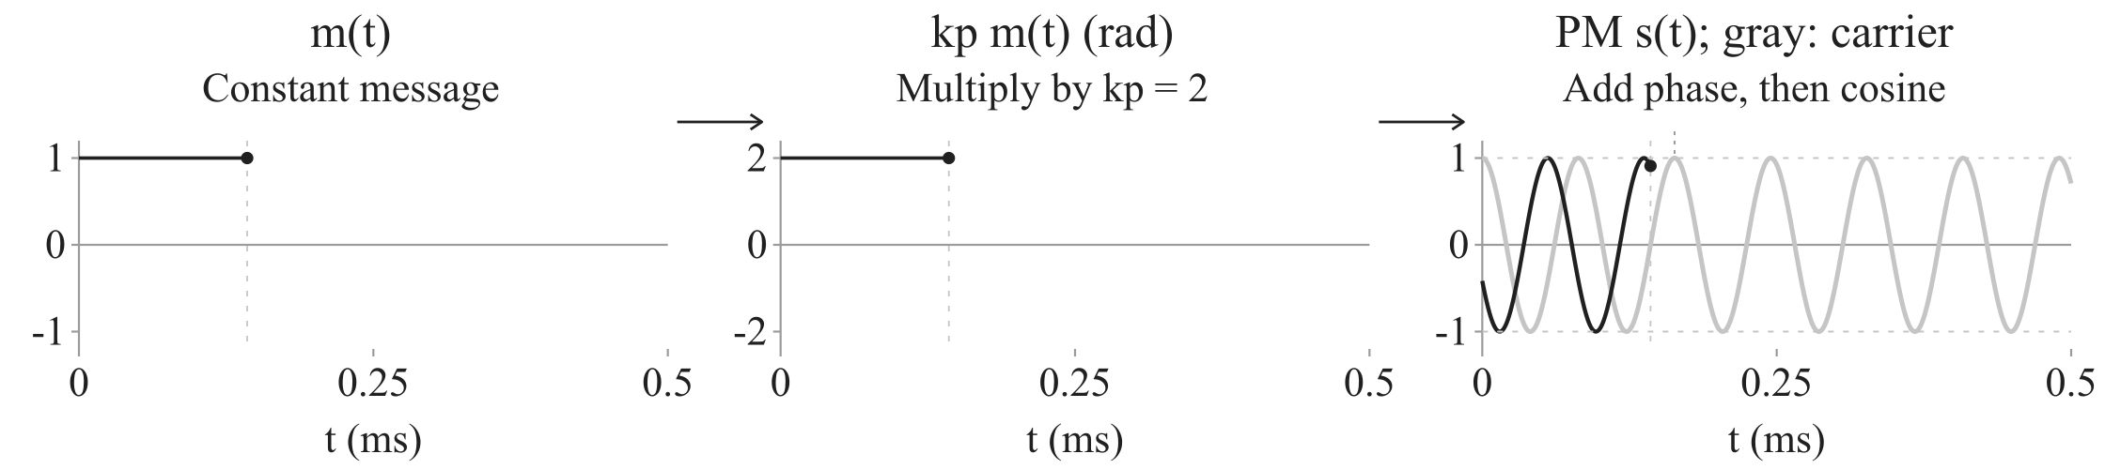
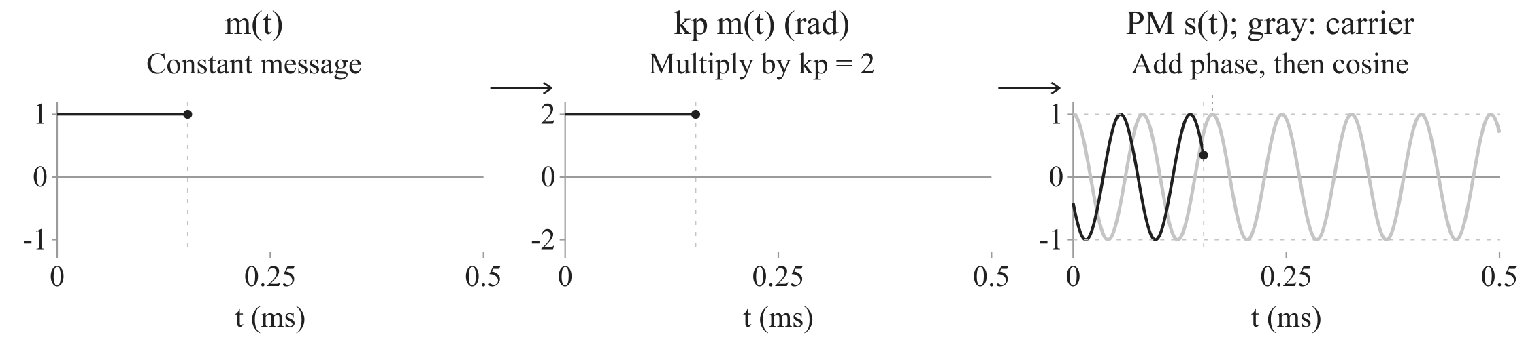
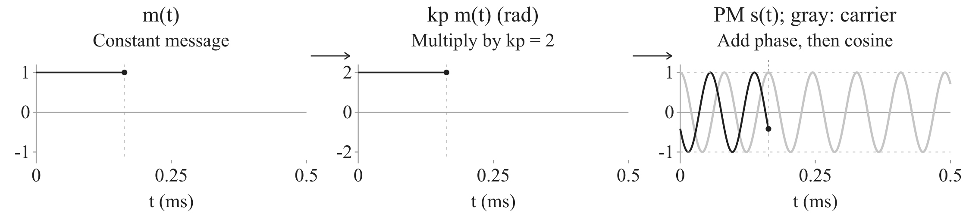
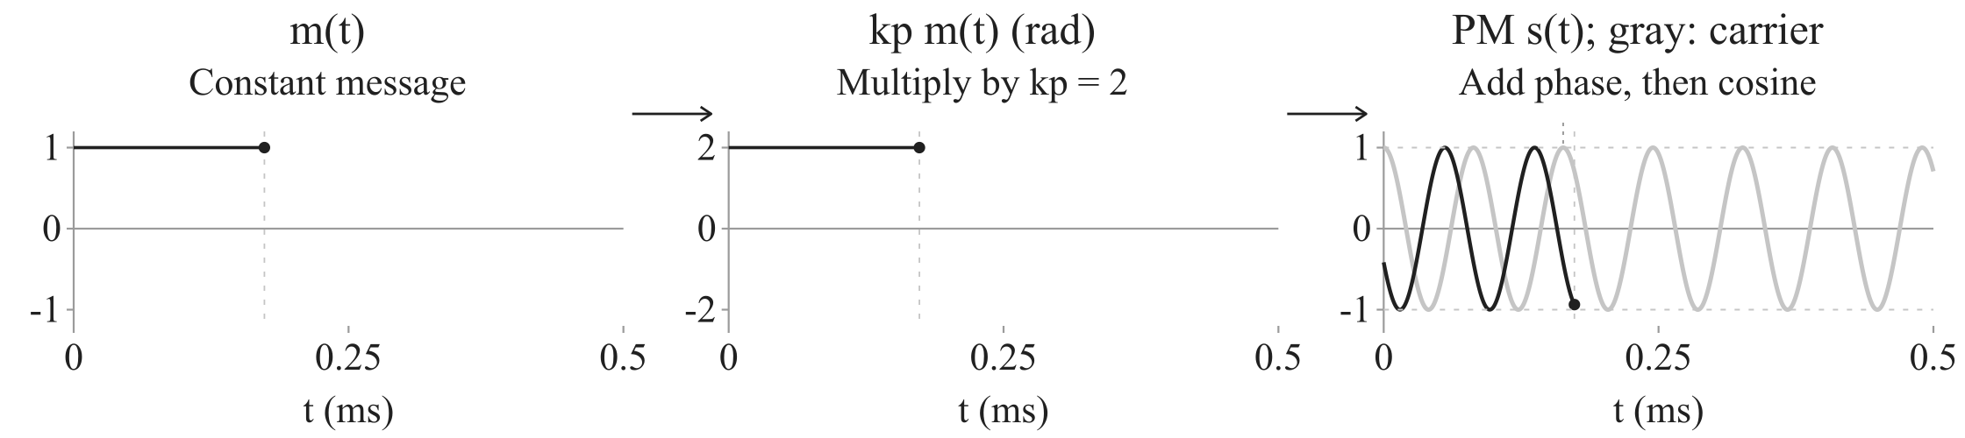




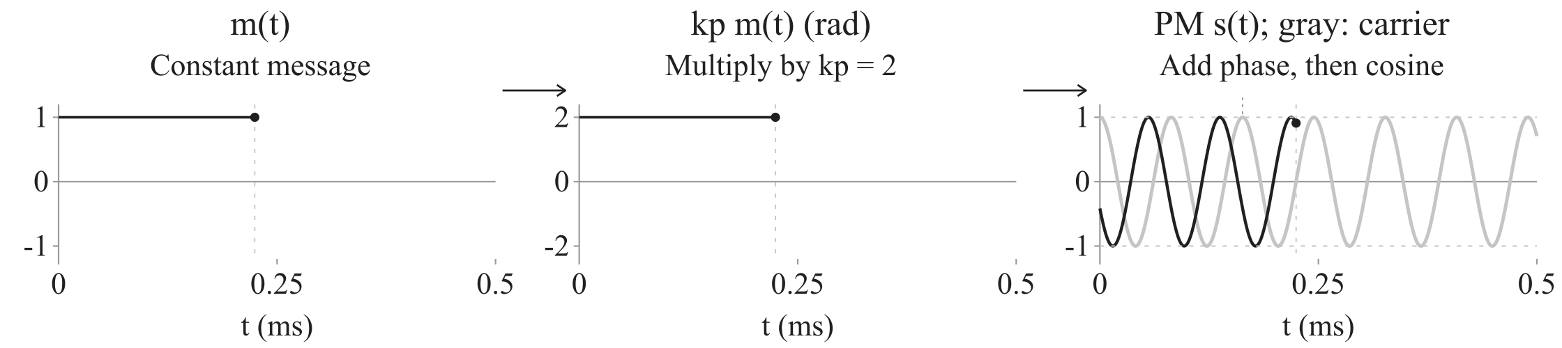
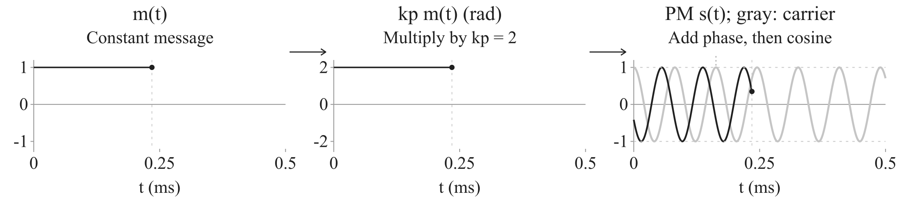



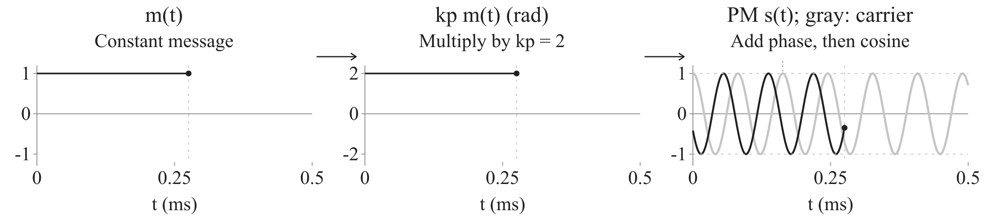


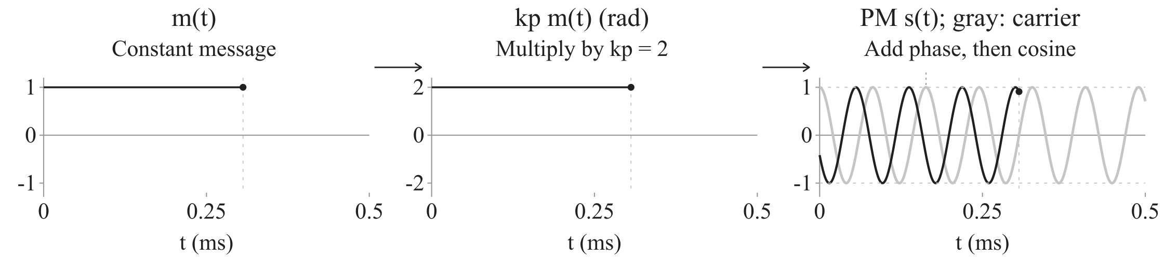
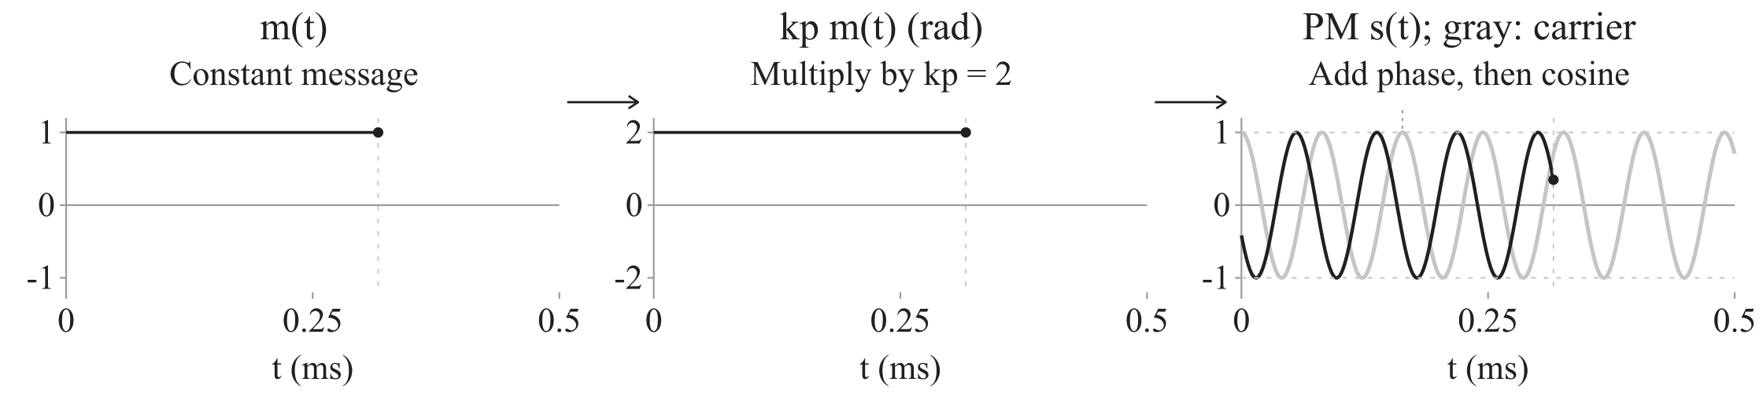
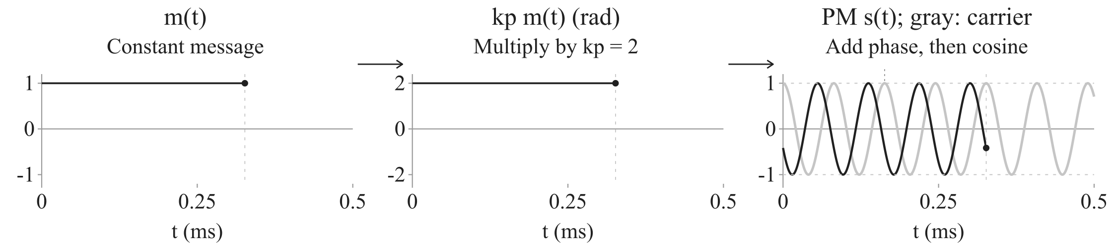

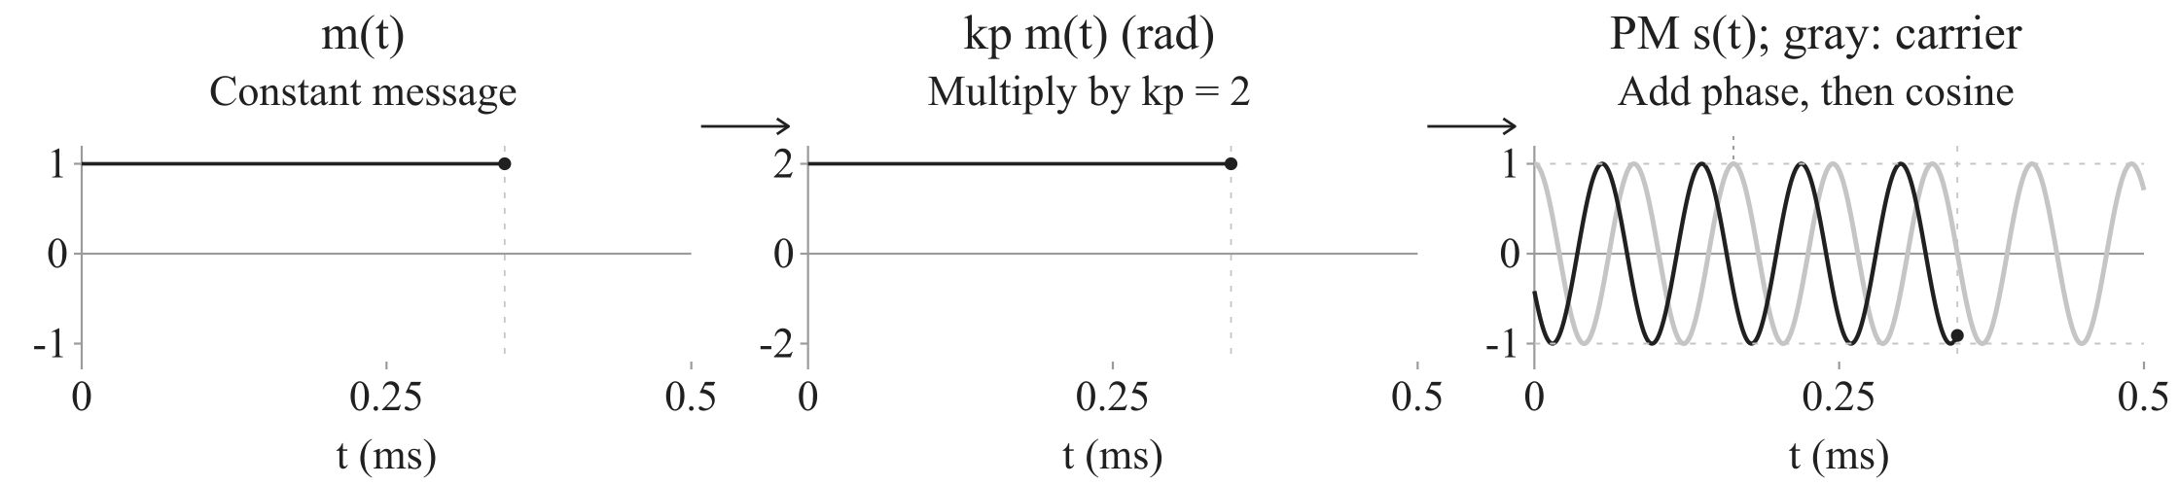
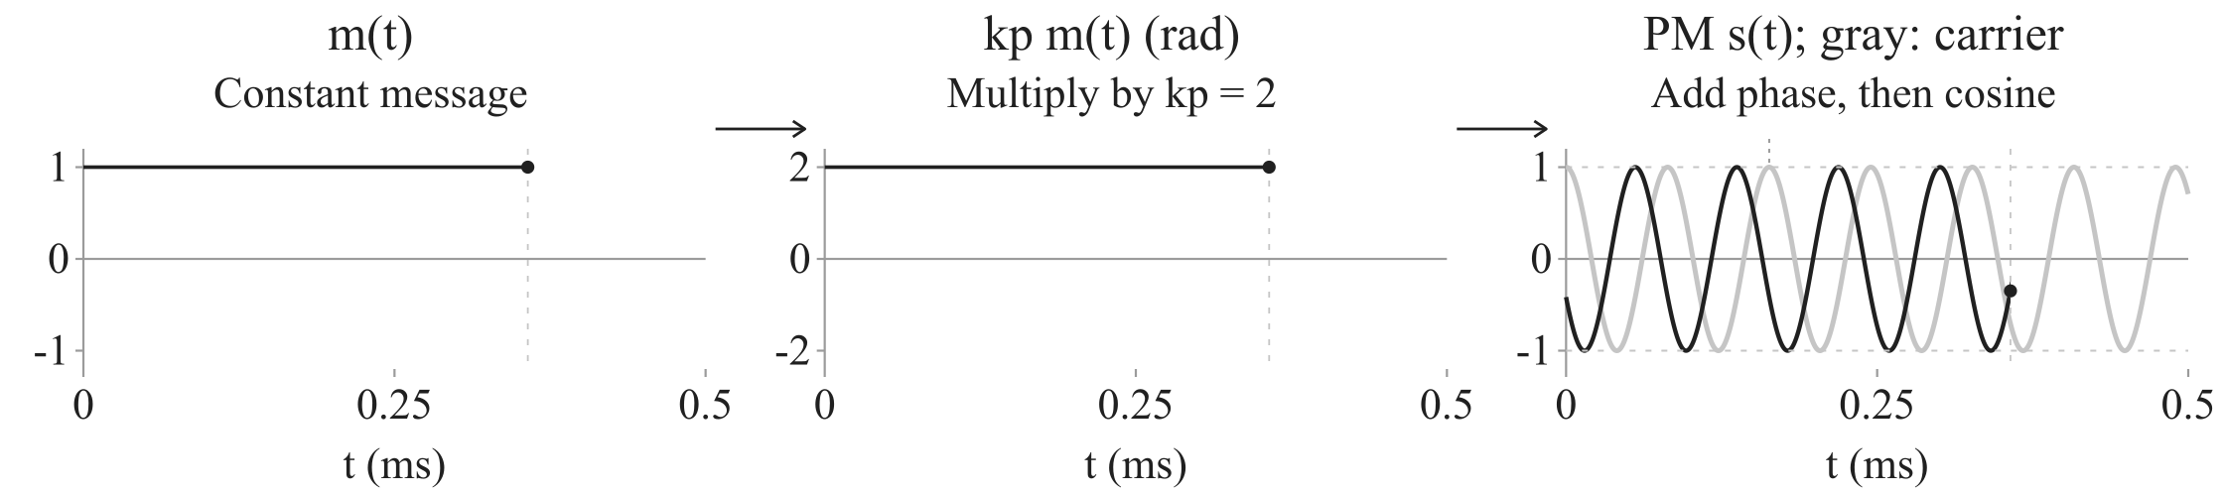
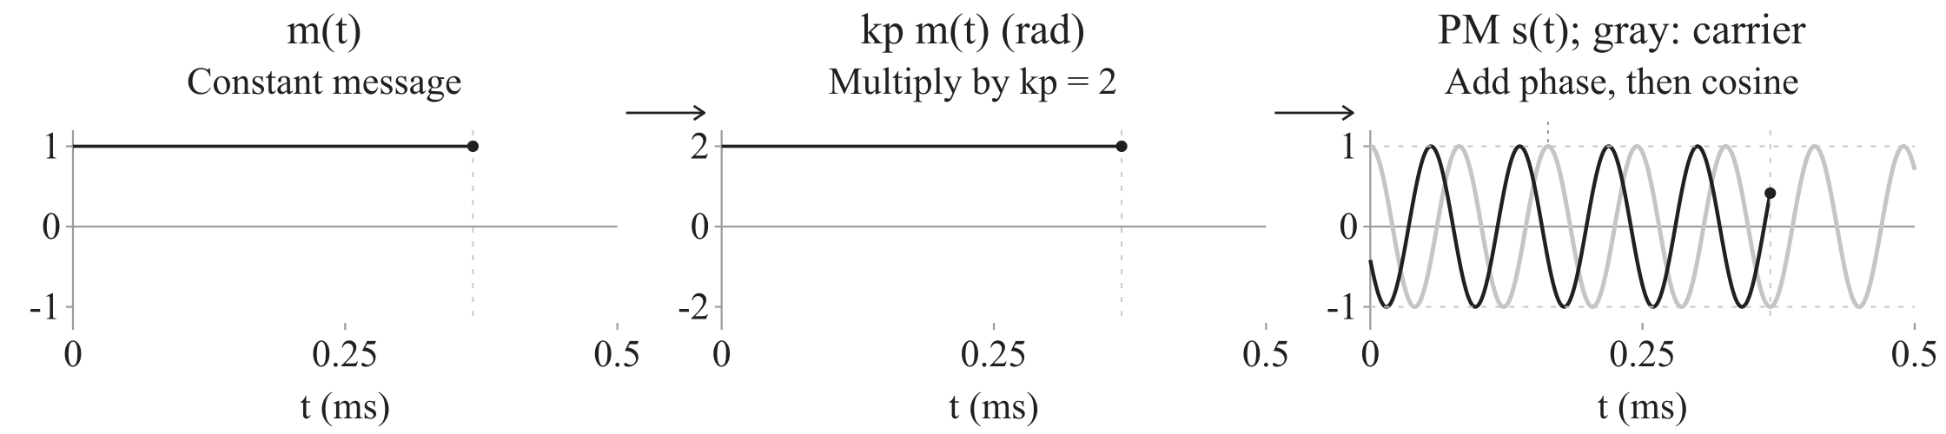


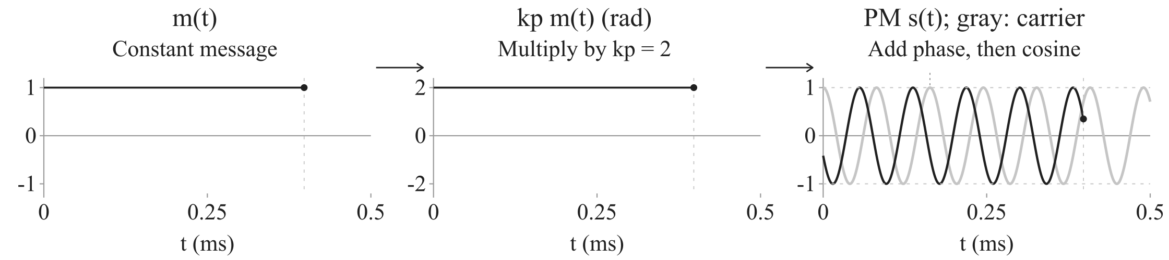
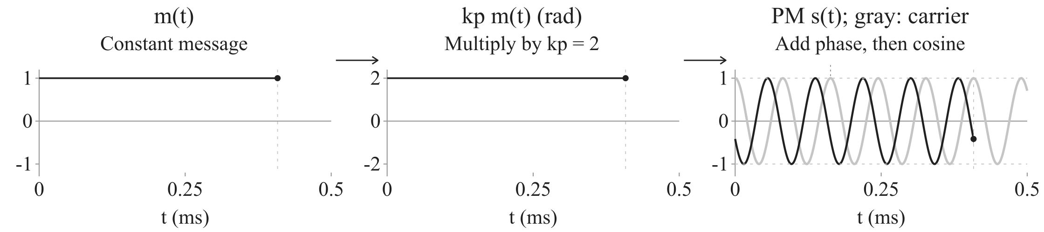
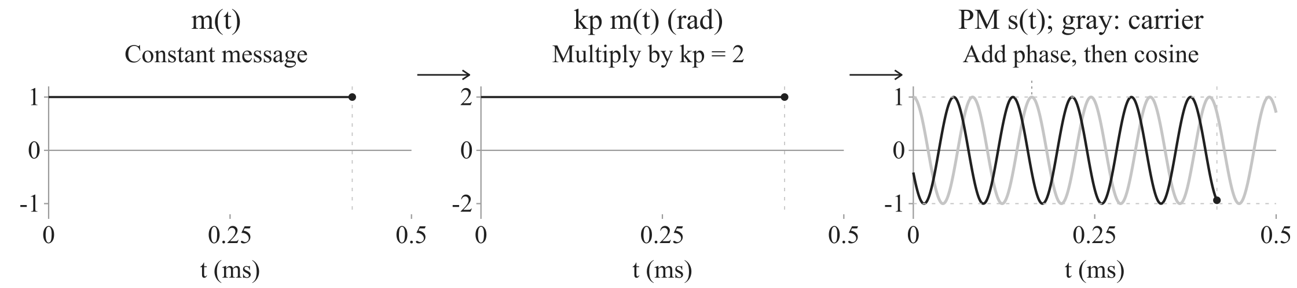
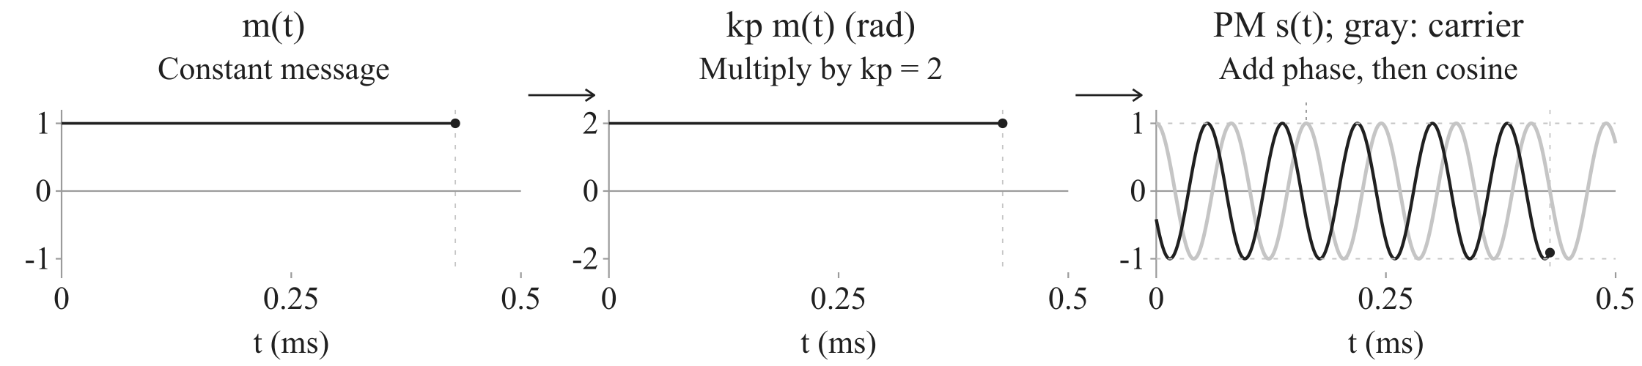

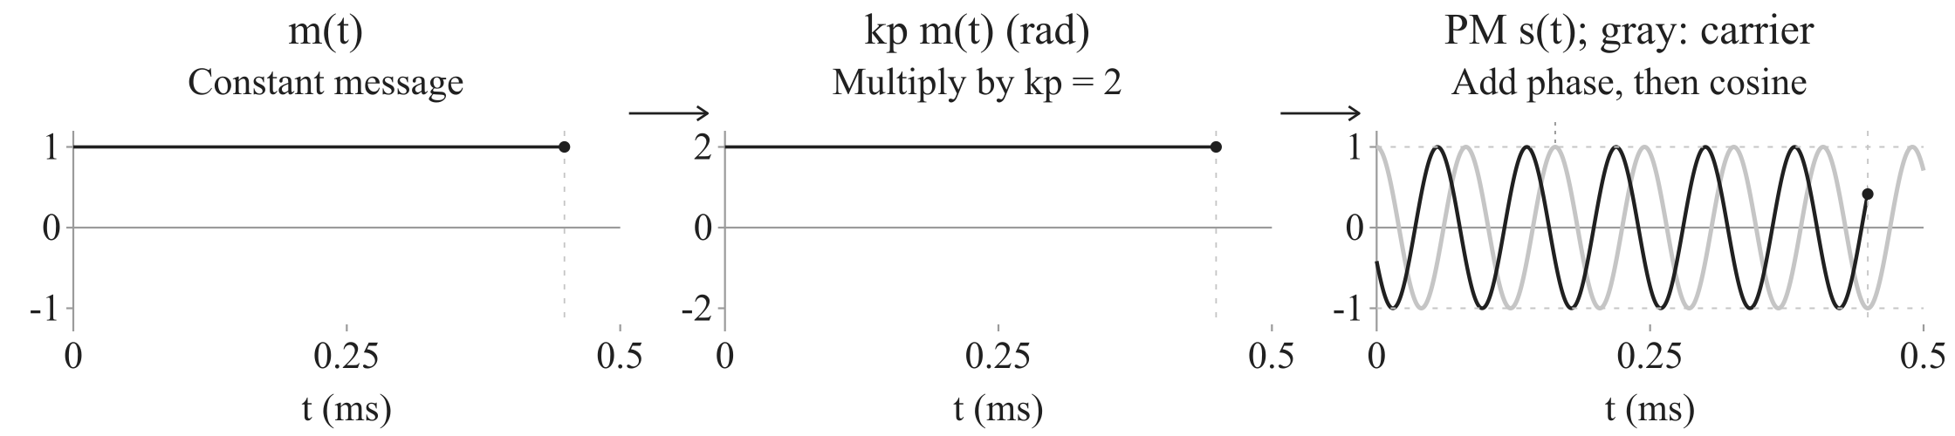
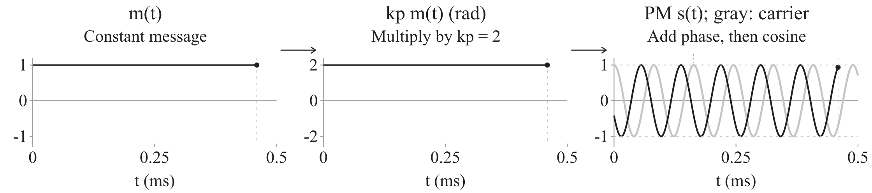

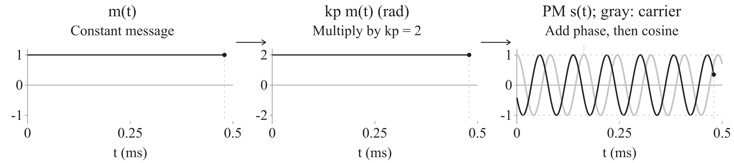
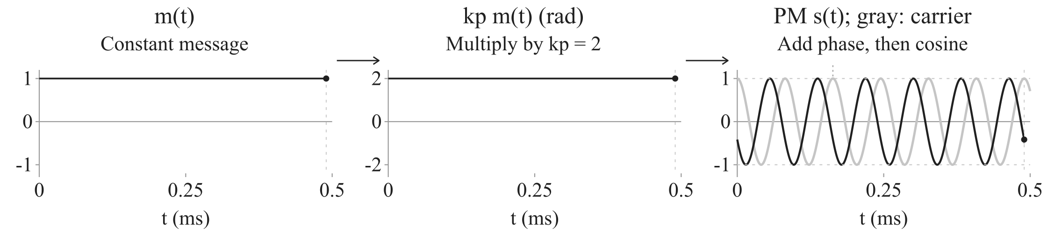
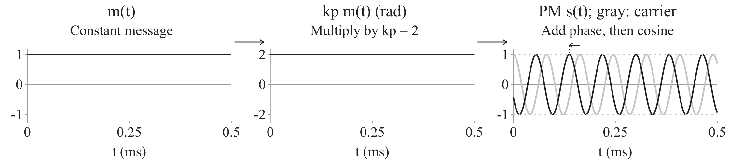
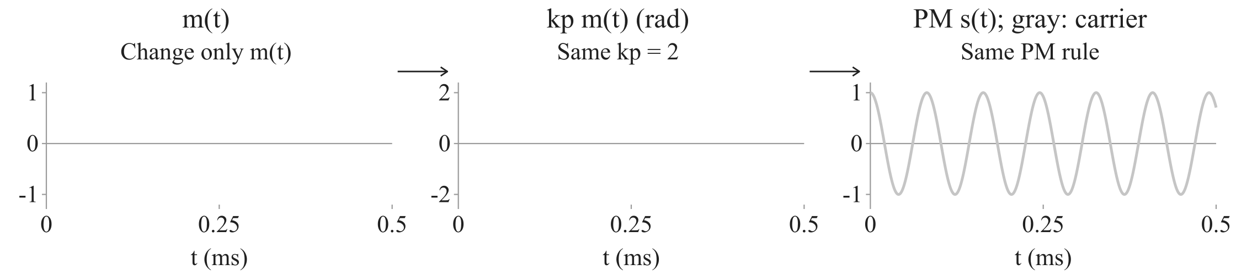
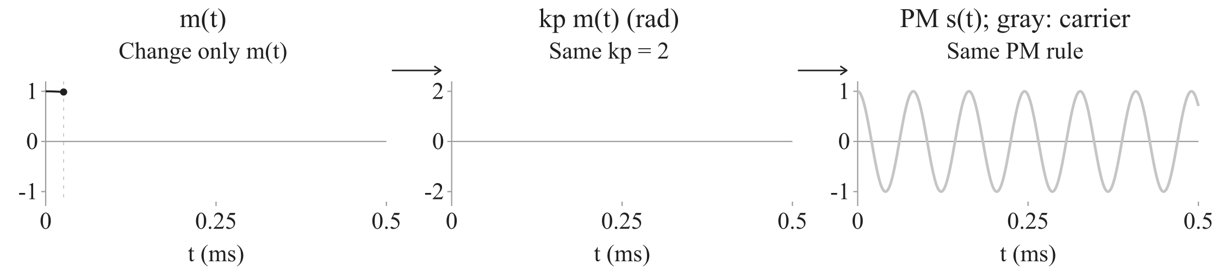
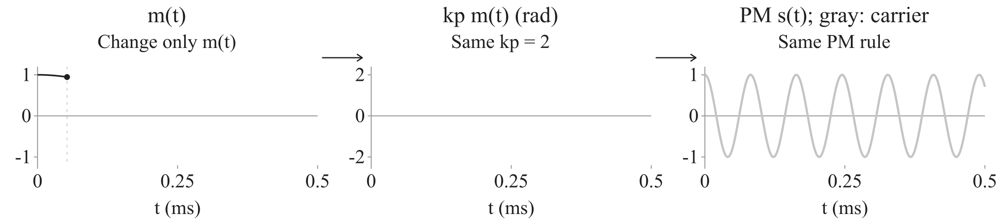

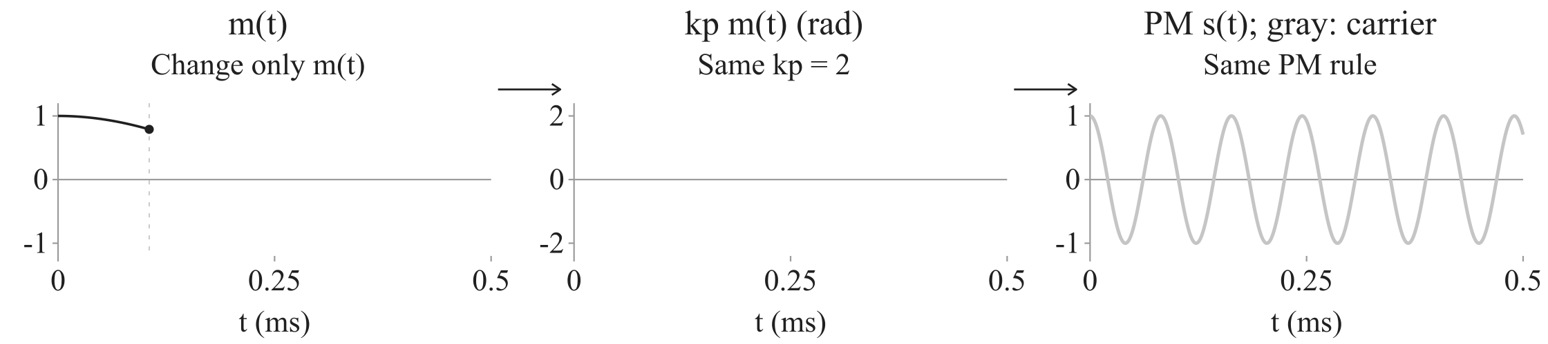
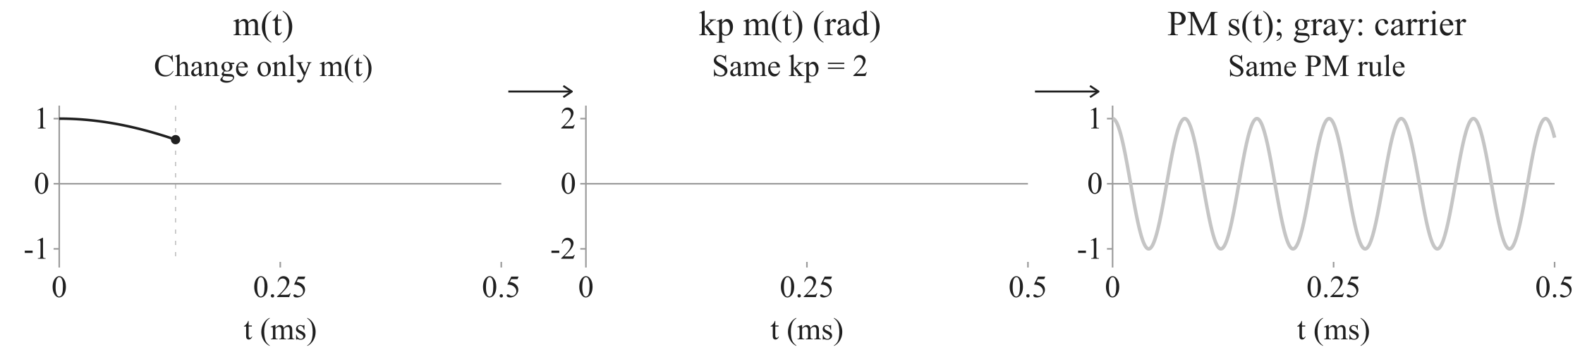
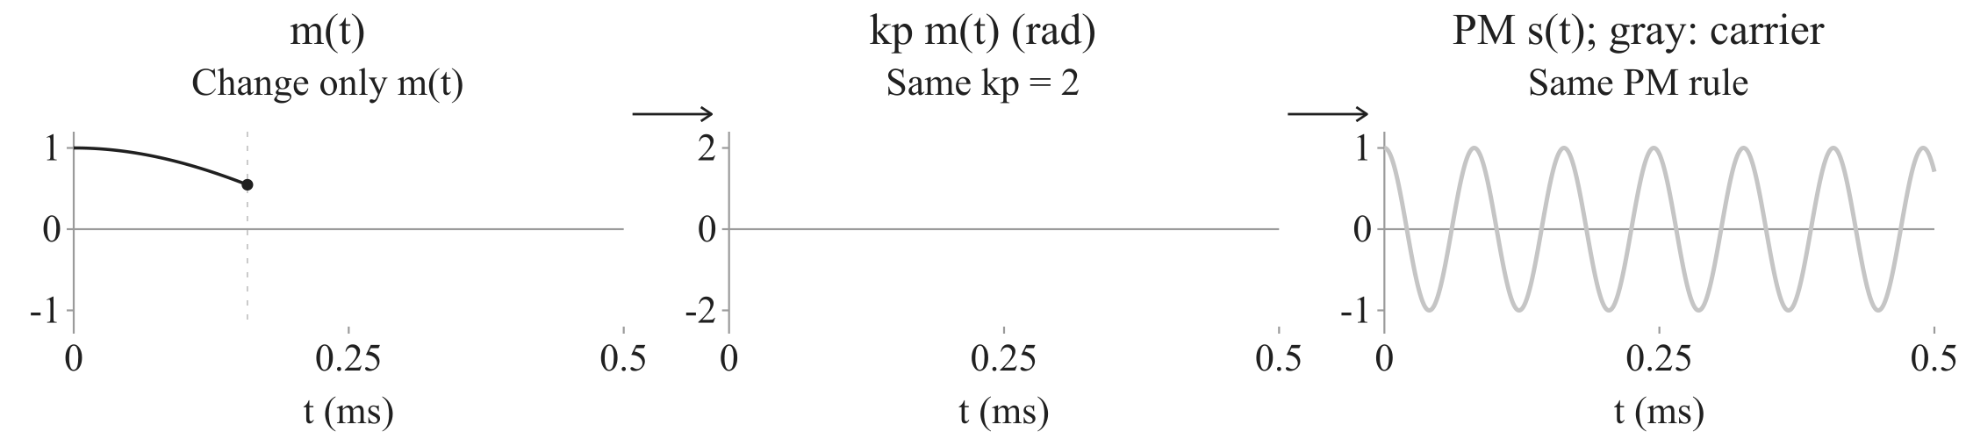
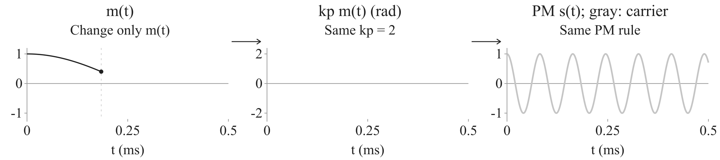




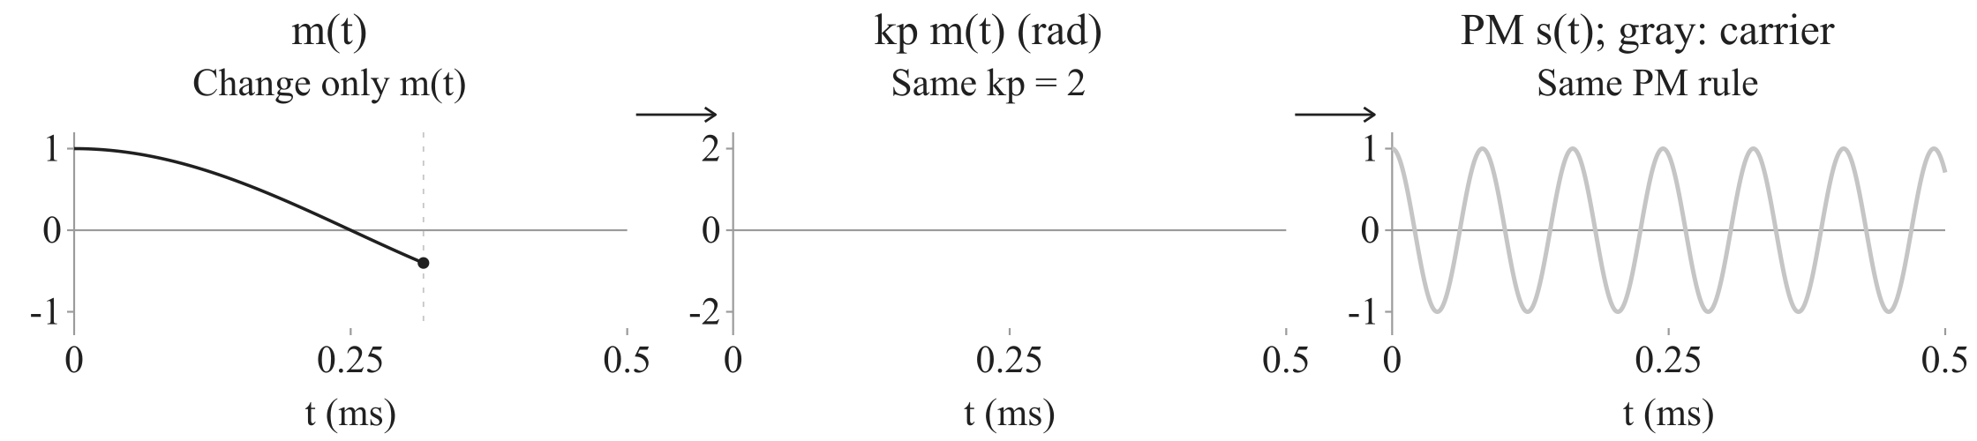



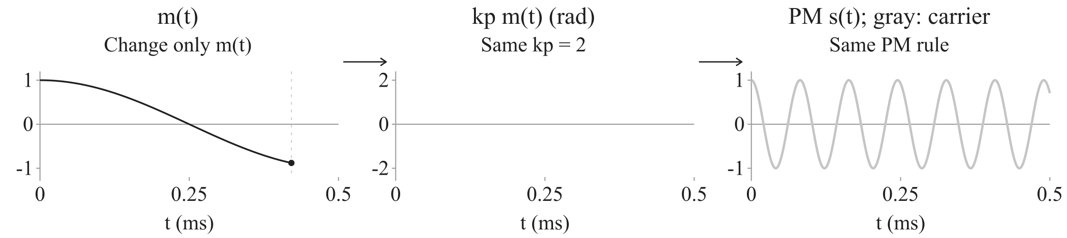
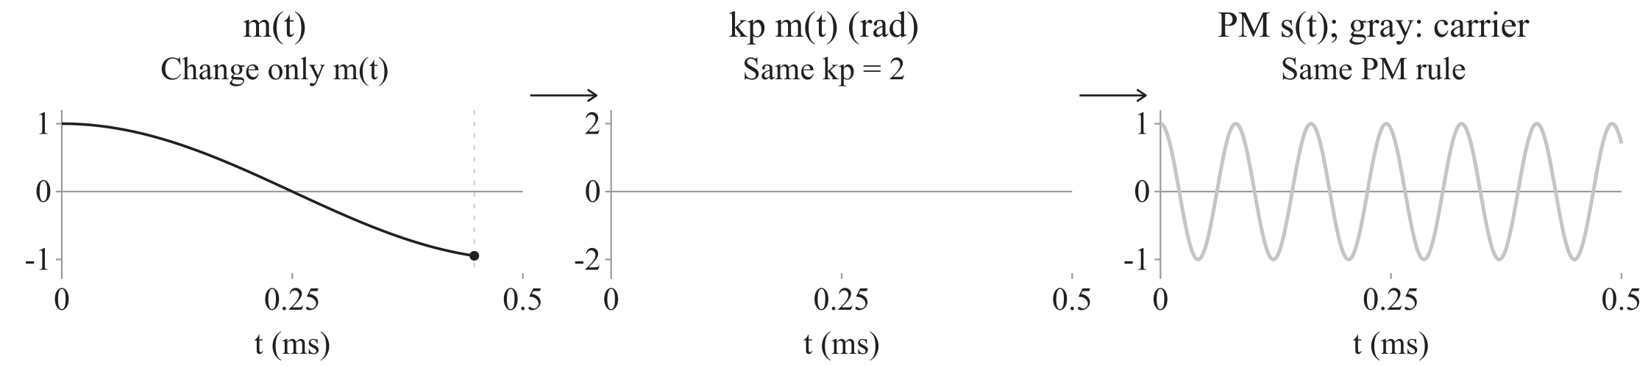
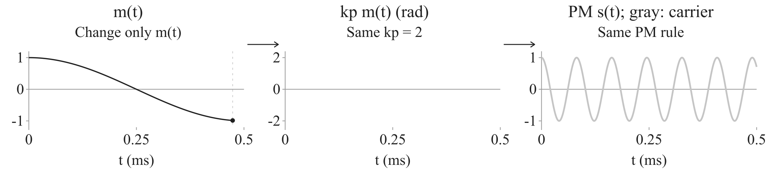

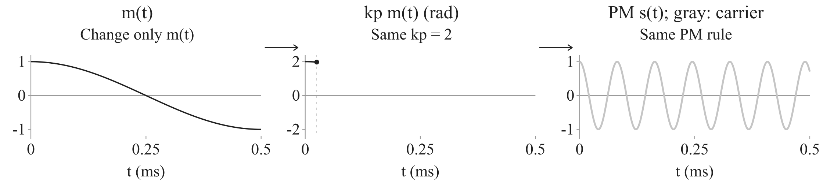
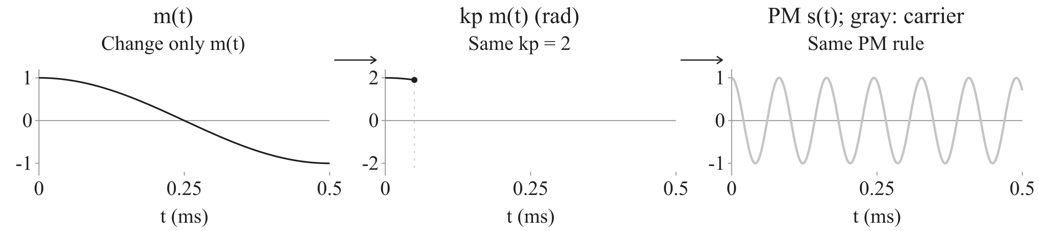
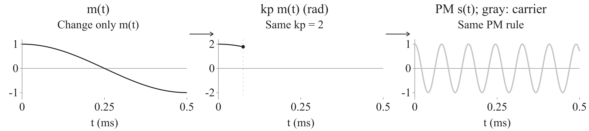

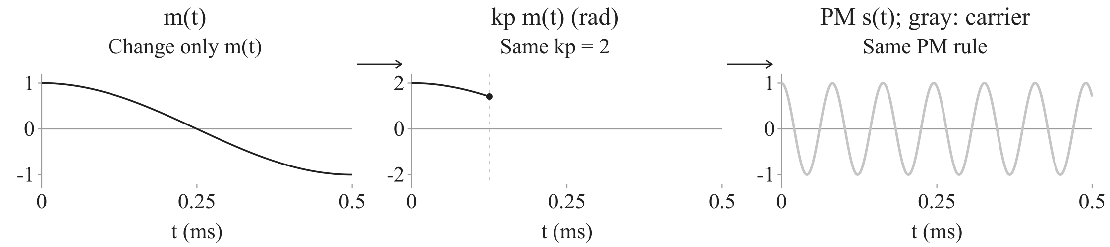

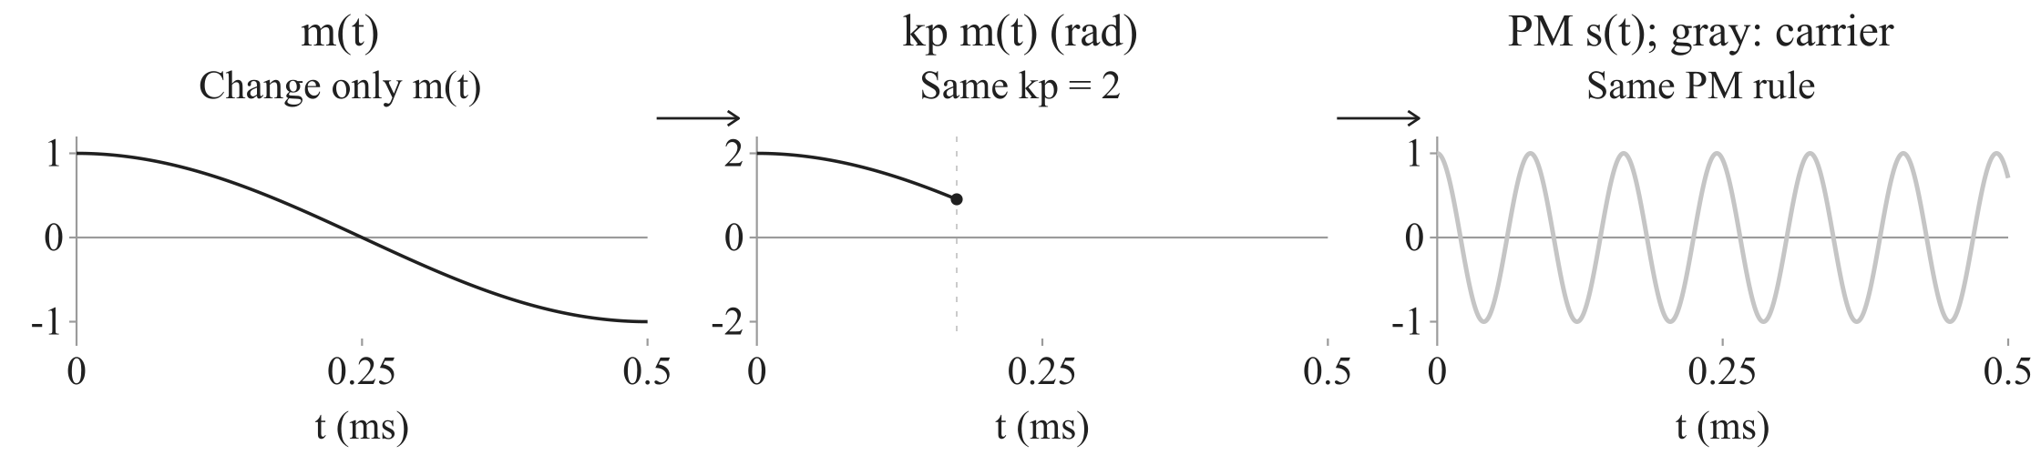


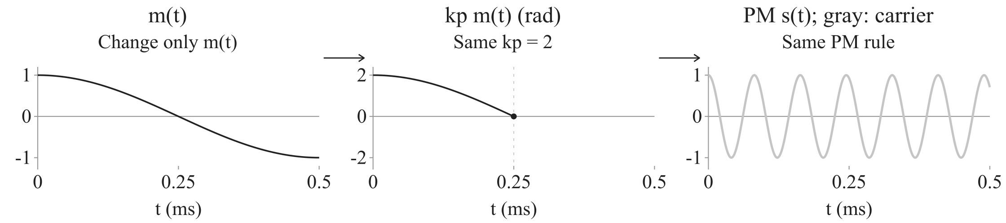





































PM
Modulation
Modulation
Demodulation
PM: add phase
Notes:
Continue the phase branch of the preceding overview. A constant message gives a constant added phase, so the carrier shifts horizontally without changing its frequency. kp is the phase sensitivity in radians per message unit. Source: Fall2026/Note6_PM_FM.pdf pp. 2-4. Numerical demonstrations are illustrations, not exercises. Unless labeled otherwise, Ac=Am=1, fc=12.25 kHz, fm=1 kHz, time in ms. Integration from zero fixes a reference phase; it is equivalent to the lecture convention up to that reference. The negative-frequency counterpart is included in spectra. Bandwidth BT refers to the width of one RF band, not the sum of both frequency halves.

Slide 8






















































FM
Modulation
Modulation
Demodulation
FM: change frequency
Notes:
FM puts the message in instantaneous frequency. Integrate fi to obtain total phase, substitute fc+kf*m, separate the constant carrier integral, evaluate it as fc*t, and keep the message integral. The initial phase is set to zero throughout. The same s expression is used on later pages. Source: Fall2026/Note6_PM_FM.pdf pp. 2-3,5-7. Numerical demonstrations are illustrations, not exercises. Unless labeled otherwise, Ac=Am=1, fc=12.25 kHz, fm=1 kHz, time in ms. Integration from zero fixes a reference phase; it is equivalent to the lecture convention up to that reference. The negative-frequency counterpart is included in spectra. Bandwidth BT refers to the width of one RF band, not the sum of both frequency halves.

Slide 9




PM and FM
Modulation
Modulation
Demodulation
FM implementation: integrate, then PM
FM modulator
Integrate
Scale
PM
Notes:
First compare the target FM signal with the PM expression written for a general input. Match their added phases: kp times the PM input must equal2pi kf integral(m). Divide by kp to derive the required input, then substitute it in the PM expression. Only after that calculation build the integrate, scale and PM diagram. The enclosing frame labels this combination as an FM modulator, not an equality of the two modulators under the same input. Assume nonzero kp. Source: Fall2026/Note6_PM_FM.pdf pp. 9. Numerical demonstrations are illustrations, not exercises. Unless labeled otherwise, Ac=Am=1, fc=12.25 kHz, fm=1 kHz, time in ms. Integration from zero fixes a reference phase; it is equivalent to the lecture convention up to that reference. The negative-frequency counterpart is included in spectra. Bandwidth BT refers to the width of one RF band, not the sum of both frequency halves.

Slide 10






FM
Modulation
Modulation
Demodulation
Same amplitude; triple the message frequency
Message
Added phase
Notes:
The integrator precedes the PM block. Compare equal-amplitude cosine messages at fm and3fm with the same kf. The left curves are the two messages; the right side explicitly calculates and plots their added phases2pi*kf*integral(m), with amplitudes kf/fm and kf/(3fm). Integrals are evaluated from zero. Extract the reciprocal-frequency rule only after both calculations. The next page varies the message frequency continuously to verify this same rule. Source: Fall2026/Note6_PM_FM.pdf pp. 10. Numerical demonstrations are illustrations, not exercises. Unless labeled otherwise, Ac=Am=1, fc=12.25 kHz, fm=1 kHz, time in ms. Integration from zero fixes a reference phase; it is equivalent to the lecture convention up to that reference. The negative-frequency counterpart is included in spectra. Bandwidth BT refers to the width of one RF band, not the sum of both frequency halves.

Slide 11




PM and FM
Modulation
Modulation
Demodulation
PM and FM keep the same amplitude
 | AM | PM | FM
Amplitude | Varies | Fixed | Fixed
Phase | Fixed carrier law | Message added | Message integrated
Notes:
Conclude generation by comparing the same message in AM, PM and FM. The input in the cosine changes timing, not envelope. PM/FM carrier-cycle average power is independent of m at fixed Ac, but instantaneous squared voltage need not be constant. This same nonlinear cosine dependence is why the next bandwidth analysis needs care. Source: Fall2026/Note6_PM_FM.pdf pp. 6-8. Numerical demonstrations are illustrations, not exercises. Unless labeled otherwise, Ac=Am=1, fc=12.25 kHz, fm=1 kHz, time in ms. Integration from zero fixes a reference phase; it is equivalent to the lecture convention up to that reference. The negative-frequency counterpart is included in spectra. Bandwidth BT refers to the width of one RF band, not the sum of both frequency halves.

Slide 12













PM
Bandwidth
Modulation
Demodulation
Bandwidth of s(t)
Assumption:
Multiply by sine
Given message spectrum
Carrier term
Notes:
Start the spectral analysis with a small added PM phase. Apply cosine addition and the small-angle approximation. It yields a carrier plus m times a sinusoid, whose known modulation property shifts M to+-fc. Condition is max|kp*m| much less than1, not small kp without an amplitude assumption. The width of each RF band is approximately2W. Source: Fall2026/Note6_PM_FM.pdf pp. 12-13. Numerical demonstrations are illustrations, not exercises. Unless labeled otherwise, Ac=Am=1, fc=12.25 kHz, fm=1 kHz, time in ms. Integration from zero fixes a reference phase; it is equivalent to the lecture convention up to that reference. The negative-frequency counterpart is included in spectra. Bandwidth BT refers to the width of one RF band, not the sum of both frequency halves.

Slide 13



PM
Bandwidth
Modulation
Demodulation
Bandwidth of s(t)
Keep the higher powers of m(t)
Notes:
Separate the known carrier from its phase factor using Euler identity, then expand that factor. The first-order approximation kept only1 and jkp*m. Higher terms contain products of the message. The next page substitutes this factor into s and takes the real part to identify the actual carrier, linear, quadratic and cubic signal terms before analyzing their frequencies. Source: Fall2026/Note6_PM_FM.pdf pp. 14-15. Numerical demonstrations are illustrations, not exercises. Unless labeled otherwise, Ac=Am=1, fc=12.25 kHz, fm=1 kHz, time in ms. Integration from zero fixes a reference phase; it is equivalent to the lecture convention up to that reference. The negative-frequency counterpart is included in spectra. Bandwidth BT refers to the width of one RF band, not the sum of both frequency halves.

Slide 14
PM
Bandwidth
Modulation
Demodulation
Bandwidth of s(t)
Higher-order terms in s(t)
Take the real part
Notes:
Substitute the known phase-factor series into s. Simplify powers of j, then take the real part. Keep the result grouped by carrier cosine and sine, with even and odd message powers inside their brackets. The sine bracket begins with negative kp*m and has a positive cubic term. Ellipses retain all higher powers. The following pages copy this same s and emphasize the term being studied rather than introducing separate terms-in-s formulas. Source: Fall2026/Note6_PM_FM.pdf pp. 14-15. Numerical demonstrations are illustrations, not exercises. Unless labeled otherwise, Ac=Am=1, fc=12.25 kHz, fm=1 kHz, time in ms. Integration from zero fixes a reference phase; it is equivalent to the lecture convention up to that reference. The negative-frequency counterpart is included in spectra. Bandwidth BT refers to the width of one RF band, not the sum of both frequency halves.

Slide 15








PM
Bandwidth
Modulation
Demodulation
Bandwidth of s(t)
Higher powers create farther sidebands
Frequencies in carrier products
Notes:
Higher powers create farther sidebands Source: Fall2026/Note6_PM_FM.pdf pp.14-15. Ideal reception and a fixed phase reference are assumed where applicable. Bandwidth counts one RF band. Numerical plots are illustrations.

Slide 16



PM
Bandwidth
Modulation
Demodulation
Bandwidth of s(t)
Add the signed signal terms
Spectrum of the sum so far
Through cubic order only
Notes:
Add the signed signal terms Source: Fall2026/Note6_PM_FM.pdf pp.14-15. Ideal reception and a fixed phase reference are assumed where applicable. Bandwidth counts one RF band. Numerical plots are illustrations.

Slide 17



















































PM
Bandwidth
Modulation
Demodulation
Bandwidth of s(t)
Increase kp
Notes:
The preceding pages established why a cosine message gives discrete components at fc+n*fm, and why higher powers add more frequencies. Now keep this message and carrier while increasing kp. Each line height is the magnitude of its cosine amplitude divided by2; changing kp changes the weights, not the spacing. This uses the exact signal. Shading indicates components whose cosine amplitudes exceed1% of Ac, not strict support. Source: Fall2026/Note6_PM_FM.pdf pp. 14-15. Numerical demonstrations are illustrations, not exercises. Unless labeled otherwise, Ac=Am=1, fc=12.25 kHz, fm=1 kHz, time in ms. Integration from zero fixes a reference phase; it is equivalent to the lecture convention up to that reference. The negative-frequency counterpart is included in spectra. Bandwidth BT refers to the width of one RF band, not the sum of both frequency halves.

Slide 18





































































PM
Bandwidth
Modulation
Demodulation
Bandwidth of s(t)
Multiplication adds frequency support
Notes:
Multiplication adds frequency support Source: Fall2026/Note6_PM_FM.pdf pp.14-15. Ideal reception and a fixed phase reference are assumed where applicable. Bandwidth counts one RF band. Numerical plots are illustrations.

Slide 19
PM
Bandwidth
Modulation
Demodulation
Bandwidth of s(t)
Higher-order terms widen the general-message spectrum
Continuous spectrum (ms)
Through cubic order; carrier weight 1/2
Notes:
Higher-order terms widen the general-message spectrum Source: Fall2026/Note6_PM_FM.pdf pp.14-15. Ideal reception and a fixed phase reference are assumed where applicable. Bandwidth counts one RF band. Numerical plots are illustrations.

Slide 20






FM
Bandwidth
Modulation
Demodulation
Bandwidth of s(t)
FM bandwidth: one cosine message
Notes:
After PM bandwidth, examine the FM signal already obtained. Use one cosine message to make the spectrum calculable. Substitution into the frequency rule defines Deltaf=kf*Am; integrating gives beta=Deltaf/fm, the added-phase amplitude. Keep this same s through all following FM spectrum pages. Source: Fall2026/Note6_PM_FM.pdf pp. 16-17. Numerical demonstrations are illustrations, not exercises. Unless labeled otherwise, Ac=Am=1, fc=12.25 kHz, fm=1 kHz, time in ms. Integration from zero fixes a reference phase; it is equivalent to the lecture convention up to that reference. The negative-frequency counterpart is included in spectra. Bandwidth BT refers to the width of one RF band, not the sum of both frequency halves.

Slide 21






FM
Bandwidth
Modulation
Demodulation
Bandwidth of s(t)
Small phase gives the nearest two sidebands
AM has the same first-order magnitudes
when the indices match.
Notes:
Small phase gives the nearest two sidebands Source: Fall2026/Note6_PM_FM.pdf pp.18-19. Ideal reception and a fixed phase reference are assumed where applicable. Bandwidth counts one RF band. Numerical plots are illustrations.

Slide 22











FM
Bandwidth
Modulation
Demodulation
Bandwidth of s(t)
The frequency components of the same s(t)
Known carrier.
Expand the other factor.
Periodicity
Notes:
To find the frequency components of the same FM signal, separate the known carrier exponential from the remaining factor. The symbol s-tilde names that factor, not another transmitted signal. It is periodic with Tm=1/fm, so a Fourier series expresses it using frequencies n*fm. The dots show only possible positions, not calculated spectral weights. Keep the definition and expansion as the two key equations; calculate their coefficients next. Source: Fall2026/Note6_PM_FM.pdf pp. 20-21. Numerical demonstrations are illustrations, not exercises. Unless labeled otherwise, Ac=Am=1, fc=12.25 kHz, fm=1 kHz, time in ms. Integration from zero fixes a reference phase; it is equivalent to the lecture convention up to that reference. The negative-frequency counterpart is included in spectra. Bandwidth BT refers to the width of one RF band, not the sum of both frequency halves.

Slide 23











FM
Bandwidth
Modulation
Demodulation
Bandwidth of s(t)
Calculate the Fourier coefficients
Odd function: areas cancel
Notes:
The first two rows retain the definition and Fourier series of the preceding periodic factor. The standard Fourier coefficient formula removes exp(j2pi n fm t) and averages over one period. Substitute the known factor before combining its exponents. For x=2pi fm t, change the differential and both bounds explicitly, then use fm*Tm=1 to simplify the prefactor. Expand the exponential into cosine plus j*sine. The sine is odd, so its integral over symmetric limits is zero; the coefficient is real. The next page names the resulting integral and returns it to the transmitted s. Source: Fall2026/Note6_PM_FM.pdf pp. 20-21. Numerical demonstrations are illustrations, not exercises. Unless labeled otherwise, Ac=Am=1, fc=12.25 kHz, fm=1 kHz, time in ms. Integration from zero fixes a reference phase; it is equivalent to the lecture convention up to that reference. The negative-frequency counterpart is included in spectra. Bandwidth BT refers to the width of one RF band, not the sum of both frequency halves.

Slide 24












FM
Bandwidth
Modulation
Demodulation
Bandwidth of s(t)
Coefficients determine the spectral lines
Increase beta: more sidebands become significant
n | Frequency (kHz) | c_n | Magnitude
0 | +/-12.25 | 0.765 | 0.383
-1 | +/-11.25 | -0.440 | 0.220
1 | +/-13.25 | 0.440 | 0.220
Notes:
Coefficients determine the spectral lines Source: Fall2026/Note6_PM_FM.pdf pp.21-23. Ideal reception and a fixed phase reference are assumed where applicable. Bandwidth counts one RF band. Numerical plots are illustrations.

Slide 25



PM and FM
Bandwidth
Modulation
Demodulation
Bandwidth of s(t)
Use the known FM expansion for PM
Notes:
For the same cosine message m=Am cos(2pi fm t), retain both the original and expanded FM signal. PM has beta_p=kp Am multiplying cosine, while FM has beta=kf Am/fm multiplying sine. Rewrite cosine as sin(x+pi/2), then apply exactly the known FM expansion with the shifted argument. Every PM component acquires phase n*pi/2. At equal beta_p and beta the two signals therefore have the same component magnitudes, for either small or large indices. The equal-magnitude claim uses the separated carrier/tone bands shown in the example. This single-tone comparison does not supply an exact finite bandwidth for a general message. Source: Fall2026/Note6_PM_FM.pdf pp. 4,17-21. Numerical demonstrations are illustrations, not exercises. Unless labeled otherwise, Ac=Am=1, fc=12.25 kHz, fm=1 kHz, time in ms. Integration from zero fixes a reference phase; it is equivalent to the lecture convention up to that reference. The negative-frequency counterpart is included in spectra. Bandwidth BT refers to the width of one RF band, not the sum of both frequency halves.

Slide 26



FM
Bandwidth
Modulation
Demodulation
Bandwidth of s(t)
Instantaneous frequency and spectral components
Frequency at each instant
Frequencies that compose the same s(t)
Still nonzero
Notes:
The FM definition fi=fc+kf*m specifies the instantaneous oscillation frequency. Its range and the Fourier components of s describe different properties of the same signal. The right graph is S, not the transform of fi. Example: fm=1kHz, beta=5, Deltaf=5kHz, fc=12.25kHz. Even the component at fc+6kHz is nonzero. Transmission bandwidth must retain significant components of S; twice the excursion is not an exact spectral support bound. Carson rule estimates an occupied band. Source: Fall2026/Note6_PM_FM.pdf pp. 11,20-23. Numerical demonstrations are illustrations, not exercises. Unless labeled otherwise, Ac=Am=1, fc=12.25 kHz, fm=1 kHz, time in ms. Integration from zero fixes a reference phase; it is equivalent to the lecture convention up to that reference. The negative-frequency counterpart is included in spectra. Bandwidth BT refers to the width of one RF band, not the sum of both frequency halves.

Slide 27



FM
Bandwidth
Modulation
Demodulation
Bandwidth of s(t)
Estimate the band containing significant components
Notes:
Estimate the band containing significant components Source: Fall2026/Note6_PM_FM.pdf pp.23-24. Ideal reception and a fixed phase reference are assumed where applicable. Bandwidth counts one RF band. Numerical plots are illustrations.

Slide 28



FM
Demodulation
Modulation
Demodulation
Frequency changes become amplitude changes
Differentiate
Take envelope
Remove DC + scale
Notes:
Under ideal reception r=s, the cosine chain rule multiplies sin(theta) by theta prime. The known FM law gives theta prime=2pi(fc+kf m), so the derivative has an amplitude containing the message. The graph shows the actual derivative with respect to seconds, while time on the horizontal axis is in milliseconds. No plotting normalization is applied. Ac=1, fm=1kHz, fc=12.25kHz, beta=5 and kf=5kHz per message unit. Source: Fall2026/Note6_PM_FM.pdf pp. 25. Numerical demonstrations are illustrations, not exercises. Unless labeled otherwise, Ac=Am=1, fc=12.25 kHz, fm=1 kHz, time in ms. Integration from zero fixes a reference phase; it is equivalent to the lecture convention up to that reference. The negative-frequency counterpart is included in spectra. Bandwidth BT refers to the width of one RF band, not the sum of both frequency halves.

Slide 29





FM
Demodulation
Modulation
Demodulation
Envelope detection and message recovery
Assume a slow envelope
Notes:
Continue the differentiated FM signal. Ideal envelope detection reads the positive coefficient E=2pi Ac(fc+kf*m). Assume Ac>0, fc>Deltaf, known nonzero kf, and an envelope slow relative to carrier oscillation. Retain E while removing its known baseline and gain in one affine operation. The three plots keep the differentiated signal, its envelope and the recovered message in fixed positions. The first animation reads E; the second fills only the final output. Graphs use Ac=1, fc=12.25kHz, fm=1kHz, kf=5kHz/unit, physical derivatives with respect to seconds, and time axes in milliseconds. Source: Fall2026/Note6_PM_FM.pdf pp. 25. Numerical demonstrations are illustrations, not exercises. Unless labeled otherwise, Ac=Am=1, fc=12.25 kHz, fm=1 kHz, time in ms. Integration from zero fixes a reference phase; it is equivalent to the lecture convention up to that reference. The negative-frequency counterpart is included in spectra. Bandwidth BT refers to the width of one RF band, not the sum of both frequency halves.

Slide 30




PM
Demodulation (supplement)
Modulation
Demodulation
PM: frequency readout + integration
Frequency readout
Differentiate + envelope
or
Integrate + scale
Add known initial value
Notes:
The calibrated frequency reader uses differentiation and envelope detection to obtain E=2pi Ac fi under the previously stated positive-frequency and slow-envelope assumptions. Subtracting fc from E/(2pi Ac) reads fi-fc for either an FM input or a PM input, considered separately. FM therefore produces kf*m, while PM produces kp*m prime/(2pi). Integration and a known m(0) recover PM. A frequency-only reader loses the unknown constant component, so the known initial value is essential. Source: Fall2026/Note6_PM_FM.pdf pp. 4,9,25-27. Numerical demonstrations are illustrations, not exercises. Unless labeled otherwise, Ac=Am=1, fc=12.25 kHz, fm=1 kHz, time in ms. Integration from zero fixes a reference phase; it is equivalent to the lecture convention up to that reference. The negative-frequency counterpart is included in spectra. Bandwidth BT refers to the width of one RF band, not the sum of both frequency halves.

Slide 31



FM
Demodulation
Modulation
Demodulation
Receiver noise: effect of differentiation
1 kHz
Differentiate
3 kHz
Differentiate
Notes:
Inspect the same differentiation block, not a new transmitter. Apply the already used cosine chain rule to a single unit-amplitude component. Read its derivative amplitude2pi|f| before drawing either output. Then compare equal input amplitudes at1 and3kHz, using one fixed output divisor2pi times1kHz, and evaluate the displayed amplitudes1 and3 only after both graph actions. The higher-frequency component is amplified more, explaining why this receiver operation can emphasize high-frequency noise. Both horizontal axes remain time. Source: Fall2026/Note6_PM_FM.pdf pp. 26. Numerical demonstrations are illustrations, not exercises. Unless labeled otherwise, Ac=Am=1, fc=12.25 kHz, fm=1 kHz, time in ms. Integration from zero fixes a reference phase; it is equivalent to the lecture convention up to that reference. The negative-frequency counterpart is included in spectra. Bandwidth BT refers to the width of one RF band, not the sum of both frequency halves.

Slide 32






FM
Demodulation
Modulation
Demodulation
PLL: adjust a local cosine to follow s(t)
Compare phase
Smooth error
Adjust local frequency
(VCO)
Input s(t)
Local cosine
Local ahead
Local cosine
Slow down
Local behind
Speed up
Notes:
A phase-locked loop adjusts a local cosine to follow the received FM signal. Near tracking, an ahead local oscillator receives a slowing correction, and a behind oscillator receives a speeding correction. Phase comparison, the loop filter and the adjustable oscillator form the feedback loop. The message is recovered from control u, not the oscillator cosine. The VCO frequency law fVCO=fc+kv*u and the input law fi=fc+kf*m give m hat=(kv/kf)u approximately equal to m during tracking. The example uses Ac=1, fm=1kHz, fc=12.25kHz, kf=5kHz/unit, kv=20kHz/unit, initial local phase0.7rad and zero initial control. The plotted recovered message is4u. The initial free-running comparison is illustrative, not the later closed-loop trajectory. The feedback direction applies locally in the normal tracking range, not as a global acquisition or stability proof. Source: Fall2026/Note6_PM_FM.pdf pp. 27. Numerical demonstrations are illustrations, not exercises. Unless labeled otherwise, Ac=Am=1, fc=12.25 kHz, fm=1 kHz, time in ms. Integration from zero fixes a reference phase; it is equivalent to the lecture convention up to that reference. The negative-frequency counterpart is included in spectra. Bandwidth BT refers to the width of one RF band, not the sum of both frequency halves.

Slide 33


FM
Demodulation
Modulation
Demodulation
Amplitude changes, frequency stays
Amplitude distortion only; not arbitrary additive noise
Notes:
Start from the same s and change only its positive amplitude to obtain r. Positivity means r is zero exactly when the same cosine is zero: this amplitude change cannot move or add zero crossings. The phase and therefore the familiar instantaneous frequency law are unchanged. Substitute that law into the already derived ideal frequency readout, visibly cancel the carrier, then cancel kf to recover m. Only then reveal and play the amplitude-distortion example, whose first frame already includes the reference message. This argument concerns ideal phase/frequency readout, not an unmodified differentiator/envelope receiver with time-varying amplitude: differentiating r also produces A prime cos(theta). It is not immunity to arbitrary additive noise. Finally recall the separate lecture result: above threshold, increasing deviation can improve noise performance at the cost of bandwidth; the amplitude-only demonstration is not its proof. Source: Fall2026/Note6_PM_FM.pdf pp. 7,28. Numerical demonstrations are illustrations, not exercises. Unless labeled otherwise, Ac=Am=1, fc=12.25 kHz, fm=1 kHz, time in ms. Integration from zero fixes a reference phase; it is equivalent to the lecture convention up to that reference. The negative-frequency counterpart is included in spectra. Bandwidth BT refers to the width of one RF band, not the sum of both frequency halves.

Slide 34



PM and FM
Recap
 | PM | FM
Generate
Single tone small phase
Single tone larger phase
General message
Recover
Read frequency, then integrate
Known m(0)
Differentiate + envelope
or PLL
Notes:
Use matched conditions for both methods. For one cosine message define beta_p=kp Am and beta=kf Am/fm. Both small-index first-order spectra have bandwidth about2fm. For either method at larger single-tone indices, significant sidebands give the same Carson estimate2fm(index+1); exact spectral tails remain. For a general message small added phase gives approximately2W for either method, provided the FM phase integral/DC reference is handled. General FM Carson bandwidth is2(Deltaf+W); general PM is not always2W and its higher powers widen the spectrum. General PM uses the same Carson estimate 2(Deltaf+W), with Deltaf defined as its own peak instantaneous-frequency deviation. Receiver statements assume the prior ideal conditions; frequency-only PM recovery needs known m(0). Source: Fall2026/Note6_PM_FM.pdf pp. 4-5,12-24,25-28. Numerical demonstrations are illustrations, not exercises. Unless labeled otherwise, Ac=Am=1, fc=12.25 kHz, fm=1 kHz, time in ms. Integration from zero fixes a reference phase; it is equivalent to the lecture convention up to that reference. The negative-frequency counterpart is included in spectra. Bandwidth BT refers to the width of one RF band, not the sum of both frequency halves.
Carson bandwidth is an occupied-band estimate, not exact spectral support. For PM, Deltaf=|kp| max|m'(t)|/(2pi); for FM, Deltaf=|kf| max|m(t)|. The form is the same, but the deviations generally differ.

Slide 35
End of Tutorial 4
Questions?
For the animated slides, please email
runbang@link.cuhk.edu.hk
Notes:
For the animated PowerPoint slides, email runbang@link.cuhk.edu.hk.

