Slide 1



Analyzing Agricultural Productivity Across Indian States using Power BI

Slide 2

Learning Objectives
Examine agricultural patterns across Indian states using real-world data
Investigate the impact of rainfall,fertilizers,and pesticide usage on crop yields
Create interactive Power BI dashboards for insightful data storytelling
Evaluate agricultural output by year and crop type
GOAL
Source :
www.freepik.com/

Slide 3
Tools and Technology used
Microsoft Excel (for initial data review)
Power BI Desktop
Slicers, Filters, Visual-level Interactions in Power BI
GitHub (for version control and submission)

Slide 4
Methodology
Gathered and preprocessed agricultural datasets (including area, yield, production, etc.)
Built dynamic dashboards in Power BI for data exploration
Represented key trends through maps, KPIs, bar charts, and line graphs
Implemented slicers to filter data by year, state, and crop
Investigated relationships between crop yield and the use of fertilizers and pesticides

Slide 5
Problem Statement:
India's agriculture plays a vital role in the nation's GDP and employment, but productivity levels differ greatly by state and crop. Leveraging data-driven analysis is essential to uncover these disparities and support better decision-making.

Slide 6
Solution:
Created an interactive Power BI dashboard to explore crop productivity in relation to rainfall, fertilizer, and
pesticide usage across different Indian states and years. The dashboard showcases high-performing crops
and regions, visualizes temporal trends, and reveals patterns between agricultural inputs and outputs.

Slide 7
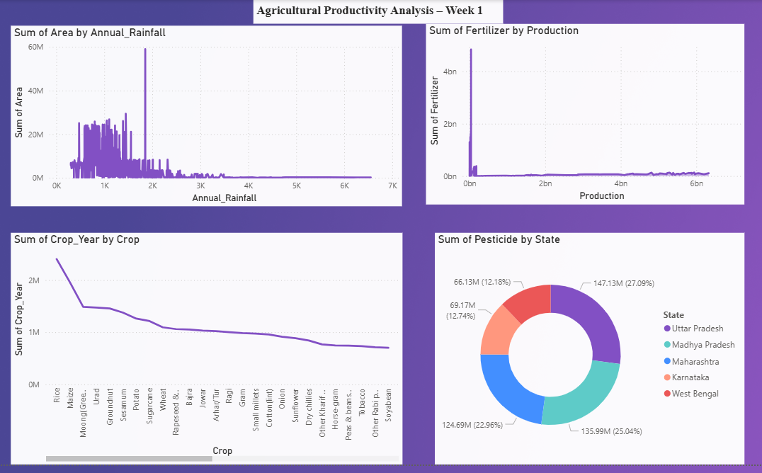
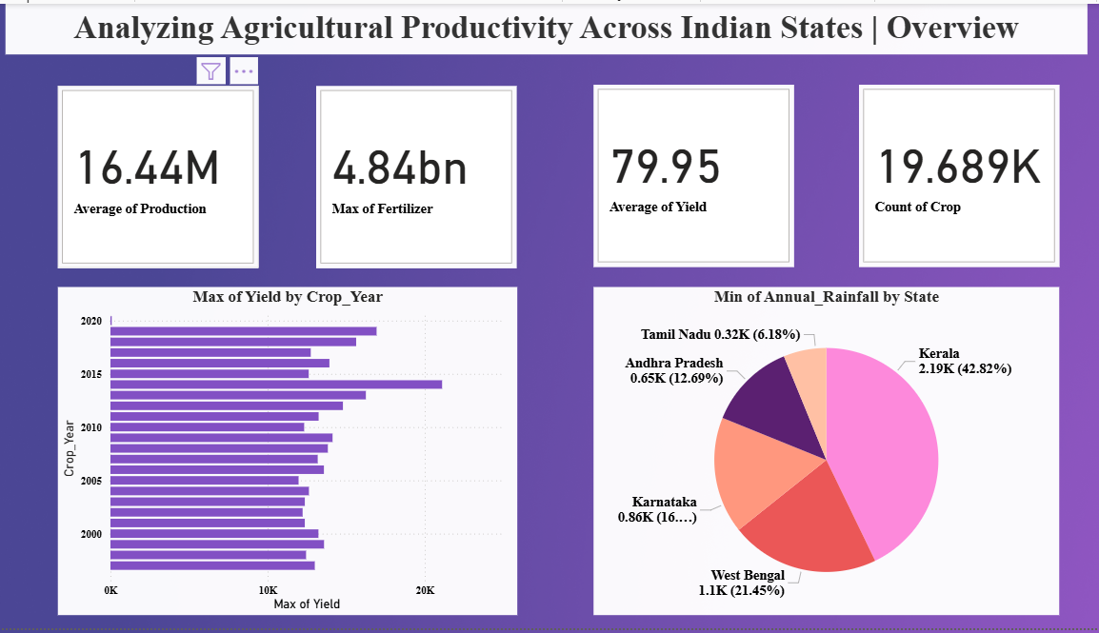
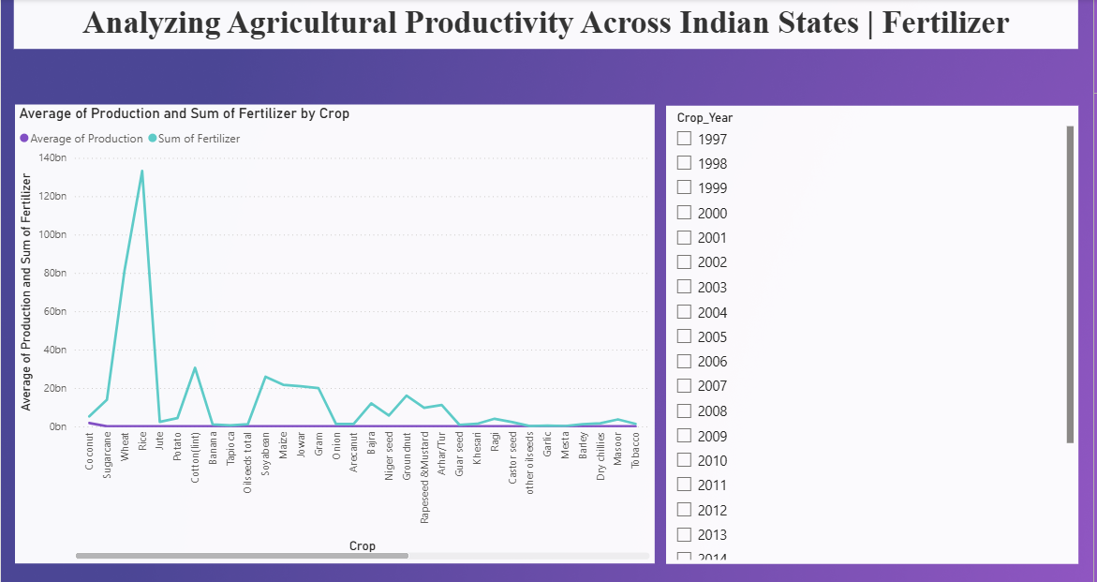
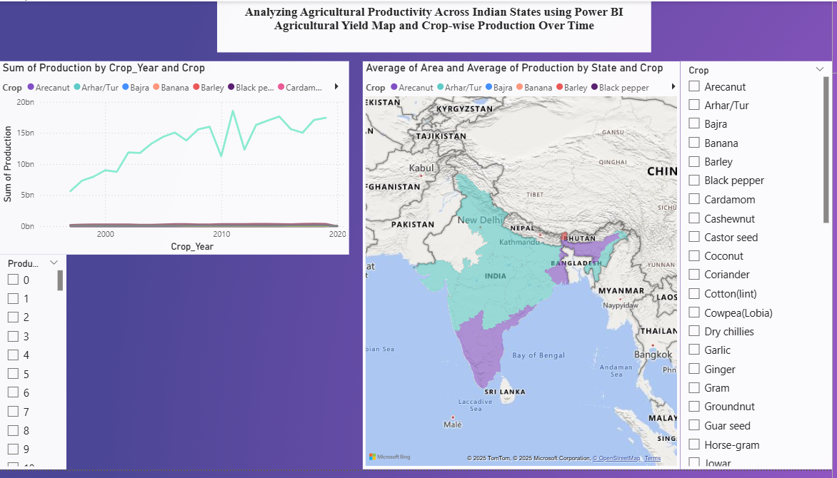
Screenshot of Output:

Slide 8
Conclusion:
Derived valuable insights on the influence of various factors on crop productivity
Recognized high-yielding crops and leading states based on production metrics
Designed interactive dashboards offering instant, state-wise agricultural overviews
Developed solid foundational expertise in Power BI, data analysis, and visualization

