Slide 1

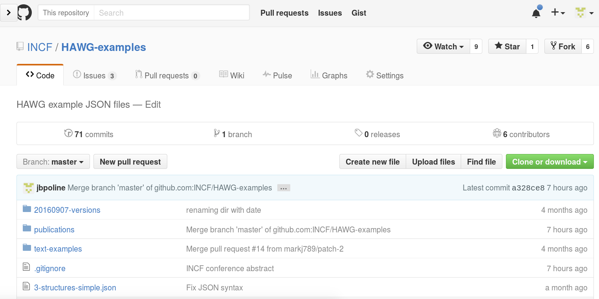
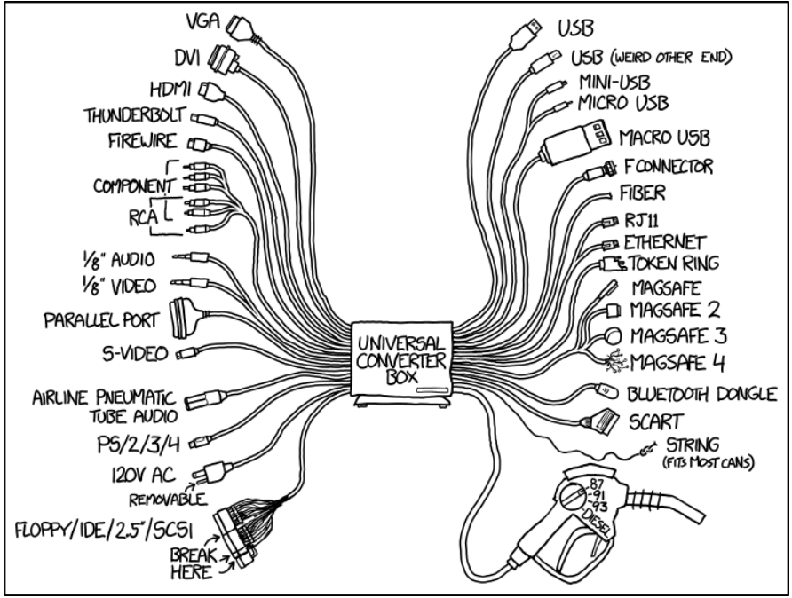
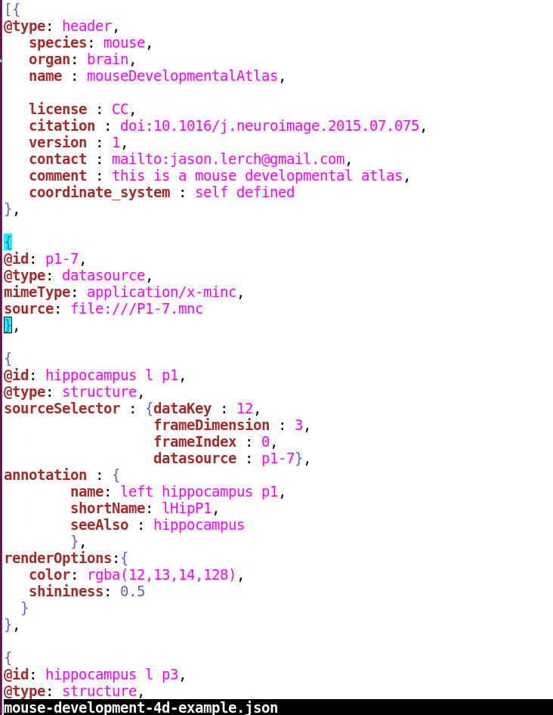
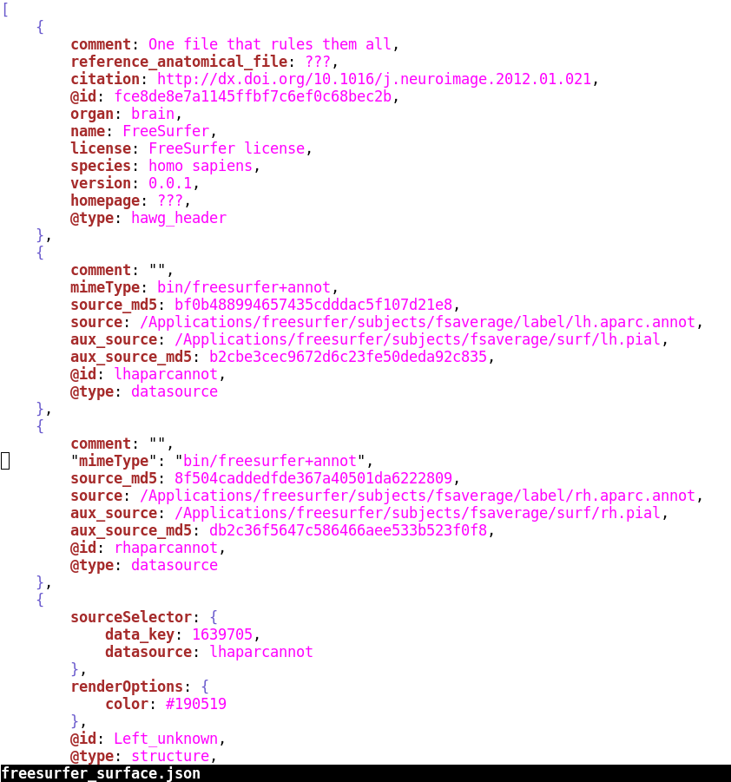
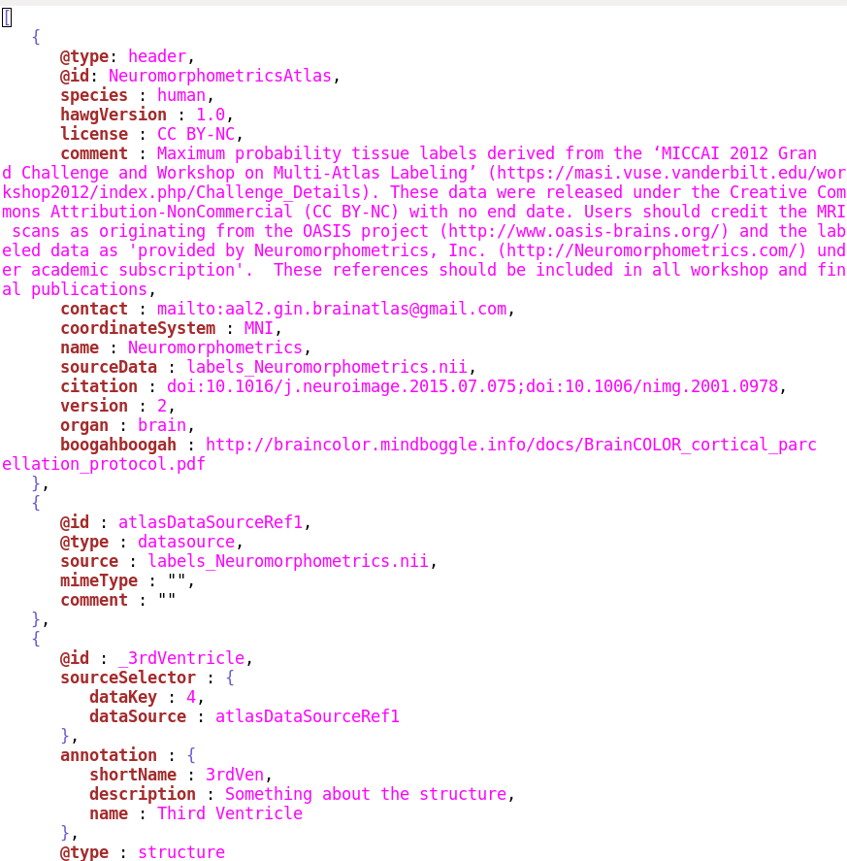
Standardizing neuroimaging atlases formats
Jean-Baptiste Poline¹, Jason Bohland², Alan Evans³, David Feng⁴, Valentin Demeusy¹⁵, Guillaume Flandin⁵, Vladimir Fonov⁶,
Satra Ghosh⁷, David Glen¹⁶, Michael Halle¹⁵, Andrew Janke⁸, Mark Jenkinson⁹, David Kennedy¹⁰, Jason Lerch¹¹, Lydia Ng⁴,
Richard Reunolds¹⁶, Jason Tourville¹², Robert Vincent³, Lilla Zollei¹⁴
1. University of California, Berkeley, Berkeley, CA 2. Department of Health Sciences, Boston University, Boston, MA 3. McGill Centre for Integrative Neuroscience, Montreal Neurological Institute, McGill University, Montreal, QC, Canada 4. Allen Institute for Brain Science, Seattle, WA, 5. Wellcome Trust Centre for Neuroimaging, London, UK 6. Montreal Neurological Institute, McGill University, Montreal, Quebec, 7. MIT, Cambridge, United States, 8. Centre for Advanced Imaging, University of Queensland, Brisbane, Australia, 9. Oxford University, Oxford, United Kingdom, 10. Univ. of Massachusetts Medical School, Worcester, MA, USA 11. Univ. of Toronto/Hospital for Sick Children, Toronto, Ontario 12. Department of Speech, Language, & Hearing Sciences, Boston University, Boston, MA 14. Massachusetts General Hospital, Boston, USA 15. Harvard Medical School, United States. 16. National Institute of Health, Bethesda, USA.
Acknowledgments: We would like to acknowledge the work of all the INCF Neuroimaging Data Sharing (NIDASH) task force members as well as of many other colleagues who have helped the task force projects. We are particularly indebted to Mathew Abrams, Linda Lanyon and all the INCF staff for their efficient support.
Motivation and goal
What did we do
* We (almost) all use brain atlases.
* There are many atlases: AAL, Harvard-Oxford, FreeSurfer labels, JuBrain Cytoarchitectonic atlas, etc.
* This number is growing, and atlases represent more and more diverse information, for example:
- anatomical-T1/diffusion,
- functional-Bold/connectivity,
- genetic (eg Allen-brain), and many more.
* We often need to investigate the correspondence between several atlases
* However, the meta data of atlases are formated in many ways. Format are associated with specific tools.
* Contacted many laboratories with experience and interest in the development of formats and atlases under the auspices of the International Neuroinformatics Coordinating Facility (INCF)
* Met twice in person (MNI, Montreal, MIT, Boston) and (mostly) agreed on the scope and ambition of the project, and some first specifications
* Used
Collaborative
Research tools
- Github / Git
- Google docs
Conclusion:
To be efficient, avoid errors, and facilitate conceptualization of the field, we need a common format and some reference implementation for common software.
HO
FreeSurfer
AAL
Allen Brain
What we have now :
Neuromorphic
Great future atlas
MNI
Connectivity atlases: As many as there are interpretations of the brain networks times the number of parcellations times the number of laboratories
Pediatric
* Design decisions:
- json file on the top of backend image format [is not specified – but nifti recommended]
- tags rather than hierachical structure
- extensible
* A first specification : github.com/INCF/HAWG-examples
* Five examples of implementation of the standard: Freesurfer, AAL, HO, Mouse and Mouse-development atlases, Neuromorphics.
* Github repository for issues, proposals, branches and implementation
* First validation tools github.com/stity/atlas-schema
Atlas version 3.14
pygmy marmoset
Neanderthal
Atlas of 3 boys 7.77-year old with no compulsive desire for chocolate
HAWG
Atlas version exp.
Simplest Atlas
ever
Who knows what this one is ?
Big brain inflammable atlas
Problems to be solved
* Problem #1: Motivation. This is not a priority in most laboratories. Priority is put on novel publishable studies, optimizing research output at the level of the researcher or the lab, not making research efficient across the brain imaging community.
* Problem #2: Sociological. creating a new format is hard: it requires to bring in the same room a number of researchers with different use cases, background and perspectives. Often, had hoc solutions have been developed locally, time has been invested and are hard to give up.
* Problem #3: Scope definition. The scope of such a standardization can vary greatly given the numerous modalities, species, dimensions (including temporal, cohorts, etc)
* Problem #4: Technical. Once problems 1-3 are resolved, the technical difficulties have to be tackled.
* Problem #5. There are interactions between problems 1-4.
Conclusions and future work
* A truly collaborative work made possible by the INCF
* Implementation in progress or envisaged in the most used brain imaging tools: SPM, FSL, AFNI, FreeSurfer, Montreal Neurological Institute tools, Allen Brain Atlas tools, and many others.
* This project taught us about the:
- difficulty of the establishment of standards despite their importance
- importance of an appropriate procedure for their establishment
- importance of a parent – non competing - organization as INCF
References
[1] AC Evans, AL Janke, DL Collins, S Baillet, “Brain templates and atlases”, Neuroimage, 2012. [2] http://fsl.fmrib.ox.ac.uk/fsl/fslwiki/Atlases.
[3] https://en.wikibooks.org/wiki/SPM/Atlases.
[4] JT Devlin, RA Poldrack, “In praise of tedious anatomy”, Neuroimage, 2006.
[5] Amunts, K., Hawrylycz, M.J., Van Essen, D.C. et al. Interoperable atlases of the human brain. Neuroimage 99, 525–532, 2014.
[6] JW Bohland, H Bokil, CB Allen, PP Mitra, “The Brain Atlas Concordance Problem: Quantitative Comparison of Anatomical Parcellations”, PLOS ONE, 2009.
[7] J.B. Poline, J. Breeze, S. Ghosh, et al., Frontiers in Neuroinformatics 2012.

