Slide 2
LA Animal Services Intake Information
Target: Shelter officers, People who want to adopt a pet, Pet owner with a missing pet
Aim: Users can investigate the trend and relationship of intake animals adopted by LA shelters, look for a lost pet

Slide 3
User Centered Design

Slide 4
Plan
User Activities
Track #animals adopted by each shelter
Investigate the general trend of intake animals
Look for taxonomy of intake animals adopted by each shelter
Uncover seasonal patterns of intake animals

Slide 5
Plan
Resource:
LA Animal Services Intake: https://data.lacity.org/A-Well-Run-City/Animal-Services-Intake-Data/8cmr-fbcu.
Data from Jan 2011 - Dec 2013
Shelter | Animal ID# | Intake Date | Intake Type | Intake Condition | Animal Type | Group | Breed 1 | Breed 2
W VALLEY | A0041356 | 11/11/2011 | OWNER SUR | DEAD | DOG | MASTIFF | AMERICAN STAFF | MIX
N CENTRA | A0163185 | 8/7/2011 | OWNER SUR | ALIVE | DOG | SPITZ | CHOW CHOW
E VALLEY | A0163432 | 12/18/2011 | OWNER SUR | DEAD | DOG |  | TERRIER X | MIX
S LA | A0164458 | 1/6/2013 | OWNER SUR | DEAD | DOG | MASTIFF | AMERICAN STAFF | MIX
W LA | A0166070 | 9/3/2011 | OWNER SUR | DEAD | DOG | SPITZ | AKITA | MIX

Slide 6
Plan
Shelter
ANNEX
E VALLEY
HARBOR
N CENTRA
N EAST
S LA
W LA
W VALLEY
Intake Type
ACTF
DISASTER
EVIDENCE
OWNER SUR
PERS PROP
POS OWNER
STRAY
WILDLIFE
Intake Condition
ALIVE
DEAD
LITTER
Animal Type
BIRD
CAT
DOG
EQUINE
LIVESTOCK
OTHER

Slide 7
Plan
Geographic data(Lat,Long): GoogleMaps

Slide 8
Research
Shelter officers: manage resource of shelters and investigate a trend
Pet owner: find a potential shelter to adopt a particular type of animal

Slide 9
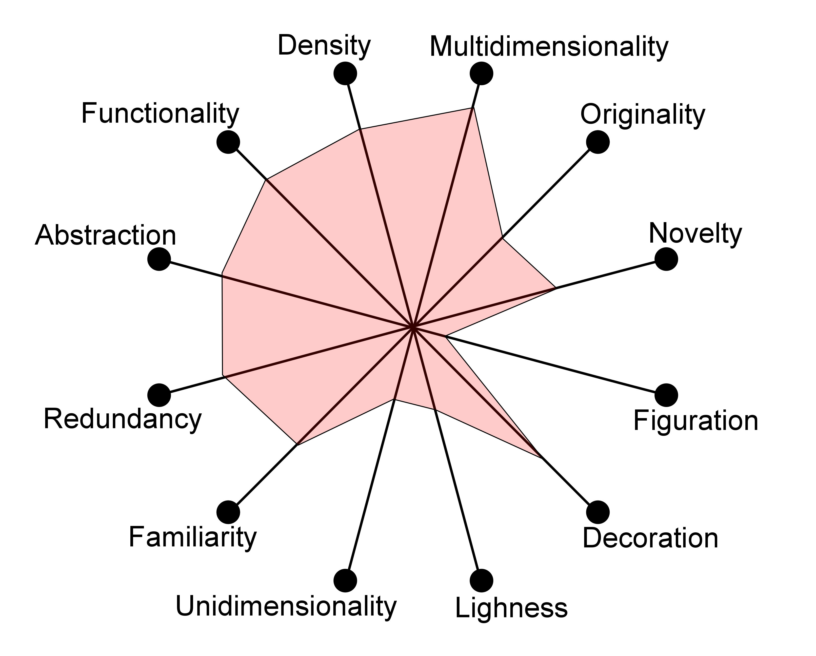
Design

