Slide 1


My Hero Academia by Kohei Horikoshi
Book Talk by Rachel Bennett
Notes:
Hi my name is Rachel Bennett and for my graphic novel booktalk I decided to do My Hero Academia by Kohei Horikoshi.

Slide 2
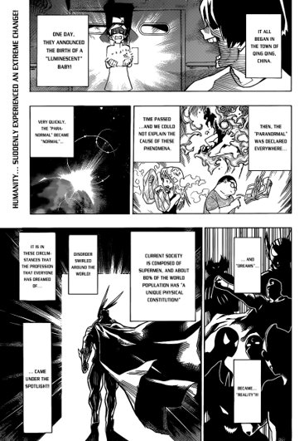
My Hero Academia is a Japanese superhero manga series written and illustrated by Kōhei Horikoshi. The story follows Izuku Midoriya, a boy born without superpowers in a world where they have become commonplace, but who still dreams of becoming a superhero himself.
  Wikipedia
Notes:
My Hero Academia is a Japanese manga, which can be read in english, and can be considered a graphic novel. Because of its origin, My Hero Academia and other mangas are read right to left instead of left to right.

Slide 3
If You Like This...
My Hero Academia: Smash!!
My Hero Academia: Vigilantes
Notes:
My Hero Academia can be for all ages but is generally set in a high school setting so will probably appeal most to high school age students. Readers who enjoy My Hero Academia may also like any of the spinoff series, such as Smash or Vigilantes. This series also has an anime tv show, movies, and games to enjoy.

Slide 4
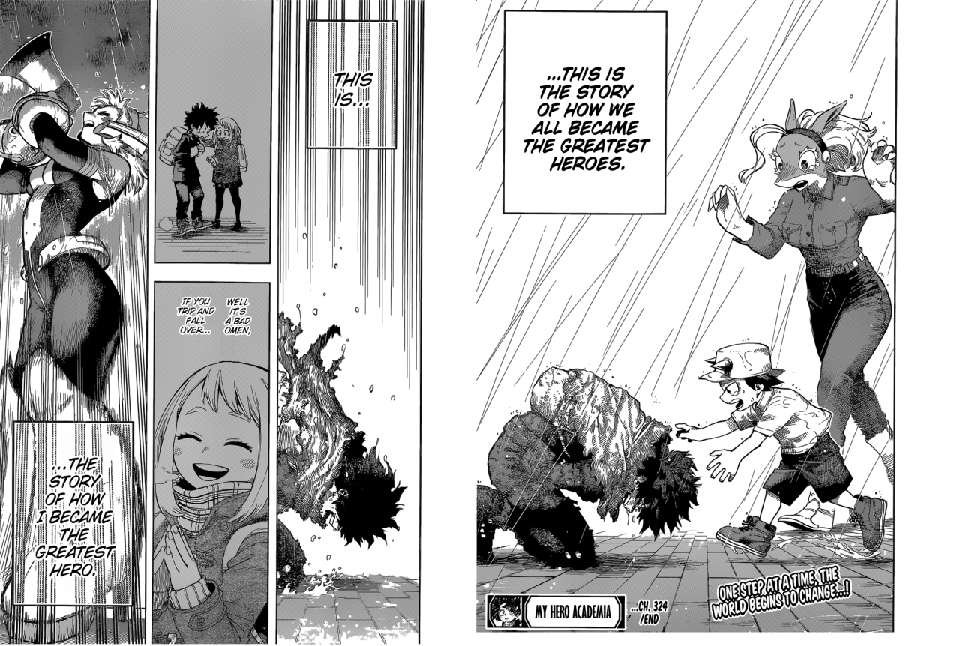
Notes:
Overall, who wouldn't love a story of a high school kid on his journey to become the number one hero?

Slide 5
Works Cited
https://upload.wikimedia.org/wikipedia/en/5/5a/Boku_no_Hero_Academia_Volume_1.png
https://en.wikipedia.org/wiki/My_Hero_Academia
https://external-preview.redd.it/dMmn27m8Xg_xsvZCDt9m0VnQ_TaypPFlqSHcNCzibV8.png?auto=webp&s=3ec8d418350f5aa8b99d71ec47795e753e1c91a6
https://64.media.tumblr.com/bf8c2049b17b19d9301c4bb222ef4067/1195673cf9088e96-11/s1280x1920/a1d93005784ed3a1e065fa71f5763b15c8829ff0.png

