Slide 1
Lecia Barker Associate Professor and Associate Chair of Undergraduate Studies Department of Information Science
NCWIT Tracking Tool and Data Challenges
Notes:
Lecia = 7 minutes

Slide 2

Notes:
Mission is to significantly increase girls’ and women’s meaningful participation in computing. Significantly because there is a lot of work to do; meaningful because we care what they are doing - i.e., we want them to innovate, to help create future technology.
“change leader” network of more than 1000 organizations, in action all year long in support of NCWIT’s mission.
NCWIT:
-convenes our change leader network,
-equips them with resources, tools, data, etc. so that when they step out as change leaders they do so based on evidence and not anecdote or whim, and
-unites them in common action platforms that leverage their combined strength for the nation (like Aspirations in Computing).
Although NCWIT focuses on women, our emphasis on systemic change means that all groups benefit from our work

Slide 3





Organized into Alliances

Slide 4

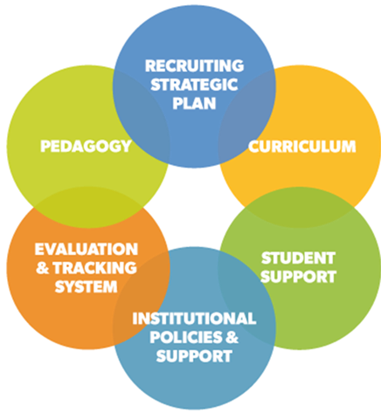
Goal: Increase Women’s Participation by Improving Experience of the Major for All Students
Notes:
-ES systemic change model reflects all the components of the department that undergraduates experience either directly or indirectly
-Focus is on revising educational systems for an inclusive experience for all students as opposed to changing the students to fit these systems
-Important when our clients are developing their strategic recruitment and retention plans to address each of these components in order to enhance the likelihood of creating a more inclusive departmental culture
Examples of questions the departmental team may explore:
-How can the department deliver a more relevant and meaningful curriculum to all students?
-Can the student experience be improved simply by the way people talk in the classroom, for example, how do women feel when faculty members only use all-male examples? What are effective models for educating faculty about creating a more inclusive classroom?
-What policies or underlying practices are in play that may inhibit a more inclusive culture? Admissions criteria that privilege certain groups? Faculty P&T criteria? Faculty recruitment practices?
All 6 of these components impact a student’s sense of belonging and inclusion

Slide 5
Data in NCWIT Tracking Tool
Attracting Students
Applications, acceptances, actual new enrollment in the major, college entry scores, and high school GPA
Broken down by race/ethnicity, gender, student level, and transfers
Retaining Students
Count of declared majors at each of five levels (freshman, sophomore, junior, senior, fifth+ year senior)
Departures (graduation, switching major, or leaving the institution)
Notes:
Getting data about minors is difficult at most campuses, very uneven, because students don’t have to declare necessarily.
Data enables departments to identify whether students in different groups are more or less likely to be enrolled at different points in the major, year to year, and whether some groups take longer to graduate than others. The data are a starting point: understanding causes requires a different kind of data (SEM) (To retain students, a department must understand what aspects of students’ experiences are cementing their interests and feelings of belonging in the major or are pushing them away. Multiple sources of data are needed for developing this understanding.)
As of late 2017, about 175 departments of computer science, computer engineering, and cognates have submitted several years of data.

Slide 6
Extreme Data Heterogeneity
When students declare the major (upon enrollment, end of 1st year, end of 2nd year, other)
Names of majors
Data availability varies by campus
Format (e.g., digital)
Totals v. demographic breakdown
Data people actually provide varies
One year… even ten years

Slide 7
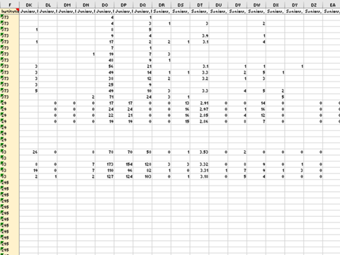
Notes:
A screen shot of the data -- can see that some inst input a lot of categories, others input only some of it.

Slide 8
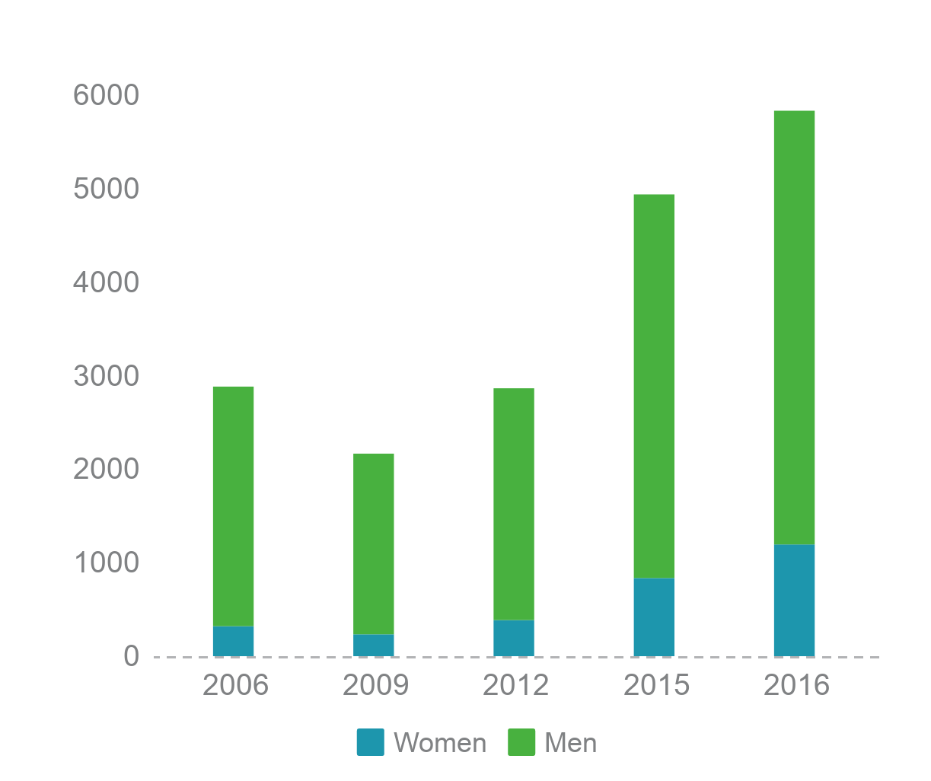
Inherent Bias
BS Awarded to Men and Women, 32 NCWIT Extension Services Clients 2007-2011
These 32 clients awarded >1/8 of all U.S. degrees in CIP 11.01 and 11.07 in 2016. Without these 32, national average is 17.2% women.
20.5% 2007-2011 clients
17.6% National average
←11.1%
=
Data source: IPEDS CIP 11.01 & 11.07, public/not-for-profit
Notes:
Between 2007-2011, NCWIT served 32 clients awarding bachelor’s degrees in computing. These degrees are categorized as Computer and Information Sciences, General and Computer Science (Classification of Instructional Program [CIP] 11.01 and 11.07, respectively[1]). In 2016, these 32 earliest clients awarded nearly one-eighth of these BS in public and not-for-profit private institutions in the U.S. Like many large departments, they were among the worst performing in the U.S. with respect to graduations of women when they began their work in 2007. Having put in place sustainable programs, by 2016 they awarded 21% of their bachelor’s degrees to women.
[1] This analysis presents data from degrees awarded under Classification of Instructional Program (CIP) code 11 and sub-codes, as categorized by the National Center for Education Statistics. CIP 11 is an umbrella code for all program types. Three program types made up 87% of the degrees awarded in 2016. These include 11.01 (Computer and Information Sciences, General; 42% of all CIP 11), 11.04 (Information Science; 11% of all CIP 11), and 11.07 (Computer Science; 34% of all CIP 11). 11.04, Information Science, can be either a technical degree or non-technical degree, including majors called “informatics,” “IT security policy analysis,” and “library and information science.” Nationally, Information science awards 24% of bachelor’s degrees to women on average, ranging from 6% to 54% among programs that awarded 30 or more degrees in 2016. However, when using only 11.01 and 11.07 in the analysis, the national average degrees awarded to women is 18%. Because 96% of the degrees reported by earliest ES clients were in CIPs 11.01 and 11.07, we compare to the national average of these two categories above. Also excluded is the all-women school we served to avoid the slight skewing of the data.

Slide 9
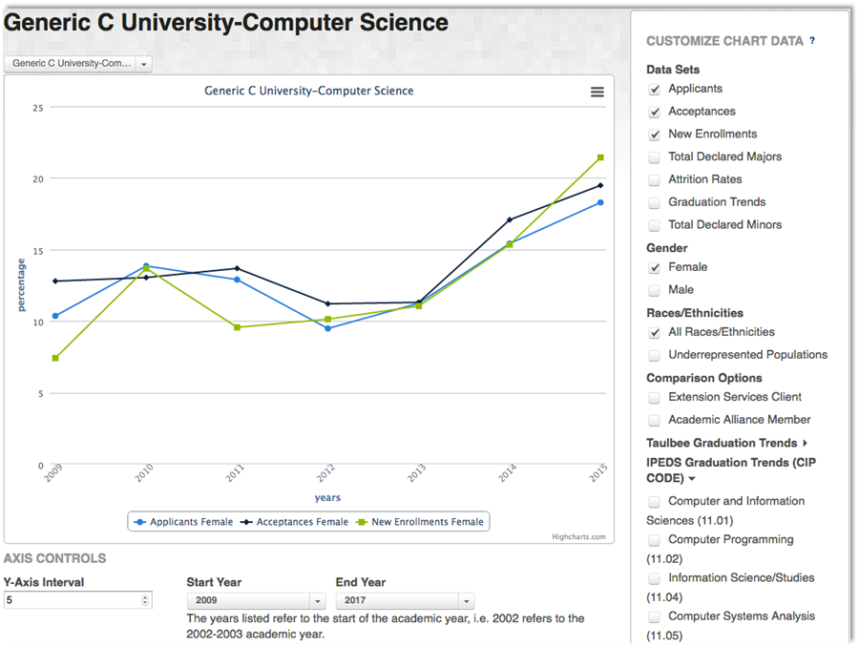
NCWIT Tracking Tool

Slide 10
Questions
How well are students (all, subgroups) “retained” year to year in their major?
Are there differences across majors or CIP codes? Across demographic variables?
Are there differences in retention depending on when students declare their major?
Are there differences across institutional type? Between “Extension Services” clients and general “Academic Alliance” members?
What is the differences between students who apply, are accepted, and actually enroll? How does this vary across <all of the above>?
What questions do you think make sense?

