Slide 1
Balancing Accuracy and Interpretability in Fake News Detection: Logistic Regression vs. Random Forest
INFO 523 - Summer 2025 - Final Project Anvesh Lohiya

Slide 2
Introduction

Slide 3
Background Information
Spread of fake news profoundly impacts the credibility and trustworthiness of news sources.
News platforms and media have the tendency to exaggerate information just to get more public attention
A promising approach - to focus and analyze the language being used in the news
Certain words and phrases often serve as strong indicators of whether the news is fake or real
In this project, I am using a dataset wherein each row consists of individual news articles, article title, and label (i.e., fake or real)
Additional columns to represent sentiment analysis were created using feature engineering
Actual names of the variables in the dataset - ‘title’, ‘text’, ‘label’, ‘title_polarity’, ‘title_subjectivity’, ‘text_polarity’, and ‘text_subjectivity’.
By applying TF-IDF feature extraction and machine learning methods, the goal is to not only classify news articles accurately, but also reveal patterns most predictive of fake news.

Slide 4
Question
Can we build an effective and interpretable fake news classifier using TF-IDF and machine learning?
Can we identify which words or phrases are most predictive of fake news content using categorical features?

Slide 5
Method of Approach
Cleaned data thereby dropping irrelevant columns
Feature engineering techniques: generated columns representing sentiment analysis
Column names are ‘title’, ‘text’, ‘label’, ‘title_polarity’, ‘title_subjectivity’, ‘text_polarity’, and ’text_subjectivity.
Trained model using logistic regression, random forest, and TF-IDF (Term Frequency Inverse Document Frequency)
Compared models using ROC AUC, F1-score, recall, accuracy, and precision

Slide 6
Column Definitions
Some columns to describe from dataset:
#: article number
title: name of news article
text: contents of the article
label: classifies the news as either FAKE or REAL
However, I dropped the ‘#’ column since it’s irrelevant.

Slide 7
Modeling

Slide 8
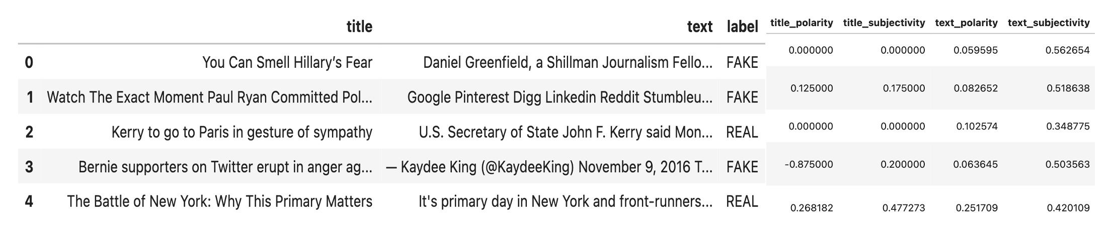
Dataset - First Few Rows

Slide 9
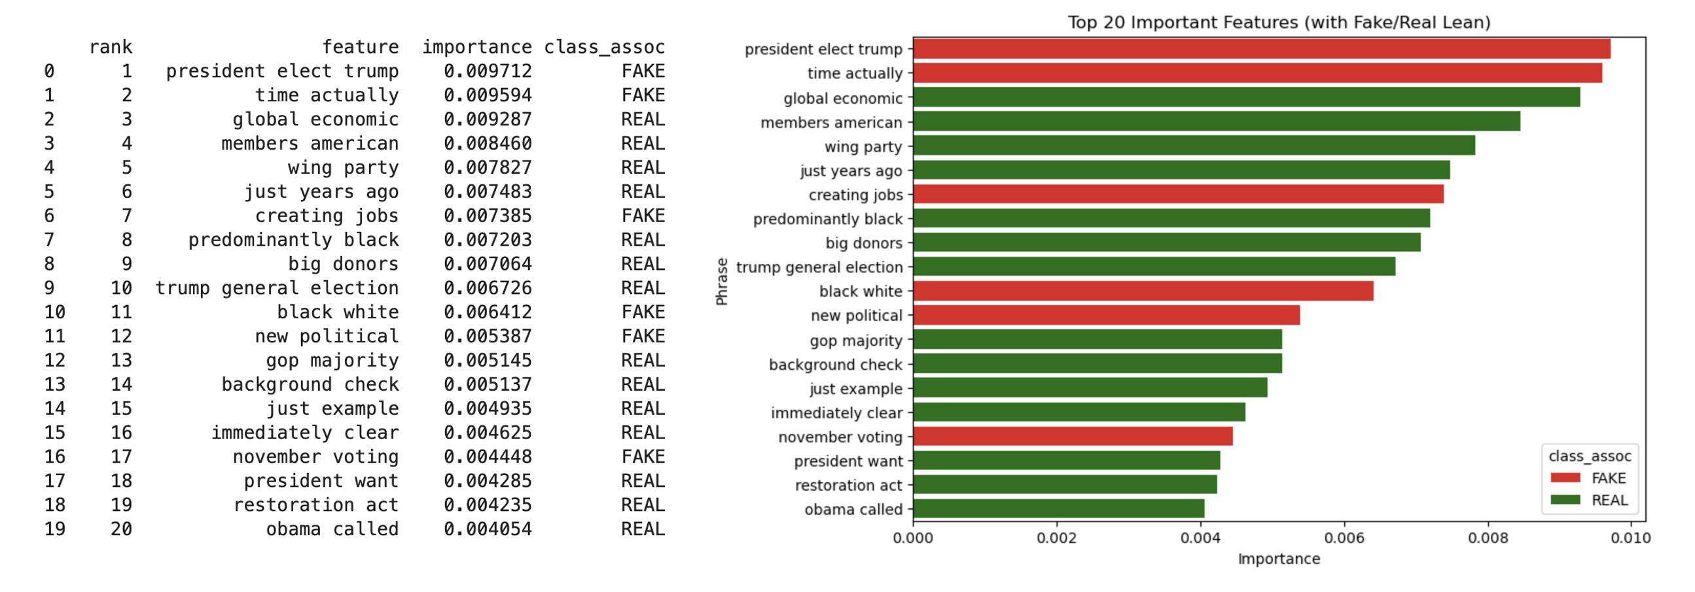
Bar Plot - Top 20 Features (Random Forest)

Slide 10
Bar Plot - Top 20 Features (Interpretation)
The bar plot using random forest classifier highlights the top 20 phrases that the RF model relies on to distinguish fake news from real news, ranked by their importance.
The model pays most attention to the top 20 phrases when deciding if an article is fake or real.
e.g., “president called trump” is the strongest signal feature in the trained model, while “obama called” is still useful, but weaker.

Slide 11
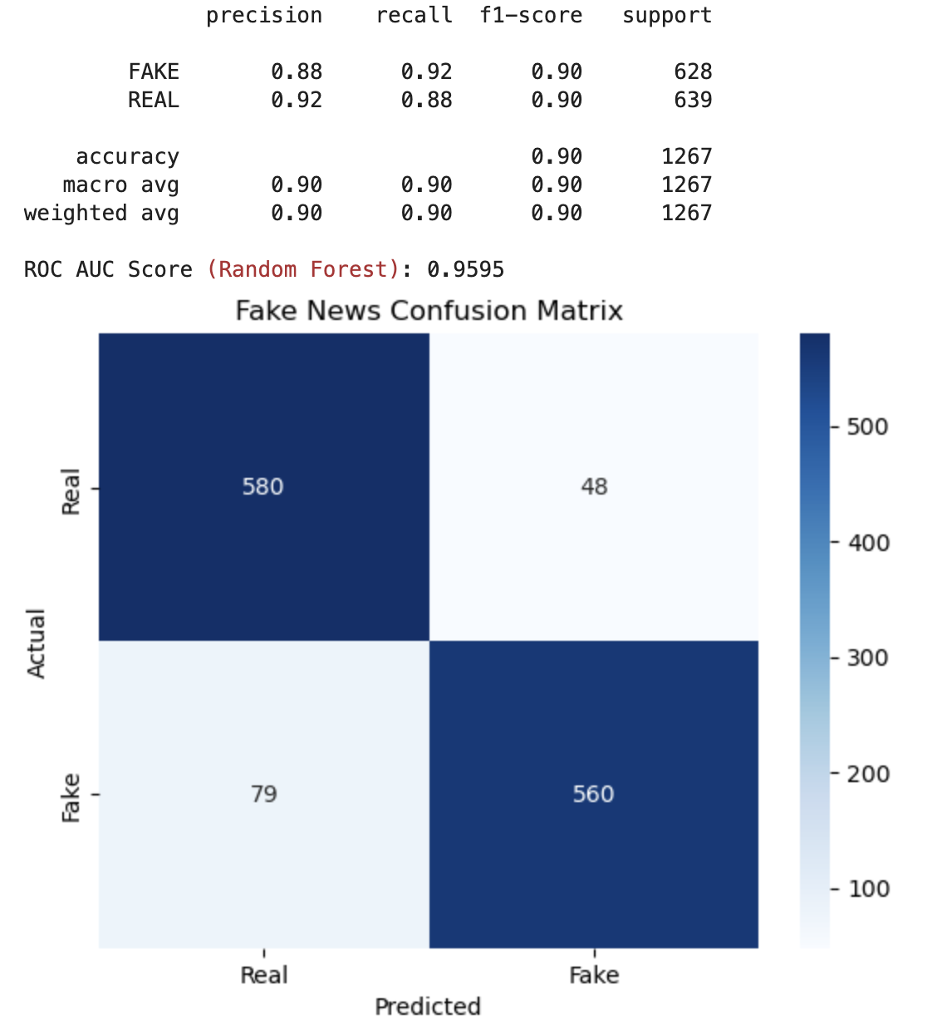
Confusion Matrix (Random Forest)

Slide 12
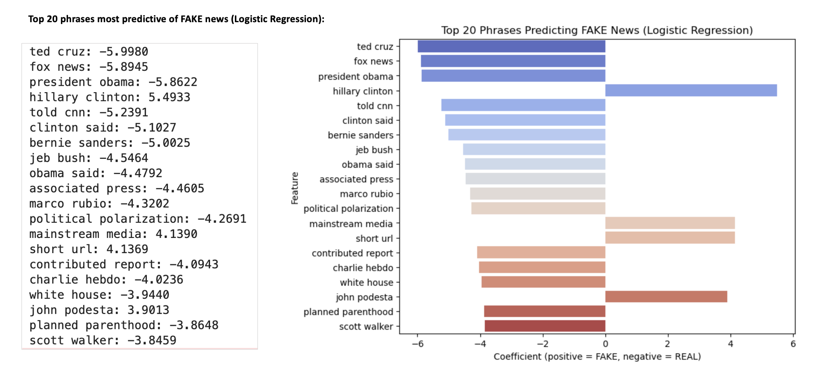
Bar Plot - Coefficients of Phrases (Logistic Regression)

Slide 13
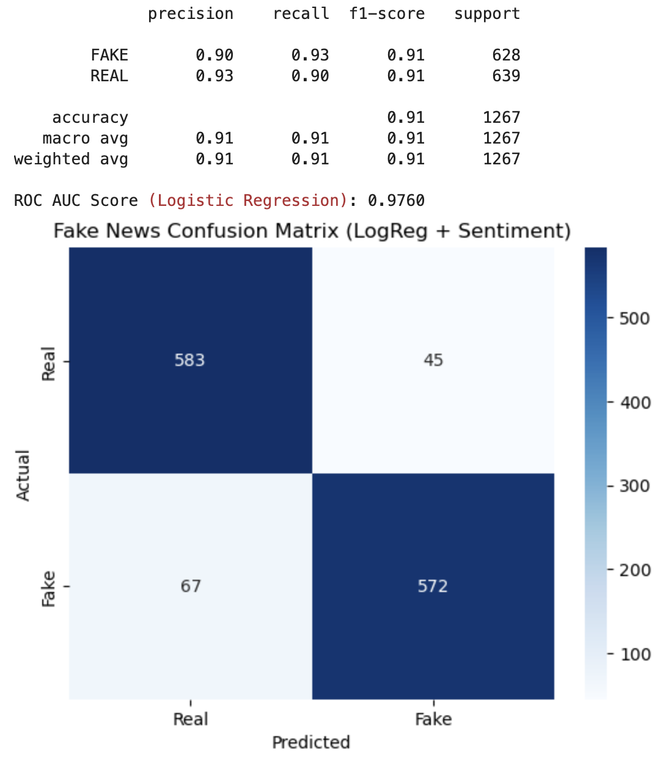
Confusion Matrix (Logistic Regression)

Slide 14
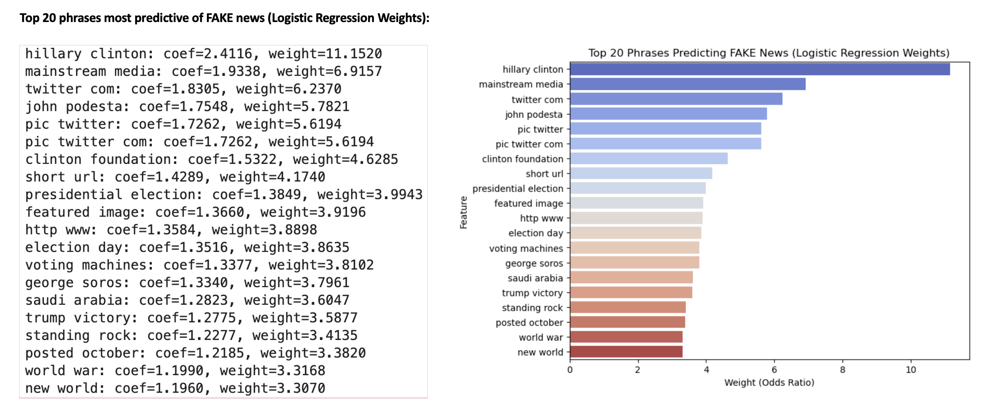
Bar Plot - Weights of Phrases (Logistic Regression)

Slide 15
Coefficients & Weights Plot (Interpretation)
The two-way bar plot provides insights into which words and phrases are most indicative of fake versus real news.
Words associated with fake news carried positive coefficients, while those linked to real news carried negative coefficients.
Coefficients: represent how much each feature contributes in the log-odds space
Weights calculated as exp(coefficient) show the multiplicative effect on the odds.

Slide 16
Evaluating Logistic & Random Forest Regression
ROC AUC (LR) = 0.9760, ROC AUC (RF) = 0.9595
LR can correctly distinguish between fake and real news 97.6% of the time
RF achieves a slightly lower performance of 95.95%.
The confusion matrix further highlights the effectiveness of both models.
Both RF and LR model had a very similar performance in terms of their ability correctly classifying true positives and true negatives.

Slide 17
Key Takeaway
This project shows that TF-IDF with machine learning can build an accurate and interpretable fake news classifier.
LR and RF both achieved high ROC AUC scores (>0.95), confirming strong predictive ability.
This project analysis also highlights the linguistic patterns that drive these predictions.
Feature analysis highlighted key phrases most indicative of fake vs. real news.
Some predictive words showed discrepancies, ultimately conveying that interpretability is not always perfectly reliable.

Slide 18
Thank You!

