Slide 1
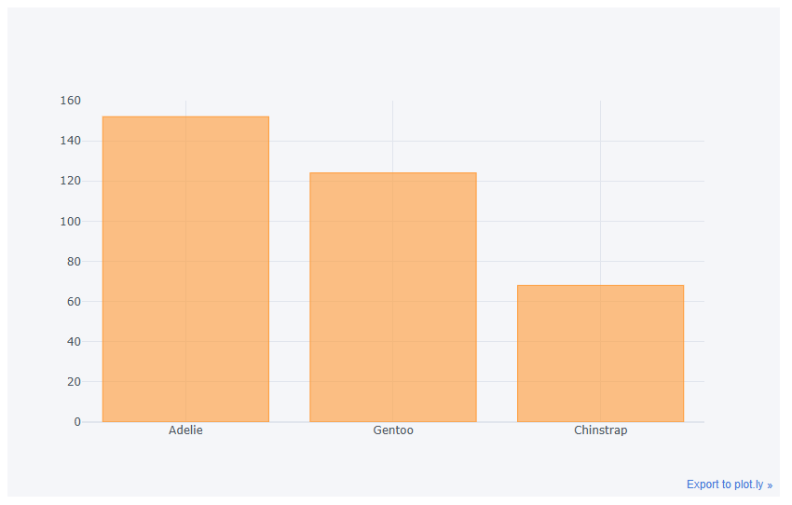
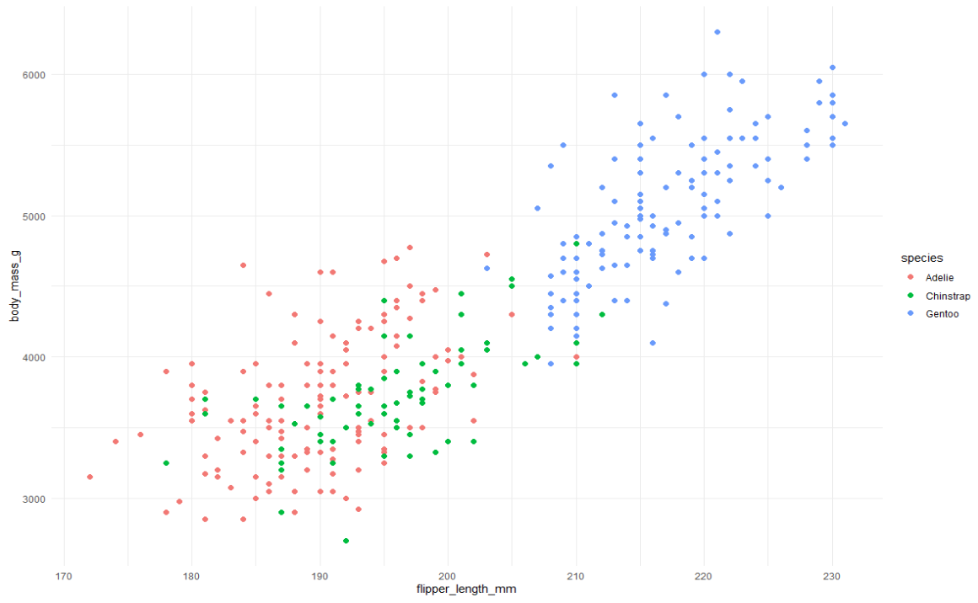
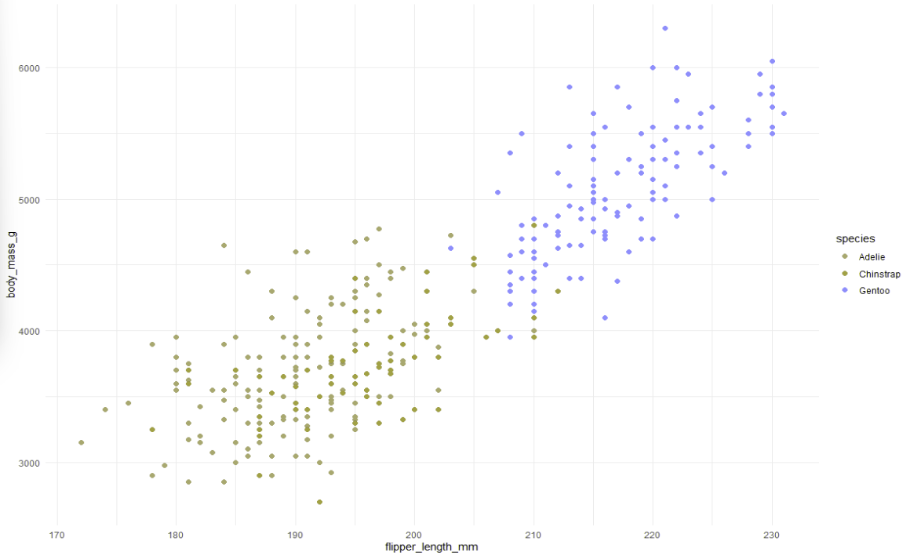
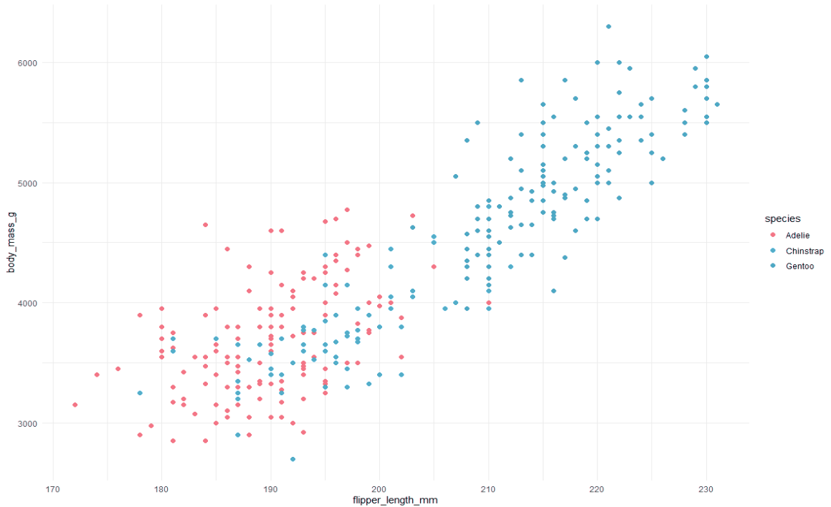
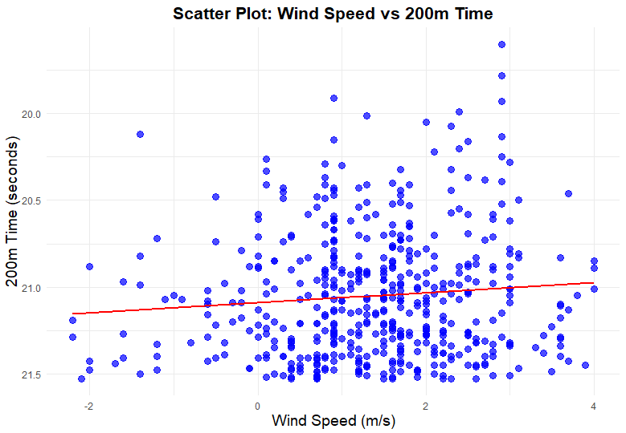
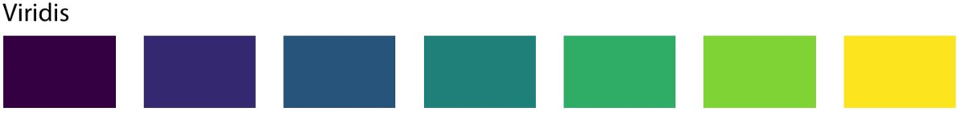
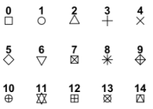

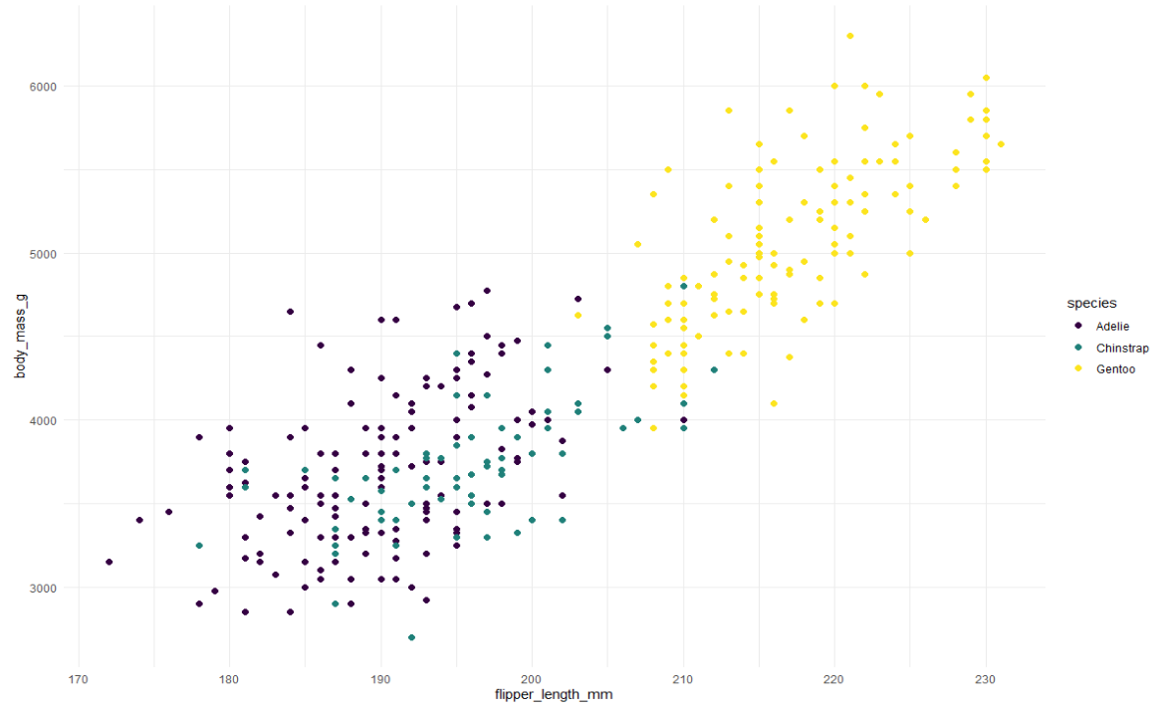
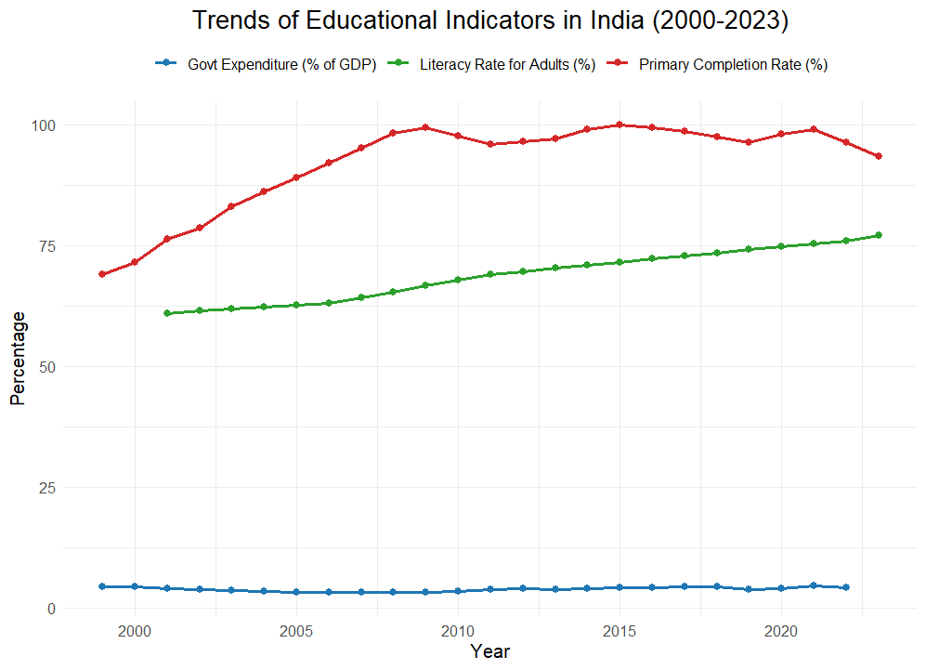
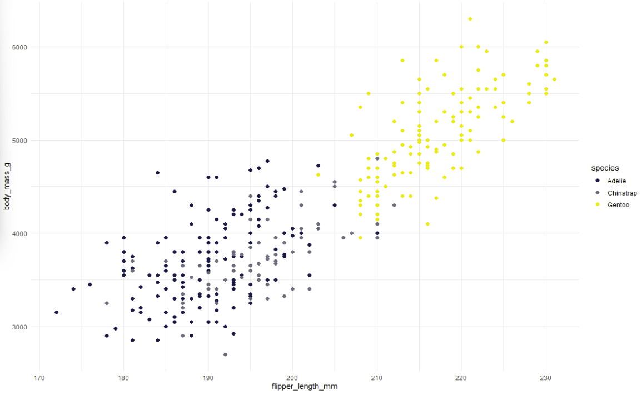
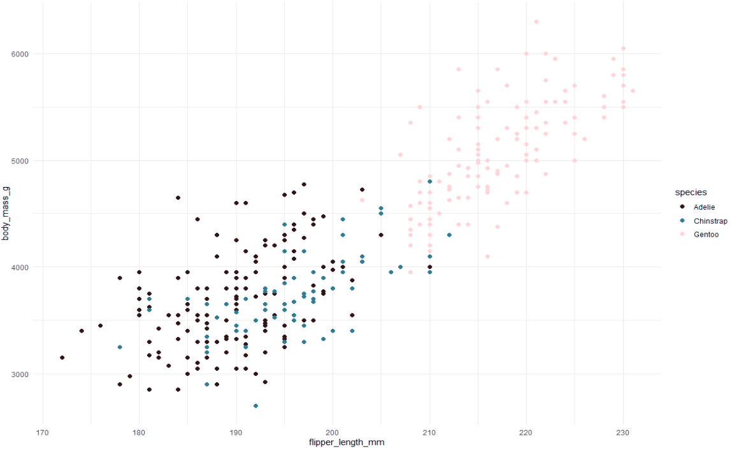
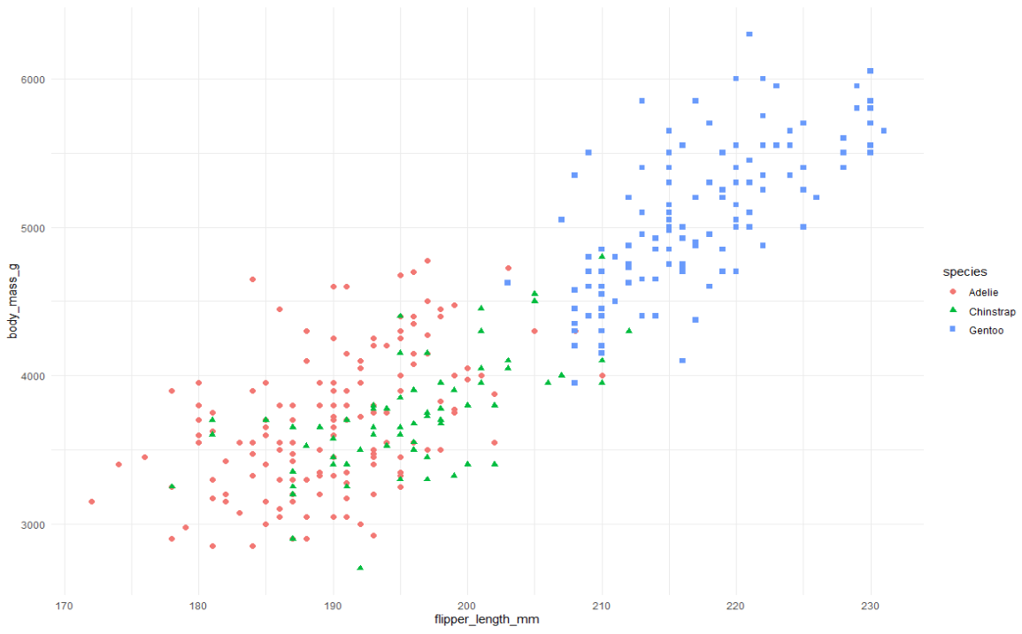
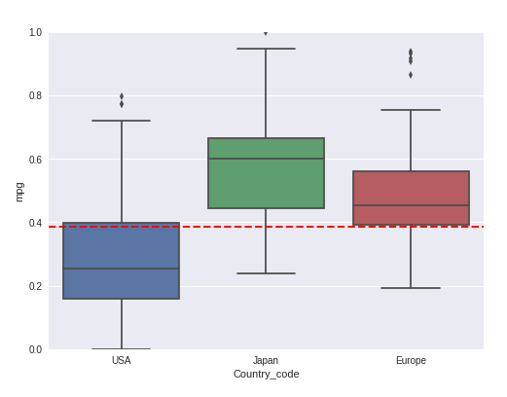
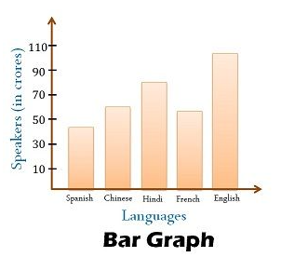
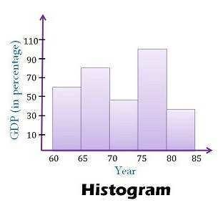
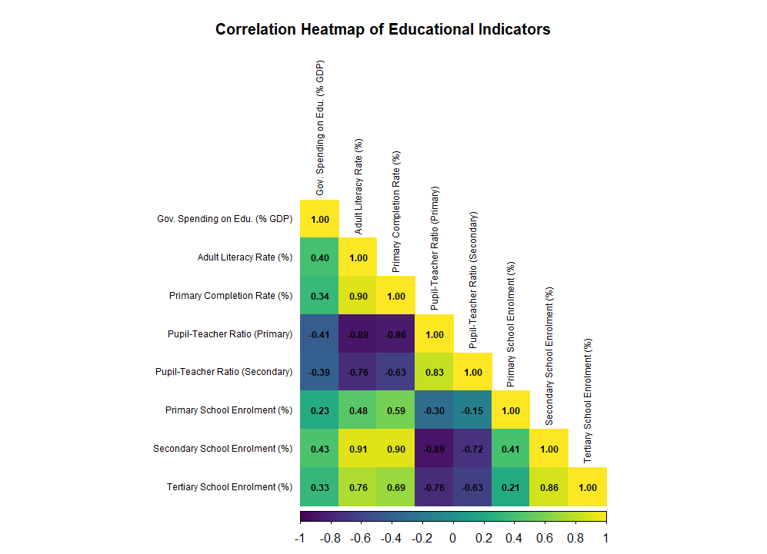
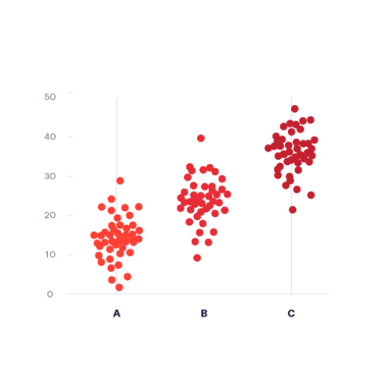
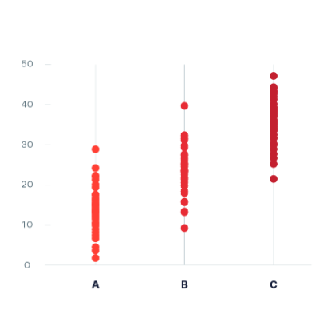
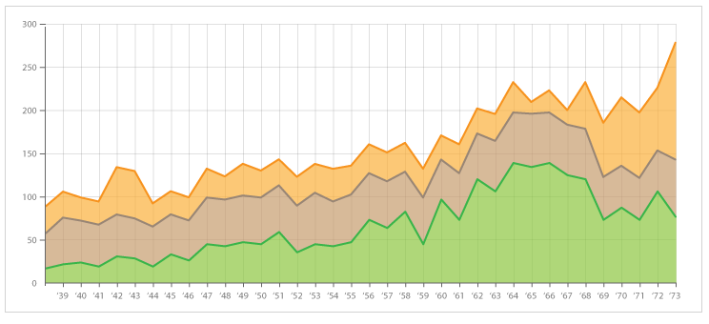
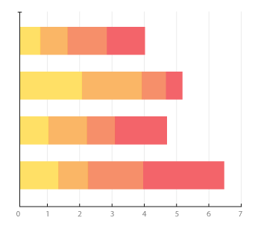
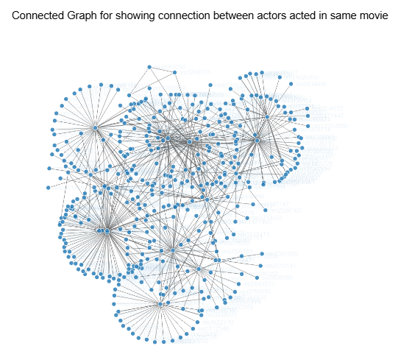
Data Visualization Essentials: Techniques, Accessibility, and Comparisons
Team Name: InfoCrew; Team Members: Tallapaneni Venkateshwara Chowdary, Trayvion White-Austin, Aastha Prasad
Why should I use visualizations to represent my data?, What are some visualizations that I can use to represent my data?, How can I make my visualizations be more accessible?, are there any visualizations that are similar but where they are used can vary based on the data?
Different Visualizations
Accessibility
Benefits:
Easy to read and interpret.
Effective for comparing quantities across categories.
Use Cases:
Count of all the categories in a feature.
The Problem
Original
Deuteranopia(Green-Blind)
Tritanopia(Blue-Blind)
Benefits:
Reveals relationships and correlations between two variables.
Helps identify outliers and clusters in data.
Use Cases:
Analyzing correlation between Wind Speed and Time.
By Color:
The Solution
By Shape:
One of the solutions for this problem is to use a color palette with contrasting color tones.
Other Examples of such color palettes include – Okabe Ito, ggplot2 hue, RColorBrewer, wacolors.
The other solution is through shapes above are some possible shapes.
By using different shapes for various categories of a feature this problem can be solved.
Solution
Benefits:
Ideal for displaying trends over time.
Highlights changes and patterns clearly.
Use Cases:
Analyzing Trends over time.
Deuteranopia(Green-Blind)
Tritanopia(Blue-Blind)
Increasing accessibility by shape
Benefits:
Summarizes data through quartiles, highlighting median and outliers.
Useful for comparing distributions across different groups.
Use Cases:
Comparing test scores across different classes or schools.
Comparisons between Visualizations
Bar Graph vs Histogram
Bar Graph, While these two visualizations are similar Bar Graph is best used for feature with discreate/ categorical values
While Histogram is best used for feature with continuous values.
Benefits:
Represents data density or intensity through color gradients.
Effective for visualizing complex data sets in a compact format.
Use Cases:
Analyzing correlations between different features
Jitter Plot vs Strip Plot
Jitter Plot, It include displacing the datapoint so that there will be no overlapping and therefore be quantified.
As for the Strip Plot, Its straightforward with no displacement complexity.
Stacked Area Chart vs Stacked Bar Chart
Stacked Area Chart is useful for studying overall.
As for the Stacked Bar Chart, Its best used for comparison among parts.
Benefits:
Visualize complex relationships and interactions between nodes, making it easier to identify patterns and clusters within the data.
Use Cases:
Social Network Analysis
References:
https://www.kaggle.com/code/devanshbesain/exploration-and-analysis-auto-mpg
https://allisonhorst.github.io/palmerpenguins/articles/intro.html
https://datavizproject.com/data-type/strip-plot/#:~:text=A%20strip%20plot%20is%20a,the%20same%20value%20can%20overlap.
https://keydifferences.com/difference-between-histogram-and-bar-graph.html#google_vignette
https://datavizproject.com/data-type/jitter-plot/
https://datavizproject.com/data-type/strip-plot/
https://datavizcatalogue.com/methods/stacked_bar_graph.html
https://datavizcatalogue.com/methods/stacked_area_graph.html

