Slide 1



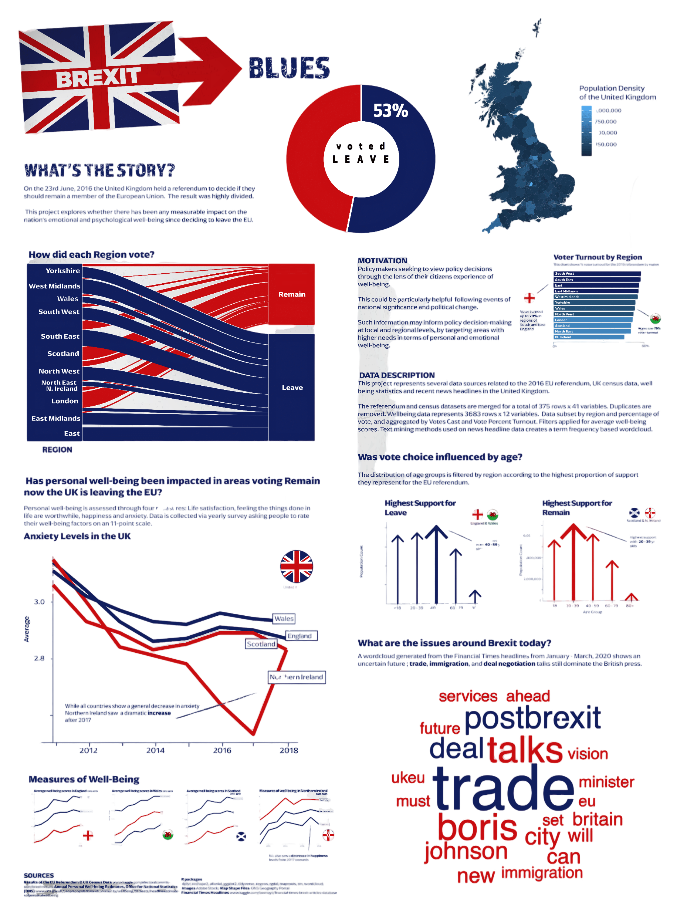







BREXIT BLUE
Saikumar Bollam, Vamshi Krishna

