Slide 1

CATALYST STUDIOS – DATA ANALYSIS
Author : Ashwini R Jannu
Mentor : Jennifer Nicols & Hana Lipke
Instructor : Dr Greg Chism

Slide 2
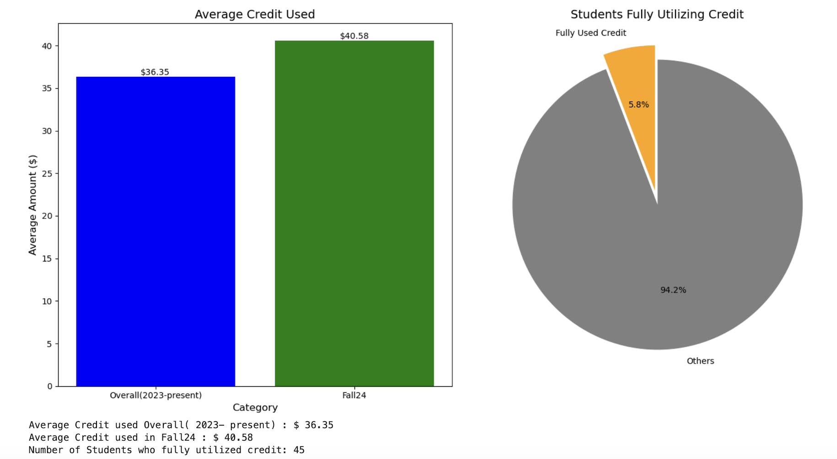
Average credit used & fully used credit

Slide 3
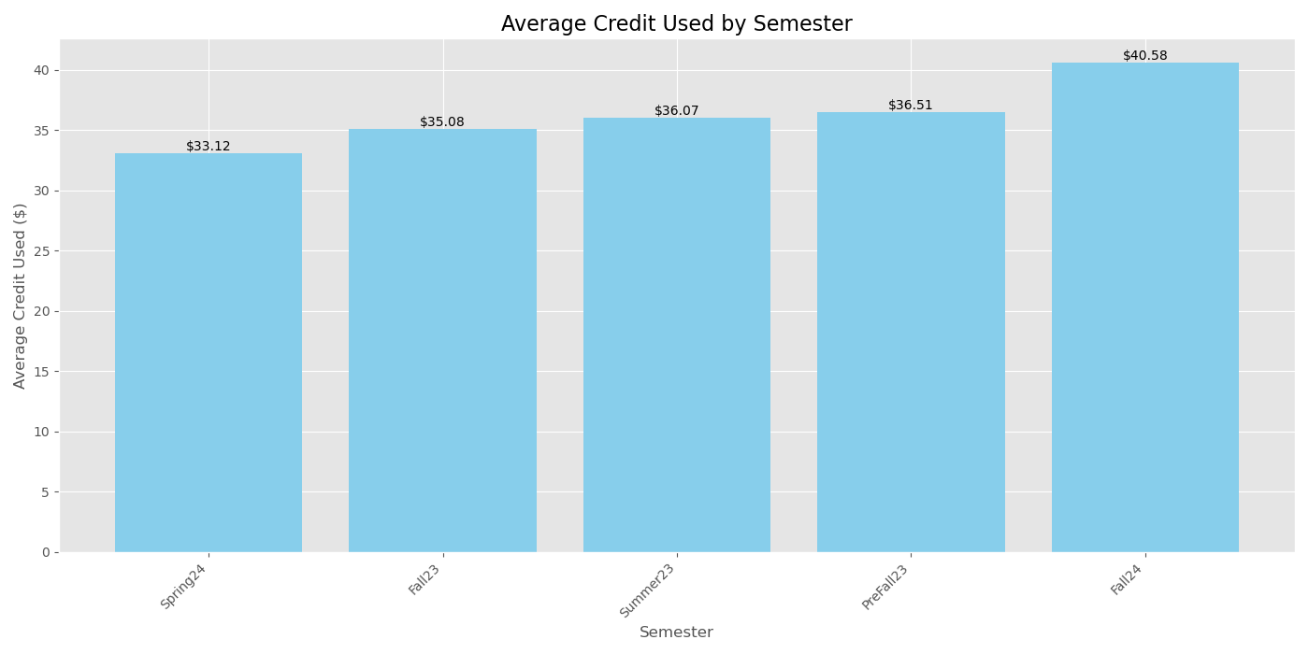
Average Credit Used by Semester
Fall24 exhibits the highest average credit used, indicating a significant allocation for this category.

Slide 4
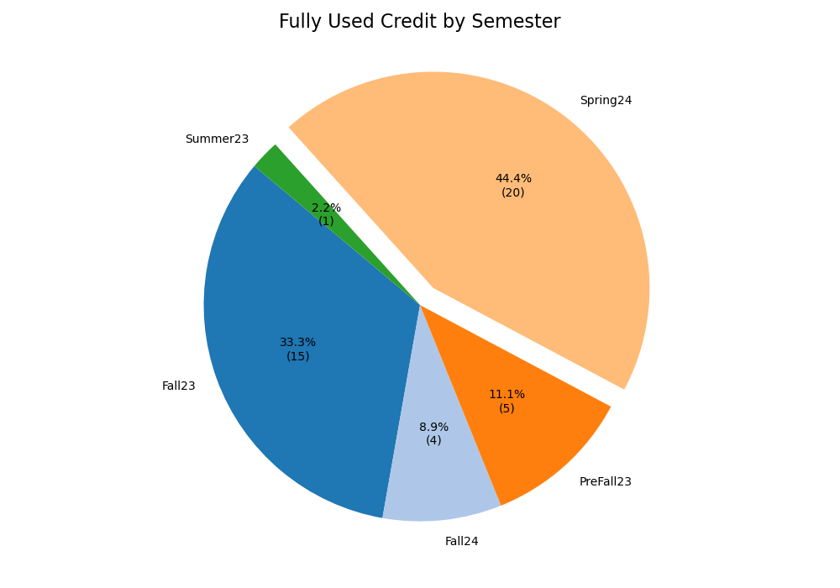
Fully used credit by semesters
Spring24 accounts for a substantial proportion of fully used credits, reflecting efficient utilization of allocated funds.

Slide 5
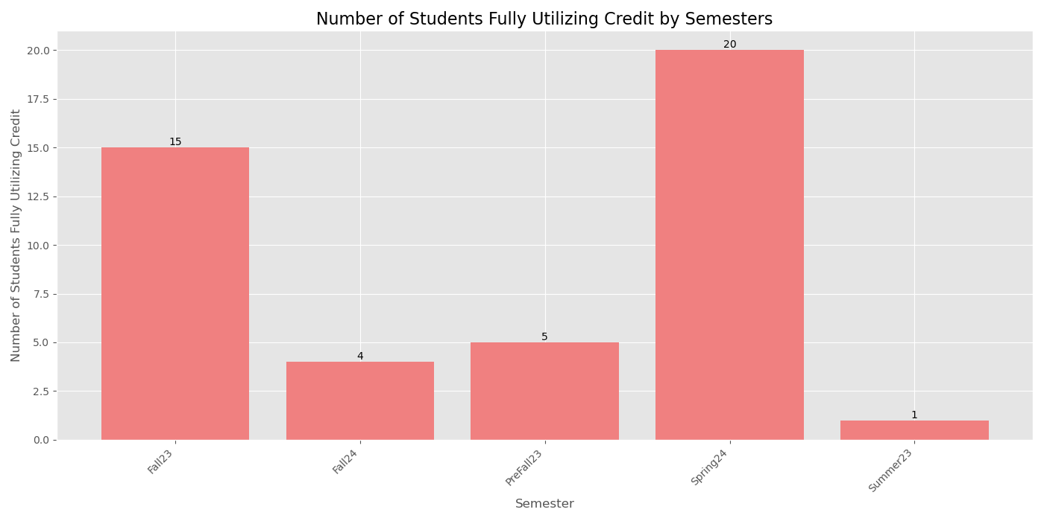
Number of students fully utilizing their credit by semesters
Spring24 has the highest number of students fully utilizing their credit allocation.

Slide 6
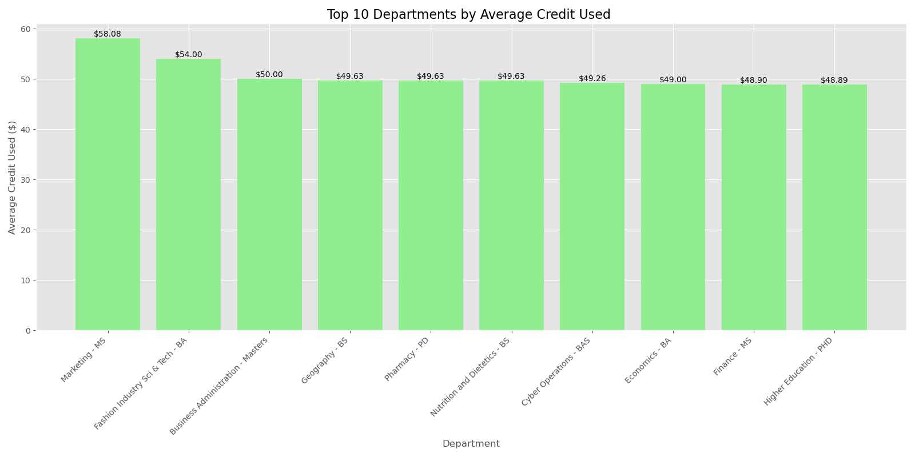
Top 10 Departments by Average Credit Used
'Marketing MS' demonstrates significantly higher average credit usage compared to others, highlighting its dominant allocation.
The remaining departments exhibit relatively balanced average credit usage.

Slide 7
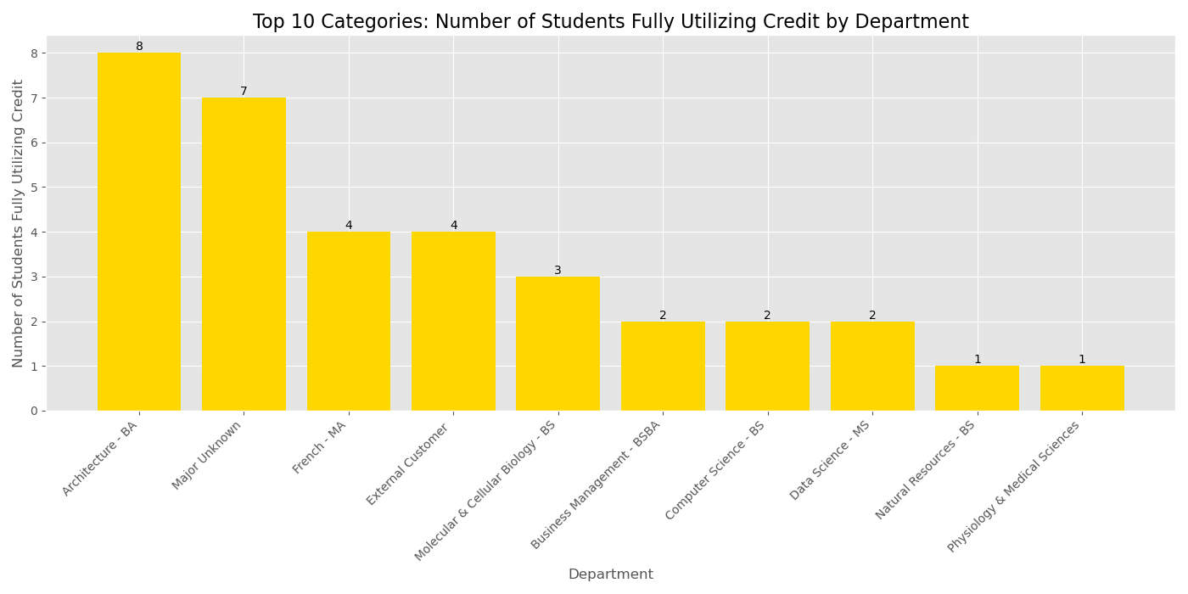
Top 10 : Students fully utilizing credit by Department
The top category here is 'Architecture –BA' which leads with substantial utilization, followed closely by others.

Slide 8
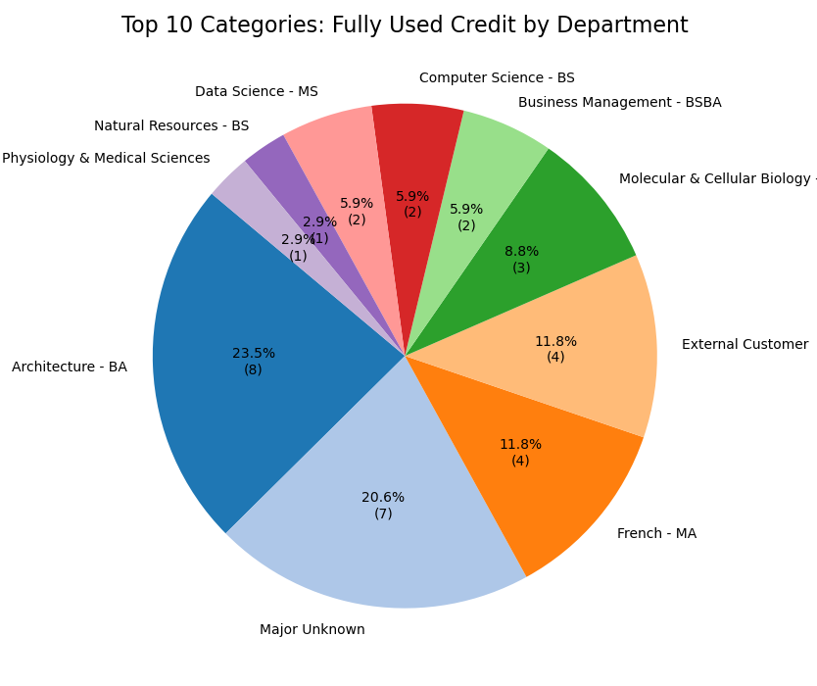
Top 10 : Fully used credit by Department
A dominant category ( 'Architecture-BA') accounts for the largest share of fully used credits, demonstrating focused utilization.
Other departments make smaller but meaningful contributions to total credit utilization.

Slide 9
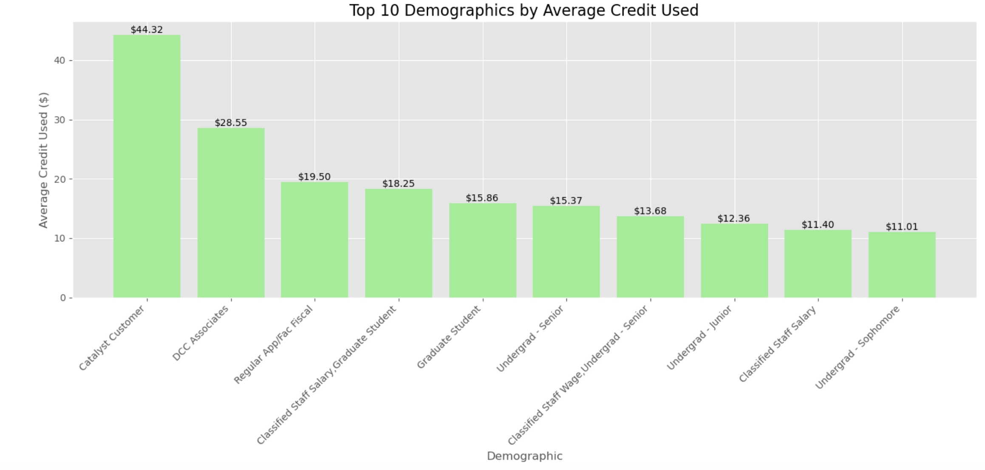
Stories of different demographics

Slide 10
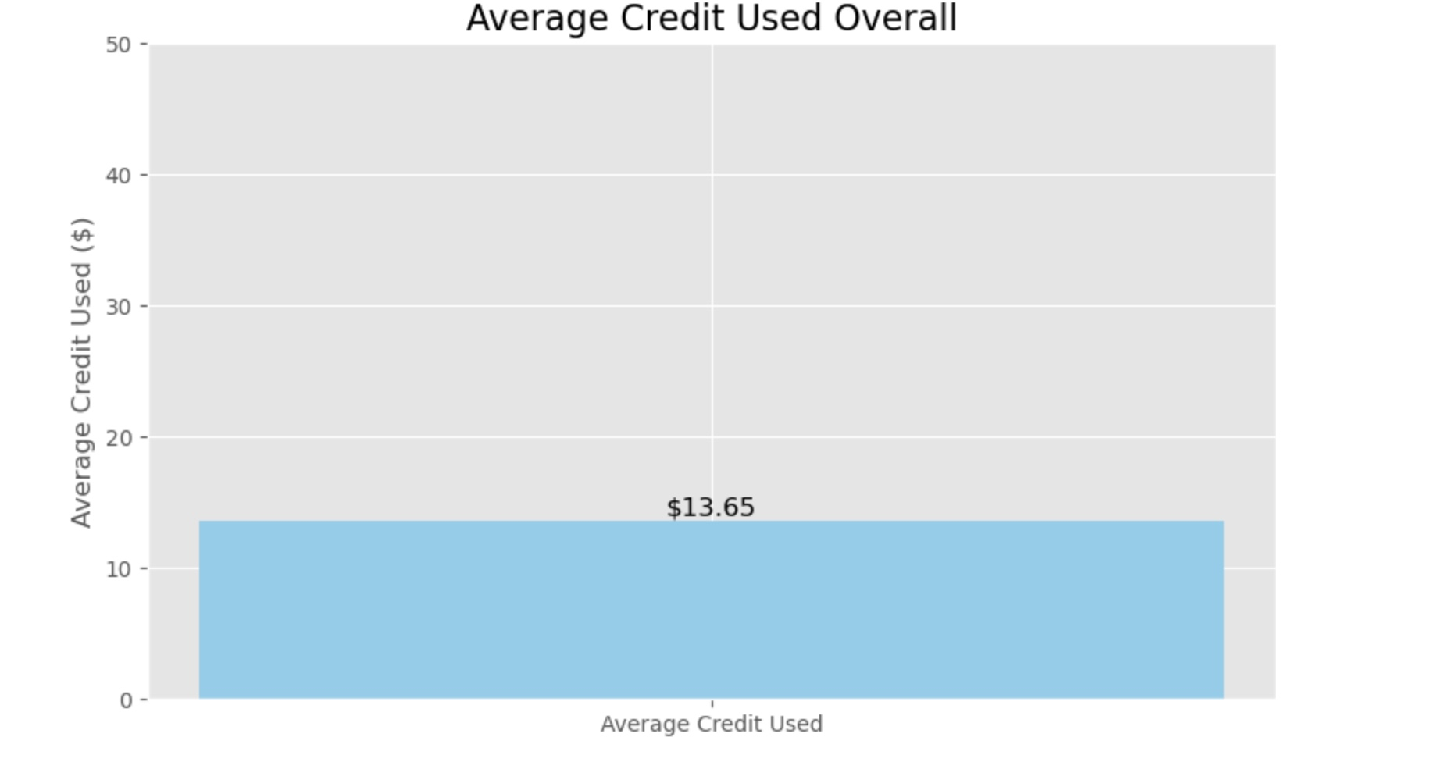
Average Credit Used overall - $13.65

Slide 11
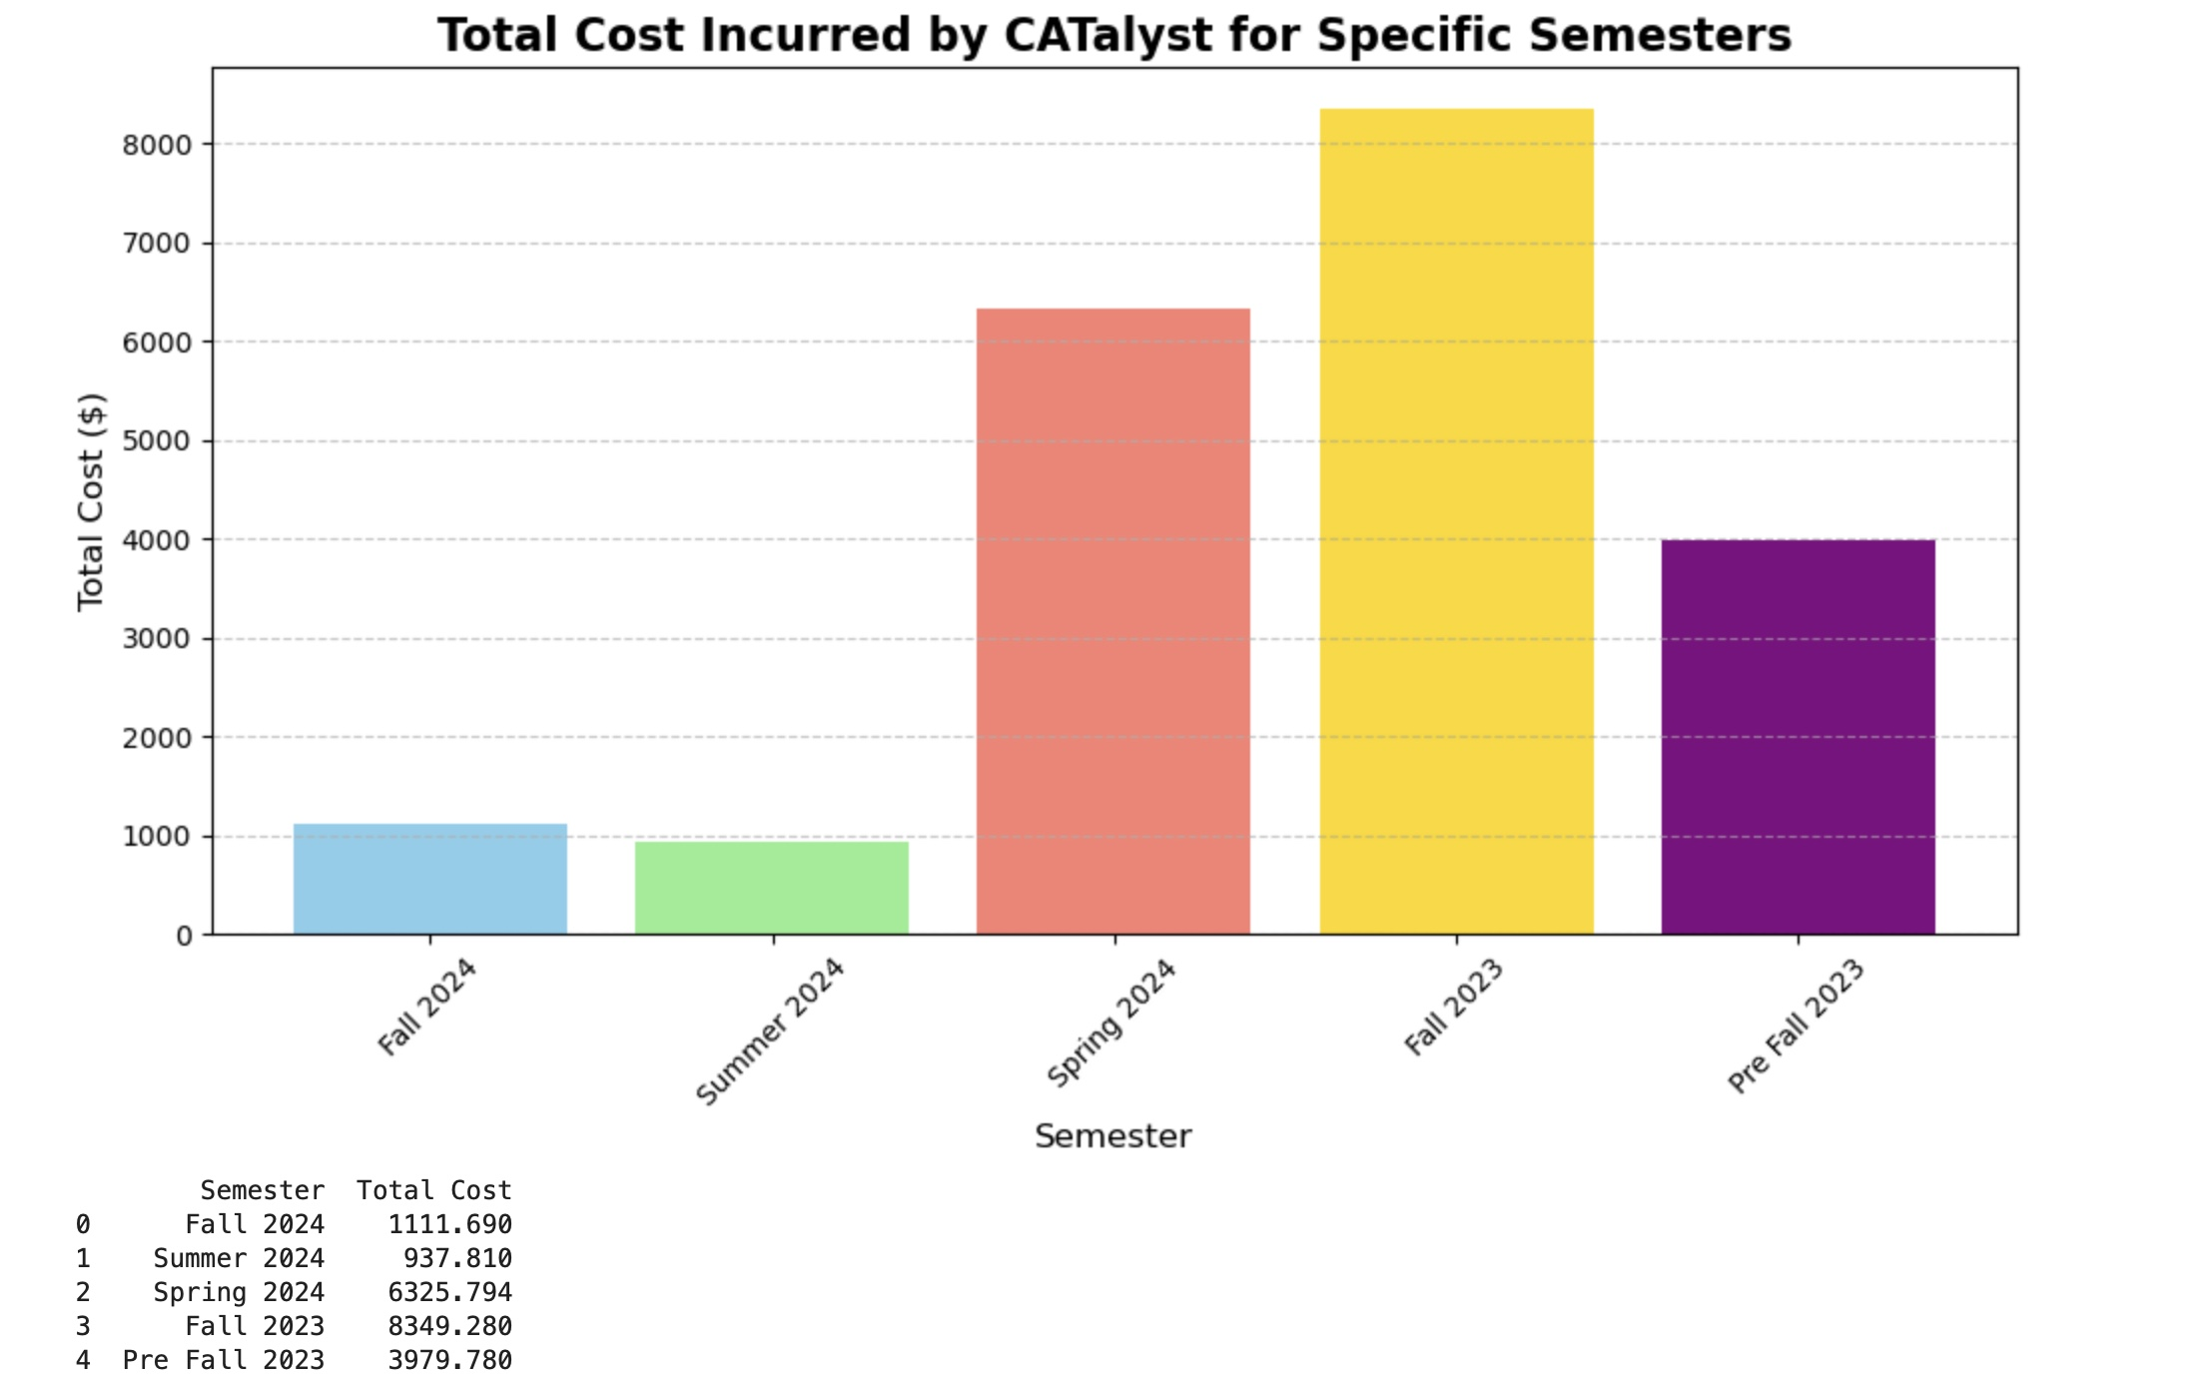
Total cost incurred by CATalyst

Slide 12
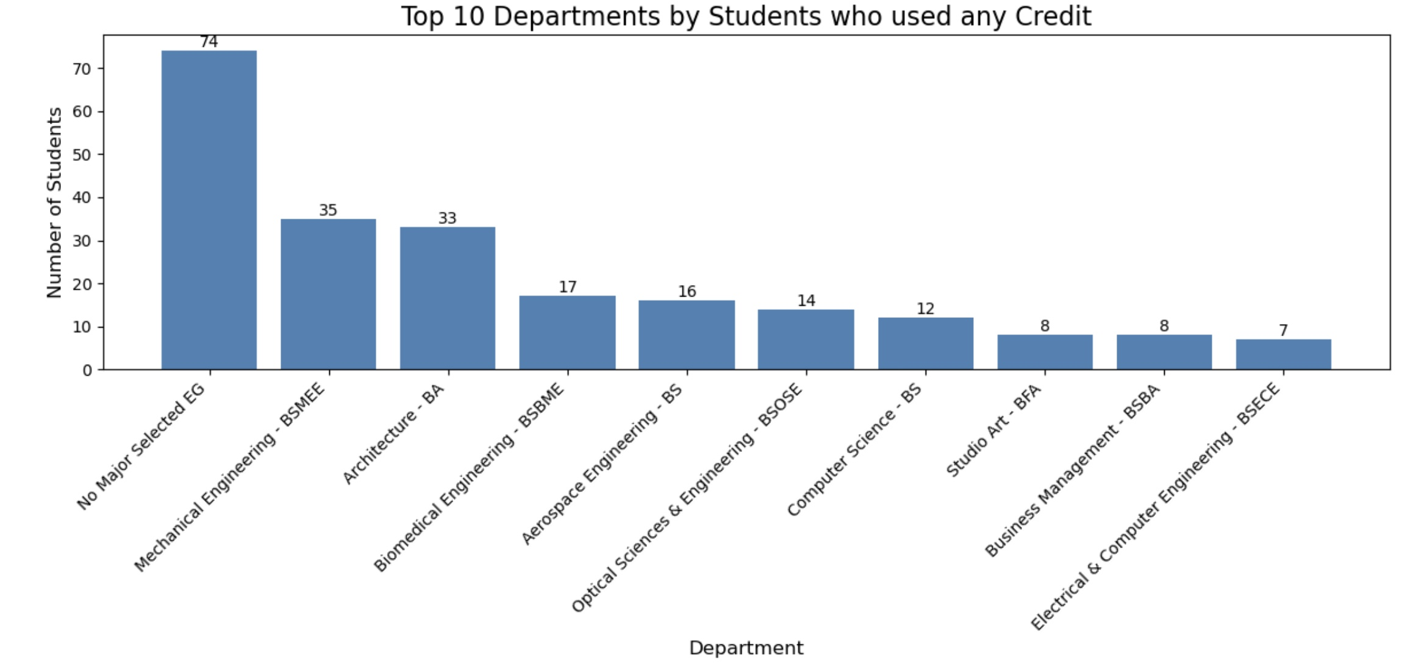
Top 10 Departments by Students who used any credit

Slide 13
Conclusion
Key Takeaways from CATalyst Data Analysis:
A significant number of students engaged with the CATalyst credit program, with noticeable variations in how credit was used across semesters and departments.
Fall 2024 saw the highest average credit usage, while Spring 2024 had the most students fully utilizing their credits, indicating increased program efficiency and awareness.
Departments like Marketing MS and Architecture–BA consistently led in both average credit use and full utilization, suggesting high relevance and adoption of the program in these areas.
Demographic patterns reveal diverse engagement, providing opportunities to tailor outreach and support to underrepresented groups.
The program incurred a notable total cost, reflecting strong participation and the need for strategic financial planning moving forward.
Overall, the CATalyst program demonstrates positive impact, widespread engagement, and offers valuable insights to optimize future iterations.

Slide 14
CATALYST STUDIOS – DATA ANALYSIS
Thank you!

