Slide 1

HYPERPARAMETERS DATABASE
TEAM – DB08
Bhavana Shanmugam
Yadukrishnan Sethumadhavan

Slide 2

Understanding the Data Source
Worked with Data science team to understand the generation of Hyperparameters
Received JSON file for one runtime
Understanding the JSON output and planned the design of the database
Created Conceptual Schema
Normalized the Data tables (till 3NF)
Created ER Diagram
Created Tables in MySQL
PROGRESS

Slide 3
Populate the tables after receiving the entire hyperparameters data
Creating 10 use cases per person
Creating 5 views per person
Creating 5 procedures per person
Creating 5 functions per person
Creating 5 indexes per person
Analytics
Conclusion
NEXT STEPS

Slide 4
DATA SOURCE - MELBOURNE HOUSING MARKET (Melbourne housing clearance data from Jan 2016)
ATTRIBUTES:
* Suburb * Address * Rooms * Type
* Price * Method *SellerG * Date
* Distance * Postcode * Bedroom2 * Car
* Bathroom * Landsize * BuildingArea
* CouncilArea * Lattitude * Longtitude
* Propertycount * Regionname * YearBuilt

Slide 5
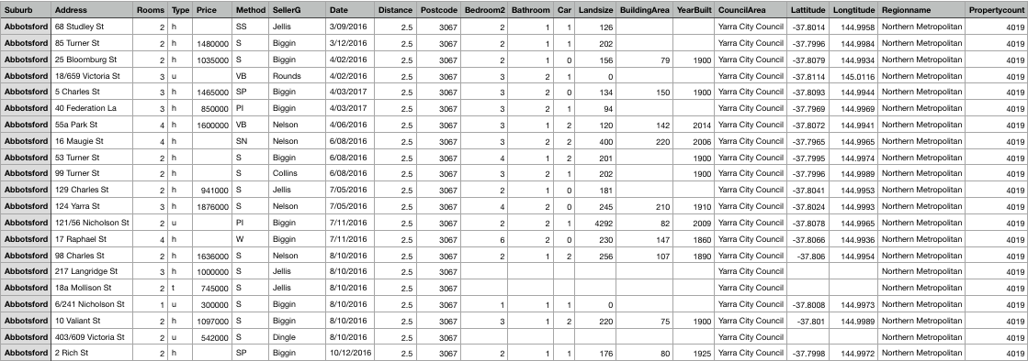
SAMPLE DATA

Slide 6
SAMPLE JSON DATA RECEIVED
{
"model_id": {
"default": null,
"actual": {
"__meta": {
"schema_version": 3,
"schema_name": "ModelKeyV3",
"schema_type": "Key<Model>"
},
"name": "GLM_grid_1_AutoML_20190410_212941_model_1",
"type": "Key<Model>",
"URL": "/3/Models/GLM_grid_1_AutoML_20190410_212941_model_1"
}
},
"training_frame": {
"default": null,
"actual": {
"__meta": {
"schema_version": 3,
"schema_name": "FrameKeyV3",
"schema_type": "Key<Frame>"
},
"name": "automl_training_py_3_sid_b3ea",
"type": "Key<Frame>",
"URL": "/3/Frames/automl_training_py_3_sid_b3ea"
}
},
"validation_frame": {
"default": null,
"actual": null
},

Slide 7
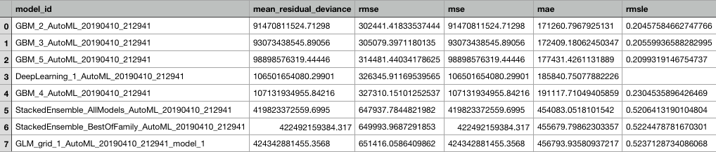
LEADER BOARD DATA:

Slide 8
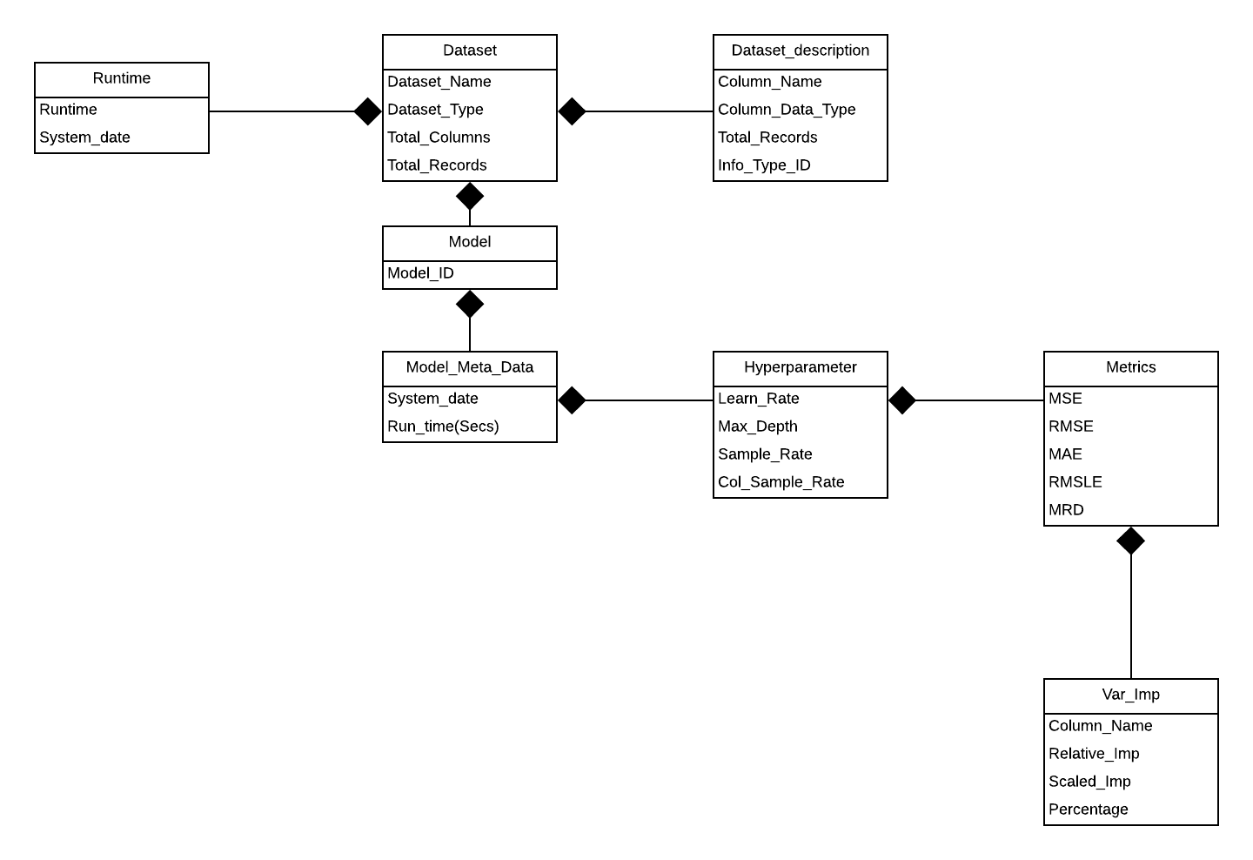
CONCEPTUAL SCHEMA

Slide 9
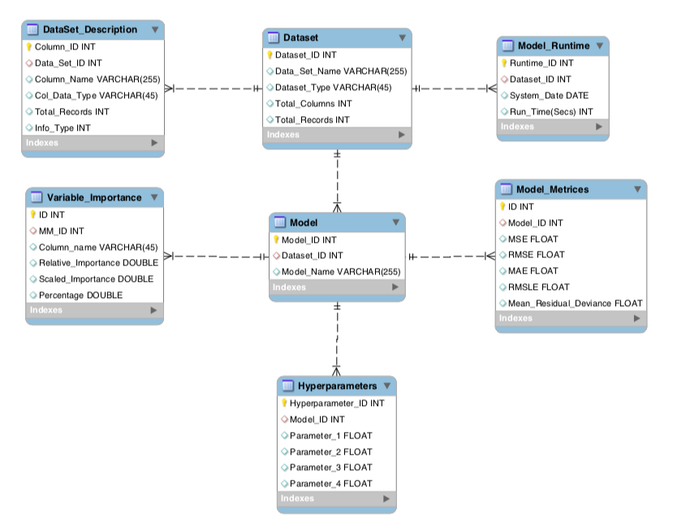
ER DIAGRAM

Slide 10
CREATING TABLES IN DATABASE
DATASET TABLE:
CREATE TABLE Dataset (
ID INT PRIMARY KEY
NOT NULL
UNIQUE,
Data_Set VARCHAR (255),
Dataset_Type VARCHAR (45),
Total_Columns INT,
Total_Records INT
);

