Slide 1
INFO 6210 Data Management and Database Design Database Project Proposal
AI Skunkworks Project
Hyperparameter Database
Team DB14
Pratiksha Milind Lavhatre: 001388250
Megha Ponneti Nanda: 001388342

Slide 2

Objective
To create Hyperparameter Database by running several hyperparameter values on Travel Insurance Dataset
To calculate the individual conditional expectations on every hyperparameter on quality of model

Slide 3
Data Source : Kaggle Dataset
A third-party TRAVEL INSURANCE servicing company that is based in Singapore.
The attributes:
Target: Claim Status
Name of agency
Type of travel insurance agencies
Distribution channel of travel insurance agencies
Name of the travel insurance products
Duration of travel
Destination of travel
Amount of sales of travel insurance policies
Commission received for travel insurance agency
Gender of insured
Age of insured

Slide 4
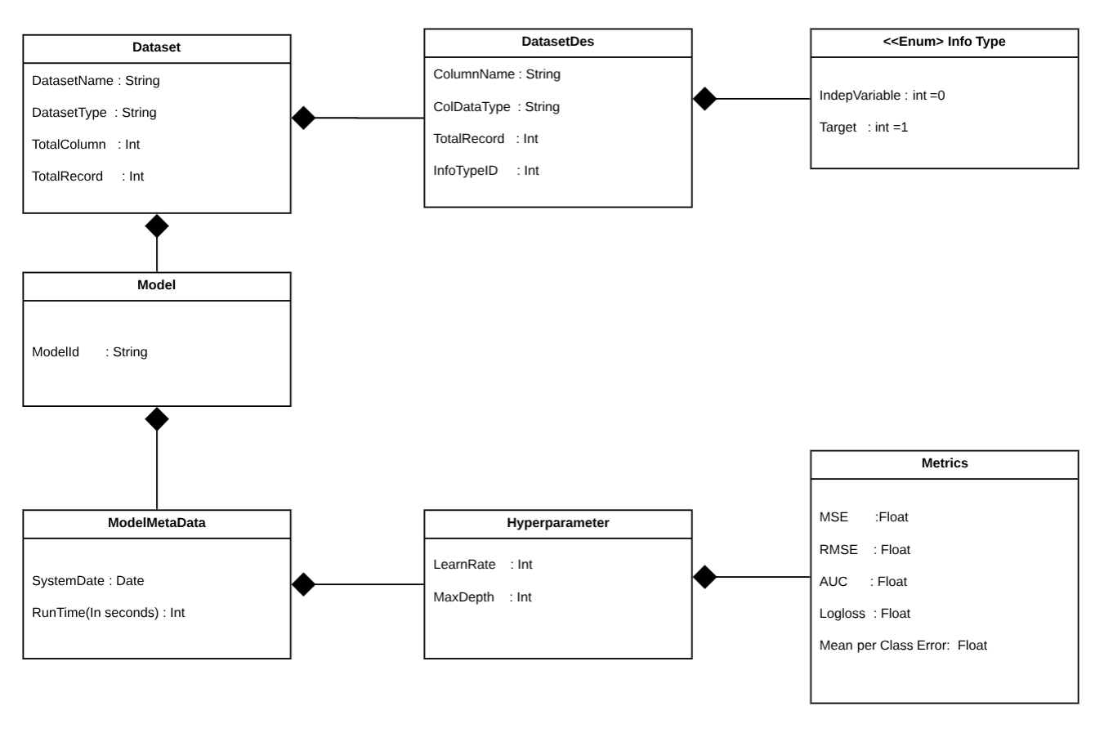

Slide 5
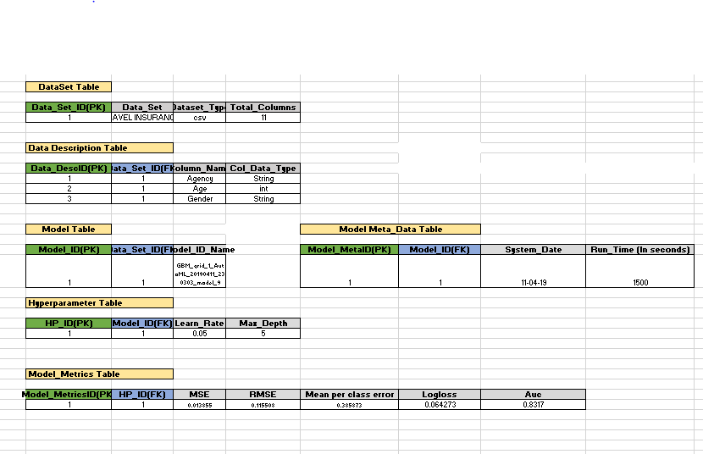

Slide 6
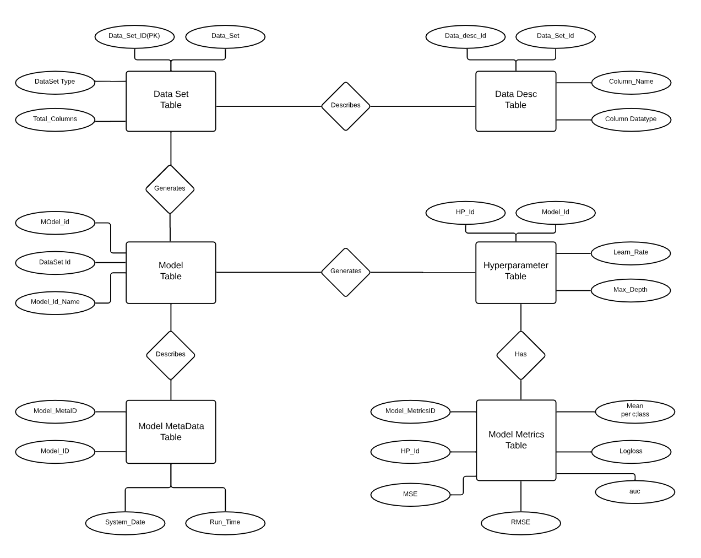

Slide 7
Tasks Completed:
We have analyzed Travel Insurance dataset
As of now two models are generated using H2O software
Best hyper parameters are chosen for the models generated
Conceptual Model and ER diagram are built on based on above
Pending Tasks:
DS team is working on generating few more models for different runtime. Hence we may need to change our ER accordingly
Later normalization will be performed and physical database will be built
Finally, analysis will be performed on database and user cases will be created on the same

Slide 8


