Slide 1
INFO 6210 Data Management and Database Design Database Project Proposal
AI Skunkworks Project
Hyperparameter Database
Team DB14
Pratiksha Milind Lavhatre: 001388250
Megha Ponneti Nanda: 001388342

Slide 2

Objective
To create Hyperparameter Database by running several hyperparameter values on Travel Insurance Dataset
To calculate the individual conditional expectations on every hyperparameter on quality of model

Slide 3
Data Source : Kaggle Dataset
A third-party TRAVEL INSURANCE servicing company that is based in Singapore.
The attributes:
Target: Claim Status
Name of agency
Type of travel insurance agencies
Distribution channel of travel insurance agencies
Name of the travel insurance products
Duration of travel
Destination of travel
Amount of sales of travel insurance policies
Commission received for travel insurance agency
Gender of insured
Age of insured

Slide 4
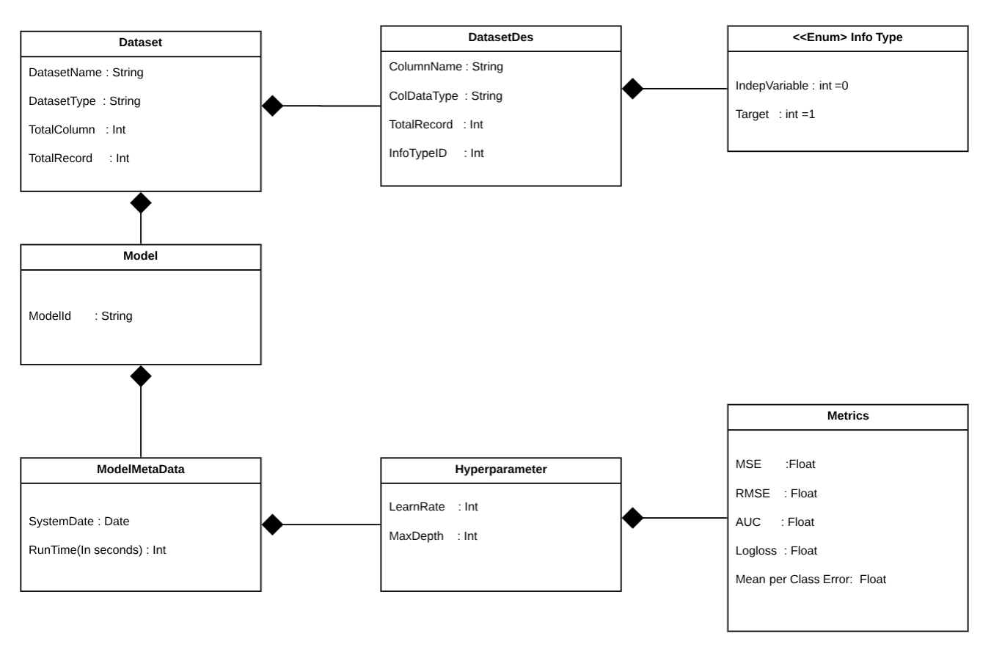

Slide 5
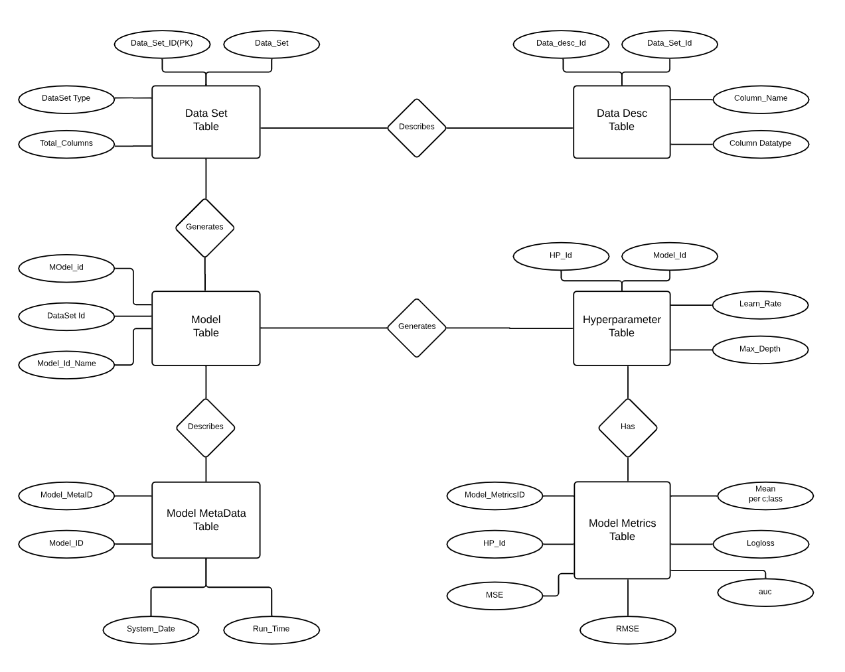

Slide 6


