Slide 1
Hyperparameters DB
1409076
Hsiang-Hua Chen

Slide 2
What's hyperparameters
Hyperparameters are parameters that are specified prior to running machine learning algorithms that have a large effect on the predictive power of statistical models.
Knowledge of the relative importance of a hyperparameter to an algorithm and its range of values is crucial to hyperparameter tuning and creating effective models.

Slide 3
Project idea
The hyperparameter database allows users to visualize and understand how to choose hyperparameters that maximize the predictive power of their models.
The hyperparameter database is created by running millions of hyperparameter values, calculating the individual conditional expectation of every hyperparameter on the quality of a model.
The data science part need to generating models using H2O to find best hyperparameters

Slide 4
Dataset
Housing price always been a popular item that people wants to predict. Since it is critical for us to find out the factors that affecting transaction price.
The data we collected and stored concerns predicting housing transaction price which contains values of cities, floors, unit area households counts and parking capacity, rooms, heat fuel, heat type and front door structure.

Slide 5
Finished
Clean the data
Denote the data into H2O
Create multiple functions to avoid the repeat code
Run H2O AutoML for different runtime ( 300, 500, 1000, 1500, 2000 seconds)
Store the best model of each runtime
Store the Leaderboard, Hyperparameter, Variable Importance from each model for every run

Slide 6
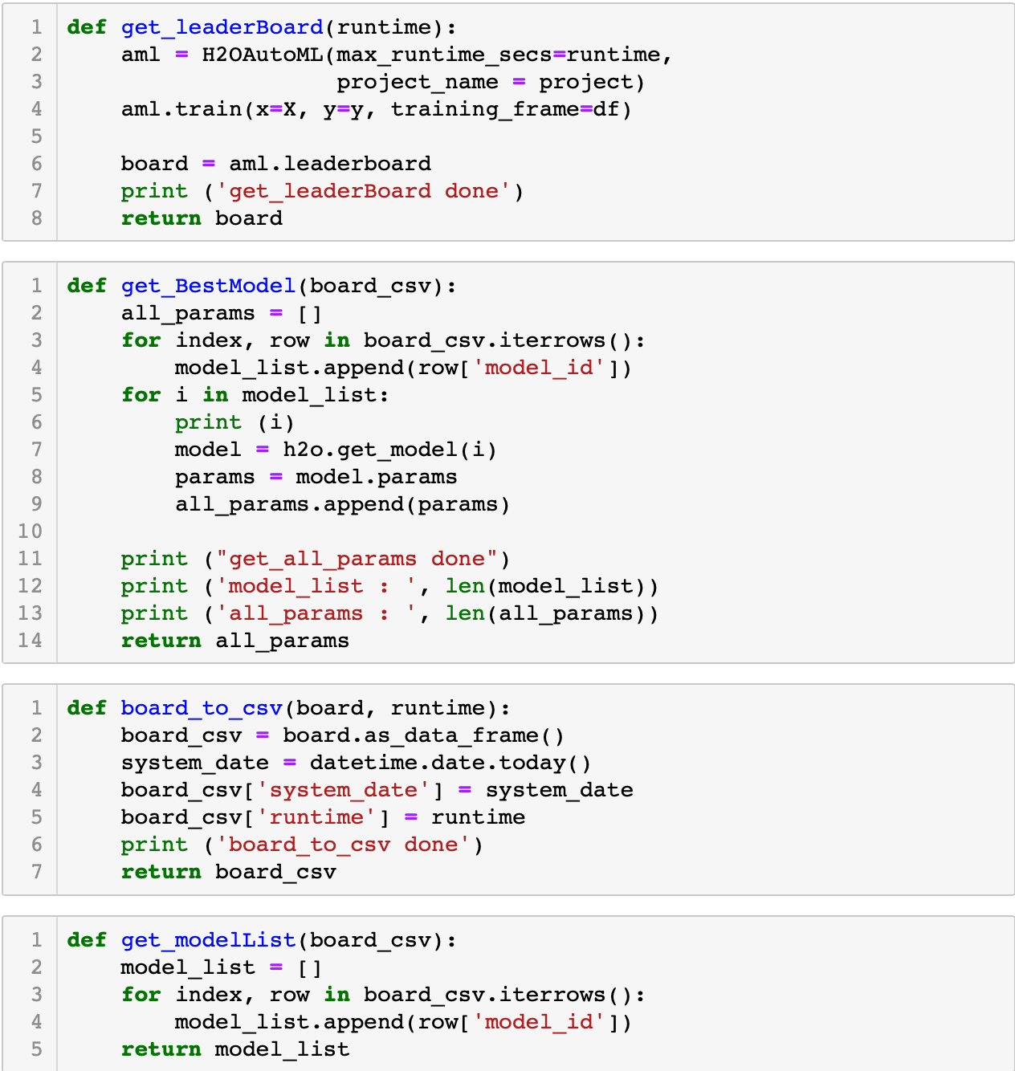
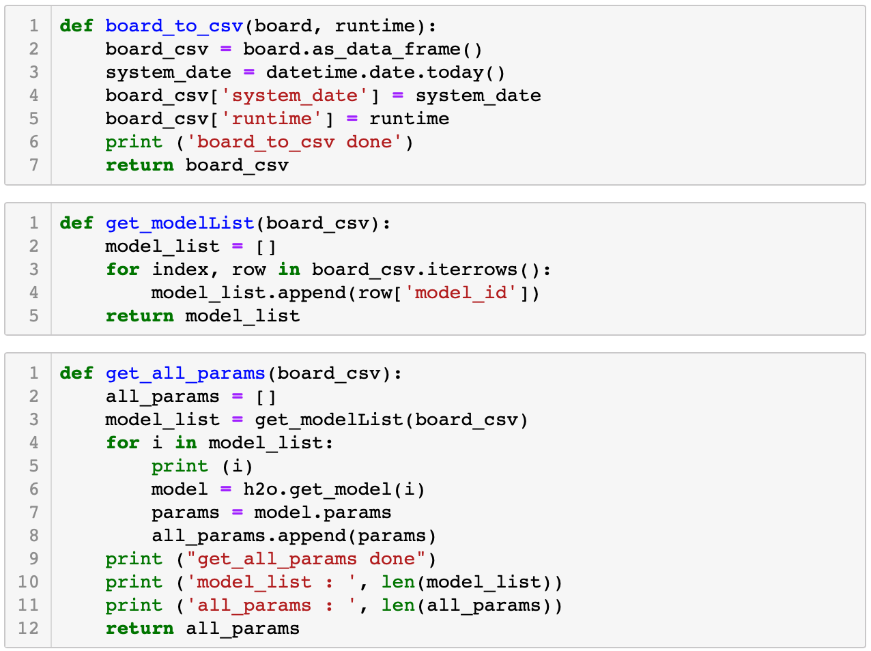
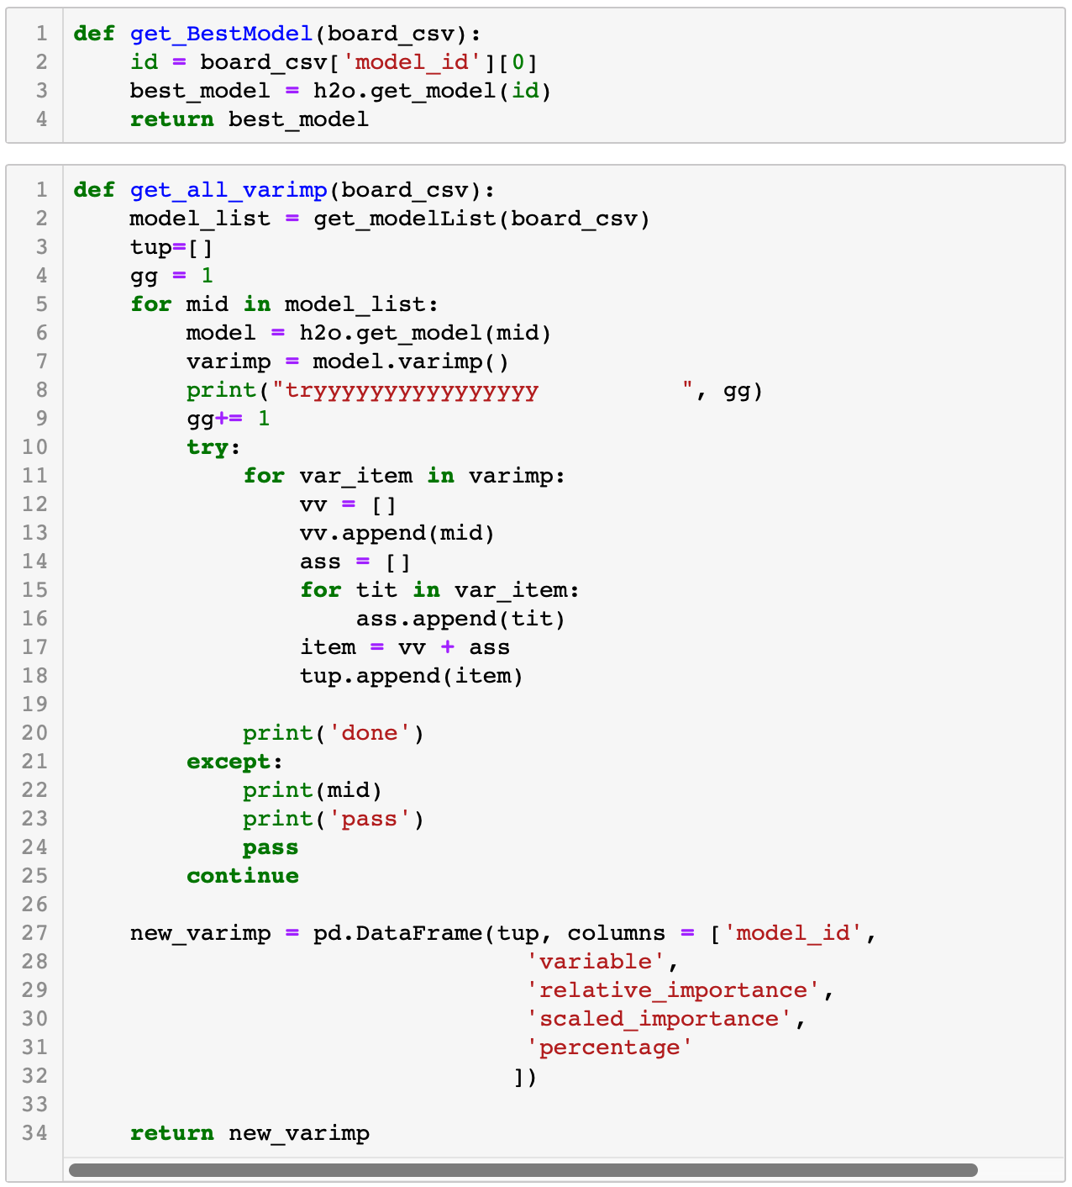

Slide 8
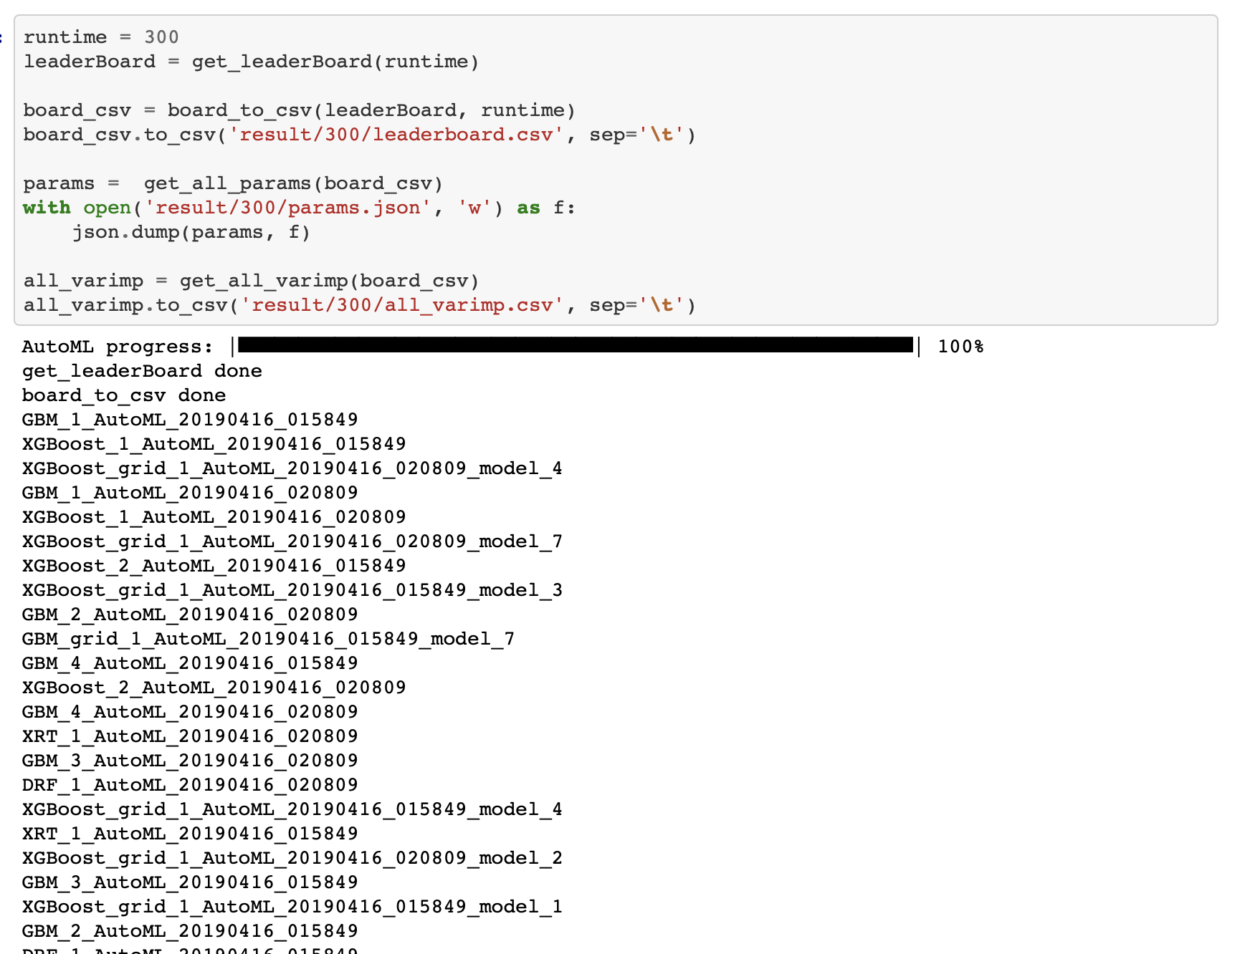

Slide 9
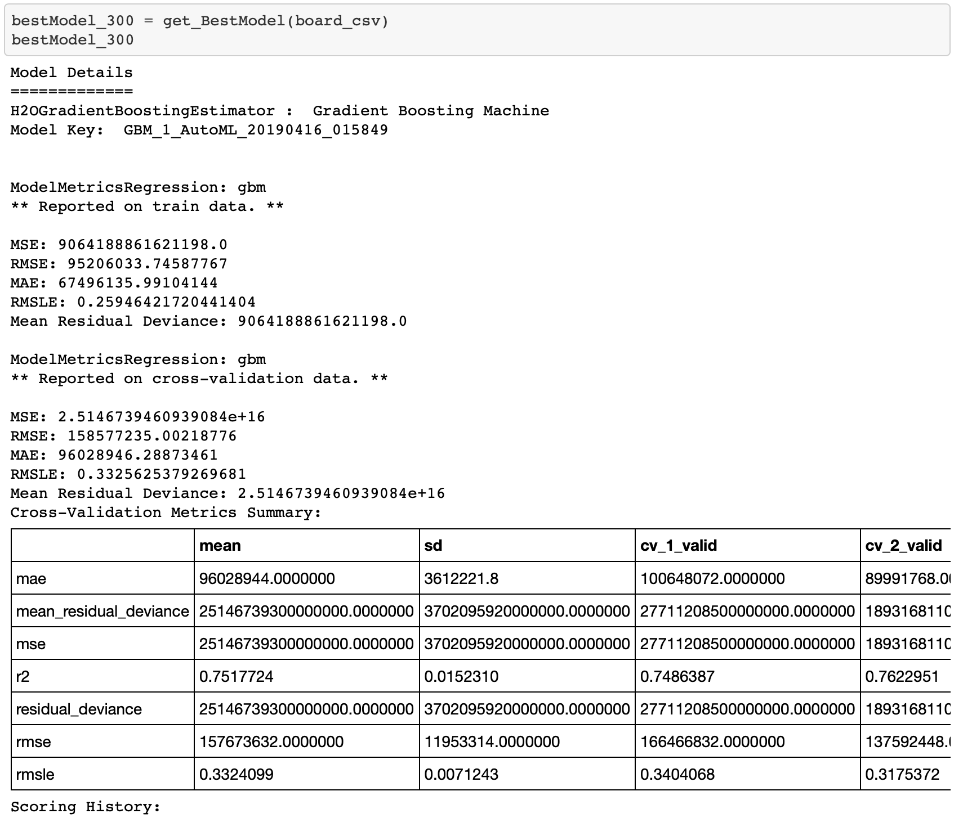

Slide 10
To Do List
Analyze the best model from each run
Find the best model
Compare the best model from different algorithms
Find the important hyperparameters of each algorithms
Complete the document

