Slide 1
Hyperparameters DB
1409076
Hsiang-Hua Chen

Slide 2
Dataset
Housing price always been a popular item that people wants to predict. Since it is critical for us to find out the factors that affecting transaction price.
The data we collected and stored concerns predicting housing transaction price which contains values of cities, floors, unit area households counts and parking capacity, rooms, heat fuel, heat type and front door structure.
And from the processing of data, I found out the supply_area is most related to the transaction price.

Slide 3
Finished
Clean the data
Denote the data into H2O
Create multiple functions to avoid the repeat code
Run H2O AutoML for different runtime ( 300, 500, 1000, 1500, 2000 seconds)
Store the best model of each runtime
Store the Leaderboard, Hyperparameter, Variable Importance from each model for every run

Slide 4
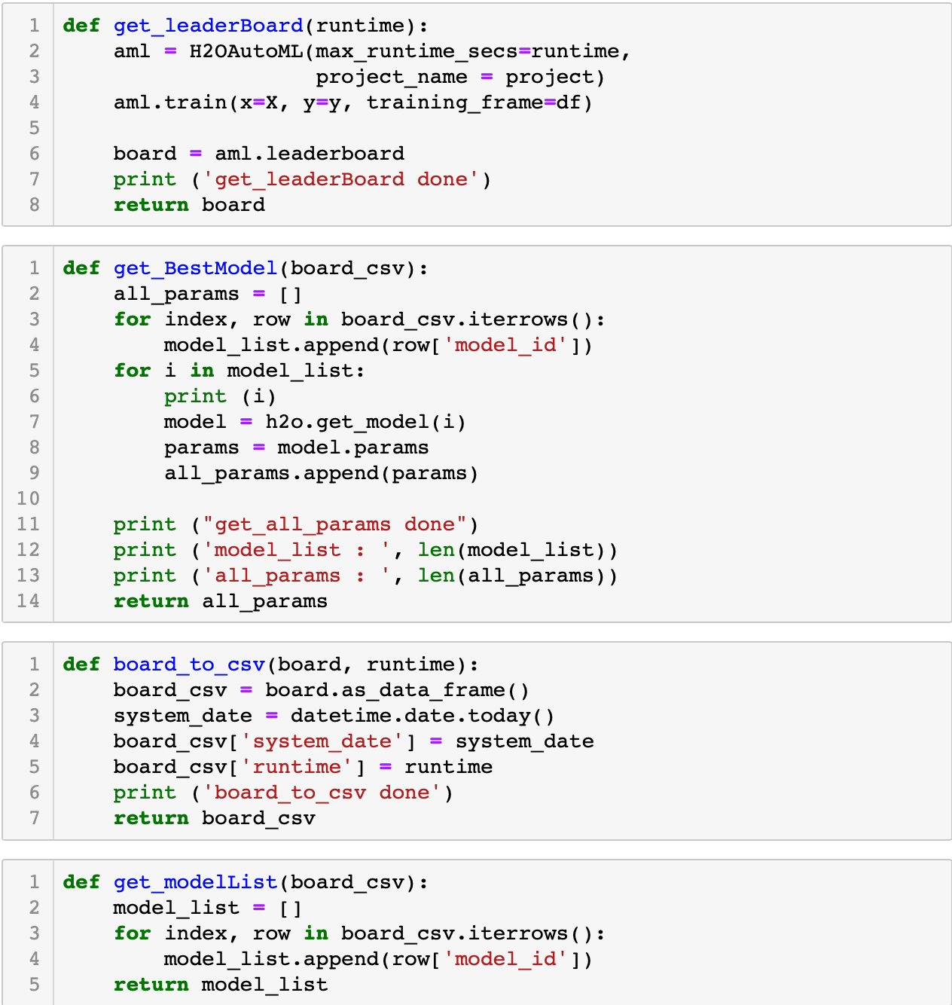
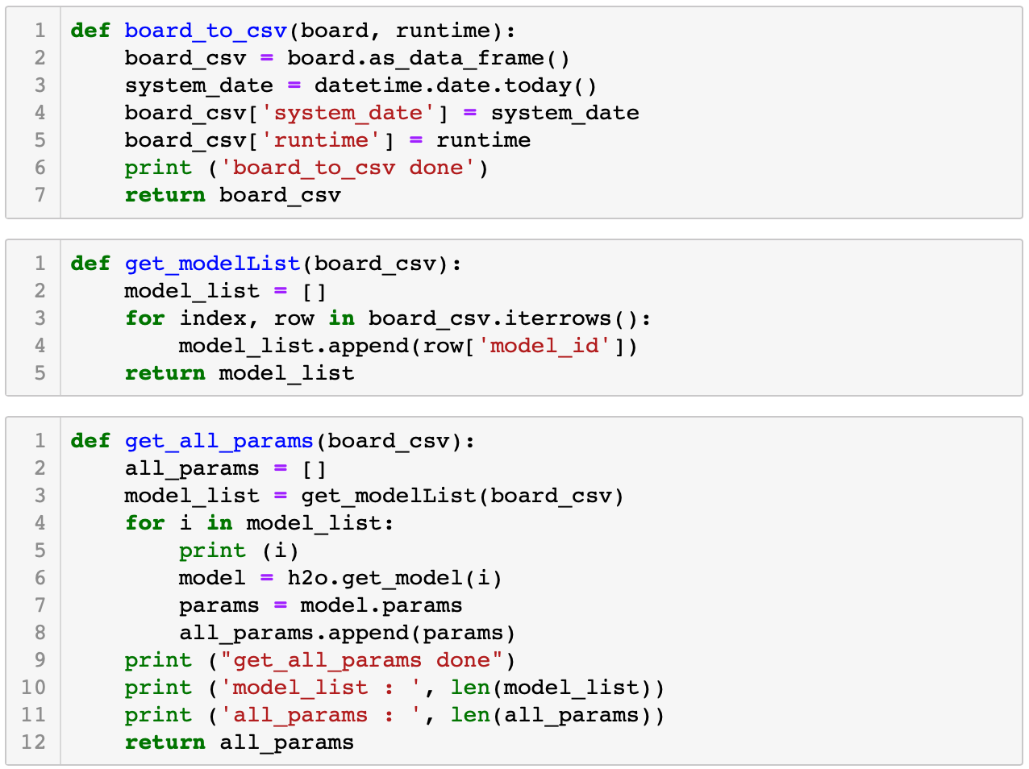
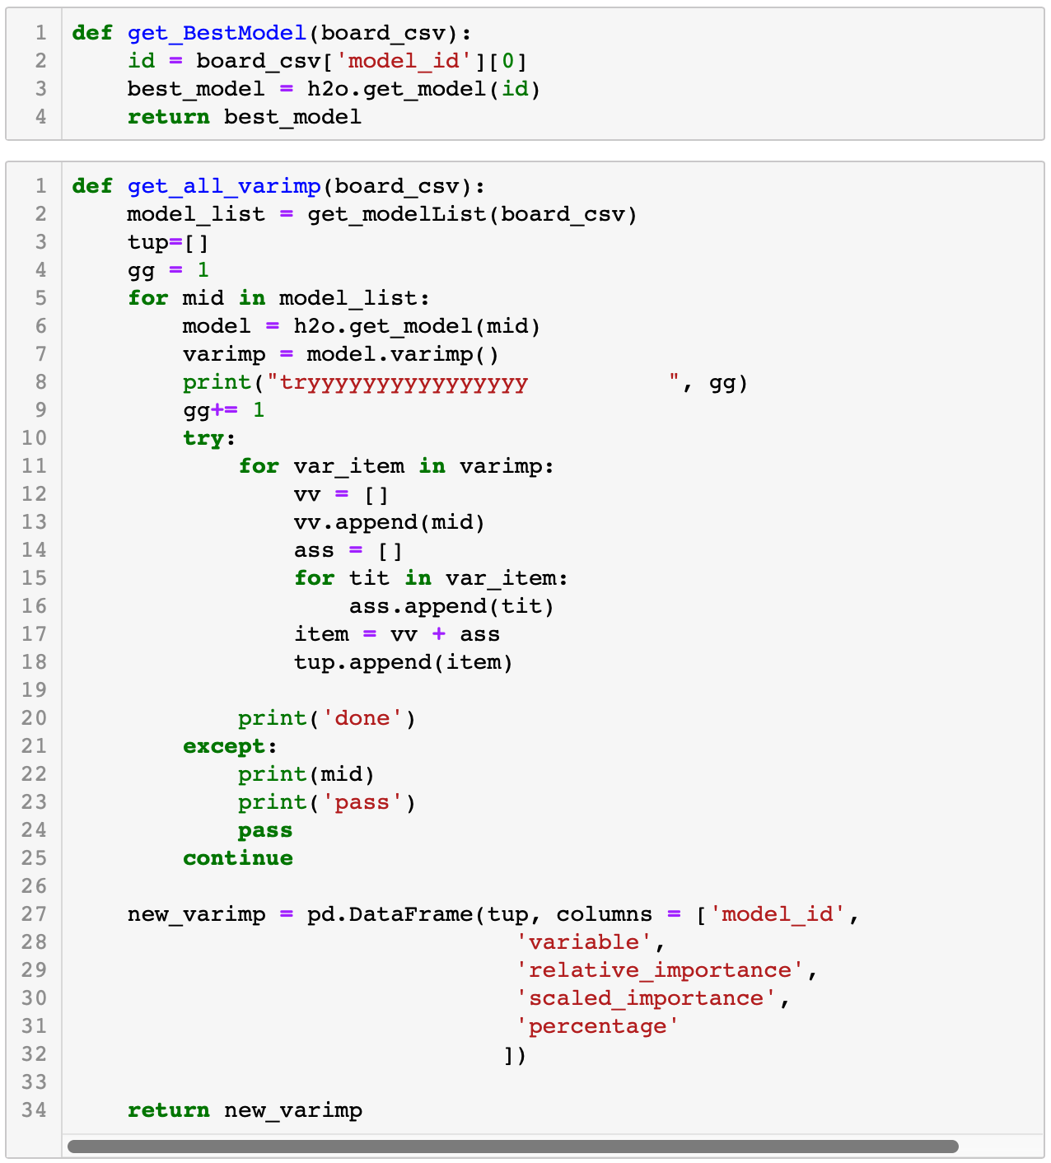

Slide 6
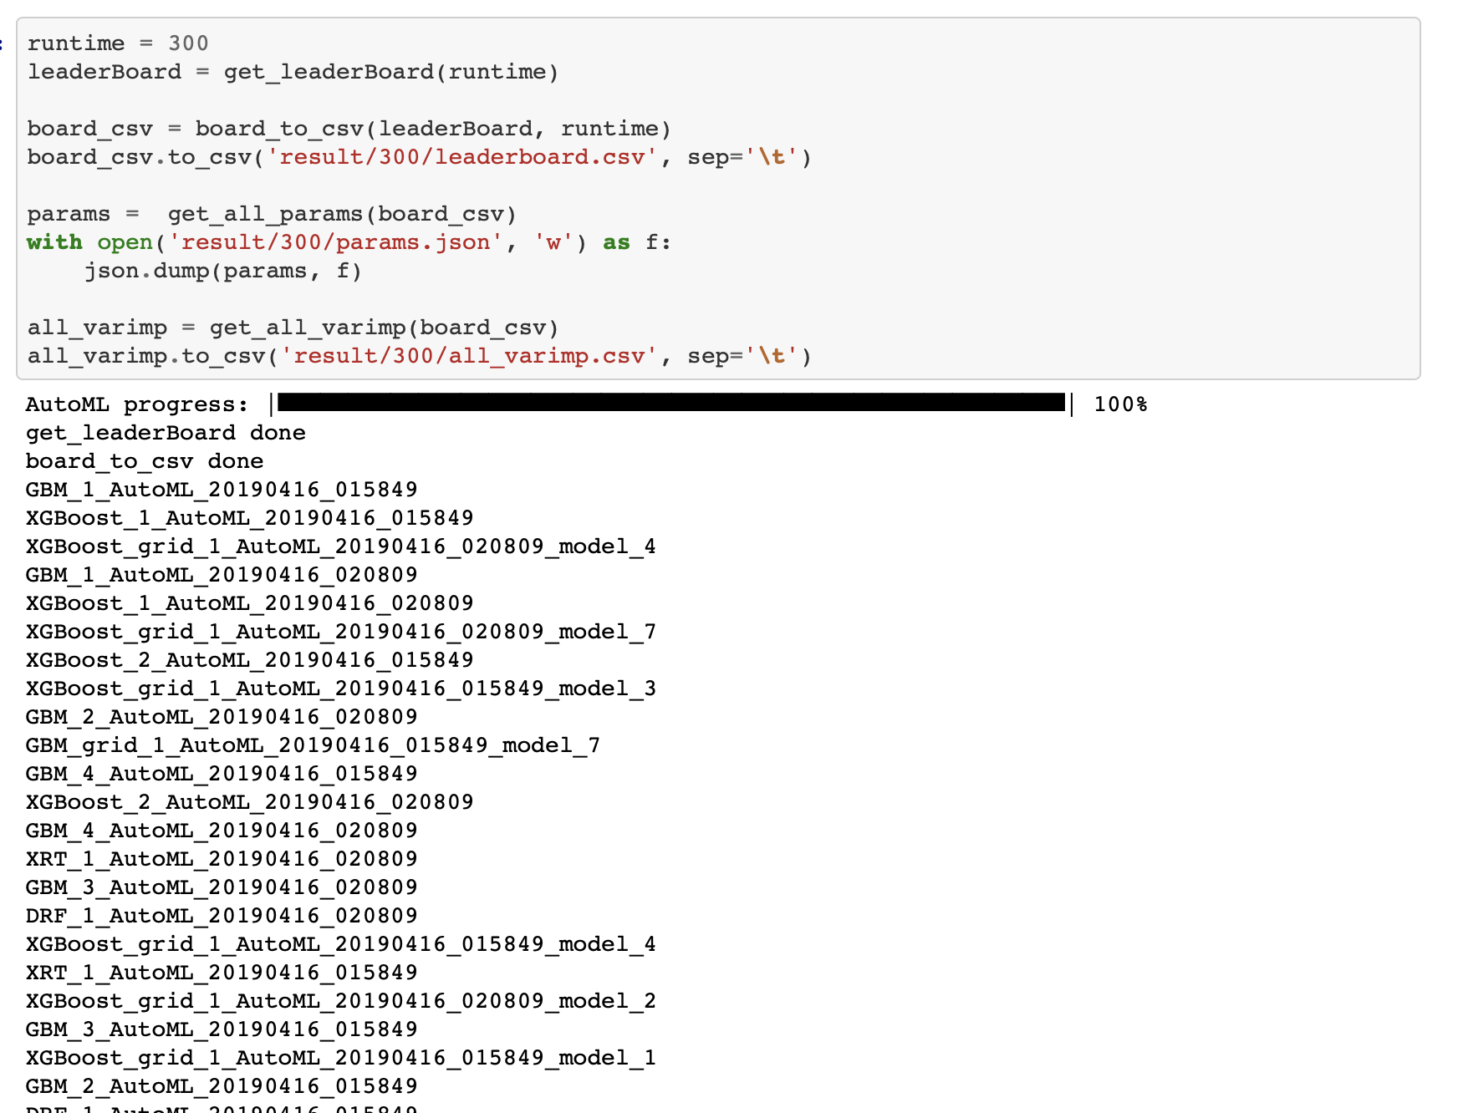

Slide 7
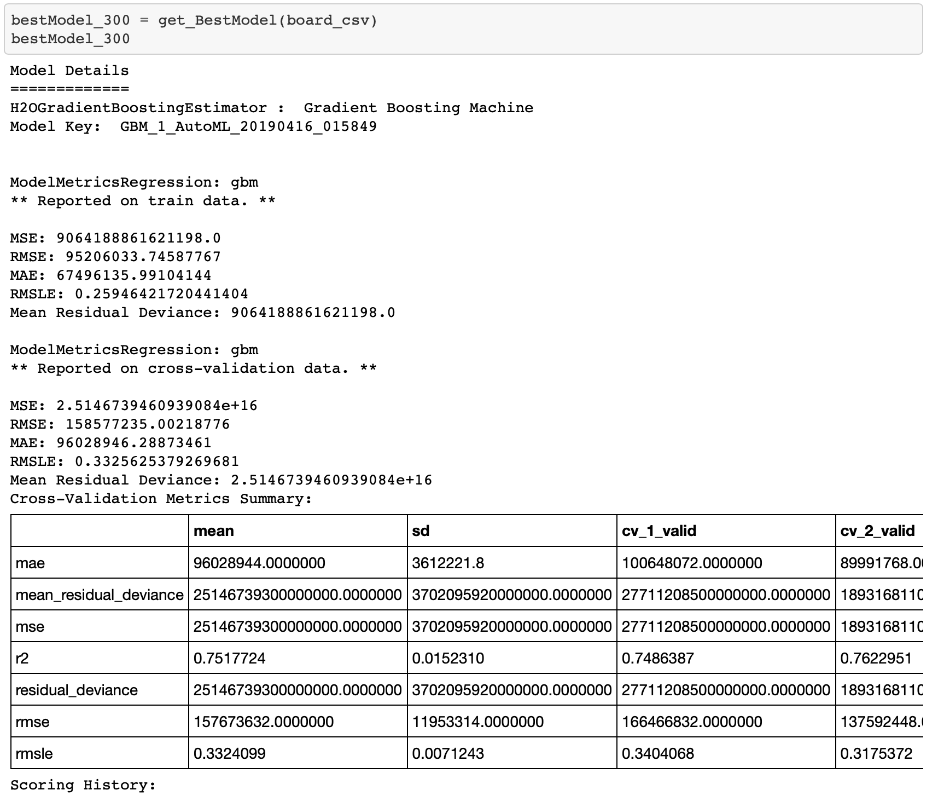

Slide 8
To Do List
Analyze the best model from each run
Compare the different best model of different runtime
Find the best model
Make a conclusion
Complete the document

