Slide 1
Hyperparameter database
Group - DS-08
Predicting the prices of Melbourne houses
Yerragunta venu gopal reddy
Nikhitha sindhiya

Slide 2
What is parameter & hyperparameter
A model parameter is a configuration variable that is internal to the model and whose value can be estimated from the given data. They are required by the models to make predictions.
A model hyperparameter is a configuration that is external to the model and whose value cannot be estimated from data. They are usually using heuristics for a given predictive model

Slide 3
Accomplishments
We have selected the Melbourne housing dataset in which we will be predicting the prices of houses
Identified the type of dataset as regression
Performed data cleaning and pre-processing
Ran H2O to get models via leaderboard for run-times of 500, 800, 1000, 1300, 1500 sec
Got the hyperparameters for every model on the leaderboard
Saved all the model’s hyperparameters, meta data in to a JSON file to be embedded in the database

Slide 4
Goals
Find the important hyperparameters
Find the range of hyperparameters
Compare the range of values across the models for different hyperparameters

Slide 5
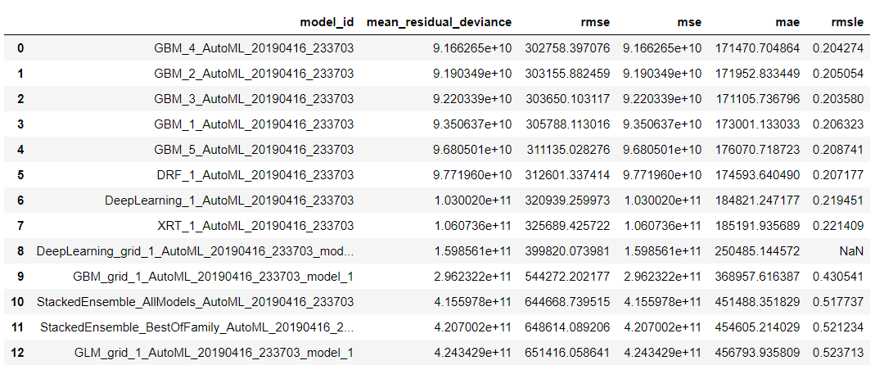
Leaderboard for runtime of 500sec

Slide 6
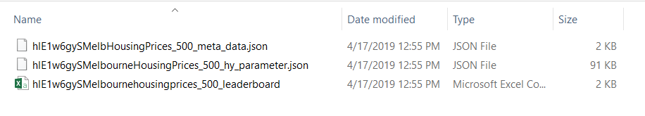
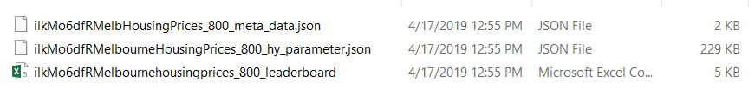
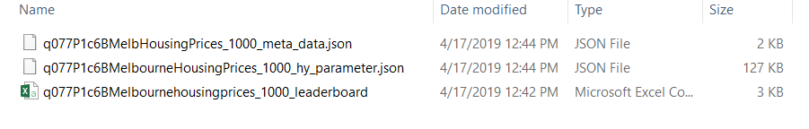
Metadata, leaderboard for runtimes of 500, 800 and 1000 seconds

Slide 7
Remaining things to do
We need to start the analysis part
Finding the best value ranges of the hyperparameters for all the models by plotting hyperparameter against its values
We will be comparing the metrics with the corresponding hyperparameter values to find the importance of hyperparameters for every algorithm

Slide 8
Thank You

