Slide 1


K.RAMAKRISHNAN COLLEGE OF TECHNOLOGY
(AUTONOMOUS), TRICHY
Pharmacy Management System
PRESENTED BY SUPERVISOR
INIYAN L Mrs.K.Valli Priyadharshini M.E., (PhD),
2303811710421065 AP/CSE.

Slide 2
PRESENTATION OVERVIEW
Objective
Project Introduction
Problem Statement
Methodologies (Programming concepts relevant to problem statement)
Architecture of the proposed system
List of Modules
7. Merits
8. Results and Discussion
9. Queries

Slide 3
OBJECTIVE
To allow users to add drugs to the inventory, providing a structured way to manage stock levels.
To facilitate the sale of drugs by allowing users to specify the drug and quantity, while ensuring that sufficient stock is available.
To provide users with the ability to view the current inventory, displaying relevant information such as drug names, prices, and quantities.

Slide 4
PROJECT INTRODUCTION
The Pharmacy Management System is a software application designed to help pharmacy managers efficiently manage drug inventory, handle sales transactions, and monitor stock levels.
This system is built using Java with AWT (Abstract Window Toolkit) for the graphical user interface (GUI). It allows users to add new drugs to the inventory, sell existing drugs, and view the current stock of drugs in the pharmacy.
The system provides a simple, interactive interface with basic functionalities necessary for managing pharmacy operations. This includes tracking drug names, prices, and quantities, along with ensuring smooth sales transactions.

Slide 5
PROBLEM STATEMENT
The lack of a digital system to track inventory updates (such as when drugs are sold) makes it difficult to maintain real-time stock information.
Selling drugs without real-time stock tracking can result in overselling, where a drug is sold even if the quantity in stock is insufficient.
The absence of an intuitive, easy-to-use interface for entering drug information and processing sales transactions makes it harder for staff to perform their tasks effectively.

Slide 6
METHODOLOGIES
Encapsulation:The Drug class encapsulates the attributes of a drug (name, price, quantity) and provides getter and setter methods to access and modify these attributes.
Abstraction:The details of how drugs are stored, sold, and managed are abstracted away from the user. The user interacts with the system through the GUI without needing to know the internal working of inventory management or stock updating processes.
Event-Driven Programming:The system is designed around the Event-Driven Programming model, where the flow of the program is determined by user interactions (events) such as clicking buttons or entering data. This methodology allows the system to respond dynamically to user actions
Error Handling: Ensures that sales cannot occur if there is insufficient stock and provides appropriate feedback.

Slide 7
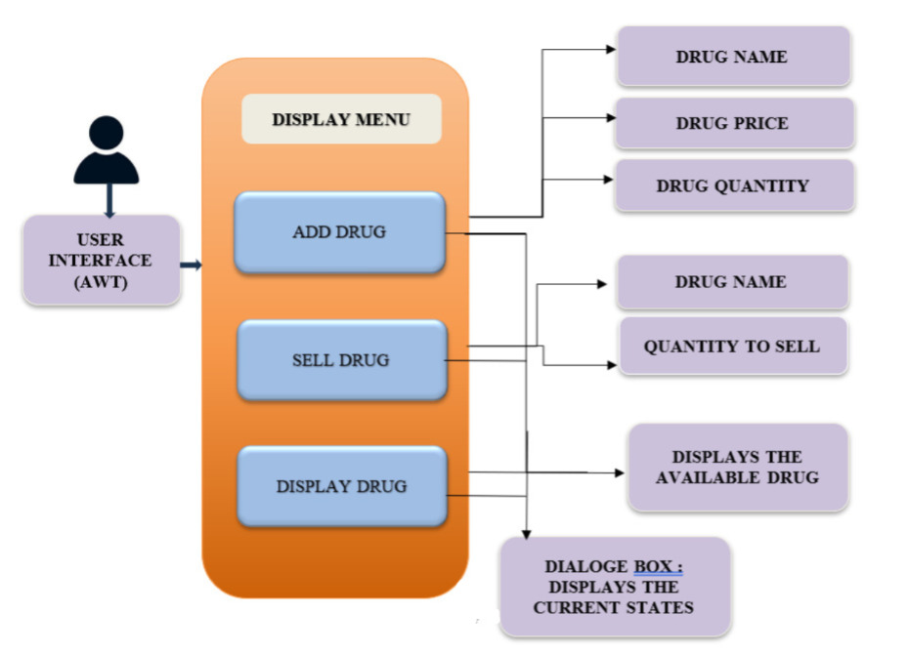
ARCHITECTURE OF THE PROPOSED SYSTEM

Slide 8
LIST OF MODULES
Drug Management Module: Manages the creation and modification of drugs.
Inventory Management Module: Keeps track of all drugs in the inventory, including quantities.
Sales Management Module: Manages the selling of drugs, checking stock availability and updating the inventory.
User Interface (UI) Module: Provides the graphical interface for the user to interact with the system.
Error Handling and Validation Module: Ensures user inputs are correct and provides feedback on errors.
Message Display Module: Displays success or error messages to users.

Slide 9
MERITS
Real-Time Inventory Management: The system keeps track of the inventory in real-time. When a drug is sold, its quantity is updated instantly, and this ensures accurate tracking of stock levels.
No Complex Database Management: The system uses an ArrayList to store inventory data, which is suitable for small-scale applications. For a more extensive system, integration with a database can be easily achieved in the future
Lightweight Design: The system is lightweight, relying on standard Java AWT components. There is no heavy dependency on external libraries, which ensures that the system runs efficiently with minimal resources.

Slide 10
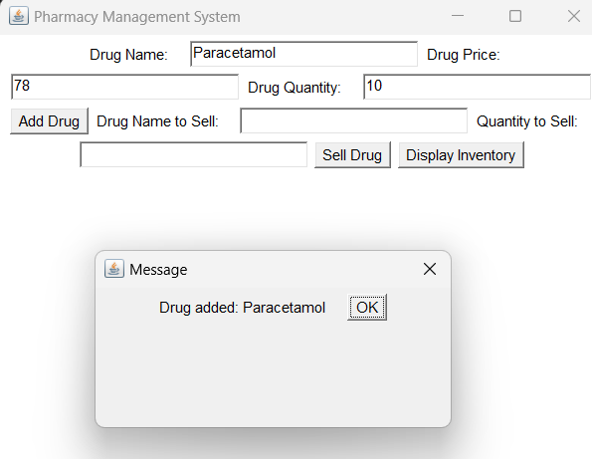
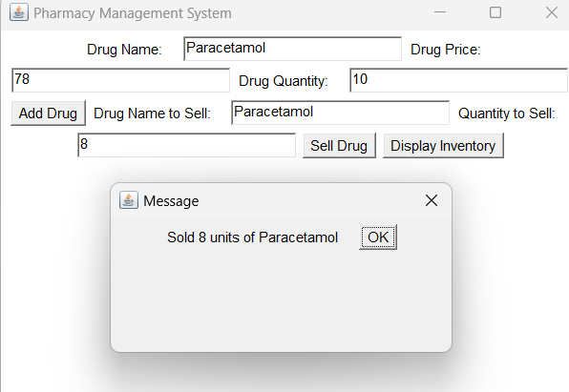
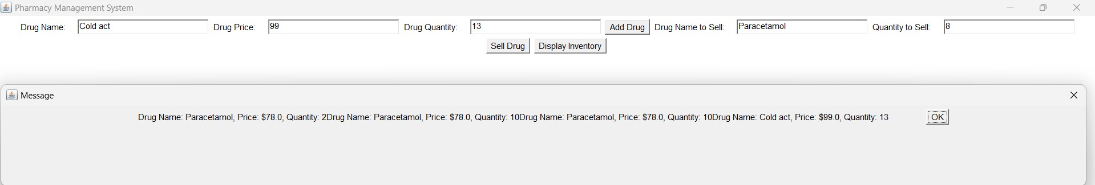
RESULTS AND DISCUSSION
ADD DRUG
SELL DRUG
DISPLAY INVENTORY

Slide 11
RESULTS AND DISCUSSION
DISPLAY INVENTORY

Slide 12

QUERIES

