Slide 1




NERO: A Neural Rule Grounding Framework for Label-Efficient Relation Extraction
Wenxuan Zhou¹, Hongtao Lin¹, Bill Yuchen Lin¹, Ziqi Wang², Junyi Du¹, Leonardo Neves³, and Xiang Ren¹
University of Southern California¹, Tsinghua University², Snapchat Inc³.

Slide 2
Relation Extraction
Microsoft was founded by Bill Gates.
Relation: founded_by
Mike was born March 26 , 1965 , in US.
Relation: origin
What is the semantic relationship between the given entities?

Slide 3







Neural Model for Relation Extraction
BiLSTM + ATT
(Zhang et al. 2018)
$$MLP+SoftMax$$
$${Attention:a}_{i}$$
0.3
$$0.05$$
0.3
$$0.05$$
$$0.3$$
founded_by
$${BiLSTM:h}_{i}$$
$${Embedding:x}_{i}$$
Microsoft was founded by Bill_Gates
Need a lot of human-annotated labels!
Research question:
How to train a good neural model with less human labor?

Slide 4

Standard Pipeline for Labeling Data
Corpus
Labels
Microsoft was founded by Bill Gates in 1975.
Apple was founded by Steven Jobs in 1976.
Amazon was founded by Jeff Bezos in 1994.
ORG: FOUNDED_BY
ORG: FOUNDED_BY
ORG: FOUNDED_BY
Neural Classifier
Annotator
Standard Data Annotation
Slow, redundant annotation efforts on similar instances!

Slide 5
Semi-supervised Learning: Self-Training
Classifier
Labeled Sentences
Labels
Microsoft was founded by Bill Gates in 1975.
Apple was founded by Steven Jobs in 1976.
ORG: FOUNDED_BY
ORG: FOUNDED_BY
1. Train
3. Merge
Unlabeled Sentences
Labels
Microsoft was established by Bill Gates in 1975.
In 1975, Bill Gates launched Microsoft.
ORG: FOUNDED_BY
PER: FOUNDER
2. Predict
Can create pseudo-labeled data, but will suffer from cascading error propagation
(Rosenberg et al., 2005)

Slide 6
Alternative Labeling Scheme: Labeling Rules
Corpus
Labels
Microsoft was founded by Bill Gates in 1975.
Apple was founded by Steven Jobs in 1976.
Amazon was founded by Jeff Bezos in 1994.
ORG: FOUNDED_BY
ORG: FOUNDED_BY
ORG: FOUNDED_BY
SUBJ-ORG was founded by OBJ-PER $→$ ORG: FOUNDED_BY
Annotator
Labeling Rules
Annotate contextually similar instances via much fewer rules
(Hearst, 1992)

Slide 7

Challenge: Language Variations
Corpus
Labels
Microsoft was founded by Bill Gates in 1975.
Apple was founded by Steven Jobs in 1976.
Microsoft was established by Bill Gates in 1975.
In 1975, Bill Gates launched Microsoft.
ORG: FOUNDED_BY
ORG: FOUNDED_BY
No Matched!
No Matched!
SUBJ-ORG was founded by OBJ-PER $→$ ORG: FOUNDED_BY
Annotator
A lot of similar sentences cannot be matched
$⇒$ Not enough training data
$⇒$ Poor performance
Do we have to add more labeling rules?

Slide 8
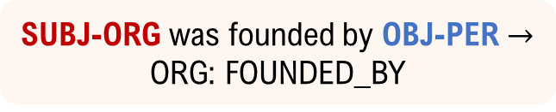
Rethinking the Matching Process
Hard-matching
No Matched
Microsoft was established by Bill Gates
SUBJ-ORG was founded by OBJ-PER
Microsoft was established by Bill Gates in 1975.
SUBJ-ORG was founded by OBJ-PER $→$ ORG: FOUNDED_BY
Microsoft was established by Bill Gates
SUBJ-ORG was founded by OBJ-PER
Neural representation
Matching Score
Soft-matching

Slide 9
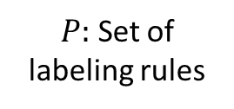
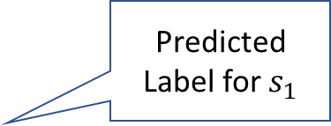









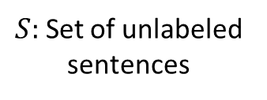
Rethinking the Matching Process
$P:$ Set of labeling rules
$S:$ Set of unlabeled sentences
label, score
Predicted Label for $s_{1}$
0.2
$$p_{1}$$
$$s_{1}$$
$$r_{1}, 0.9$$
$$p_{2}$$
0.9
$$s_{2}$$
$$r_{2}, 0.3$$
…
0.5
…
…
$$p_{m}$$
$$s_{n}$$
$$r_{n}, 0.7$$
1. soft-matching of rule-sentence pairs
2. weighting labels by matching scores

Slide 10
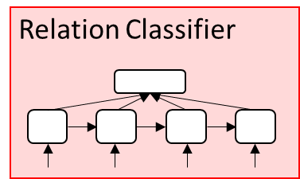
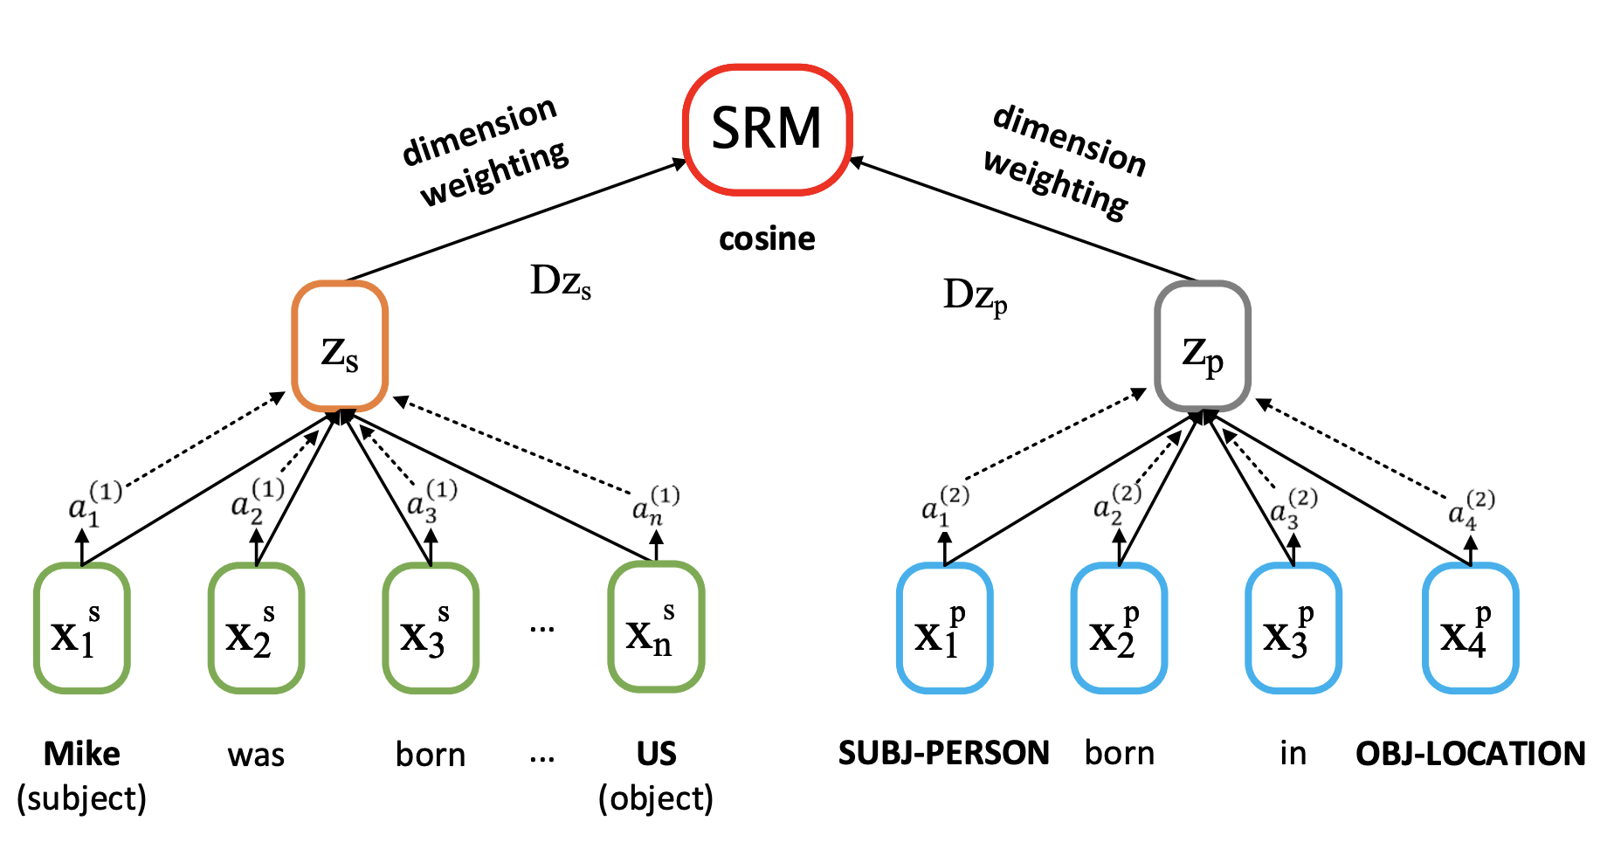
Our Idea: Neural Rule Grounding for Data Augmentation
Generalizing rules’ coverage via text similarity
Matched Sentences
Labels
Corpus
Microsoft was founded by Bill Gates in 1975.
Apple was founded by Steven Jobs in 1976.
ORG: FOUNDED_BY
ORG: FOUNDED_BY
Microsoft was founded by Bill Gates in 1975.
Apple was founded by Steven Jobs in 1976.
Microsoft was established by Bill Gates in 1975.
In 1975, Bill Gates launched Microsoft.
Unmatched Sentences
Labels + Matching Score
Microsoft was established by Bill Gates in 1975.
In 1975, Bill Gates launched Microsoft.
ORG: FOUNDED_BY 0.8
ORG: FOUNDED_BY 0.7
1. Hard-matching
Labeling Rules
2. Dynamic
Soft-matching
SUBJ-ORG was founded by OBJ-PER $→$ ORG: FOUNDED_BY
SUBJ-PER born in OBJ-LOC $→$ PER: ORIGIN
Soft Rule Matcher
Notes:
Block

Slide 11
Soft Rule Matcher: Architecture
Unmatched Sentences
Labels + Matching Score
Microsoft was established by Bill Gates in 1975.
In 1975, Bill Gates launched Microsoft.
ORG: FOUNDED_BY 0.8
ORG: FOUNDED_BY 0.7
Labeling Rules
SUBJ-ORG was founded by OBJ-PER $→$ ORG: FOUNDED_BY
SUBJ-PER born in OBJ-LOC $→$ PER: ORIGIN
2. Dynamic
Soft-matching

Slide 12
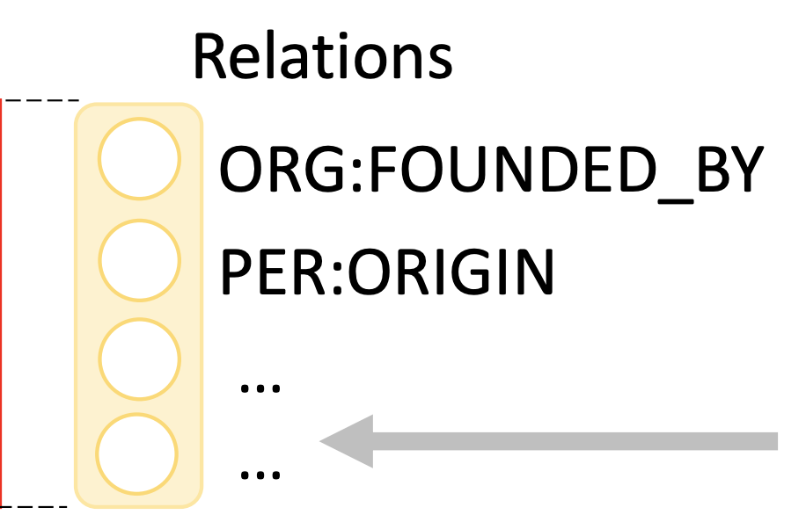
Joint Parameter Learning: Relation Extractor + Soft Rule Matcher
Matched Sentences
Labels
Microsoft was founded by Bill Gates in 1975.
Apple was founded by Steven Jobs in 1976.
ORG: FOUNDED_BY
ORG: FOUNDED_BY
Labeling Rules
SUBJ-ORG was founded by OBJ-PER $→$ ORG: FOUNDED_BY
SUBJ-PER born in OBJ-LOC $→$ PER: ORIGIN
Unmatched Sentences
Labels + Matching Score
Microsoft was established by Bill Gates in 1975.
In 1975, Bill Gates launched Microsoft.
ORG: FOUNDED_BY 0.8
ORG: FOUNDED_BY 0.7
2. Dynamic
Soft-matching
$$L_{matched}$$
$$L_{unmatched}$$
$$L_{rules}$$
Cross-entropy loss on relation labels

Slide 13
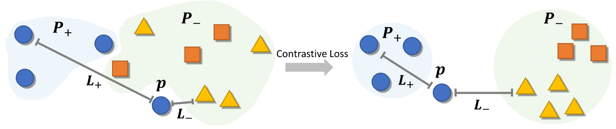
Joint Parameter Learning: Relation Extractor + Soft Rule Matcher
Labeling Rules
SUBJ-ORG was founded by OBJ-PER $→$ ORG: FOUNDED_BY
SUBJ-PER born in OBJ-LOC $→$ PER: ORIGIN
$$L_{clus}$$
Contrastive loss for discriminating rule bodies

Slide 14
Joint Parameter Learning: Relation Extractor + Soft Rule Matcher
$$L=L_{matched}+α⋅L_{unmatched}+β⋅L_{rules}+γ⋅L_{clus}$$
Matched Sentences
Labels
Corpus
Microsoft was founded by Bill Gates in 1975.
Apple was founded by Steven Jobs in 1976.
ORG: FOUNDED_BY
ORG: FOUNDED_BY
Microsoft was founded by Bill Gates in 1975.
Apple was founded by Steven Jobs in 1976.
Microsoft was established by Bill Gates in 1975.
In 1975, Bill Gates launched Microsoft.
Unmatched Sentences
Labels + Matching Score
Microsoft was established by Bill Gates in 1975.
In 1975, Bill Gates launched Microsoft.
ORG: FOUNDED_BY 0.8
ORG: FOUNDED_BY 0.7
1. Hard-matching
Labeling Rules
2. Dynamic
Soft-matching
SUBJ-ORG was founded by OBJ-PER $→$ ORG: FOUNDED_BY
SUBJ-PER born in OBJ-LOC $→$ PER: ORIGIN

Slide 15

Generating Labeling Rules
Corpus
Microsoft was founded by Bill Gates in 1975.
Apple was founded by Steven Jobs in 1976.
Microsoft was established by Bill Gates in 1975.
In 1975, Bill Gates launched Microsoft.
No need to write labeling rules by yourself!
1. Automatic Pattern Mining
Frequent Patterns
Labeling Rules
SUB-ORG was founded by OBJ-PER.
SUBJ-ORG was founded by OBJ-PER $→$ ORG: FOUNDED_BY
2. Annotate Patterns
Annotator

Slide 16
Results on Relation Extraction
F1 score
Relation Extraction Performance (in F1 score) on TACRED

Slide 17
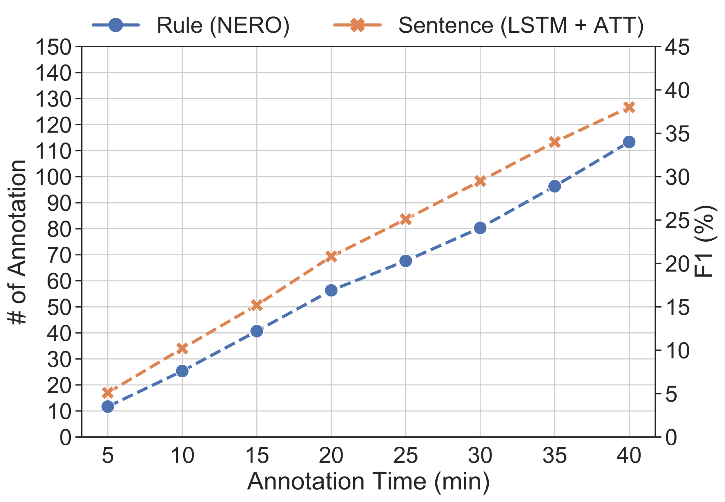
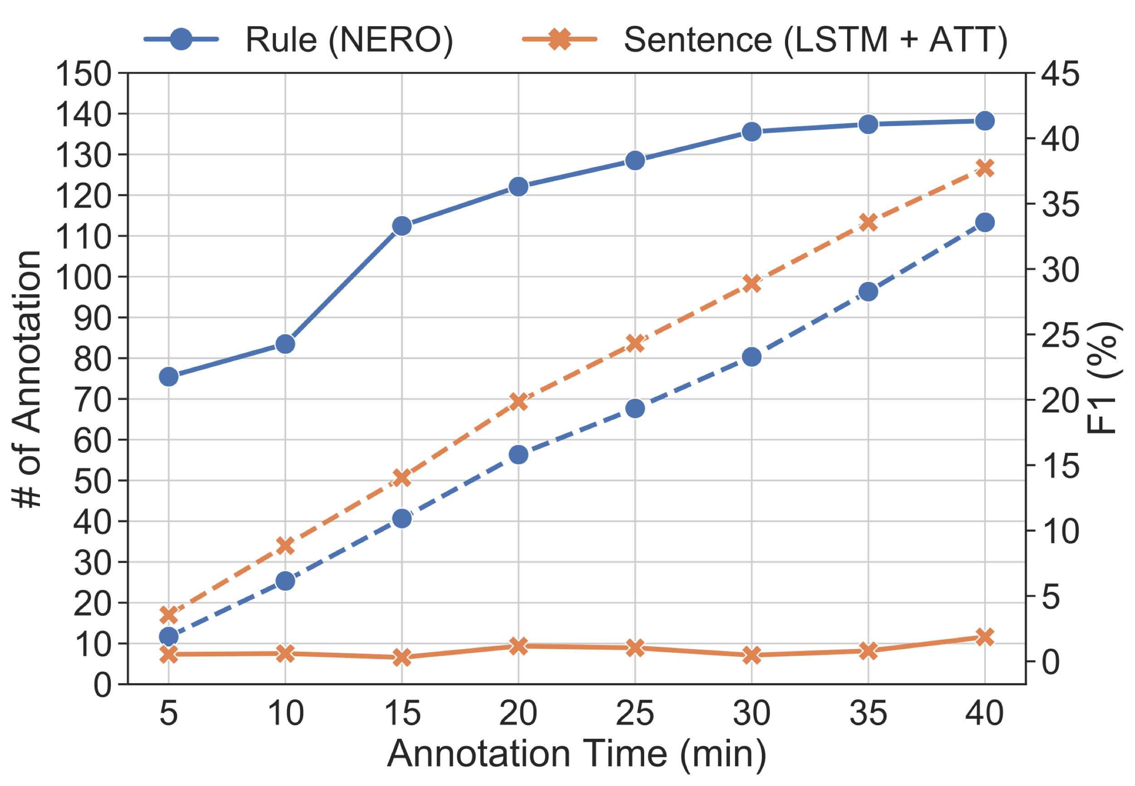
Study on Label Efficiency
Spent 40min
on labeling instances from TACRED
Dashed: Avg # of rules / sentences labeled by annotators.
Solid: Avg model F1 trained with corresponding annotations.
{Rules + Neural Rule Grounding} produces much more effective model with limited time!

Slide 18
Conclusion
Soft-matching mechanism for increased coverage.
A novel framework for label-efficient relation extraction.
Hard-matching + Dynamic Soft-matching
Joint Parameter Learning
Code available at https://github.com/INK-USC/NERO

