Slide 1

FINLATICS DS PROJECT
DIGITAL MARKETING

Slide 2
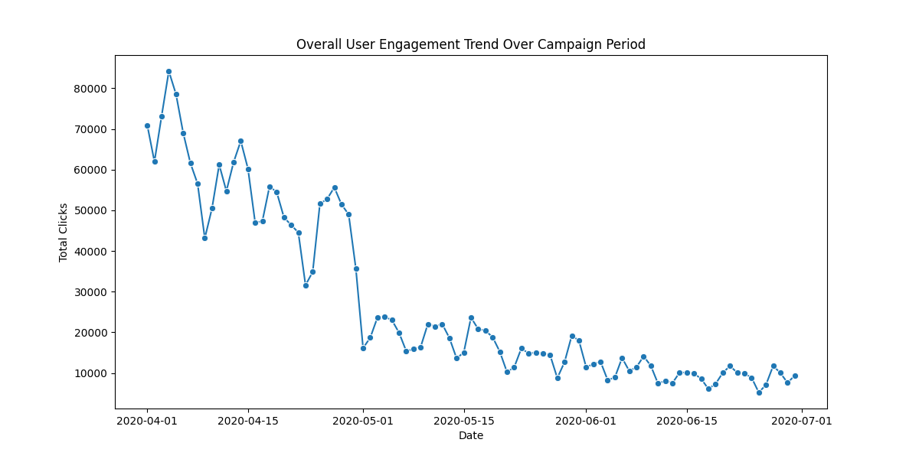
What is the overall trend in user engagement throughout the campaign period?
User engagement shows a significant overall downward trend throughout the campaign period, starting with a peak of over 80,000 total clicks in early April and steadily declining to approximately 10,000 clicks by July.

Slide 3
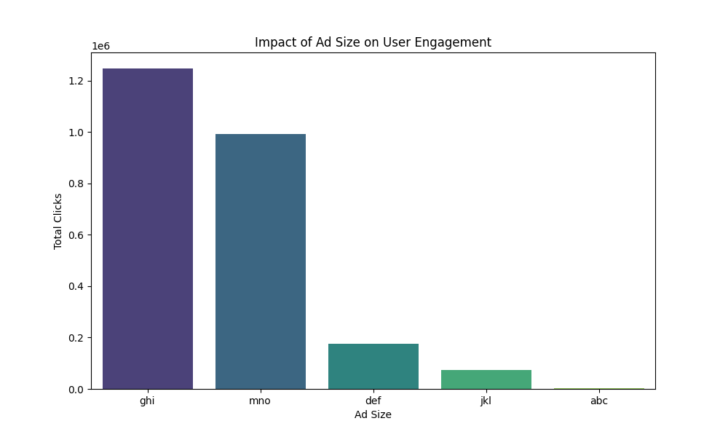
How does the size of the ad (banner) impact the number of clicks generated?
The number of clicks generated varies significantly by banner size, with "ghi" performing best with over 1.2 million clicks and "abc" performing worst with nearly zero clicks based on the scale.

Slide 4
Which publisher spaces (placements) yielded the highest number of displays and clicks
Placement type “mno” has 143161775 displays which is the highest number of displays overall.
Placement type “ghi” has 1247049 clicks which is highest number of clicks overall.

Slide 5
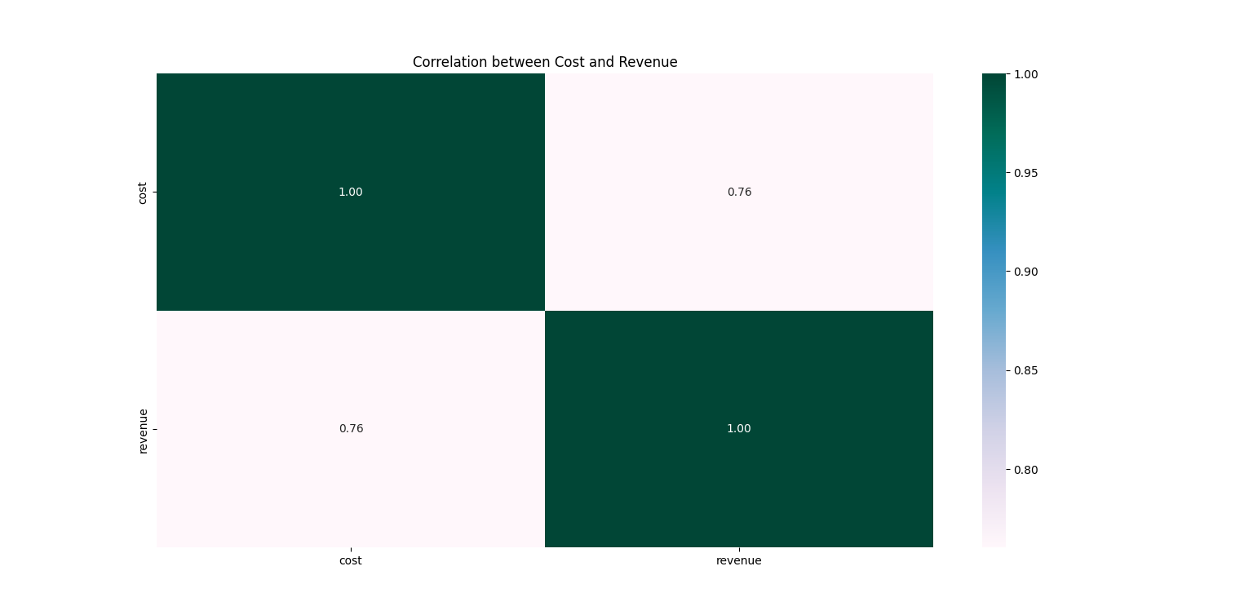
Is there a correlation between the cost of serving ads and the revenue generated from clicks?
There is a strong positive correlation of 0.76 between the cost of serving ads and the revenue generated from clicks.

Slide 6
What is the average revenue generated per click for Company X during the campaign period?
The Average Revenue Generated per for Click Company X during the campaign period :
0.0929432967821166 Dollars

Slide 7
Which campaigns had the highest post-click conversion rates?
Campaign First had the highest number of post-click conversion rates.

Slide 8
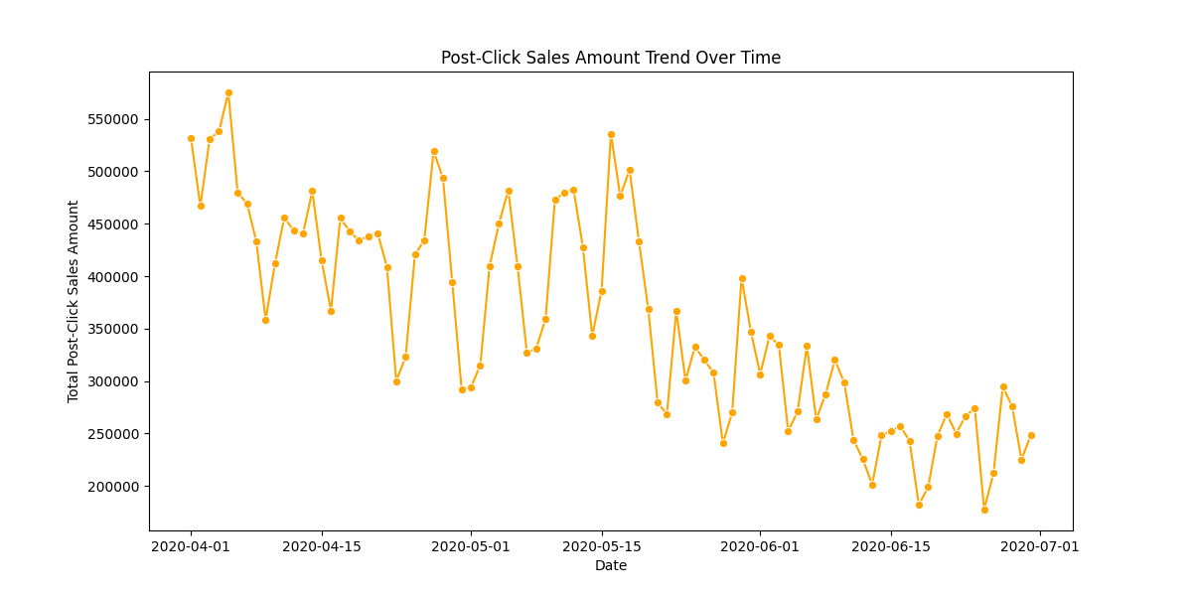
Are there any specific trends or patterns in post-click sales amounts over time?
The post-click sales amount shows a volatile overall downward trend from a peak of over 550,000 in early April to a low of under 200,000 in mid-June, despite a temporary recovery in mid-May.

Slide 9
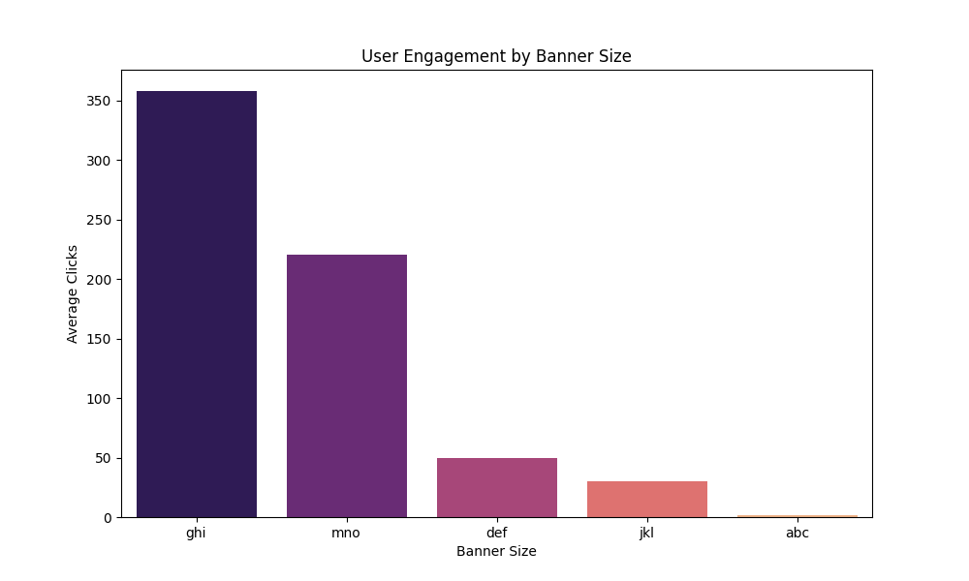
How does the level of user engagement vary across different banner sizes?
User engagement varies significantly across banner sizes, with ghi and mno generating the highest engagement levels, while def, jkl, and abc show progressively lower average and total clicks.

Slide 10
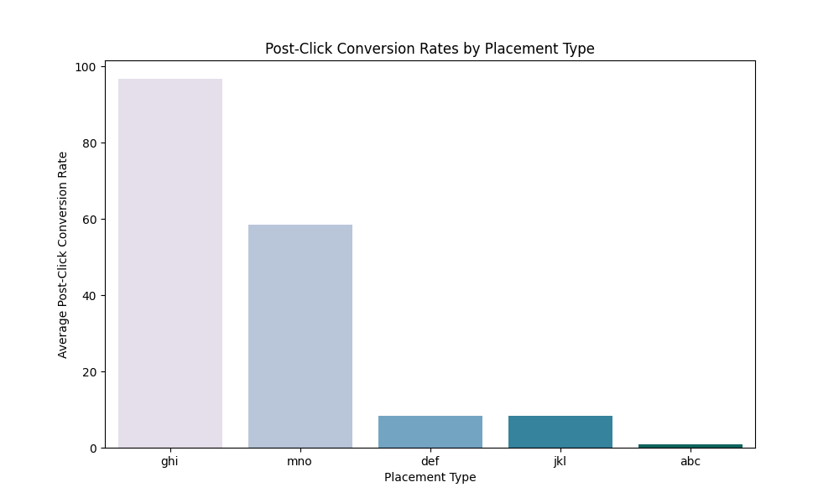
Which placement types result in the highest post-click conversion rates?
The placement types ghi and mno result in the highest average post-click conversion rates, with ghi significantly outperforming all others at nearly 100.

Slide 11
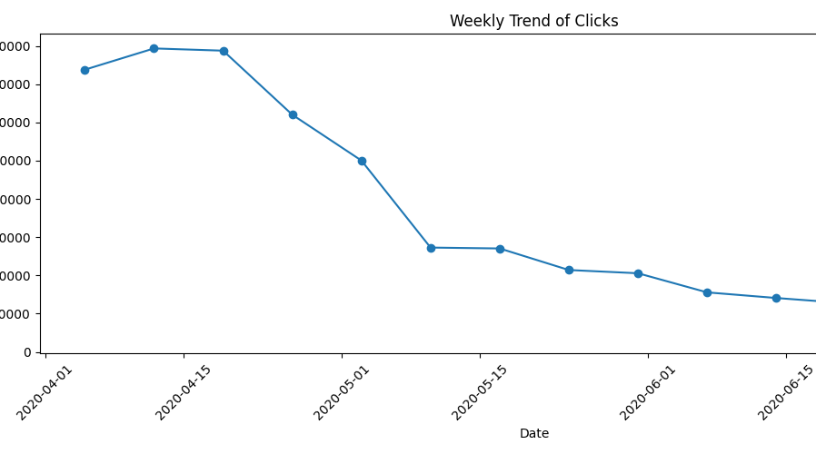
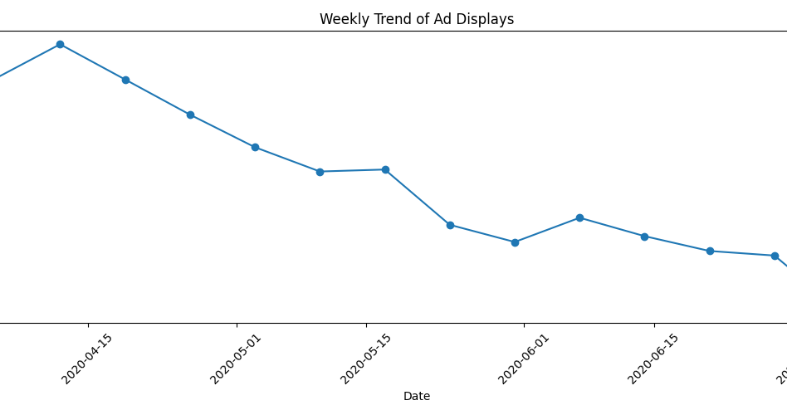
Can we identify any seasonal patterns or fluctuations in displays and clicks throughout the campaign period?
The weekly trends for both displays and clicks show a consistent seasonal decline throughout the campaign period, characterized by an initial peak in mid-April followed by a steady downward fluctuation ending in July

Slide 12
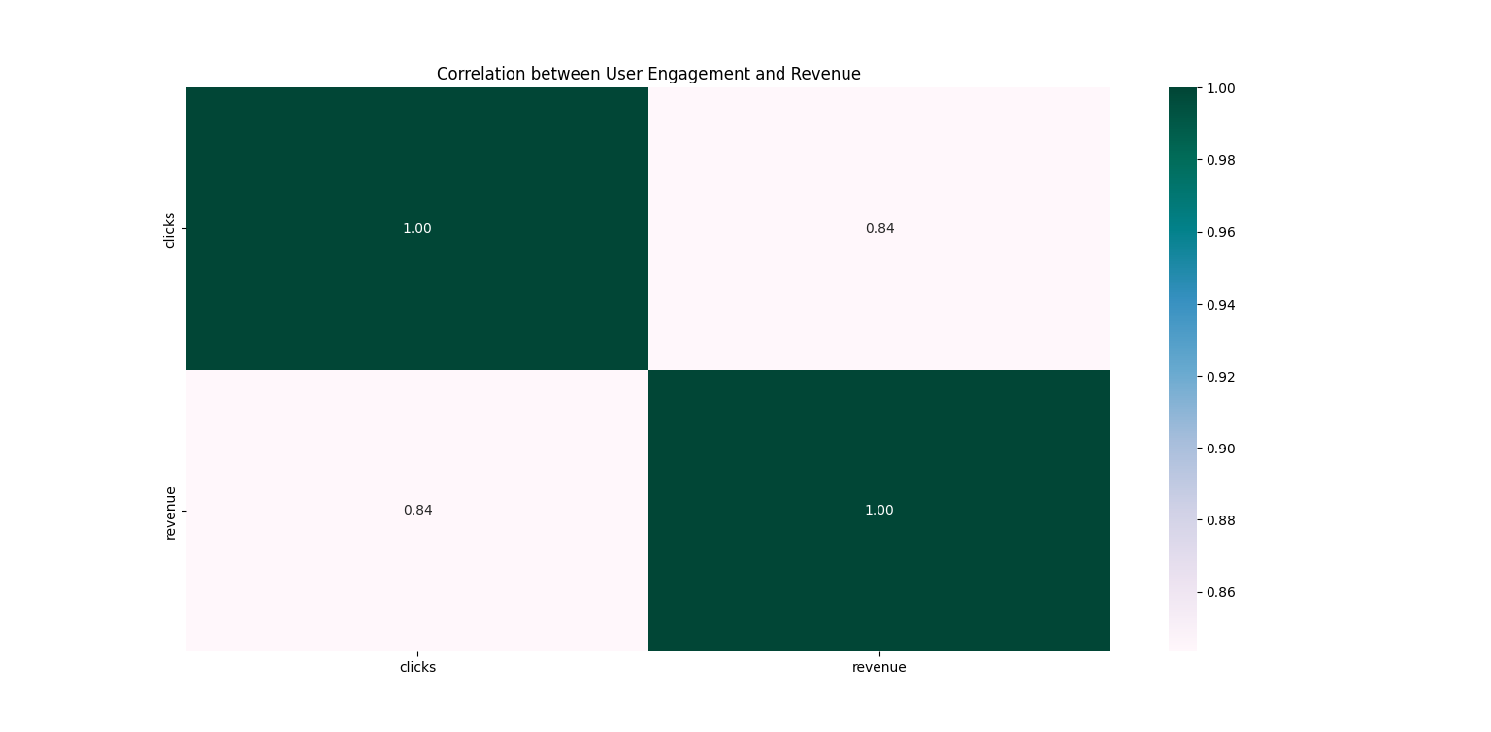
Is there a correlation between user engagement levels and the revenue generated?
There is a strong positive correlation of 0.84 between user engagement levels (clicks) and the revenue generated.

Slide 13
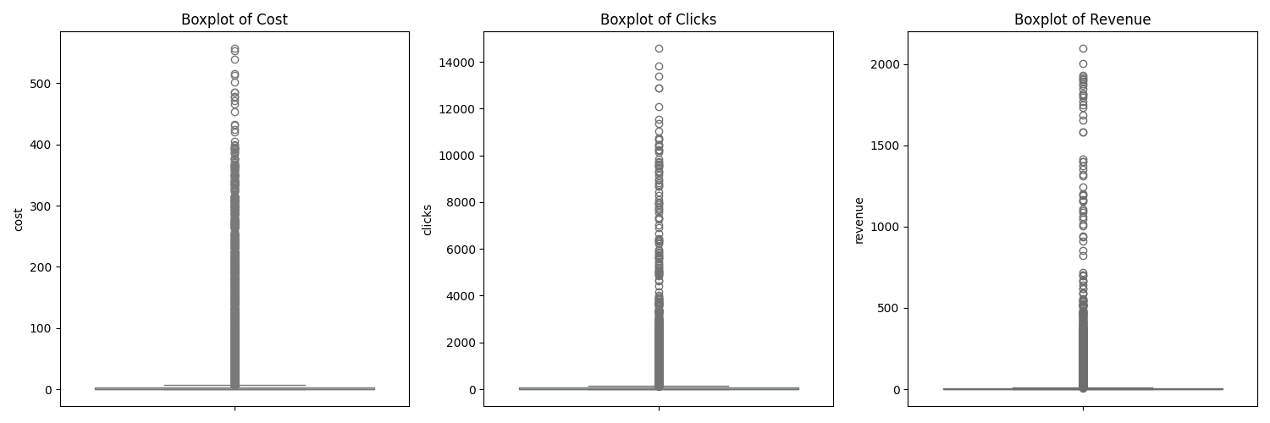
Are there any outliers in terms of cost, clicks, or revenue that warrant further investigation?
All three metrics (cost, clicks, and revenue) exhibit numerous high-value outliers far above their respective medians, with cost exceeding 500, clicks surpassing 14,000, and revenue reaching over 2,000, all of which warrant further investigation.

Slide 14
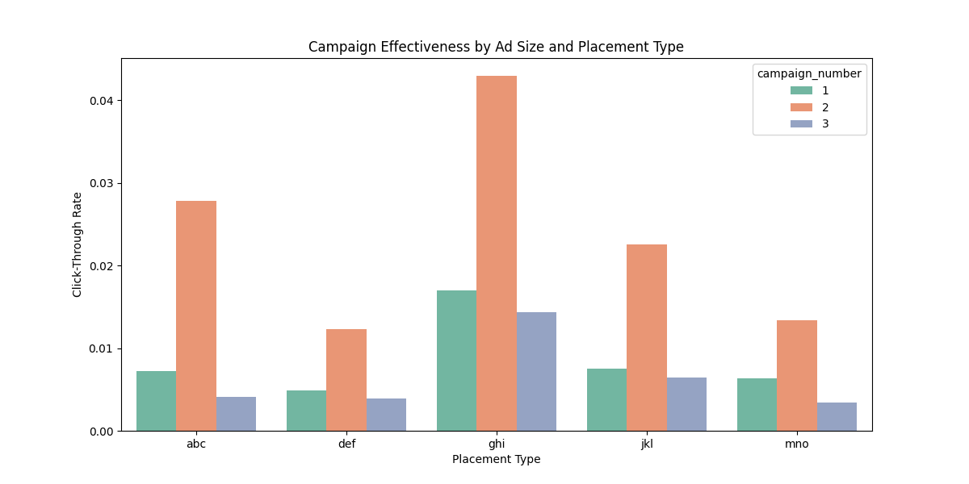
How does the effectiveness of campaigns vary based on the size of the ad and placement type?
Campaign effectiveness, measured by Click-Through Rate, varies significantly by placement and ad size, with campaign 2 consistently outperforming others across all placement types and achieving its peak effectiveness at placement ghi.

Slide 15
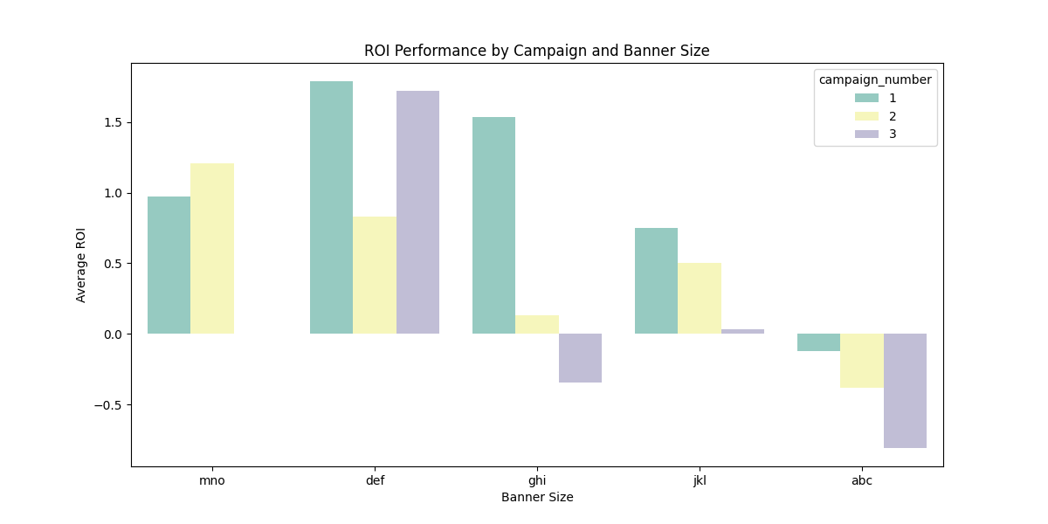
Are there any specific campaigns or banner sizes that consistently outperform others in terms of ROI?
Campaign 1 consistently outperforms other campaigns in terms of ROI across most banner sizes, while the def banner size achieves the highest ROI peaks for both campaigns 1 and 3

Slide 16
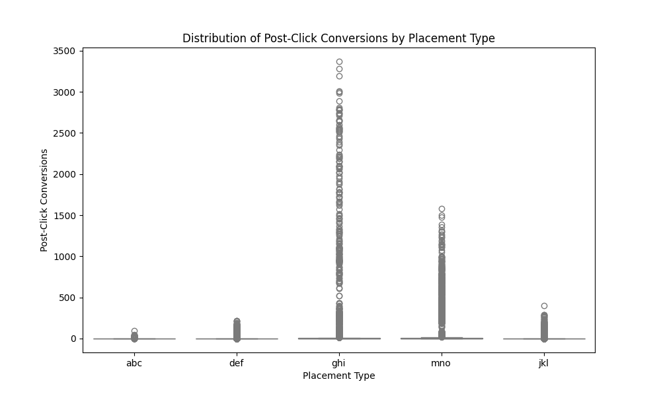
What is the distribution of post-click conversions across different placement types?
Post-click conversions are concentrated near zero for most placement types, but ghi and mno exhibit a high volume of extreme outliers reaching up to 3,400 and 1,600 conversions respectively.

Slide 17
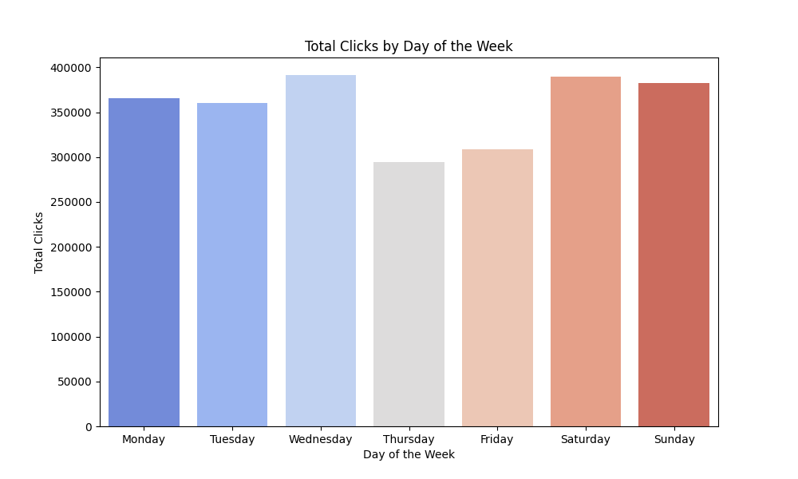
Are there any noticeable differences in user engagement levels between weekdays and weekends?
Total clicks remain relatively high and stable across the week, with Wednesday, Saturday, and Sunday showing the highest levels of engagement, while Thursday and Friday experience a slight dip in performance.

Slide 18
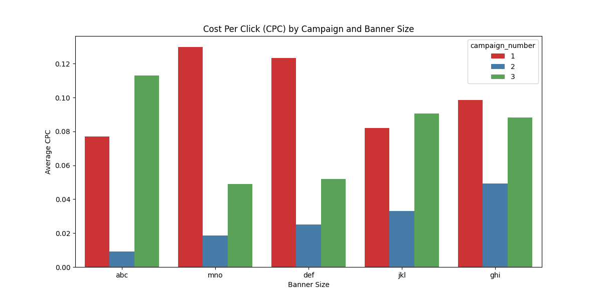
How does the cost per click (CPC) vary across different campaigns and banner sizes?
Average CPC varies significantly across categories, with Campaign 1 generally maintaining the highest costs peaking at banner size mno while Campaign 2 consistently achieves the lowest CPC across all banner sizes.

Slide 19
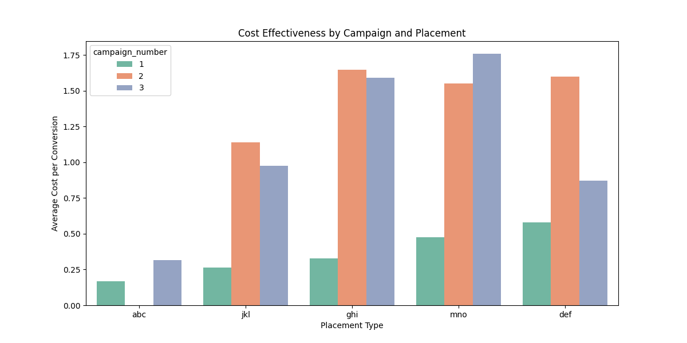
Are there any campaigns or placements that are particularly cost-effective in terms of generating post-click conversions?
Campaign 1 is the most cost-effective overall, particularly at placement type abc, where it achieves the lowest average cost per conversion of approximately 0.18.

Slide 20
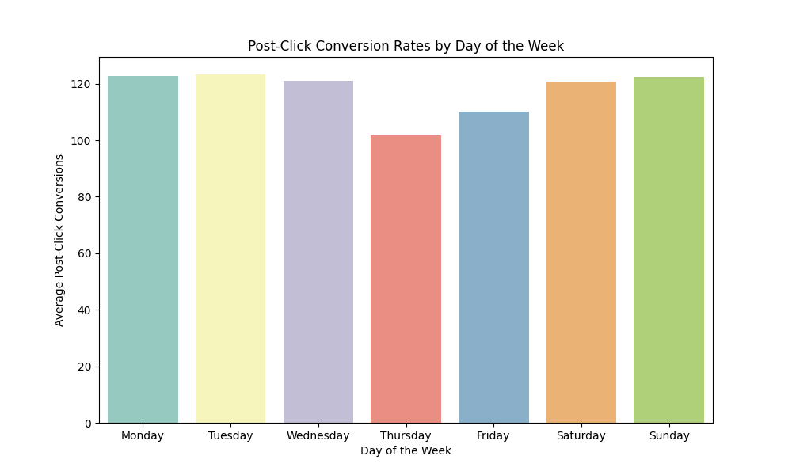
Can we identify any trends or patterns in post-click conversion rates based on the day of the week?
Average post-click conversion rates remain relatively stable and high early in the week and on weekends, with a distinct decrease observed on Thursday and Friday.

Slide 21
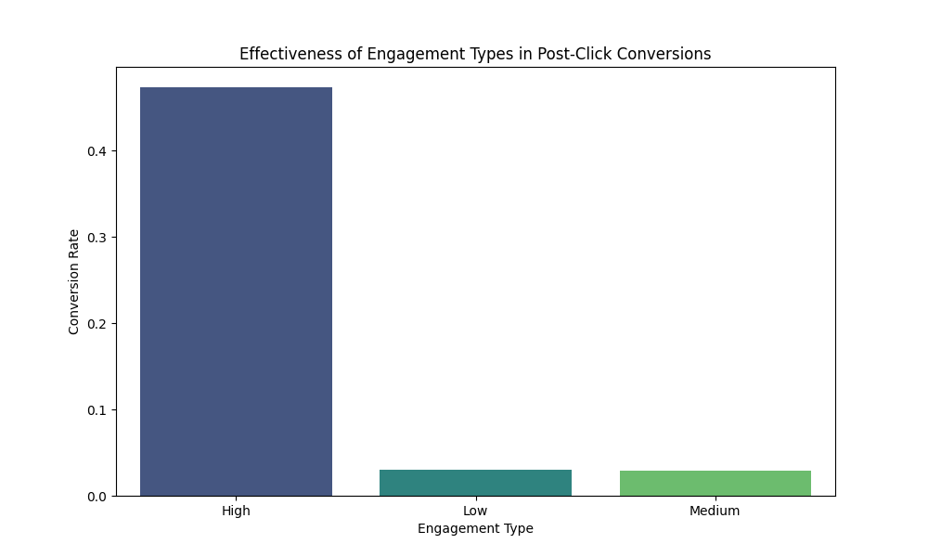
How does the effectiveness of campaigns vary throughout different user engagement types in terms of post-click conversions?
High user engagement types result in a significantly higher post-click conversion rate (approaching 0.5) compared to low and medium engagement types, which both yield rates below 0.05.

Slide 22

THANK YOU

