Slide 1
Simulation of Biological Neural Networks:
Neuron Models
Abigail Morrison, Jyotika Bahuguna
Nov 28th, 2016

Slide 2
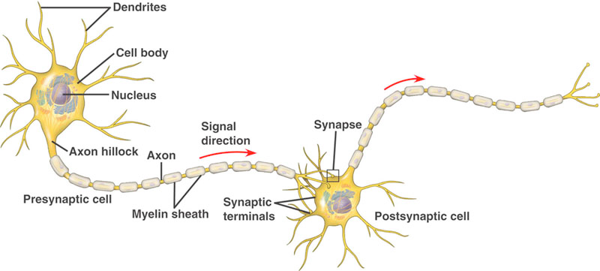
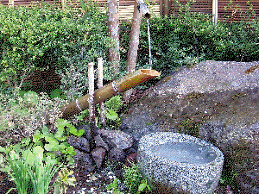
Neuron Models
Nov 28th, 2016
The physiological neuron: a “typical” cell
However, they all function in much the same way:
local input (dendrite)
integration (soma)
long range conducting (axon)
output (synapses)

Slide 3
Neuron Models
Nov 28th, 2016
Overview
Review of spatial structure and dynamics of a physiological neuron
Modeling approaches: detail or abstraction?
Representation of physiological neuron features in a point neuron model
Advantages of the point neuron modeling approach
Simulating a mathematical model
Choosing a model

Slide 4
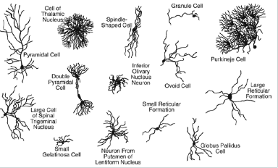
Neuron Models
Nov 28th, 2016
The physiological neuron: spatial structure
There are thousands of different neuron types with different structural features
based on drawings by Cajal (1852 -1934)

Slide 5
Neuron Models
Nov 28th, 2016
The physiological neuron: spatial structure
There are thousands of different neuron types with different structural features
based on drawings by Cajal (1852 -1934)

Slide 6
Neuron Models
Nov 28th, 2016
The physiological neuron: a “typical” cell
However, they all function in much the same way:
local input (dendrite)
integration (soma)
long range conducting (axon)
output (synapses)

Slide 7
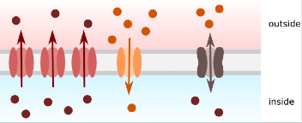


Neuron Models
Nov 28th, 2016
The physiological neuron: resting potential
K⁺/Na⁺ pump pushes Na⁺ out of the cell and K⁺ into it
This creates a concentration gradient
- a ‘force’ which acts outwards on K⁺
K⁺ leaks out, dissipating the
gradient
This causes a net negative charge on
the inside of the membrane
electrical force now acts inwards on K⁺
Equilibrium reached when diffusion and electrical forces balanced: the Nernst Potential
Resting potential is the weighted average of the equilibrium potentials for
each ion

Slide 8
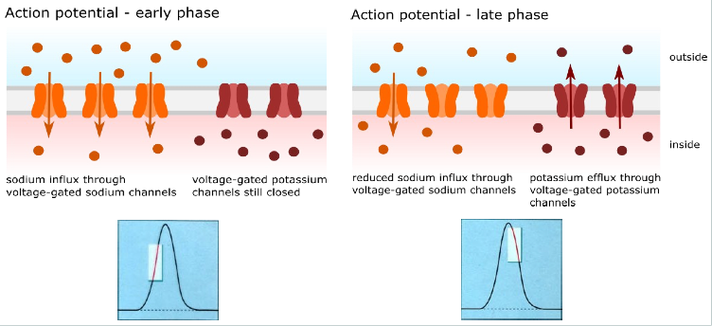
Neuron Models
Nov 28th, 2016
The physiological neuron: action potential

Slide 9
Neuron Models
Nov 28th, 2016
Essential features of neurons
Connectivity / morphology
Internal dynamics that integrate inputs
Generation of action potentials

Slide 10
Neuron Models
Nov 28th, 2016
Modeling neurons
If we want to investigate the behavior of neurons outside of the electrophysiology lab, we need a model that captures these essential features
There are two main approaches:
Detailed (biophysical) neuron models
Reduced (abstract) neuron models
Here we focus on the latter approach, specifically on point neuron models.

Slide 11
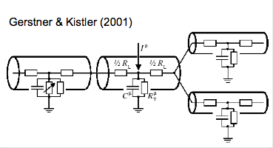
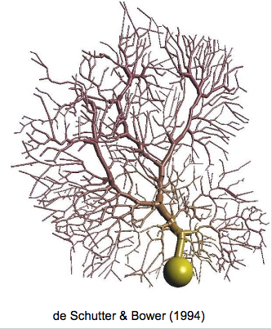
Neuron Models
Nov 28th, 2016
Detailed neuron models
Reconstruct neuron morphology from images
Decompose into many compartments
Define properties of each compartment
Simulate using e.g. NEURON or GENESIS

Slide 12
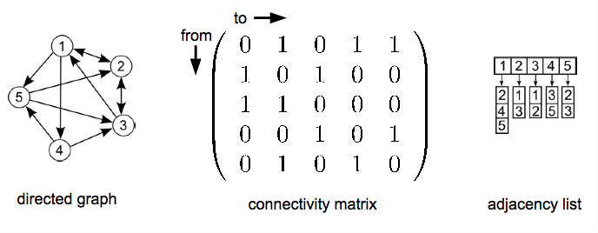
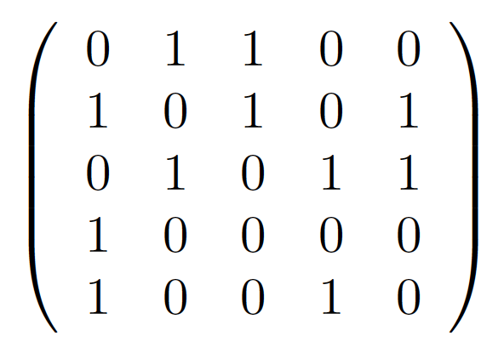
Neuron Models
Nov 28th, 2016
Point neuron models: spatial structure
Morphology of the real neuron is reduced to a directed graph
from
to

Slide 13

Neuron Models
Nov 28th, 2016
Point neuron models: spatial structure
Morphology of the real neuron is reduced to a directed graph
from
to

Slide 14

Neuron Models
Nov 28th, 2016
Point neuron models: spatial structure
Morphology of the real neuron is reduced to a directed graph
from
to

Slide 15



Neuron Models
Nov 28th, 2016
Point neuron models: dynamics
One isopotential compartment
Reduction of dynamics to a few differential equations
Some examples:
Integrate-and-fire (Lapicque, 1907)
Hodgkin-Huxley (1952)
FitzHugh-Nagumo (1962)

Slide 16
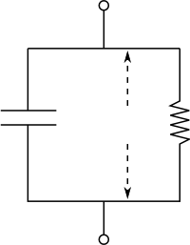







Neuron Models
Nov 28th, 2016
Point neuron models: dynamics
The leaky integrate-and-fire model:
Kirchhoff’s current law:
Threshold behaviour: ?
Additional simplifications:
linear subthreshold integration
time invariant parameters
outside
inside

Slide 17
Neuron Models
Nov 28th, 2016
Comparison of detailed and point neuron models
Detailed neuron models:
Have physical extent
Give a good approximation of the electrical properties of a physiological neuron
Can be made arbitrarily complex
Point neuron models:
Have no physical extent
Represent the dynamics in an extremely reduced fashion
Are very simple
Why would anyone want to use a point neuron model?

Slide 18
Neuron Models
Nov 28th, 2016
Comparison of detailed and point neuron models
Detailed neuron models:
Have physical extent
Give a good approximation of the electrical properties of a physiological neuron
Can be made arbitrarily complex
Point neuron models:
Have no physical extent
Represent the dynamics in an extremely reduced fashion
Are very simple
Why would anyone want to use a point neuron model?

Slide 19
Neuron Models
Nov 28th, 2016
Why use point neuron models?
Much less initial investment
Analysis
Network simulation
Not as bad an approximation as one might think

Slide 20
Neuron Models
Nov 28th, 2016
Why use point neuron models?
Much less initial investment
Analysis
Network simulation
Not as bad an approximation as one might think

Slide 21
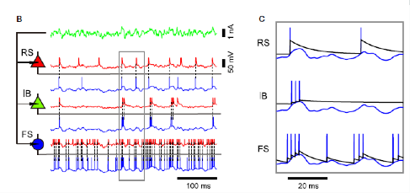
Neuron Models
Nov 28th, 2016
Point neurons: not as bad as all that
Point neurons can exhibit a wide range of dynamics:
Kobayashi et al. (2009);
see also Izhikevich (2004)

Slide 22
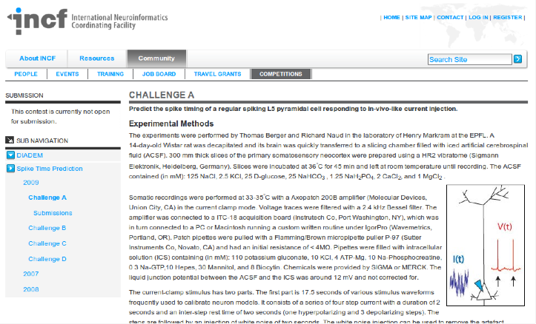
Neuron Models
Nov 28th, 2016
Point neurons: not as bad as all that

Slide 23

Neuron Models
Nov 28th, 2016
Point neurons: not as bad as all that

Slide 24

Neuron Models
Nov 28th, 2016
Point neurons: not as bad as all that

Slide 25
Neuron Models
Nov 28th, 2016
Point neurons: not as bad as all that
Point neurons won all challenges in all years, despite behaviorally relevant incentives
The MAT2 model (Kobayashi et al., 2009) only has one dynamic variable more than the standard leaky I&F model
The arbitrary complexity of biophysical neuron models makes them a parameter fitting nightmare
Save complexity for when you really need it

