Slide 1

While(!logic)

Slide 2
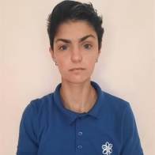
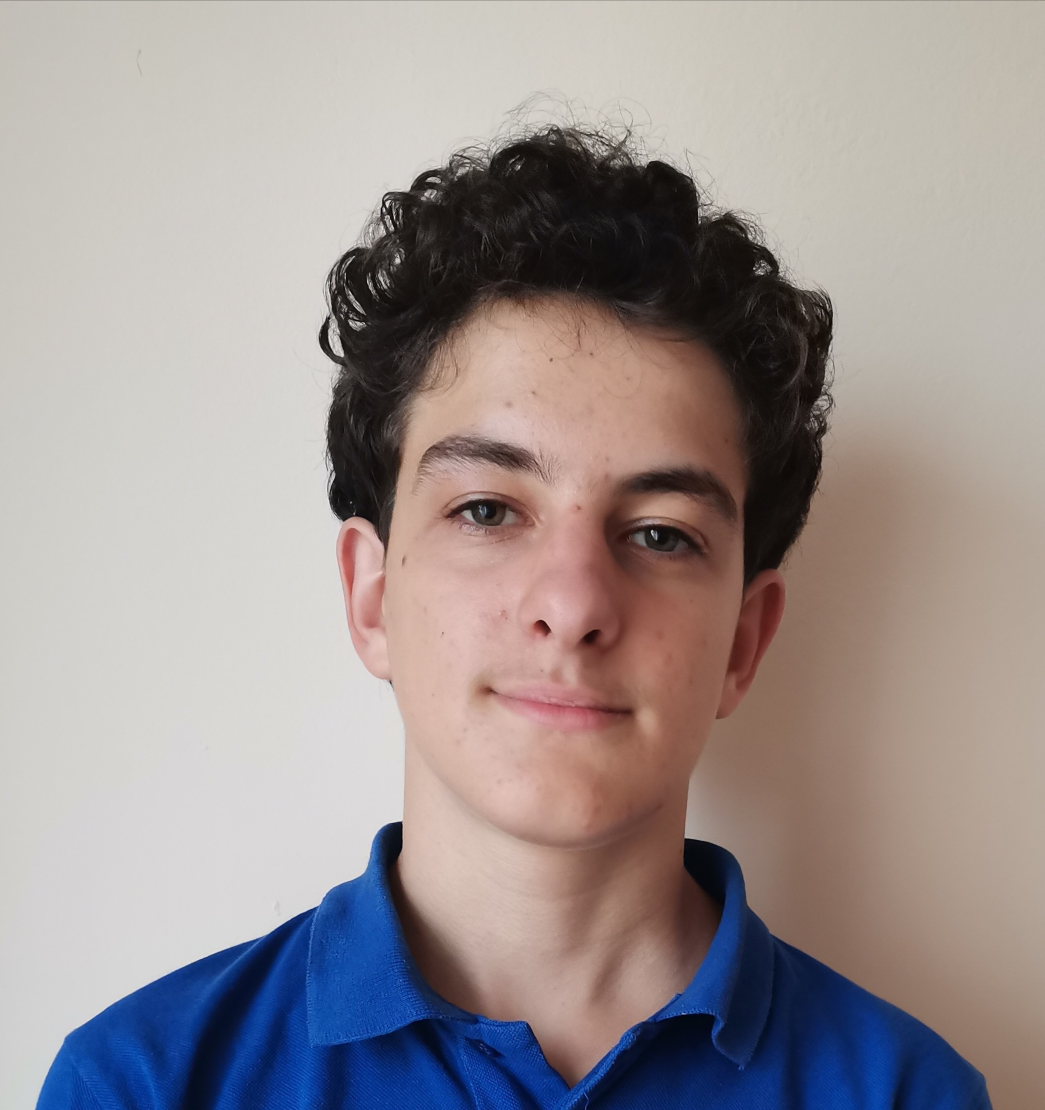
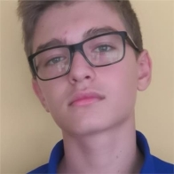
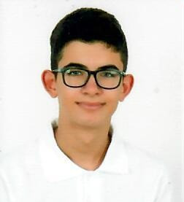
OUR TEAM
Iliyana Michevska
Scrum Trainer
Plamen Daylyanov
Back-end Developer
Kaloyan Dimov
Back-end Developer
Konstantin Dinev
QA Engineer

Slide 3
Stages of realization
Understanding the concept
Testing our code
Presentation
Distribution of tasks
Bugs and errors correction
Final

Slide 4









Used languages and tools

Slide 5
Let’s move on to our game!

