Slide 1


History project with linked-list
By Grey Warriors

Slide 2




Our team
Ivan Mihaylov
Veselin Stoyanov
Ivaylo Markov
Yanislav Stoyanov
Front end developer
Back end developer
QA engineer
Scrum trainer

Slide 3
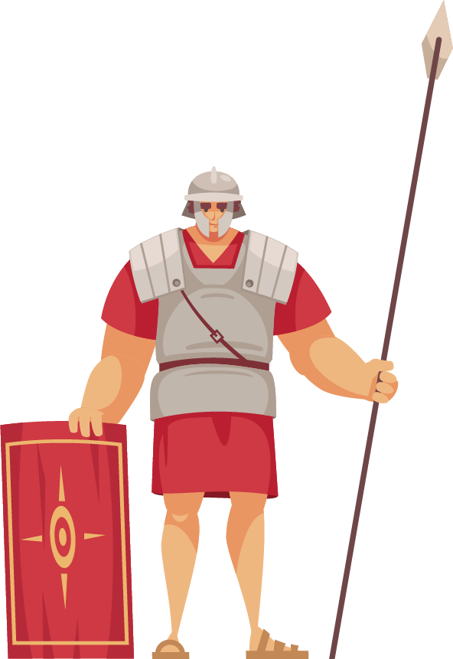
topic

Slide 4
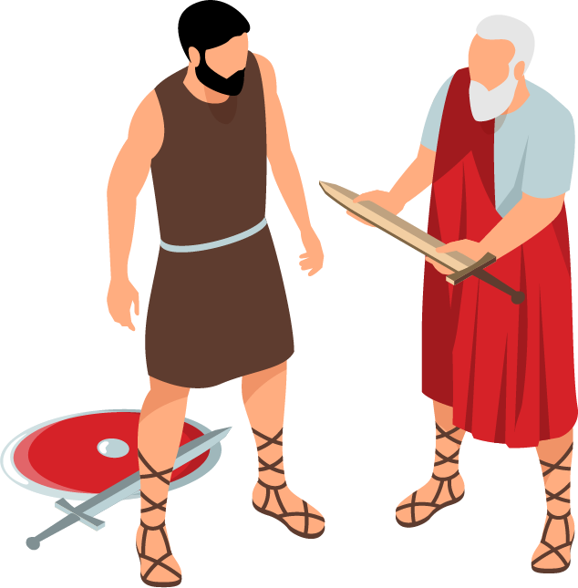
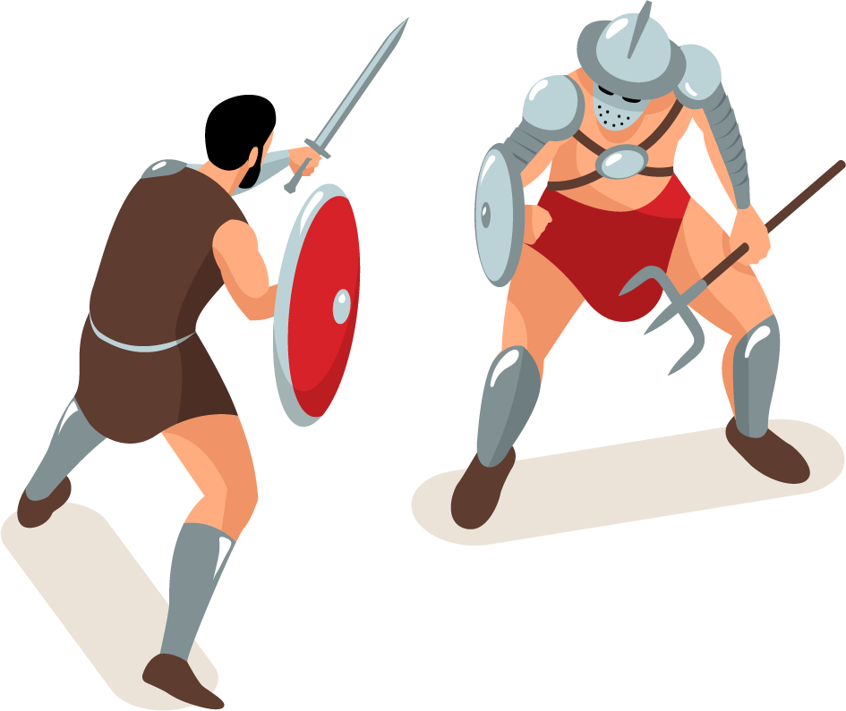
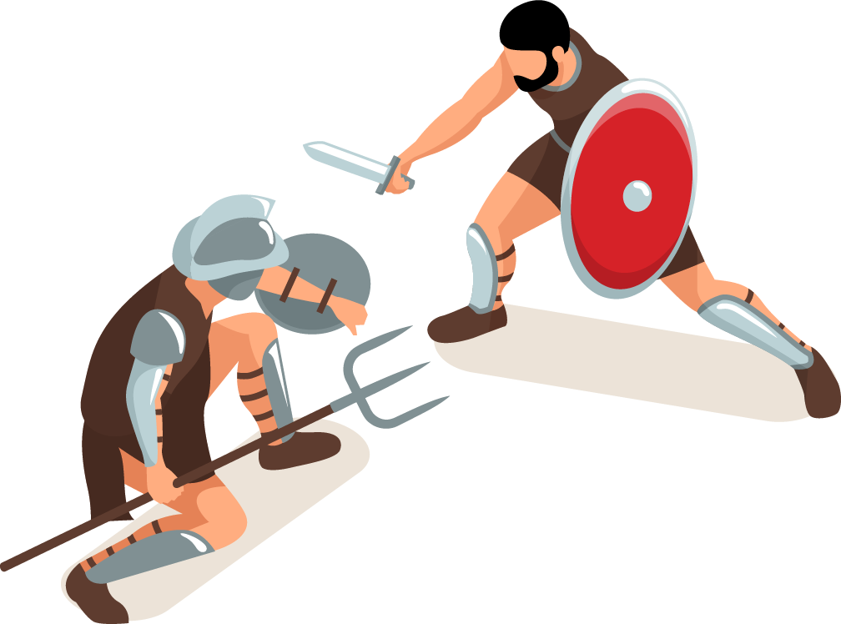
Milestones

Slide 5








Used technologies
Visual Studio
C++
GITHUB
teams
PHOTOSHOP
WORD
EXCEL
POWERPOINT

Slide 6
Review of the product

Slide 7
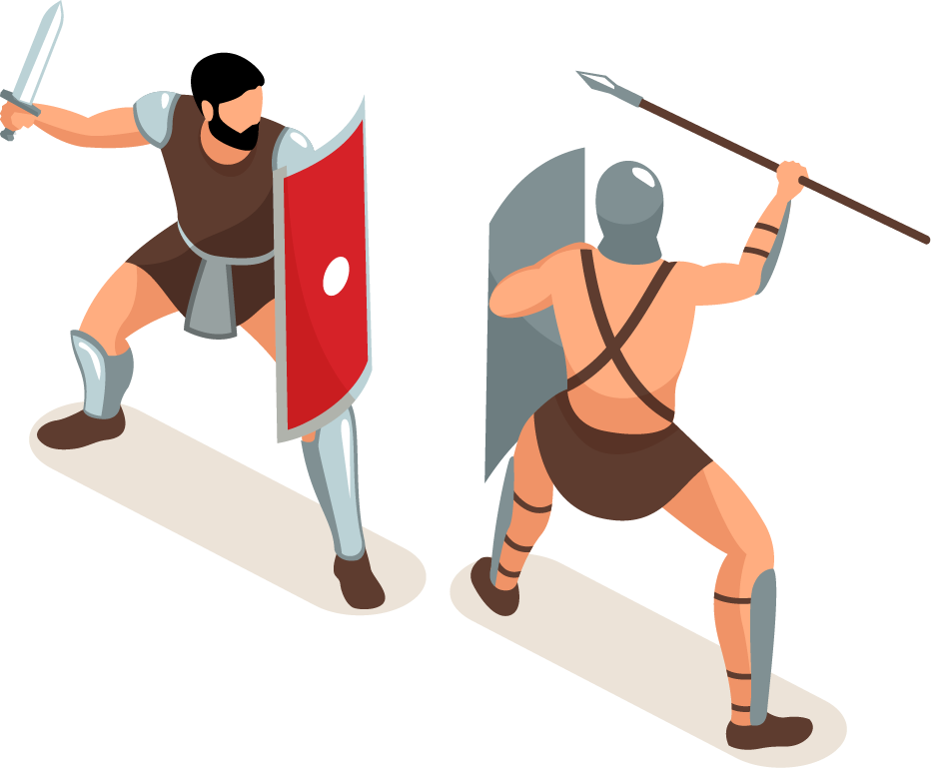
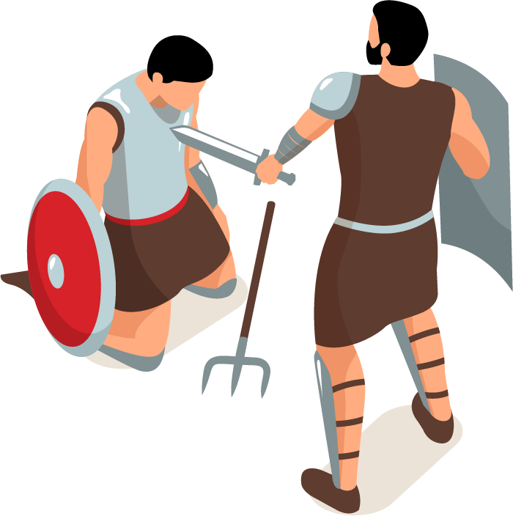
Thank you for you attention!

