Slide 1


ElectroMioGraphy
An example of biological signals
Dr. Santiago Flores Postdoctoral Fellow
Department of Biomedical Physiology & Kinesiology | Simon Fraser University

Slide 2
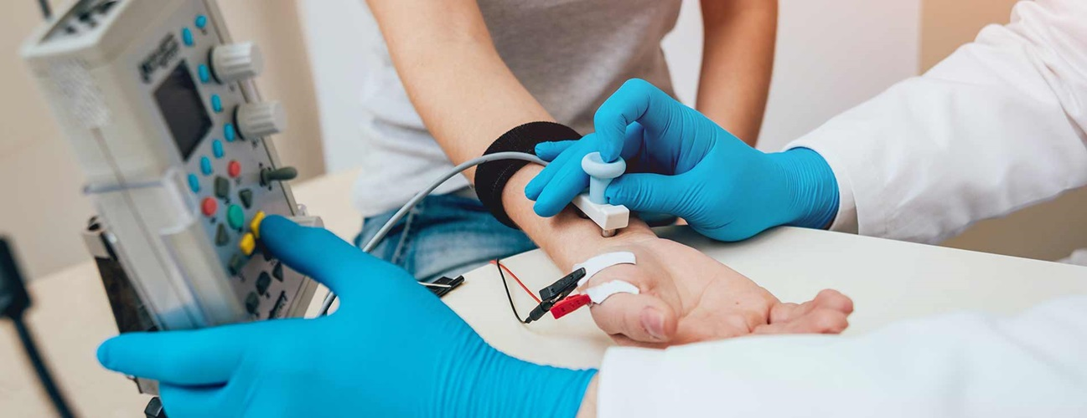
What is an EMG?
EMG, which is an electrophysiologiocal technique for evaluating and recording the electrical activity produced by skeletal muscles.
We use them to assess the health of muscles and the nerve cells that help control them.
https://www.hopkinsmedicine.org/health/treatment-tests-and-therapies/electromyography-emg

Slide 3
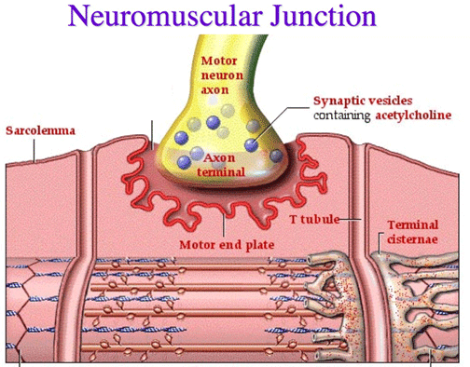
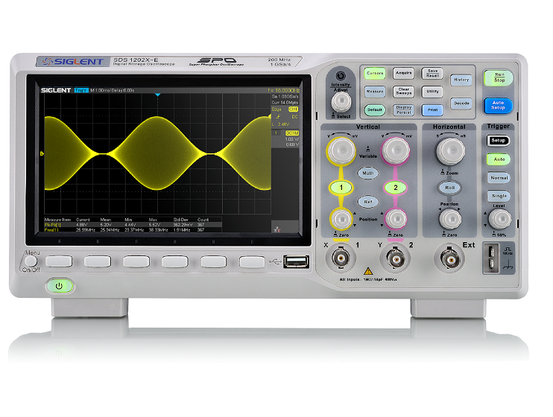
What does an EMG measure?
Your muscles move when (electrochemical) nerve signals from your Central Nervous System (CNS) tell them to work. An EMG is used to measure the muscles respond to these signals.
The electrodes in an EMG device are used to measure the electrical activity caused at different levels of muscle contraction: rest, slight contraction, and forceful contraction.
https://www.amazon.com/Siglent-Technologies-SDS1202X-Oscilloscope-Channels/dp/B07PVZMV16

Slide 4
EMG Waves
The size and shape of a wave, which represents activation of motor units, gives information about how the muscle activity and health.
A healthy muscle will show no electrical activity during rest, meaning it will not show any signs of an action potential. It will only show electric activity when the muscle moves or contracts.
When you contract your muscle more forcefully, more and more muscle fibers are activated, making more action potentials.

Slide 5
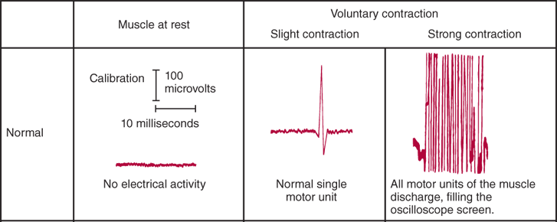
EMG Waves
Here, you can see how the activity of a normal muscle is represented.
https://neurology.mhmedical.com/data/books/1844/demyer8_ch7_f021.png

Slide 6
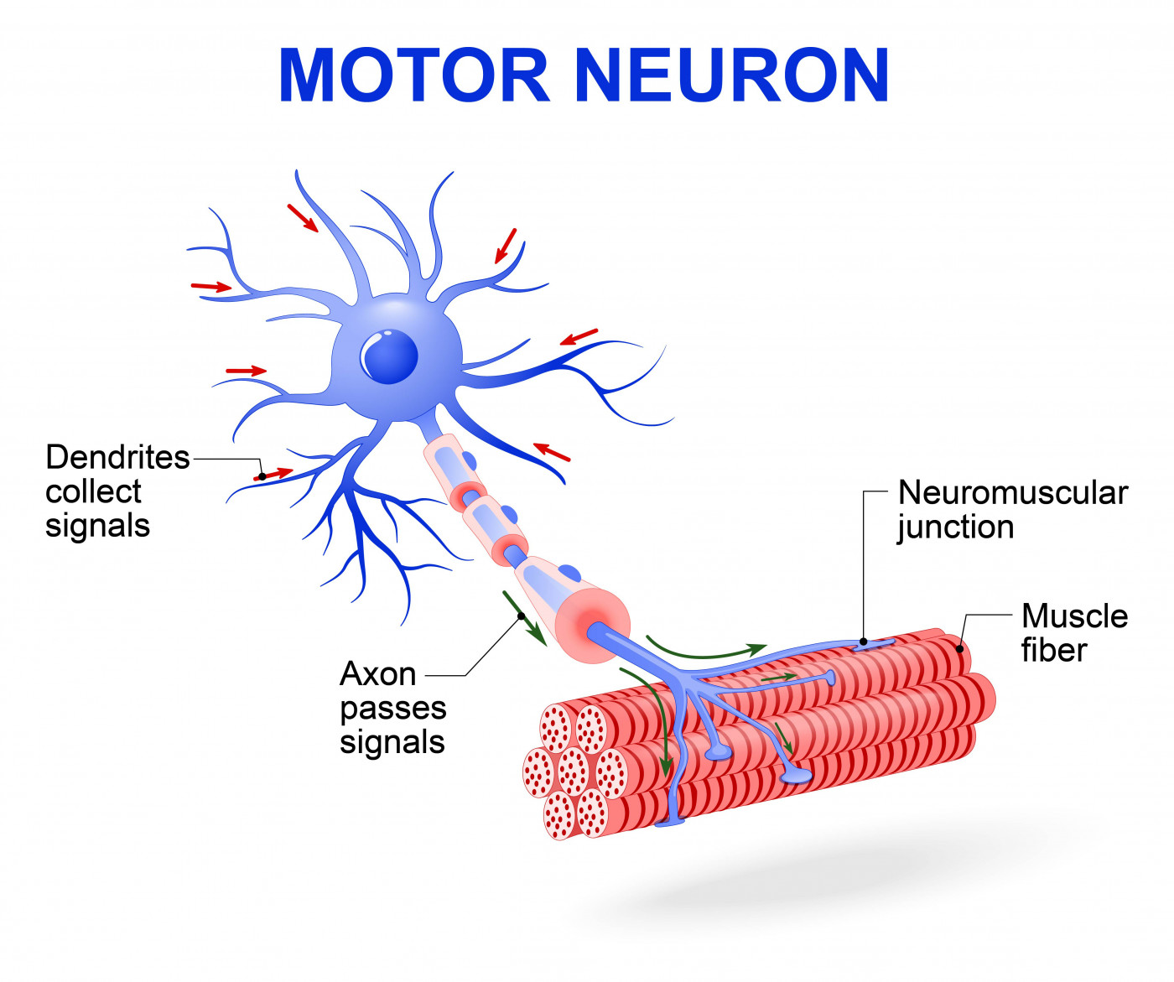
What is a motor neuron?
A motor neuron is a neuron that carries information from the central nervous system to the muscles throughout our bodies.
They are specialized cells that enable us to move by relaying information from our brains to our muscles in the form of electric signals called action potentials, such as when to contract and move.
https://smanewstoday.com/2017/09/12/sam-research-may-get-boost-from-study-using-skin-cells-to-create-human-motor-neurons

Slide 7
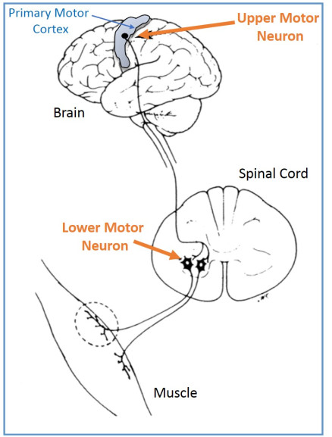
Motor Neurons
There are two primary types of motor neurons:
Upper motor neurons, originating in a region of our brains called the motor cortex, send electrical signals (action potentials) to lower motor neurons.
Lower motor neurons are attached to our muscles and act as direct messengers to tell them to start contracting.
https://impremedia.net/diagram-of-motor-neurone

Slide 8
Motor Unit Recruitment
Motor unit recruitment may be defined as "the successive activation of the same and additional motor units with increasing strength of voluntary muscle contraction." The central nervous system can increase the strength of muscle contraction by the following:
Increasing the number of active motor units (ie, spatial recruitment)
Increasing the firing rate (firing frequency) at which individual motor units fire to optimize the summated tension generated (ie, temporal recruitment)
Both mechanisms occur concurrently.

Slide 9
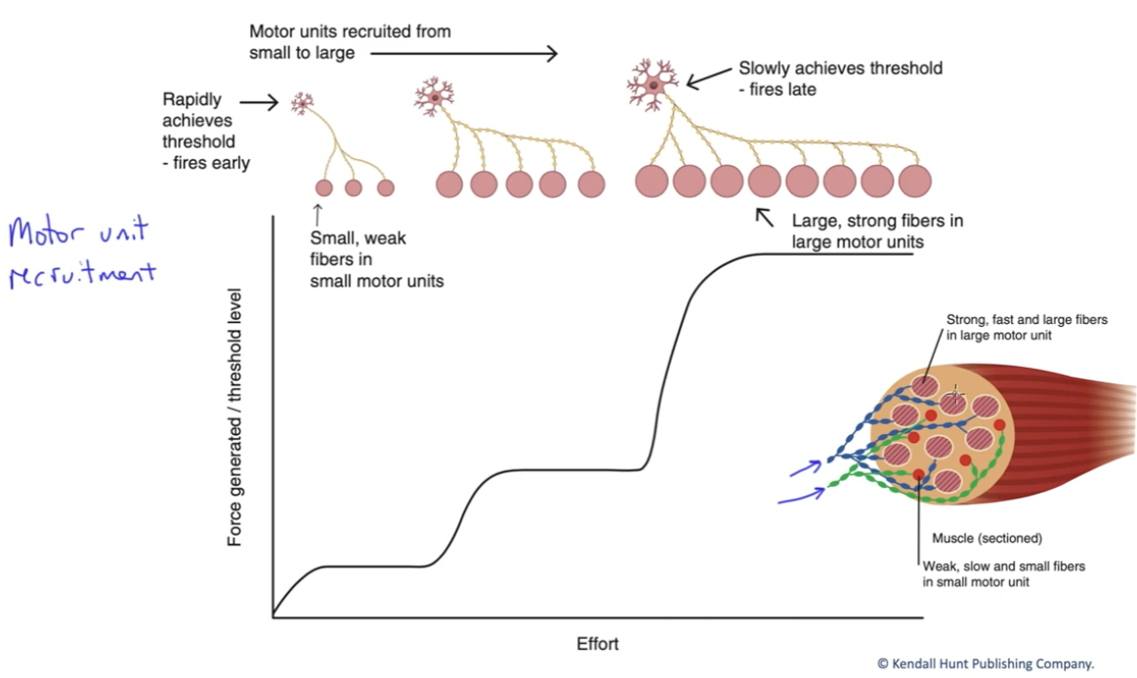
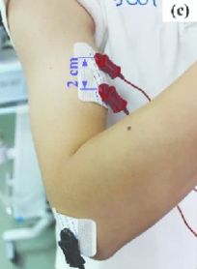
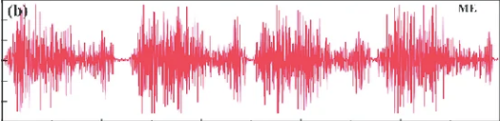
Order of Recruitment
As a general rule, motor units are recruited in order of their size.
This fibers are not 100% in sync = very ‘fast messy signal’

