Slide 1
Introduction to Bayesian methods
BMI 713
Lecture 12
December 5, 2017

Slide 2
Some philosophical considerations…
The meaning of probability has influenced method development.
The frequentist interpretation understands probability as the long run frequency of an event occurring amongst many trials.
E.g., in a coin toss, P(H) = ½ is interpreted as: if the coin were tossed a very large number of times, half of the tosses would result in heads.
This frequentist interpretation gave rise to many (all?) of the statistical methods covered so far in this course.

Slide 3
The p-value
With the frequentist interpretation of probability in mind, let’s revisit the p-value.
So, what is a p-value and how is it interpreted? Tricky..
Notes:
Hint: the frequentist understanding of probability occurs SOMEWHERE in the underpinnings of p-values.

Slide 4
The p-value
With the frequentist interpretation of probability in mind, let’s revisit the p-value.
So, what is a p-value and how is it interpreted? Tricky..
Strictly speaking: it is the probability of observing the given data or a more extreme configuration assuming a specific probability model is true (the null hypothesis).
Frequentist probability arises in: the probability of rejecting H₀ when H₀ is true is 𝛼. Requires repeatable trials.

Slide 5
The p-value
With the frequentist interpretation of probability in mind, let’s revisit the p-value.
So, what is a p-value and how is it interpreted? Tricky..
Strictly speaking: it is the probability of observing the given data or a more extreme configuration assuming a specific probability model is true (the null hypothesis).
Frequentist probability arises in: the probability of rejecting H₀ when H₀ is true is 𝛼. Requires repeatable trials.
Note the funny language: one rejects H₀ at ”significance level 𝛼”, not with “probability 𝛼” and “fail to reject” vs. ”accept” H₀.

Slide 6
The confidence interval
What is a confidence interval and how to interpret it?
True/False: the specific 95% confidence interval presented by a study has a 95% chance of containing the mean.

Slide 7
The confidence interval
What is a confidence interval and how to interpret it?
True/False: the specific 95% confidence interval presented by a study has a 95% chance of containing the mean.
False: if the procedure to construct a 95% C.I. is applied to a very large number of trials, then 95% of the constructed C.I.s will contain the mean.
Is the frequentist contribution here obvious? What is random here?
Perhaps this is the motivation for the strange terminology “95% confidence level” rather than ”95% probability”?

Slide 8
Assessing the procedure
These tools are assessed by frequentist-flavored ideas:
P-values: given a significance level 𝛼 and a very large number of experiments, H₀ will be incorrectly rejected at rate 𝛼.
Confidence intervals: after constructing a very large number of 95% confidence intervals, 95% of those intervals will contain the parameter.
Frequentist methods are often confined to making claims about the long run properties of the procedure rather than in any specific instance.
This is because the methods are often aimed at non-repeatable events, such as the true value of a parameter being equal to 3 or H₀ being false.
..but having these guarantees is still a great thing!

Slide 9
Awkward methods?
Given how hard it is for students and researchers alike to correctly recant the highly specific meanings of significance tests and confidence intervals, it is perhaps fair to refer to these as potentially awkward tools.
What researchers often want to say is: the probability that a specific model X is true is Y%.
..or the probability that the true parameter is in my interval I is Z%.
These appear to be reasonable statements, but are in fact incompatible with the frequentist understanding of probability.
Is there an alternative?

Slide 10
Bayesian probability
These and other considerations have led to an alternative interpretation of probability: instead of the frequency notion, let probability simply represent the belief that an event will occur.
In this way, probability describes one’s uncertainty about an event.
This allows one to talk about the probability of an event without imagining a repeatable trial. E.g.,
What is the probability of rain tomorrow?
What is the probability of the Red Sox winning the World Series in 2018?
Conveniently, all of the properties of probability are then ready to support calculations.

Slide 11
The Bayesian approach to inference
Apply the Bayesian interpretation of probability to the problem of statistical inference. E.g.,
To provide point estimates or intervals about parameters of interest, the Bayesian treats the parameter as a random variable with a distribution.
To compare hypotheses, the Bayesian can assign a probability to the statement “H₀ is false” or “H₀ is less likely than H₁.”
IMPORTANT: this is not to say that the parameters of interest are actually random. They are fixed, but the language and calculus of probability are now being used to quantify our uncertainty about the parameters’ true values.

Slide 12
The Bayesian machine
The Bayesian methodology prescribes a highly routine method to produce a posterior distribution, which is the primary object used for inference.
The posterior distribution is a proper probability density function!
There are 3 basic steps to this process:
Specify a model that relates data and parameters.
Specify a prior distribution on the parameters
Given some observations, combine the model and the prior via Bayes’ rule to produce the posterior distribution of the parameters.

Slide 13
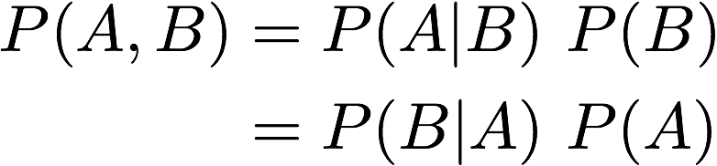
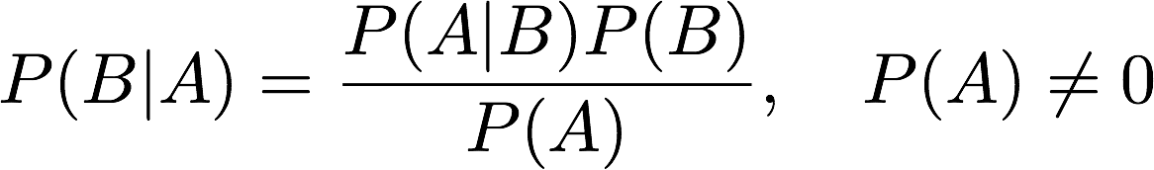
Bayes’ rule
Bayes’ rule is a basic result in probability theory and is not controversial.
It results from the definition of conditional probability: for general events A and B, the joint distribution P(A, B) can be factored by conditioning on either of the two events: P(A, B) = P(A|B) P(B).
The same joint distribution is obtained whether one conditions on A or B:
Rearranging terms gives Bayes rule:

Slide 14
Bayes’ rule in Bayesian inference
Likelihood function
Prior distribution
Posterior distribution
”Marginal” distribution

Slide 15
Coin tossing example
To make things more concrete, consider a coin tossing experiment.
The experimenter will toss a coin N times with probability p of obtaining heads is fixed but unknown.
The number of heads X is tallied.

Slide 16
Coin tossing step 1: the likelihood function
For the moment, assume we know the true parameter p. Then the model Binomial(N, p) model seems appropriate.
Both Bayesians and frequentists can agree on this.
The model provides the likelihood function.
The likelihood function represents all of the salient information in the data pertaining to the parameter of interest.

Slide 17
Coin tossing step 2: the prior distribution
The prior distribution is an attempt to describe our belief about the parameter p before observing any data.
In this case, let’s suppose we know nothing about p.
To reflect this, let every value of p be equally likely. Thus P(p) = 1, for 0 < p < 1.
This is an example of an (attempt at a) uninformative prior.

Slide 18
Coin tossing step 3: applying Bayes’ rule
With the likelihood function and prior distribution in hand, we can apply Bayes’ rule to derive the posterior:

Slide 19
Coin tossing step 3: applying Bayes’ rule
With the likelihood function and prior distribution in hand, we can apply Bayes’ rule to derive the posterior:
The marginal distribution P(X = x) is calculated directly from the likelihood and the prior. Does not depend on p!

Slide 20
Coin tossing: inference
Now that the posterior distribution is in hand, what do we do with it?
If we want a point estimate for p, there are many options:
The mean of the posterior
The mode of the posterior
The median of the posterior
…
If we instead want to put an interval on p, we can now talk about the probability that some interval contains p.
E.g., select the smallest subset of [0,1] for which the density sums to p.
Hypothesis testing: it is possible to compare 2 models using an analogous procedure.

Slide 21
Simplified example
Suppose there are two coins: C and C_{b}.
C is a fair coin with P(H|C) = ½
C_{b} is a biased coin with P(H|C_{b}) = ¾.
Consider the experiment: first choose a coin, then begin flipping the coin.
Assume the coins are unlabeled, so the probability of choosing C or C_{b} is ½.
A coin is only chosen one time and used for all subsequent coin tosses.
Suppose you choose a coin and toss it once, obtaining heads. What is the probability that you chose the biased coin?

Slide 22
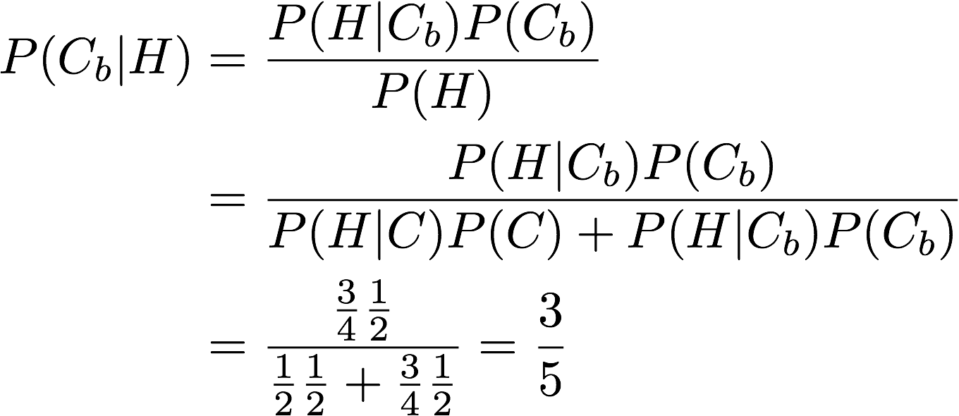
Using Bayes’ theorem
How would things change if we saw two heads?
Note: frequentist method is the same. This is an artificial case where frequentist probability can consider P(C).

Slide 23
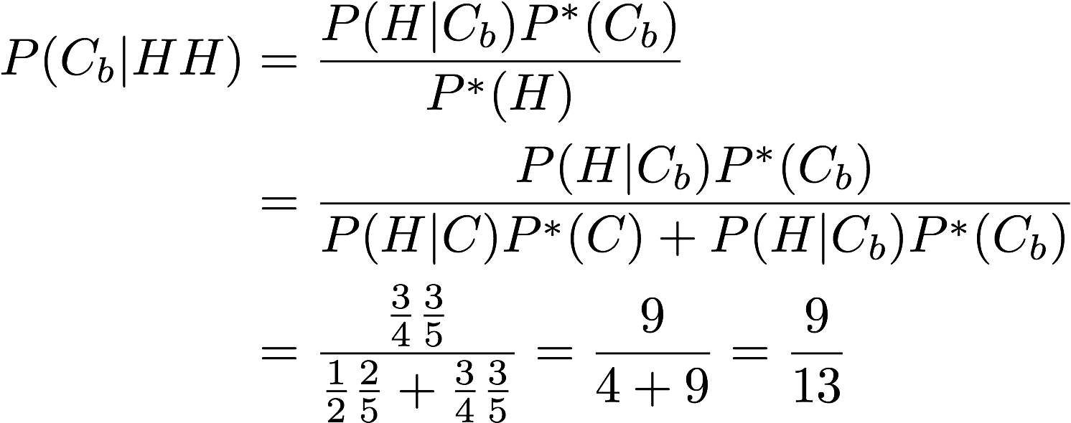
Put the previous information into the “prior”
Let P*(…) represent the probability computed on the previous slide: P*(C) = 2/5 and P*(C_{b}) = 3/5.
We can “update“ the previous expression.

Slide 24
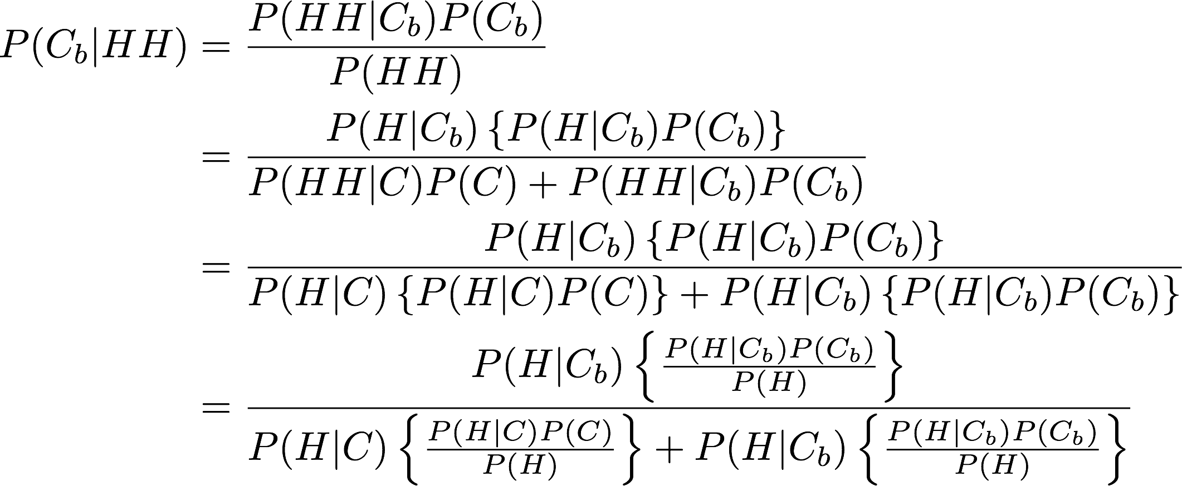
Updating in more detail
Values in curly braces are the posterior probabilities of C and C_{b} after observing one heads.

Slide 25
Bayesian vs. Frequentist
In the previous example, the two approaches agreed.
As mentioned, this is because the problem was set up to be accessible to the frequentist understanding of probability.
Now let’s generalize to a case where the two approaches differ.
Instead of choosing from one of two coins, suppose there is only one coin but we do not know the probability p of obtaining heads.
In any case, we toss the coin 3 times and observe 3 heads.
Is the coin is fair (p = 1/2)?

Slide 26
Frequentist approach
In the frequentist approach, one sets up a hypothesis test for p = ½.
Since 3 heads and 3 tails are the most extreme possible events under the null, each with probability 1/8, the p-value of the test is 1/8 + 1/8 = 0.25.
This is not significant at the conventional 0.05 level and we fail to reject H₀.

Slide 27
Bayesian approach: deriving the posterior
Let’s choose a uniform prior, P(p) = 1. This is a subjective choice.
The likelihood is binomial(3, p). In fact, we already derived the posterior distribution earlier:
For 3 heads (N = x = 3), this simplifies to 4p³.
In practice the posterior rarely works out so cleanly. With more parameters, we must usually also worry about integrating out “nuisance parameters”.
The integrals produced in this way often have no simple solution and must be approximated. There is a vast literature on methods, the most popular of which is Monte Carlo sampling
A particular augmentation, Markov Chain Monte Carlo (MCMC) is of particular interest.

Slide 28
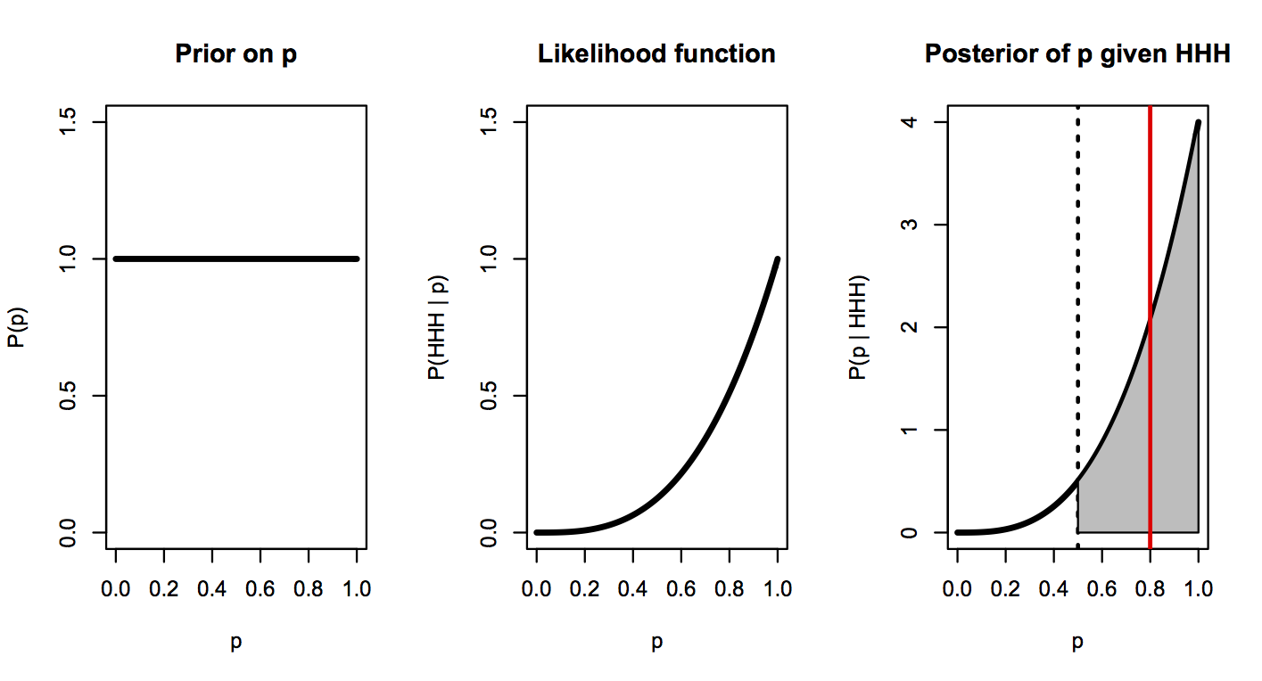
Bayesian approach: using the posterior
E[p | HHH]
= 0.8
P(p > ½ | HHH)
= 0.94
95% Bayesian interval: (0.47, 1)

Slide 29
Bayesian vs. frequentist results
In this case, neither the Bayesian nor frequentist reject the possibility that the coin is biased.
For the Bayesian, this is because the 95% “credible interval” includes 1/2.
For the Bayesian:
Possible point estimates for the unknown p include 0.8, the mean of the posterior distribution or even p = 1, the mode of the posterior.
Unlike the frequentist, the Bayesian can make a statement about the probability that p is greater than 1/2: the shaded area included 94% of the area under the curve.
The Bayes Factor for model selection: ratio of P(C_{b}) to P(C) = 0.94/0.06 = approx. 16.

Slide 30
A major objection: the prior
A major objection to Bayesian methods is the need to specify a prior.
Priors are viewed as lacking objectivity, an important disadvantage for scientific pursuits.
However, much effort has been spent to discover priors with objective qualities: “noninformative priors.”
These include “flat priors” as we used in the previous example.
Unfortunately, flat priors become “improper” on infinite parameter spaces.
The “Jeffreys” prior is another attempt an objectivity. It attempts to preserve inferences under nice transformations of the parameters.

Slide 31
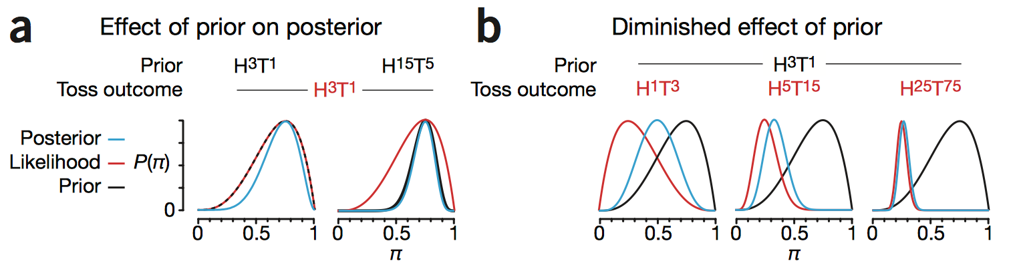
Priors
However, the influence of the prior diminishes as more data are gathered.
But this depends on the strength of the prior vs. the data.
On the other hand, priors allow an opportunity to incorporate previous knowledge--gained in this experiment or not—into the inference.

Slide 32
Summary: advantages
Frequentist
Bayesian
Ease of use; “automatic”
Objectivity
Incoherence (!)
Natural interpretation; allows us to ask some of the questions we really want to ask
Updating with new data
Incorporating outside knowledge
Can address very complicated models

Slide 33
Summary: disadvantages
Frequentist
Bayesian
Incoherence
Ad hoc, often unintuitive methods
Is it always clear what the null hypothesis should be?
Subjectivity of priors
Computational cost
Computational accuracy (convergence of MCMC approximations)

