Slide 1
WSN APPLICATION FOR MONITORING PATIENTS
BODY TEMPERATURE IN HOSPITALS
Test-bed project by Habibul and Dinesh
Sensor Network Systems (DTEK2011_2016)

Slide 2
OVERVIEW OF THE PROJECT
MAIN FUNCTIONS:
Monitor the patient’s body temperature
Display it to the doctor through webserver
Use of wireless communication system for remote patient monitoring
Transmitting module continuously reads patient’s body temperature through a digital temperature sensor
Constantly observe the temperature and maintain a record of it

Slide 3
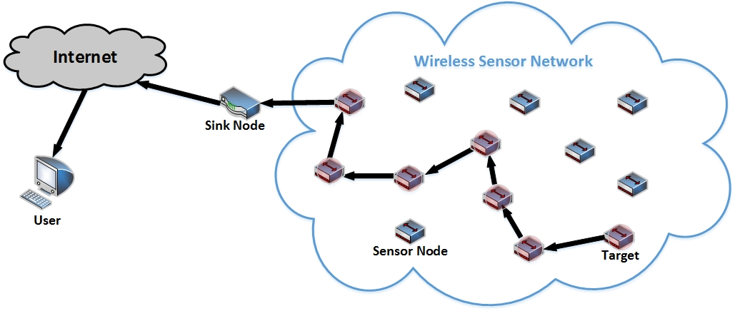
WIRELESS SENSOR NETWORK

Slide 4
PROJECT REQUIREMENTS
HARDWARE REQUIREMENTS
2 Zolertia Z1 motes
Tmp102 (Temparature sensor)
Micro USB cable
Computers
Power supply
Display
SOFTWARE REQUIREMENTS
OS- Contiki 2.7
Programming language- C and Python
Compiler (gcc-msp430)
Plotly API

Slide 5
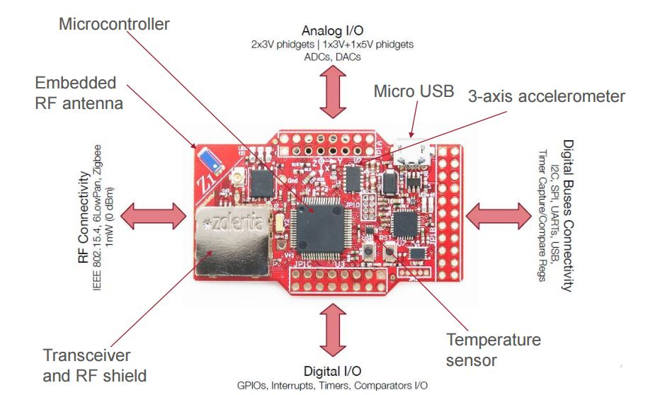
Zolertia Z1

Slide 6
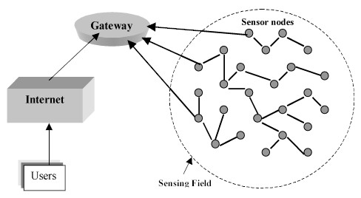
BUILDING THE COMMUNICATION

Slide 7
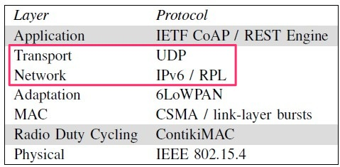
COMMUNICATION PROTOCOLS
RPL
RPL is the IPv6 routing protocol for Low-power and Lossy Networks (LLNs)
Networking protocol for IoT
Multipoint-to-point traffic from devices towards a central control point
Point-to-multipoint traffic from the central control point
Support for point-to-point traffic is also available

Slide 8
COMMUNICATION PROTOCOLS
UDP
Prior communications are not required to set up transmission channels or data paths
UDP uses a simple connectionless transmission mode
UDP is suitable for purposes where error checking and correction is either not necessary
UDP is message oriented
UDP because dropping packets is preferable to waiting for delayed packets
Light weight but may be not that reliable

Slide 9



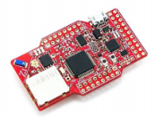


Project Implementation
Internet
HTTP GET
https://plot.ly/~dinsap/2.embed
Gateway
Python Script (reads serial data)
HTTPS (POST)
Feeds data to Plotly API
User
Dev/i2cmaster.h Communication device driver
RPL Unicast
dev/tmp102.h
(sensor driver)
RPL
Receiver
User Datagram Protocol (UDP)
Port 1986
RPL (6LoWPAN)
Sender
gcc-msp430 contiki Compiler+library

Slide 10
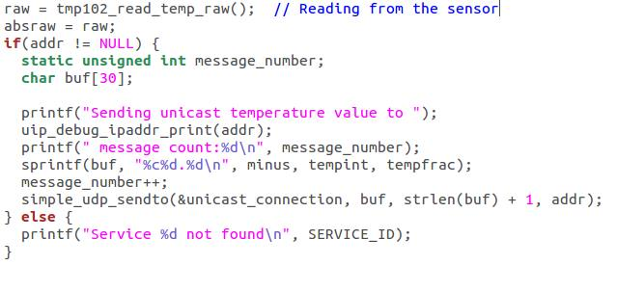
UDP SENDER

Slide 11
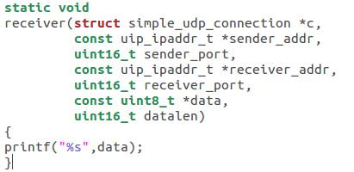
UDP RECEIVER

Slide 12
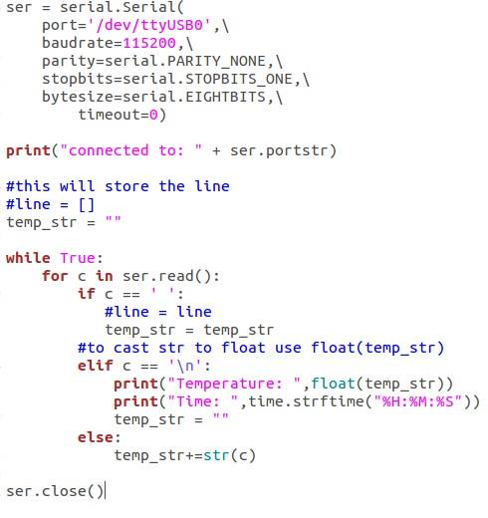
COLLECTING SERIAL DATA

Slide 13
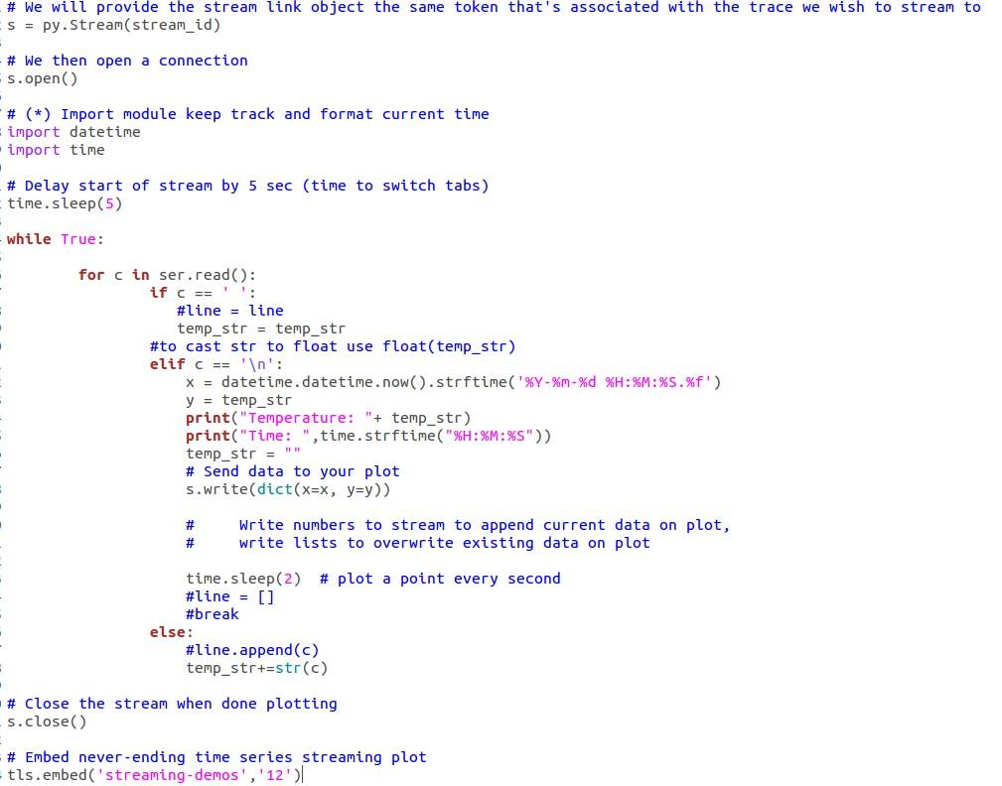
IMPLEMENTATION OF PLOTLY API

Slide 14
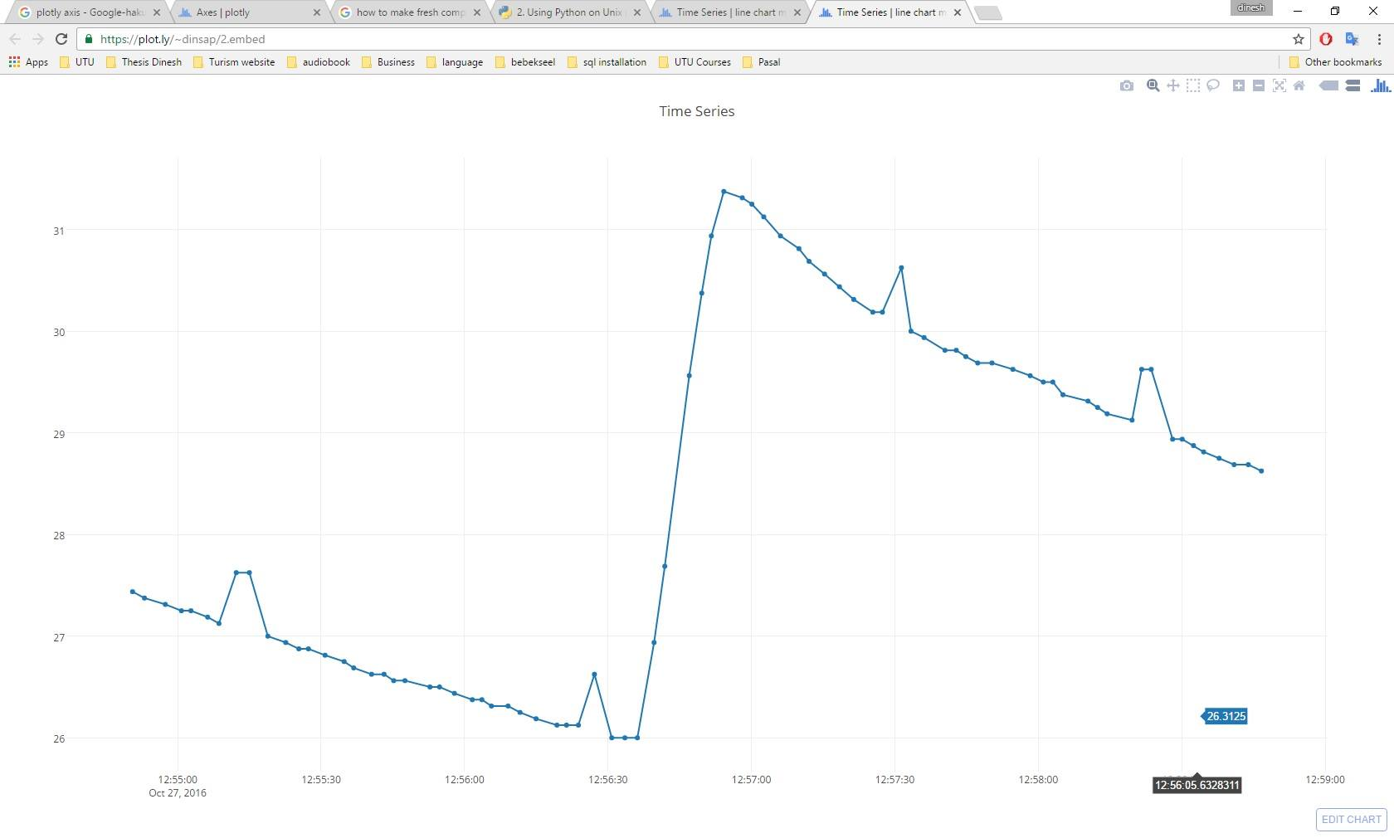
TEMPERATURE DATA

Slide 15
Demo Session

