Slide 1
The Evolution of Libnet
The RSA Conference
February 2004
Mike Schiffman, Cisco Systems

Slide 2
Agenda
Introduction, overview, and what you’ll learn
What is libnet?
Where we came from: Libnet 1.0.x
  Process
  Deficiencies
Where we are: Libnet 1.1.x
  Process
  Key concepts
  Usage
  With other components
    GNIP
    TRIG
  Internals
Closing comments and questions

Slide 3

Mike Schiffman
Researcher for Cisco Systems
  Critical Infrastructure Assurance Group [CIAG]
Technical Advisory Boards: Qualys, Sensory Networks, Vigilant, IMG Universal
Consulting Editor for Wiley & Sons
R&D, Consulting, Speaking background
  Firewalk, Libipg, Libnet, Libsf, Libradiate, various whitepapers and reports
Done time with: @stake, Guardent, Cambridge Technology Partners, ISS
Current book:
  Modern Network Infrastructure Security, Addison Wesley (2005)
Previous books:
  Building Open Source Network Security Tools, Wiley & Sons
  Hacker’s Challenge Book I, Osborne McGraw-Hill
  Hacker’s Challenge Book II, Osborne McGraw-Hill

Slide 4
What you will learn today
The Libnet programming library
  What it is, what it isn’t
Common network tool techniques and how they are codified
How to employ Libnet to rapidly build useful network security tools

Slide 5
What you should already know
The C programming language
General understanding of the TCP/IP protocol suite
  Primarily layers 1 – 3 (OSI layers 2 – 4)
General network security concepts
  For example; the difference between packet sniffing and port scanning

Slide 6
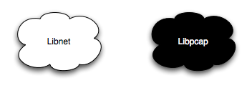
What is libnet?
A C Programming library for packet construction and injection
The Yin to the Yang of libpcap
Libnet’s Primary Role in Life:
  A simple interface for packet construction and injection
Libnet IS good for:
  Tools requiring meticulous control over every field of every header of every packet
Libnet IS not well suited for:
  Building client-server programs where the operating system should be doing most of the work

Slide 7
Components are building blocks
Libnet is a component
  That’s nice. What is a component?
  Before we define a component, let’s talk about network security tools (toolkits are nice, but they’re just enablers)
A network security tool can be modularized and broken down into three layers: Control, Technique, Component
  Eases conception and fast-tracks construction of tools
  Control: high level abstract, delivery mechanism for techniques
  Technique: answers “what does this tool do?”
  Component: fundamental layer, answers “how does this tool do what it does?”
Libnet is a fundamental building block used to create network security tools

Slide 8
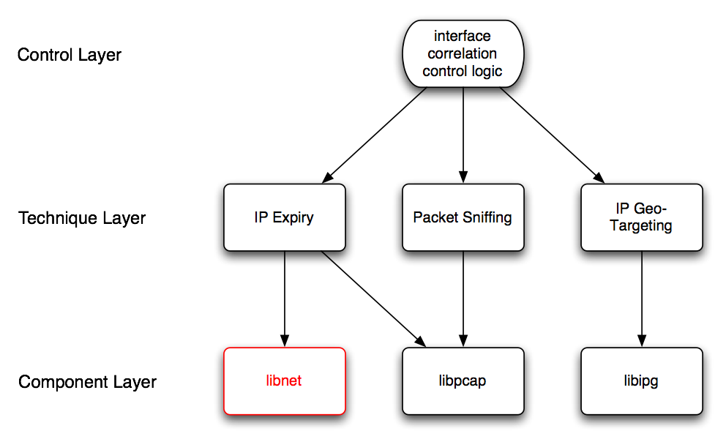
The Modular Model of Network Security Tools

Slide 9
What’s inside of libnet?
As of libnet 1.1.2:
  About 18,000 lines of C source code
  109 exported functions, 67 packet builder functions
  Portable to all of today’s hottest operating systems:
    Windows, OS X, BSD, Linux, Solaris, HPUX

Slide 10
Why use libnet?
Portability
  Libnet is portable to all of our favorite and exquisitely cherished operating systems
Ease of Use
  As we will see, Libnet 1.1.x exports a braindead simple interface to building and injecting packets (4 easy steps)
Robustness
  Libnet supports all of today’s in-demand protocols with more added all the time
    More than 30 supported in Libnet 1.1.2 (see next slide)
    Several link layers: Ethernet, Token Ring, FDDI, 802.11 planned
Open Source
  Licensing
    Libnet is released under a BSD license meaning it is basically free to use
  Response-time in bug fixes
    Large user-base; bugs are fixed quickly

Slide 11
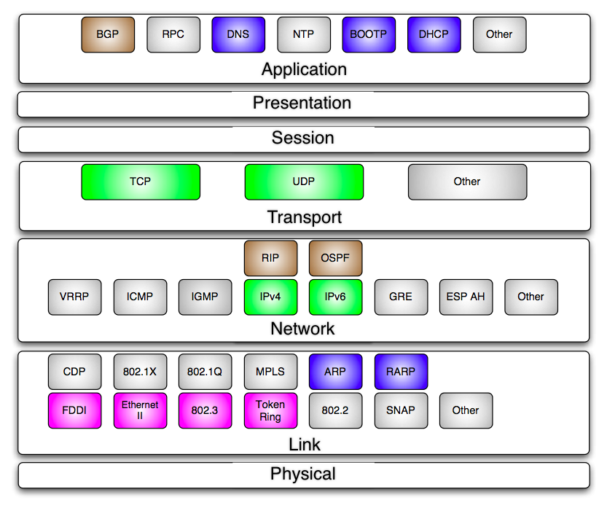
Libnet 1.1.x protocols

Slide 12
A brief history of Libnet
1998 - 2001
(The formative years)

Slide 13
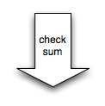




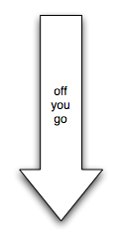
Libnet 1.0.x process
libnet_init_packet(...);
libnet_open_link_interface(...);
libnet_build_ip(...);
libnet_build_ethernet(...);
libnet_build_tcp(...);
libnet_do_checksum(...);
libnet_do_checksum(...);
libnet_write_link_layer(...);
libnet_destroy_packet(...);
libnet_close_link_interface(...);

Slide 14
Libnet 1.0.x deficiencies
Oh wow is that user-unfriendly
  Too many steps in building a packet (up to 10!)
  Too much to do, alot can go wrong
No state maintenance
  Couldn’t track anything
Over-reliance on the application programmer
  Memory allocation / de-allocation
  Memory offsets for packets
  Checksums
Libnet 1.1.x was designed to address all of these issues

Slide 15
Libnet 1.1.x
2001 - ...
My boy’s all grown’s up

Slide 16

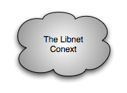


Libnet 1.1.2 process
libnet_init(...);
libnet_build_tcp(...);
libnet_build_ipv4(...);
libnet_build_ethernet(...);
libnet_build_write(...);
libnet_destroy(...);

Slide 17
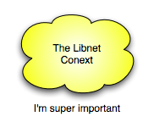
The libnet context
Opaque monolithic data structure that is returned from libnet_init();
  “l”
Maintains state for the entire session
  Tracks all memory usage and packet construction
  Defines and describes a libnet session
Used in almost every function
(More detail later)

Slide 18
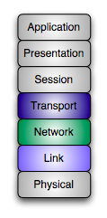
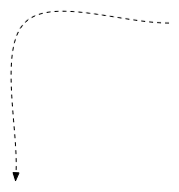


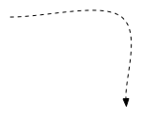
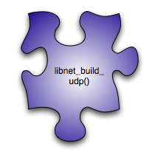
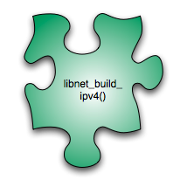
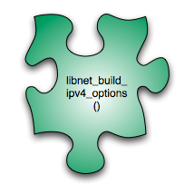
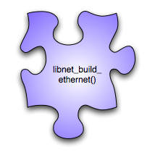
Packet construction
The core of Libnet’s functionality
Packets are built in pieces
  Each protocol layer is usually a separate function call
    Generally two - four function calls to build an entire packet
Packet builders take arguments corresponding to header values
Approximates an IP stack; must be called in order
  From the highest on the OSI model to the lowest
A successful call to a builder function returns a ptag

Slide 19
Packet construction
tcp = libnet_build_tcp(
src_prt, /* source port */
dst_prt, /* destination port */
0x01010101, /* sequence number */
0x02020202, /* acknowledgement num */
TH_SYN, /* control flags */
32767, /* window size */
0, /* checksum */
0, /* urgent pointer */
LIBNET_TCP_H + payload_s, /* TCP packet size */
payload, /* payload */
payload_s, /* payload size */
l, /* context */
0); /* ptag */

Slide 20
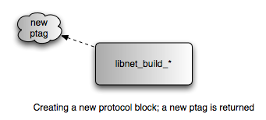
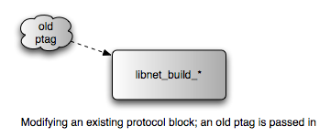
Ptags and Pblocks
Protocol Tag == ptag
Protocol Block == pblock
Protocol Tags (ptags) used to track Protocol Blocks (pblocks)
  Whenever a new packet piece is built it is stored in a pblock and a new ptag is returned
  Whenever an existing packet piece is modified, an old ptag is used
    Looped packet updating
Ptags are handled directly by the user, pblocks are not
tcp = libnet_build_tcp(
src_prt, /* source port */
dst_prt, /* destination port */
0x01010101, /* sequence number */
0x02020202, /* acknowledgement num */
TH_SYN, /* control flags */
32767, /* window size */
0, /* checksum */
0, /* urgent pointer */
LIBNET_TCP_H + payload_s, /* TCP packet size */
payload, /* payload */
payload_s, /* payload size */
l, /* context */
0); /* ptag */

Slide 21



The payload interface
A simple interface to append arbitrary payloads to packets
  TCP, UDP, ICMP, IP
All packet builder functions support this interface
Use is optional
tcp = libnet_build_tcp(
src_prt, /* source port */
dst_prt, /* destination port */
0x01010101, /* sequence number */
0x02020202, /* acknowledgement num */
TH_SYN, /* control flags */
32767, /* window size */
0, /* checksum */
0, /* urgent pointer */
LIBNET_TCP_H + payload_s, /* TCP packet size */
payload, /* payload */
payload_s, /* payload size */
l, /* context */
0); /* ptag */

Slide 22
Wire injection methods
Raw socket interface (less complex)
  Mid-level interface, packets built at the IP layer and above
    No link header needs to be built
  Removes all routing and interface decisions
  Useful for “legitimate” packet tools that do not need to spoof address information
  Packet passes through kernel’s IP stack
    Routing, checksums, firewalls all an issue
  Less than granular level of control (next slide)
Link layer interface (more complex)
  Low-level interface, packets built at the link layer
  Packet does not pass through the kernel’s IP stack
    Sovereign control of every field of the packet
    All address and routing information needs to be provided
    Some operating systems stamp outgoing MAC address of the Ethernet header (this is bypassable)

Slide 23
Raw Socket Non-Sequitur
 | IP Fragmentation | IP Total Length | IP Checksum | IP ID | IP Source | Max size before kernel complains
Linux 2.2+ | Performed if packet is larger than MTU | Always filled in | Always filled in | Filled in if left 0 | Filled in if left 0 | 1500 bytes
Solaris 2.6+ | Performed if packet is larger than MTU; Sets DF bit |  | Always filled in
OpenBSD 2.8+ | Performed if packet is larger than MTU |  | Always filled in

Slide 24
Packet checksums
Programmer no longer has to worry about checksum computation
Common usage: programmer specifies a “0”; libnet autocomputes
  Can be toggled off to use checksum of “0”
Alternative usage: programmer specifies value, libnet uses that
  Useful for fuzzing, using pre-computed checksums
ip = libnet_build_ipv4(
LIBNET_IPV4_H + LIBNET_TCP_H + payload_s, /* length */
0, /* TOS */
242, /* IP ID */
0, /* IP frag */
64, /* TTL */
IPPROTO_TCP, /* protocol */
0, /* checksum */
src_ip, /* source IP */
dst_ip, /* destination IP */
NULL, /* payload */
0, /* payload size */
l, /* context */
0); /* ptag */

Slide 25
Libnet 1.1.x Functions
Just some of the more important ones

Slide 26
Initialization
libnet_t *
libnet_init(int injection_type, char *device, char *err_buf);
Initializes the libnet library and create the environment
SUCCESS | A libnet context suitable for use
FAILURE | NULL, err_buf will contain the reason
injection_type | LIBNET_LINK, LIBNET_RAW4
device | “fxp0”, “192.168.0.1”, NULL
err_buf | Error message if function fails
l = libnet_init(LIBNET_LINK, “fxp0”, err_buf);
if (l == NULL)
{
fprintf(stderr, “libnet_init(): %s”, errbuf);
}

Slide 27
Device (interface) selection
Happens during initialization
libnet_init(LIBNET_LINK, “fxp0”, errbuf);
  Will initialize libnet’s link interface using the fxp0 device
libnet_init(LIBNET_LINK, “192.168.0.1”, errbuf);
  Will initialize libnet’s link interface using the device with the IP address 192.168.0.1
libnet_init(LIBNET_LINK, NULL, errbuf);
  Will initialize libnet’s link interface using the first “up” device it can find
  libnet_getdevice(l);
libnet_init(LIBNET_RAW4, NULL, errbuf);
  Under the Raw socket interface no device is selected
    Exception: Win32 does this internally since it is built on top of Winpcap
New: devices with no IP address can be specified for use (stealth)

Slide 28
Error handling
char *
libnet_geterror(libnet_t *l);
Returns the last error message generated by libnet
SUCCESS | An error string, NULL if none occurred
FAILURE | This function cannot fail
l | The libnet context pointer
l = libnet_autobuild_ipv4(len, IPPROTO_TCP, dst, l);
if (l == NULL)
{
fprintf(stderr, “libnet_autobuild_ipv4(): %s”,
libnet_geterror(l));
}

Slide 29
Address resolution
u_int32_t
libnet_name2addr4(libnet_t *l, char *host_name, u_int8_t use_name);
Converts a IPv4 presentation format hostname into a big endian ordered IP number
SUCCESS | An IP number suitable for use with libnet_build_*
FAILURE | -1, which is technically “255.255.255.255”
l | The libnet context pointer
host_name | The presentation format address
use_name | LIBNET_REOLVE, LIBNET_DONT_RESOLVE
dst = libnet_name2addr4(l, argv[optind], LIBNET_DONT_RESOLVE);
if (dst == -1)
{
fprintf(stderr, “libnet_name2addr4(): %s”, libnet_geterror(l));
}

Slide 30
Address resolution
char *
libnet_addr2name4(u_int32_t address, u_int8_t use_name);
Converts a big endian ordered IPv4 address into a presentation format address
SUCCESS | A string of dots and decimals or a hostname
FAILURE | This function cannot fail
address | The IPv4 address
use_name | LIBNET_REOLVE, LIBNET_DONT_RESOLVE
printf("%s\n", libnet_addr2name4(i, LIBNET_DONT_RESOLVE));

Slide 31
Packet construction: UDP
libnet_ptag_t
libnet_build_udp(u_int16_t sp, u_int16_t dp, u_int16_t len, u_int16_t sum, u_int8_t *payload, u_int32_t payload_s, libnet_t *l, libnet_ptag_t ptag);
Builds a UDP header
SUCCESS | A ptag referring to the UDP packet
FAILURE | -1, and libnet_get_error() can tell you why
sp | The source UDP port
dp | The destination UDP port
len | Length of the UDP packet (including payload)
sum | Checksum, 0 for libnet to autofill
payload | Optional payload
payload_s | Payload size
l | The libnet context pointer
ptag | Protocol tag

Slide 32
Packet construction: IPv4
libnet_ptag_t
libnet_build_ipv4(u_int16_t len, u_int8_t tos, u_int16_t id, u_int16_t frag, u_int8_t ttl, u_int8_t prot, u_int16_t sum, u_int32_t src, u_int32_t dst, u_int8_t *payload,
u_int32_t payload_s, libnet_t *l, libnet_ptag_t ptag);
Builds an IPv4 header
SUCCESS | A ptag referring to the IPv4 packet
FAILURE | -1, and libnet_get_error() can tell you why
len | Length of the IPv4 packet (including payload)
tos | Type of service bits
id | IP identification
frag | Fragmentation bits
ttl | Time to live
prot | Upper layer protocol
sum | Checksum, 0 for libnet to autofill
src | Source IP address

Slide 33
Packet construction: IPv4
libnet_ptag_t
libnet_build_ipv4(u_int16_t len, u_int8_t tos, u_int16_t id, u_int16_t frag, u_int8_t ttl, u_int8_t prot, u_int16_t sum, u_int32_t src, u_int32_t dst, u_int8_t *payload,
u_int32_t payload_s, libnet_t *l, libnet_ptag_t ptag);
Builds an IPv4 header
SUCCESS | A ptag referring to the UDP packet
FAILURE | -1, and libnet_get_error() can tell you why
dst | Destination IP address
payload | Optional payload
payload_s | Payload size
l | The libnet context pointer
ptag | Protocol tag

Slide 34
Packet construction: Ethernet
libnet_ptag_t
libnet_build_ethernet(u_int8_t *dst, u_int8_t *src,
u_int16_t type, u_int8_t *payload, u_int32_t payload_s, libnet_t *l, libnet_ptag_t ptag);
Builds an Ethernet header
SUCCESS | A ptag referring to the Ethernet frame
FAILURE | -1, and libnet_get_error() can tell you why
dst | Destination ethernet address
src | Source ethernet address
type | Upper layer protocol type
payload | Optional payload
payload_s | Payload size
l | The libnet context pointer
ptag | Protocol tag

Slide 35
Shutdown
void
libnet_destroy(libnet_t *l);
Shuts down the libnet environment
l | The libnet context pointer
libnet_destroy(l);

Slide 36
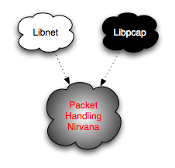
Libnet with other components
GNIP: A poor man’s ping

Slide 37
A simple application
Simple ping client
250 lines of source
Illustrates some of libnet’s (and libpcap’s) core concepts
  IPv4 packet construction
  ICMP packet construction
  Looped packet updating
  Packet filtering, capturing and dissection

Slide 38



#include <libnet.h>
#include <pcap.h>
#define GNIP_FILTER "icmp[0] = 0"
void usage(char *);
int
main(int argc, char **argv)
{
libnet_t *l = NULL;
pcap_t *p = NULL;
u_int8_t *packet;
u_int32_t dst_ip, src_ip;
u_int16_t id, seq, count;
int c, interval = 0, pcap_fd, timed_out;
u_int8_t loop, *payload = NULL;
u_int32_t payload_s = 0;
libnet_ptag_t icmp = 0, ip = 0;
char *device = NULL;
fd_set read_set;
struct pcap_pkthdr pc_hdr;
struct timeval timeout;
struct bpf_program filter_code;
bpf_u_int32 local_net, netmask;
struct libnet_ipv4_hdr *ip_hdr;
struct libnet_icmpv4_hdr *icmp_hdr;
char errbuf[LIBNET_ERRBUF_SIZE];
while((c = getopt(argc, argv, "I:i:c:")) != EOF)
{
switch (c)
{
case 'I':
device = optarg;
break;
case 'i':
interval = atoi(optarg);
break;
case 'c':
count = atoi(optarg);
break;
}
}
c = argc - optind;
if (c != 1)
{
usage(argv[0]);
exit(EXIT_FAILURE);
}

Slide 39

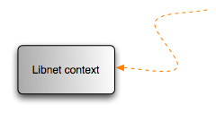
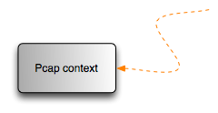


/* initialize the libnet library */
l = libnet_init(LIBNET_RAW4, device, errbuf);
if (l == NULL)
{
fprintf(stderr, "libnet_init() failed: %s", errbuf);
exit(EXIT_FAILURE);
}
if (device == NULL)
{
device = pcap_lookupdev(errbuf);
if (device == NULL)
{
fprintf(stderr, "pcap_lookupdev() failed: %s\n", errbuf);
goto bad;
}
}
/* handcrank pcap */
p = pcap_open_live(device, 256, 0, 0, errbuf);
if (p == NULL)
{
fprintf(stderr, "pcap_open_live() failed: %s", errbuf);
goto bad;
}
/* get the subnet mask of the interface */
if (pcap_lookupnet(device, &local_net, &netmask, errbuf) == -1)
{
fprintf(stderr, "pcap_lookupnet(): %s", errbuf);
goto bad;
}
/* compile the BPF filter code */
if (pcap_compile(p, &filter_code, GNIP_FILTER, 1, netmask) == -1)
{
fprintf(stderr, "pcap_compile(): %s", pcap_geterr(p));
goto bad;
}
/* apply the filter to the interface */
if (pcap_setfilter(p, &filter_code) == -1)
{
fprintf(stderr, "pcap_setfilter(): %s", pcap_geterr(p));
goto bad;
}
dst_ip = libnet_name2addr4(l, argv[optind], LIBNET_RESOLVE);
if (dst_ip == -1)
{
fprintf(stderr, "Bad destination IP address (%s).\n",
libnet_geterror(l));
goto bad;
}

Slide 40

src_ip = libnet_get_ipaddr4(l);
if (src_ip == -1)
{
fprintf(stderr, "Can't determine source IP address (%s).\n",
libnet_geterror(l));
goto bad;
}
interval ? interval : interval = 1;
timeout.tv_sec = interval;
timeout.tv_usec = 0;
pcap_fd = pcap_fileno(p);
fprintf(stderr, "GNIP %s (%s): %d data bytes\n",
libnet_addr2name4(dst_ip, 1), libnet_addr2name4(dst_ip, 0),
LIBNET_IPV4_H + LIBNET_ICMPV4_ECHO_H + payload_s);

Slide 41
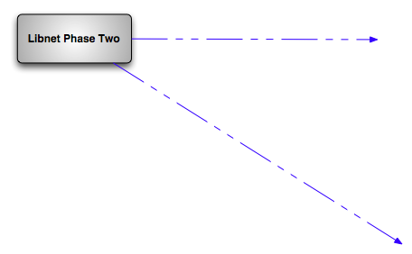
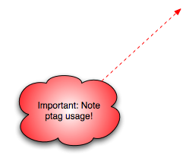

loop = 1;
for (id = getpid(), seq = 0, icmp = LIBNET_PTAG_INITIALIZER; loop; seq++)
{
icmp = libnet_build_icmpv4_echo(
ICMP_ECHO, /* type */
0, /* code */
0, /* checksum */
id, /* id */
seq, /* sequence number */
payload, /* payload */
payload_s, /* payload size */
l, /* libnet context */
icmp); /* ptag */
if (icmp == -1)
{
fprintf(stderr, "Can't build ICMP header: %s\n",
libnet_geterror(l));
goto bad;
}
ip = libnet_build_ipv4(
LIBNET_IPV4_H + LIBNET_ICMPV4_ECHO_H + payload_s, /* length */
0, /* TOS */
id, /* IP ID */
0, /* IP Frag */
64, /* TTL */
IPPROTO_ICMP, /* protocol */
0, /* checksum */
src_ip, /* source IP */
dst_ip, /* destination IP */
NULL, /* payload */
0, /* payload size */
l, /* libnet context */
ip); /* ptag */
if (ip == -1)
{
fprintf(stderr, "Can't build IP header: %s\n", libnet_geterror(l));
goto bad;
}
c = libnet_write(l);
if (c == -1)
{
fprintf(stderr, "Write error: %s\n", libnet_geterror(l));
goto bad;
}

Slide 42



FD_ZERO(&read_set);
FD_SET(pcap_fd, &read_set);
for (timed_out = 0; !timed_out && loop; )
{
c = select(pcap_fd + 1, &read_set, 0, 0, &timeout);
switch (c)
{
case -1:
fprintf(stderr, "select() %s\n", strerror(errno));
goto bad;
case 0:
timed_out = 1;
continue;
default:
if (FD_ISSET(pcap_fd, &read_set) == 0)
{
timed_out = 1;
continue;
}
/* fall through to read the packet */
}
packet = (u_int8_t *)pcap_next(p, &pc_hdr);
if (packet == NULL)
{
continue;
}
ip_hdr = (struct libnet_ipv4_hdr *)(packet + 14);
icmp_hdr = (struct libnet_icmpv4_hdr *)(packet + 14 +
(ip_hdr->ip_hl << 2));
if (ip_hdr->ip_src.s_addr != dst_ip)
{
continue;
}
if (icmp_hdr->icmp_id == id)
{
fprintf(stderr, "%d bytes from %s: icmp_seq=%d ttl=%d\n",
ntohs(ip_hdr->ip_len),
libnet_addr2name4(ip_hdr->ip_src.s_addr, 0),
icmp_hdr->icmp_seq, ip_hdr->ip_ttl);
}
}
}
libnet_destroy(l);
pcap_close(p);
return (EXIT_SUCCESS);

Slide 43
GNIP output
[rounder:Projects/misc/] root# ./gnip 4.2.2.2
GNIP vnsc-bak.sys.gtei.net (4.2.2.2): 28 data bytes
28 bytes from 4.2.2.2: icmp_seq=0 ttl=247
28 bytes from 4.2.2.2: icmp_seq=1 ttl=247
28 bytes from 4.2.2.2: icmp_seq=2 ttl=247
28 bytes from 4.2.2.2: icmp_seq=3 ttl=247
28 bytes from 4.2.2.2: icmp_seq=4 ttl=247
^C

Slide 44
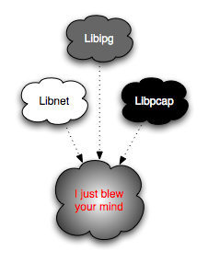
Libnet with other components
TRIG: A rich man’s traceroute

Slide 45
A simple application
Simple traceroute client with geo-targeting of IP addresses
280 lines of source
Illustrates more of libnet’s, libpcap’s) core concepts
  IPv4 packet construction
  ICMP packet construction
  Looped packet updating
  IP geo-targeting
  Packet filtering, capturing and dissection

Slide 46
#include <libnet.h>
#include <pcap.h>
#include "./libipg.h"
int
do_lookup(u_int32_t ipn, ipgeo_t *ipg);
u_int8_t do_cc, do_country, do_city, do_region, do_isp, do_lat, do_long;
int main(int argc, char **argv)
{
pcap_t *p = NULL;
libnet_t *l = NULL;
ipgeo_t *ipg = NULL;
time_t start;
u_char *packet;
int c, ttl, done;
char *device = NULL;
extern char *optarg;
extern int optind;
struct pcap_pkthdr ph;
libnet_ptag_t icmp, ip;
u_int32_t dst_ip;
struct libnet_icmpv4_hdr *icmp_h;
struct libnet_ipv4_hdr *ip_h, *oip_h;
char errbuf[LIBNET_ERRBUF_SIZE];
printf("Trig 1.0 [geo-targeting traceroute scanner]\n");
do_cc = do_country = do_city = do_region = do_isp = do_lat = do_long = 0;
while ((c = getopt(argc, argv, "i:CcyrsLl")) != EOF)
{
switch (c)
{
case 'i':
device = optarg;
break;
case 'C':
do_cc = 1;
break;
case 'c':
do_country = 1;
break;
case 'y':
do_city = 1;
break;
case 'L':
do_lat = 1;
break;
case 'l':
do_long = 1;
break;
case 'r':
do_region = 1;
break;

Slide 47
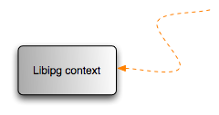
case 's':
do_isp = 1;
break;
}
}
c = argc - optind;
if (c != 2)
{
fprintf(stderr, "usage:\t%s\t\t [-i interface][-Ccyrs] host file\n",
argv[0]);
goto done;
}
if (do_cc == 0 && do_country == 0 && do_city == 0 && do_region == 0 &&
do_isp == 0 && do_lat == 0 && do_long == 0)
{
printf("No IP geo-targeting?\n");
}
l = libnet_init(LIBNET_RAW4, NULL, errbuf);
if (l == NULL)
{
fprintf(stderr, "libnet: %s\n", errbuf);
return (EXIT_FAILURE);
}
p = pcap_open_live(device, 60, 0, 500, errbuf);
if (p == NULL)
{
fprintf(stderr, "pcap: %s\n", errbuf);
return (EXIT_FAILURE);
}
ipg = ipgeo_init(argv[optind + 1], 0, errbuf);
if (ipg == NULL)
{
fprintf(stderr, "ipgeo: %s\n", errbuf);
return (EXIT_FAILURE);
}
dst_ip = libnet_name2addr4(l, argv[optind], LIBNET_RESOLVE);
if (dst_ip == 0)
{
fprintf(stderr, "libnet: %s\n", libnet_geterror(l));
goto done;
}

Slide 48
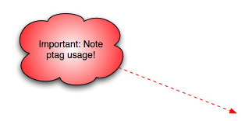
for (done = icmp = ip = 0, ttl = 1; ttl < 31 && !done; ttl++)
{
icmp = libnet_build_icmpv4_echo(
ICMP_ECHO, /* type */
0, /* code */
0, /* checksum */
242, /* id */
ttl, /* sequence */
NULL, /* payload */
0, /* payload size */
l, /* libnet context */
icmp); /* libnet id */
if (icmp == -1)
{
fprintf(stderr, "libnet: %s\n", libnet_geterror(l));
return (EXIT_FAILURE);
}
ip = libnet_build_ipv4(
LIBNET_IPV4_H + LIBNET_ICMPV4_ECHO_H, /* length */
0, /* TOS */
242, /* IP ID */
0, /* IP Frag */
ttl, /* TTL */
IPPROTO_ICMP, /* protocol */
0, /* checksum */
libnet_get_ipaddr4(l), /* src ip */
dst_ip, /* dst ip */
NULL, /* payload */
0, /* payload size */
l, /* libnet context */
ip); /* libnet id */
if (ip == -1)
{
fprintf(stderr, "libnet: %s\n", libnet_geterror(l));
return (EXIT_FAILURE);
}
c = libnet_write(l);
if (c == -1)
{
fprintf(stderr, "libnet: %s\n", libnet_geterror(l));
return (EXIT_FAILURE);
}
fprintf(stderr, "%02d: ", ttl);

Slide 49
/* read loop */
for (start = time(NULL); (time(NULL) - start) < 2; )
{
packet = (u_char *)pcap_next(p, &ph);
if (packet == NULL)
{
continue;
}
/* assume ethernet here for simplicity */
ip_h = (struct libnet_ipv4_hdr *)(packet + 14);
if (ip_h->ip_p == IPPROTO_ICMP)
{
icmp_h = (struct libnet_icmpv4_hdr *)(packet + 34);
/* expired in transit */
if (icmp_h->icmp_type == ICMP_TIMXCEED &&
icmp_h->icmp_code == ICMP_TIMXCEED_INTRANS)
{
oip_h = (struct libnet_ipv4_hdr *)(packet + 42);
if (oip_h->ip_id == htons(242))
{
fprintf(stderr, "%s ",
libnet_addr2name4(ip_h->ip_src.s_addr, 0));
if (do_lookup(ip_h->ip_src.s_addr, ipg) == -1)
{
fprintf(stderr, "ipgeo: %s\n", ipgeo_geterror(ipg));
}
break;
}
}
/* terminal response */
if (icmp_h->icmp_type == ICMP_ECHOREPLY)
{
if (icmp_h->icmp_id == 242 && icmp_h->icmp_seq == ttl)
{
fprintf(stderr, "%s ",
libnet_addr2name4(ip_h->ip_src.s_addr, 0));
if (do_lookup(ip_h->ip_src.s_addr, ipg) == -1)
{
fprintf(stderr, "ipgeo: %s\n", ipgeo_geterror(ipg));
}
done = 1;
break;
}
}
}
}
}

Slide 50
int
do_lookup(u_int32_t ipn, ipgeo_t *ipg)
{
if (ipgeo_lookup(ipn, 0, ipg) == -1)
{
return (-1);
}
if (do_cc)
{
fprintf(stderr, "%s ", ipgeo_get_cc(ipg));
}
if (do_country)
{
fprintf(stderr, "%s ", ipgeo_get_country(ipg));
}
if (do_city)
{
fprintf(stderr, "%s ", ipgeo_get_city(ipg));
}
if (do_region)
{
fprintf(stderr, "%s ", ipgeo_get_region(ipg));
}
if (do_isp)
{
fprintf(stderr, "%s ", ipgeo_get_isp(ipg));
}
if (do_lat)
{
fprintf(stderr, "%.4f ", ipgeo_get_lat(ipg));
}
if (do_long)
{
fprintf(stderr, "%.4f ", ipgeo_get_long(ipg));
}
fprintf(stderr, "\n");
return (1);
}

Slide 51
done:
if (l)
{
libnet_destroy(l);
}
if (p)
{
pcap_close(p);
}
if (ipg)
{
ipgeo_destroy(ipg);
}
return (EXIT_SUCCESS);
}

Slide 52
TRIG output
[rounder:Projects/libipg/sample] root# ./trig -ien1 -LlCry 4.2.2.2 ../../IP-COUNTRY-REGION-CITY-LATITUDE-LONGITUDE-ISP-FULL/IP-COUNTRY-REGION-CITY-LATITUDE-LONGITUDE-ISP.CSV
Trig 1.0 [geo-targeting traceroute scanner]
01: 66.123.162.113 US SAN RAMON CALIFORNIA 37.7661 -121.9730
02: 63.203.35.65 US SAN FRANCISCO CALIFORNIA 37.7002 -122.4060
03: 63.203.35.17 US SAN FRANCISCO CALIFORNIA 37.7002 -122.4060
04: 64.161.1.30 CA MONTREAL QUEBEC 45.5000 -73.5830
05: 64.161.1.54 CA MONTREAL QUEBEC 45.5000 -73.5830
06: 144.223.242.81 US KANSAS CITY MISSOURI 39.1749 -94.5804
07: 209.245.146.245 US UNKNOWN UNKNOWN 0.0000 0.0000
08: 209.244.3.137 US BROOMFIELD COLORADO 39.9135 -105.0930
09: 64.159.4.74 US SAN CLEMENTE CALIFORNIA 33.4322 -117.5780
10: 4.24.9.142 EG CAIRO AL QAHIRAH 30.0500 31.2500
11: 4.2.2.2 US PROVIDENCE RHODE ISLAND 41.8231 -71.4204

Slide 53
Libnet 1.1.x Internals
The stuff that makes it go

Slide 54
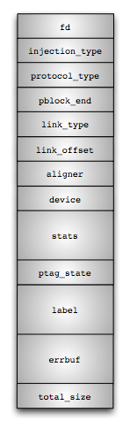
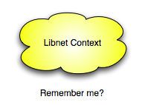
Introduction to the context
We’ve already met.
Something you don’t know: Libnet supports a multiple packet interface
The “context queue” interface
  A multiple context interface

Slide 55
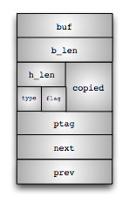
Introduction to the pblock
Libnet’s internal packet buffer system
Header to every packet piece
Analogous to BSD’s mbuf
All packet memory is handled with one of these babies

Slide 56
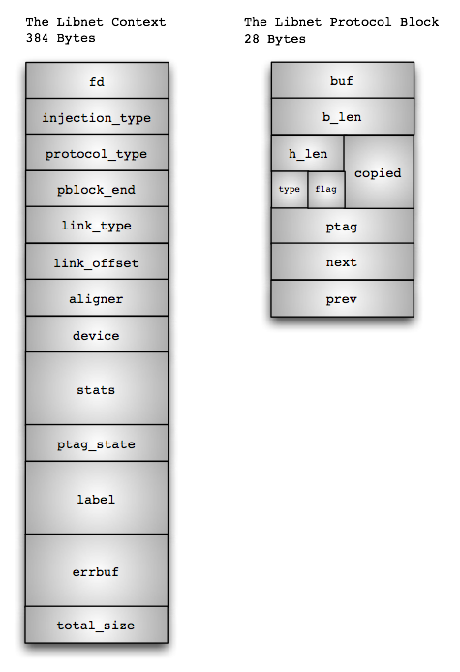

Slide 57
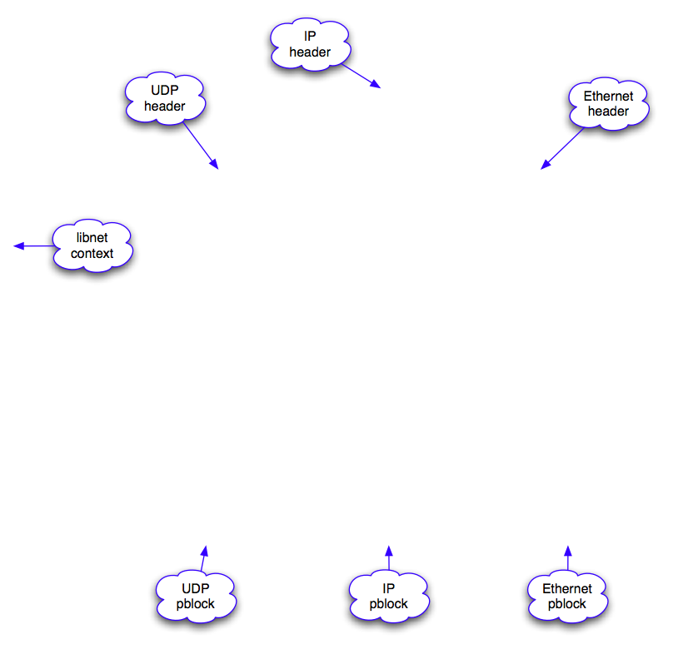
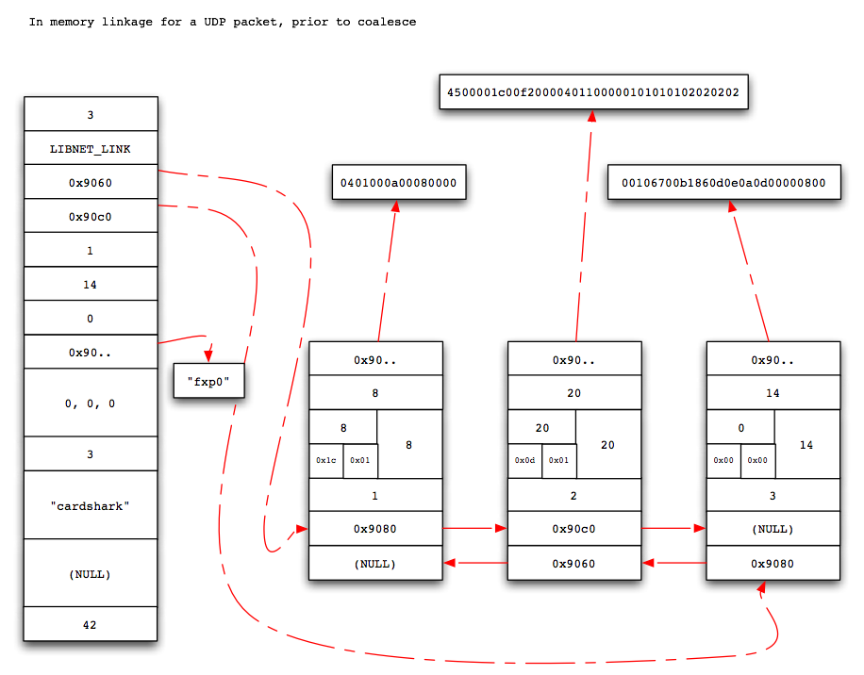

Slide 58
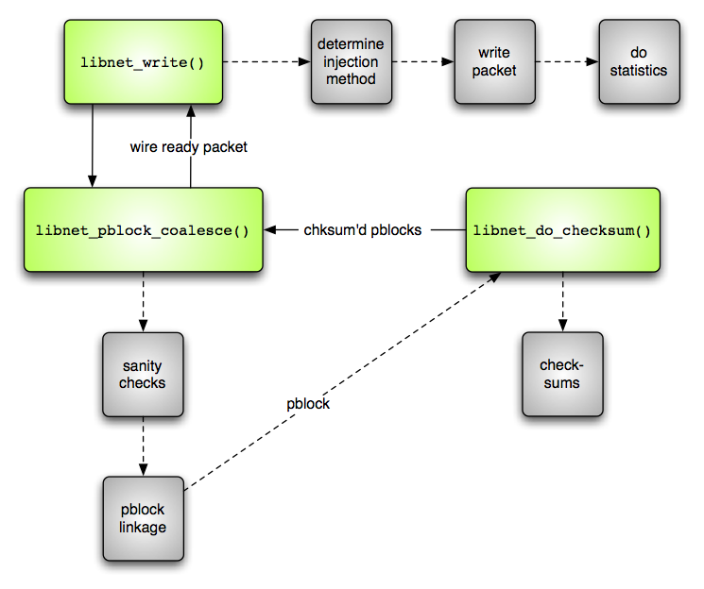
Internal packet injection logic

Slide 59
Who uses Libnet?
Ettercap
  A multipurpose sniffer / interceptor / logger for a switched LAN
  http://ettercap.sourceforge.net
Firewalk
  A gateway portscanning tool
  http://www.packetfactory.net/firewalk
ISIC
  IP stack integrity checker
  http://www.packetfactory.net/ISIC
Snort
  A lightweight network intrusion detection system
  http://www.snort.org
Tcpreplay
  Replays saved tcpdump files at arbitrary speeds
  tcpreplay.sourceforge.net

Slide 60
Tell your story walking
We’re done.
Questions? Comments?
mike@infonexus.com

