Slide 1
Here we could include general slides for the stream

Slide 2
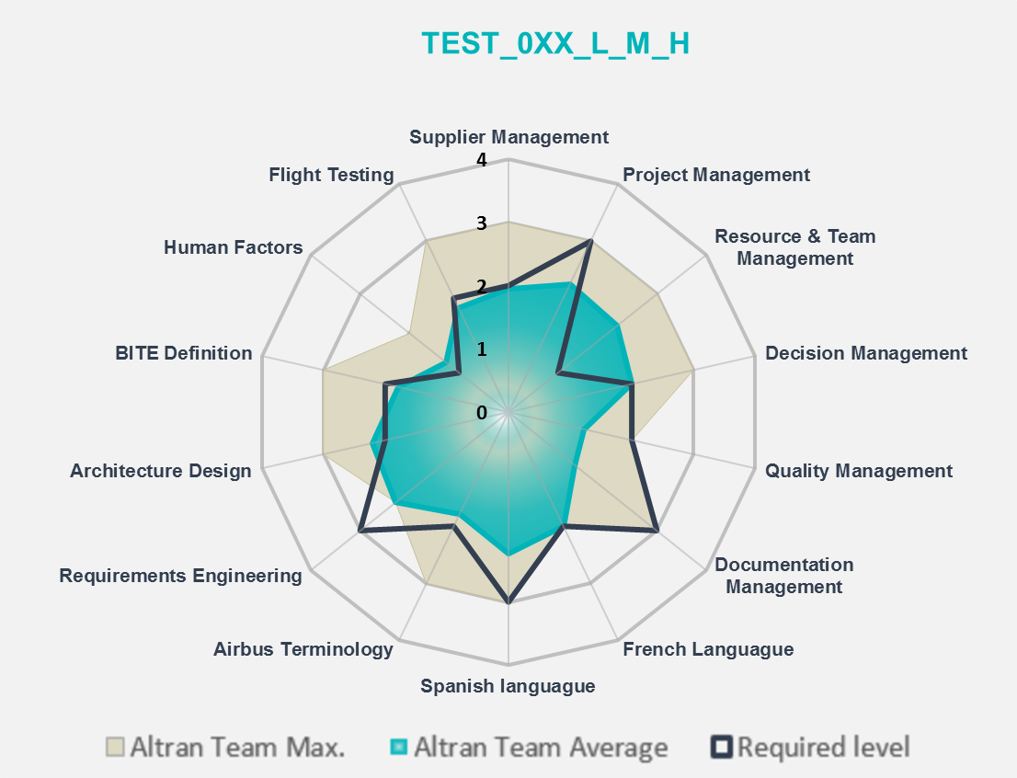
Catalog Item Title: <WU Title>
Catalog Item No: <Wu ID e.g. TAEWS_001>
Outsourcing: Onsite/Offsite
Localization: Spain/Germany
Objectives
<describe objectives>
Skills & Tools Needed vs Actual
Inputs Dependencies |  |  | General Requirements
<describe inputs> |  |  | <describe general requirements>

Slide 3


Catalog Item Title: <WU Title>
Catalog Item No: <Wu ID e.g. TAEWS_001>
MASTER DOCUMENTS
Activities Description
Activities Description
<Summarise activities description based on WU description here and draw a brief process diagramm>
START:
RISK 1
RISK 2
RISK 3
Task 1
Task 2
Task 3
DELIVERY
Input
t0
t0 + x
t0 + x
t0 + x
t0 + x

Slide 4
Catalog Item Title: <WU Title>
Catalog Item No: <Wu ID e.g. TAEWS_001>
Risks Lists
ID | Detection | Risk Level | Cause | Impact | Cause Reduction Actions | Impact Reduction Actions
1
2
3
4
Deliverables
<describe deliverables from WU d<escription here>
Acceptance Criteria
1. <describe acceptance criteria from WU description here>

Slide 5
Catalog Item Title: <WU Title>
Catalog Item No: <Wu ID e.g. TAEWS_001>
Evidencies
Siglum/Customer | Altran’s Contact Data | Duration | Hours | Management Level | See more...
Description
Description
Description
Description
For MANAGEMENT LEVEL PLEASE INSERT:
Structure Team Expertise
Fix Price Project
Service Catalogue
Please, delete this box!!!!

Slide 6
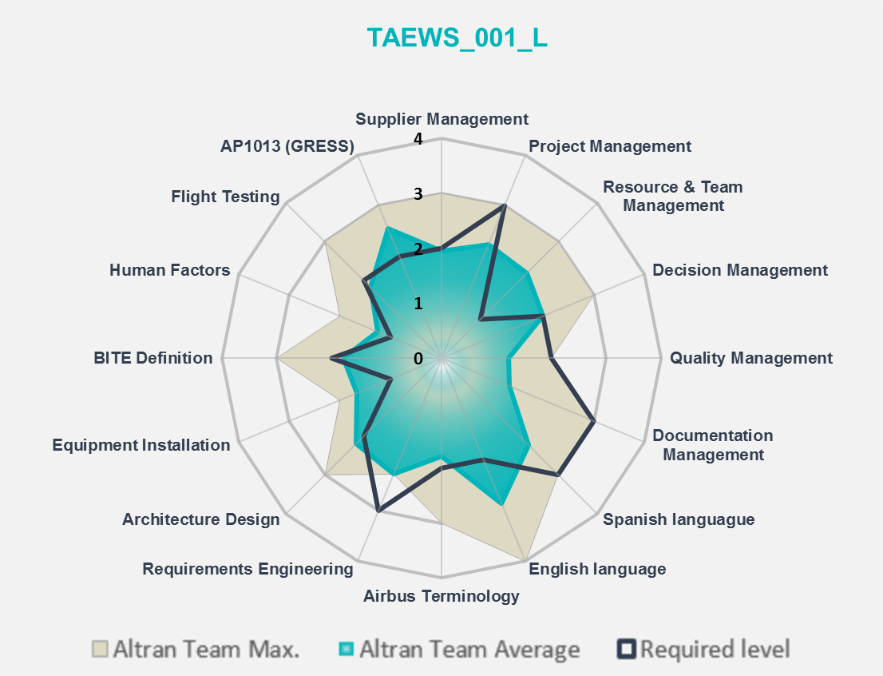
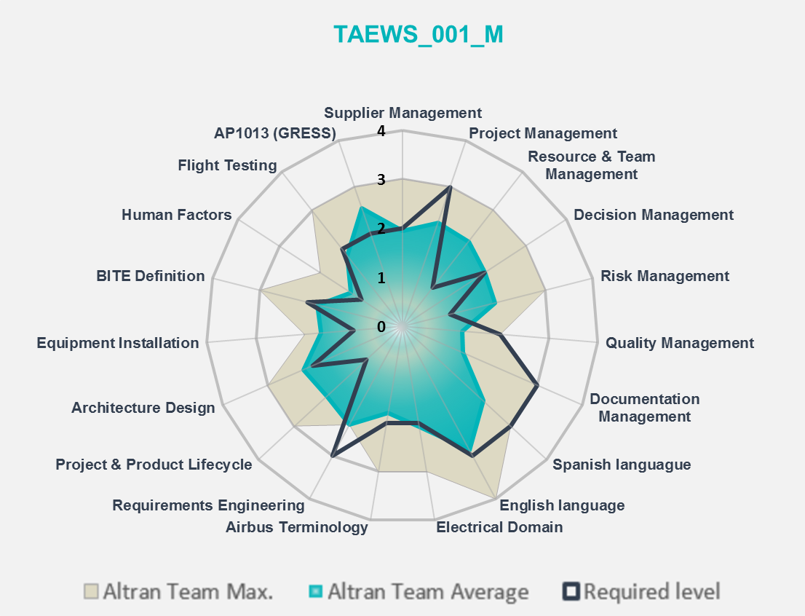
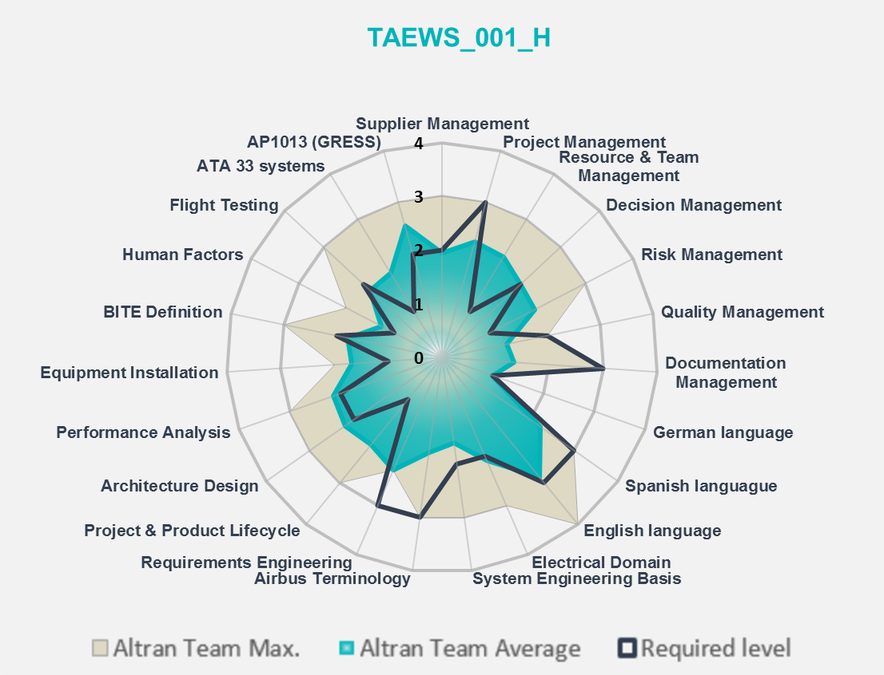
Catalog Item Title: Service Bulletins Airworthiness Scrutiny, including ERCs review and comments
Catalog Item No: TAEWS_001
Outsourcing: Onsite
Localization: Spain
Objectives
Skills & Tools Needed vs Actual
Inputs Dependencies |  |  | General Requirements
Service Bulletins in draft - Event Record Cards - Additional design documentation as required in a case by case basis |  |  | Min. required. Security Clearance: Confidential, dependent on the particular project NATO restricted or specific ITAR regulations might have to be obeyed Nationality Restrictions / Requirements: NATO restrictions are applicable, for specific areas in the project. Language Requirements: English is required, French or German highly appreciated Location of Work (onsite / offsite): onsite or offsite with dedicated scheduled panel meetings Some activities might require a secured IT connection from offsite.

Slide 7
Catalog Item Title: Service Bulletins Airworthiness Scrutiny, including ERCs review and comments
Catalog Item No: TAEWS_001
MASTER DOCUMENTS
Activities Description
Activities Description
Scrutiny of the SBs under in order to assure the accomplishment of all the Airworthiness criteria and authoring of a report per SB scrutinized.
In addition a whole SB scrutiny is performed in order to guarantee the SB accuracy from technical point of view.
Support tasks in order to get the Authorities approval of the SB.
Review of Event Record Cards raised during SB implementation
START:
RISK 1
RISK 2
RISK 3
Task 1
Task 2
Task 3
DELIVERY
Input
t0
t0 + x
t0 + x
t0 + x
t0 + x

Slide 8
Catalog Item Title: Service Bulletins Airworthiness Scrutiny, including ERCs review and comments
Catalog Item No: TAEWS_001
Risks Lists
ID | Detection | Risk Level | Cause | Impact | Cause Reduction Actions | Impact Reduction Actions
1 | Low | High | IT Tools Failure | Deliverables Delay |  | Save relevant information out of tools
2 | High | Low | Documentation approval delay | Delay in the documentation issuance |  | Monitoring document approval end date needs
3 | High | Low | Recurrence of quality issues | Deliverables quality | Delivery check list creation and updating | Altran internal checking procedures and RCA
4 | High | Low | Workload higher than planned | Deliverables Delay | Constant Work load monitoring | Synergies with other Altran projects
Deliverables
Services Bulletins Airworthiness Scrutiny, including Event Records Cards (ERCs) review and comments. For each reviewed Service Bulletin, a written report with the identified comments. If not comments or mistake, the report should state that there are not comments. For each Service bulletin received the comments or review must be available within 2 working days
Acceptance Criterias
1. Technical quality following agreed airworthiness regulations. 2. On time delivery according agreed program schedule to be provided in Detailed Delivery Description. 3. Comprehensive description of the work performed in line with directives established by each program.

Slide 9
Catalog Item Title: Service Bulletins Airworthiness Scrutiny, including ERCs review and comments
Catalog Item No: TAEWS_001
Evidencies
Siglum/Customer | Altran’s Contact Data | Duration | Hours | Management Level | See more...
Description
Description
Description
Description

