Slide 1

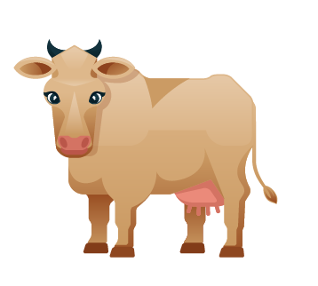
COWSERS
Math Game

Slide 2

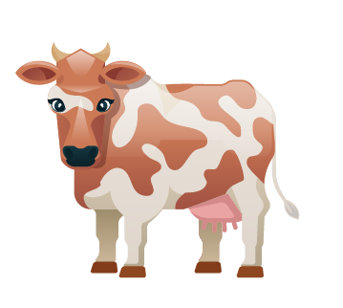
OUR IDEA
Our idea is to create a singleplayer version of the math game "Bulls and Cows", which can help you to improve your logical skills.

Slide 3
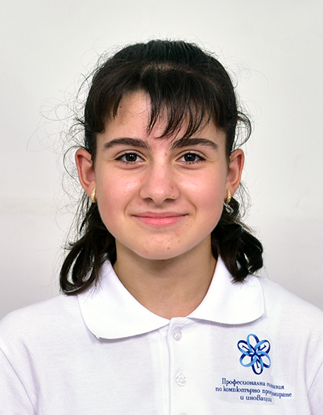
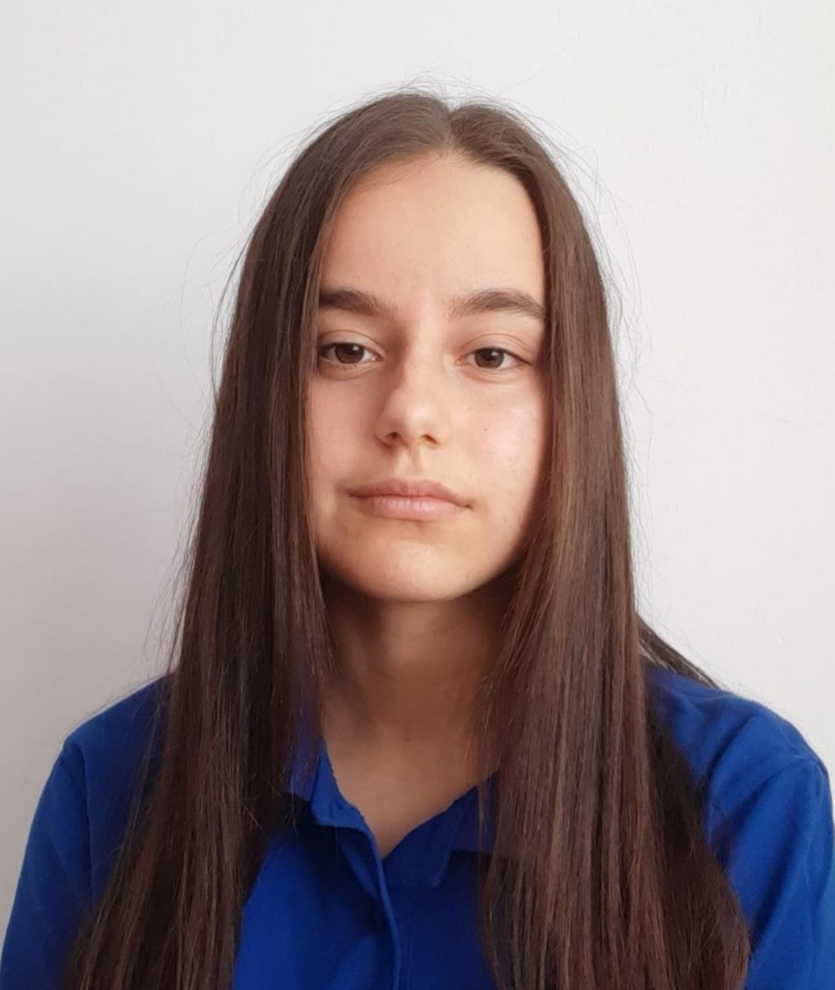
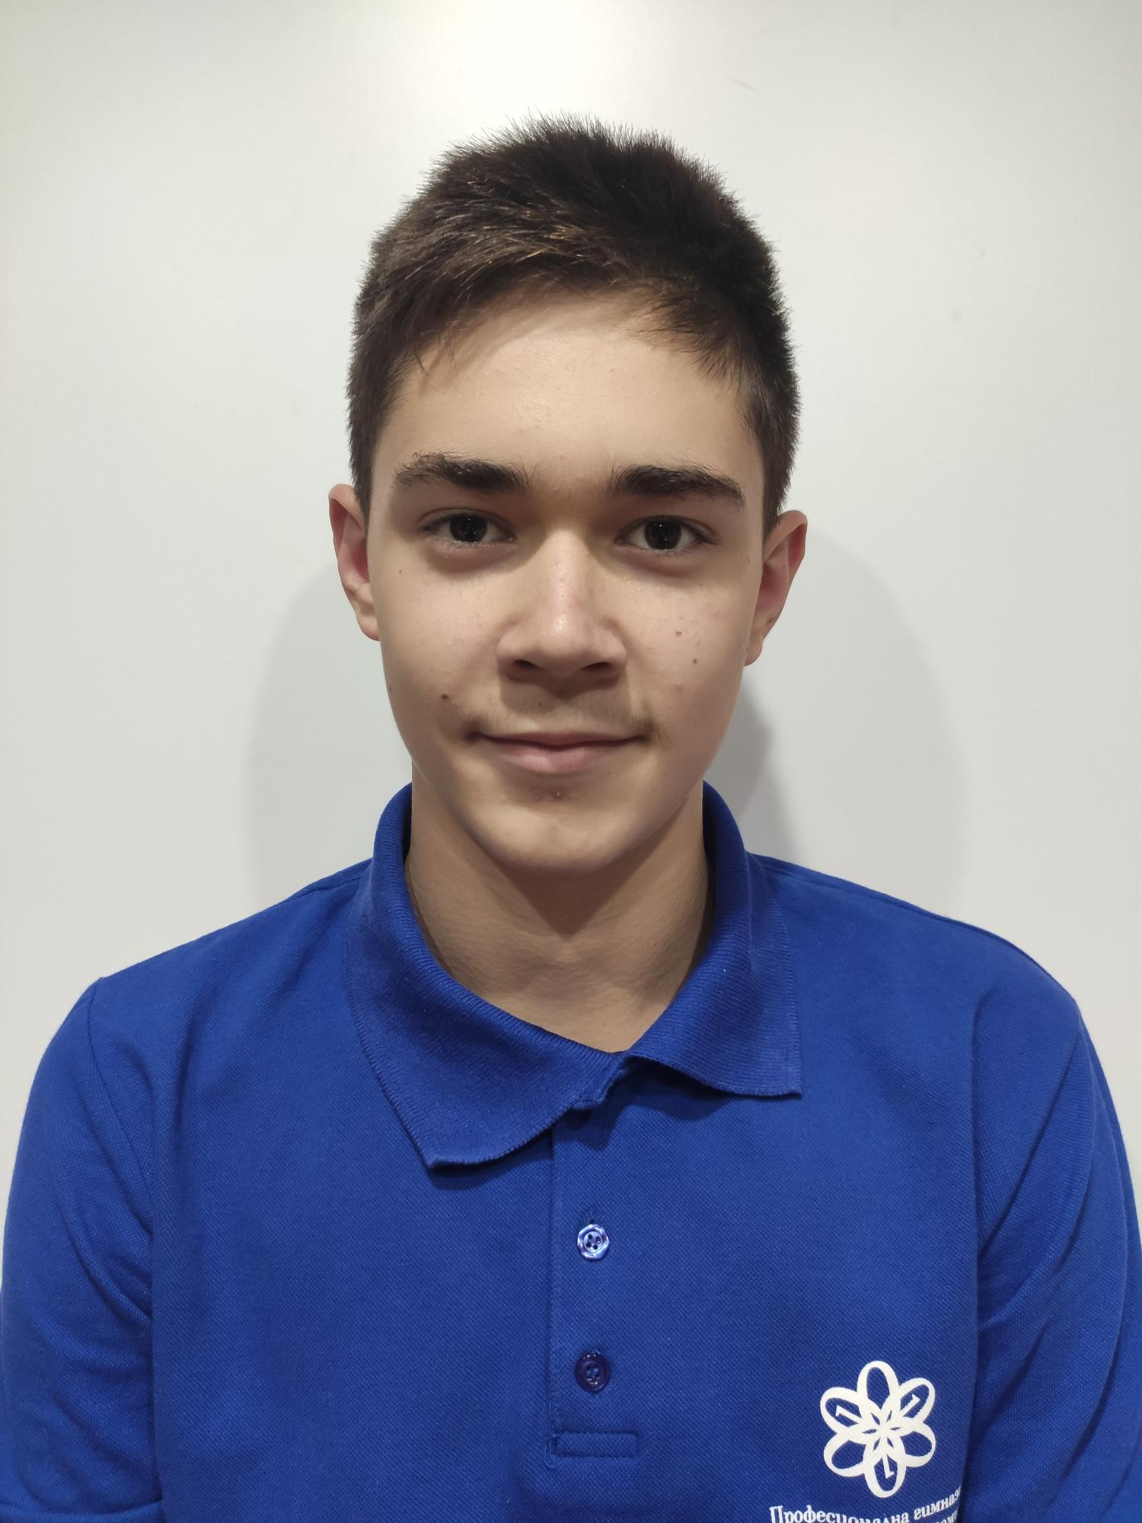
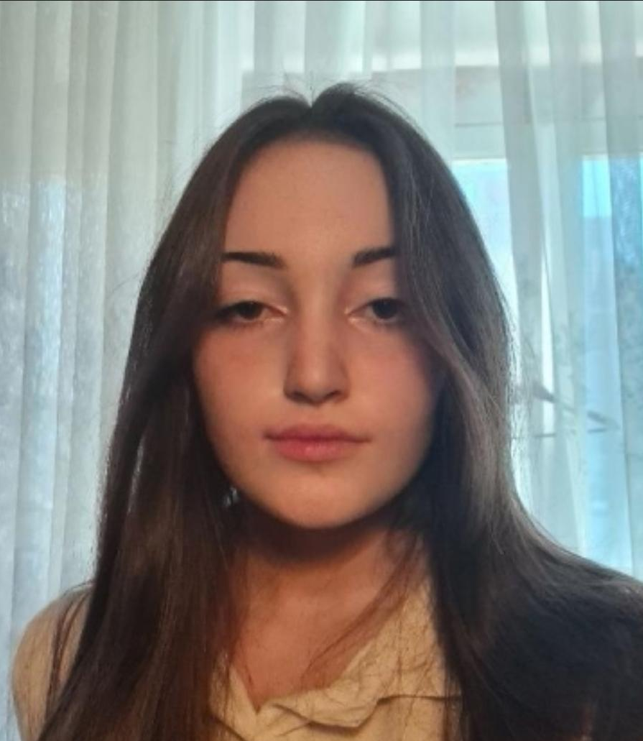
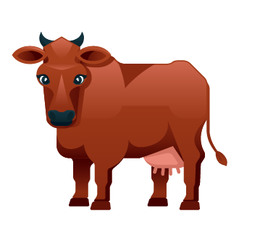
OUR TEAM
Svetoslav Zhelev
Polina Dineva
Iva Nedkova
Yana Ilcheva
Scrum trainer
Back-end developer
Back-end developer
QA engineer

Slide 4

STAGES OF REALIZATION
We chose the theme of the game
We assigned roles
We created the logo
We made the README file
We wrote the code for the game
We created the presentation and the documentation

Slide 5
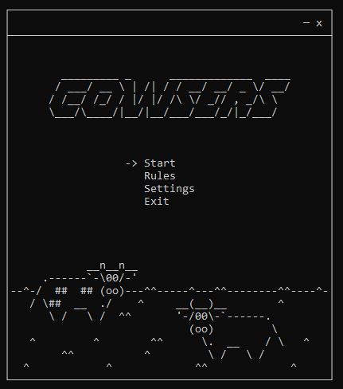
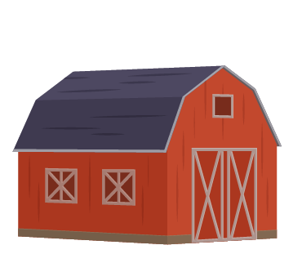
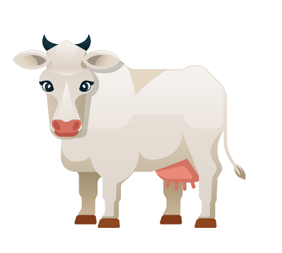
DEMO OF OUR PROJECT

Slide 6









USED TECHNOLOGIES

Slide 7
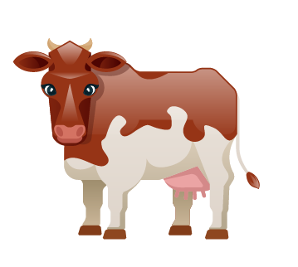
Now let us guide you to our game!

